Slide 1

Connecting with Your Values as a Supervisor
ACBS Supervision & Consultation SIG
Dr. Sarah Pegrum

Slide 2

Focus of Today
What are your values as a supervisor?
How can you connect with them?

Slide 3

Reflection Exercise: Learning Experiences
Notes:
Get into a comfortable position. Close your eyes. Imagine you are watching a screen. Now, bring to mind a time when you were receiving supervision or training, and it wasn’t overly helpful. If you can, bring to mind a specific supervision session or training that encapsulates ‘not helpful’. Imagine it is playing on a screen, and you are watching it. The camera right now is focused on the supervisor or trainer. What are they saying or doing that made you identify this as less helpful? Now the camera pans to you, and you are on screen. This camera is a special camera, and it is also able to capture your thoughts and feelings. What are the thoughts and feelings you are having? What are you saying and doing? The screen fades, and you are now left sitting. Breathing. Pause. Notice and try to identify any values that were threatened or there was a disconnection from in that clip. Place those values on the screen.
Now bring to mind a time when you were receiving supervision or training that was helpful. If you can think of a specific session or training, imagine it playing on the screen, and you are watching it. The camera right now is focused on the supervisor or trainer. What are they saying or doing that made you identify this as help. Now the camera pans to you, and you are on screen. This camera is a special camera, and it is also able to capture your thoughts and feelings. What are the thoughts and feelings your are having? What are you saying and doing? The screen fades, and you are now left sitting. Breathing. Pause. Notice and try to identify any values that you felt closer to in that clip. Place those values on the screen.
Now let go of the image. Move your attention to the breathe and when you feel ready open your eyes.

Slide 4

Reflection & Sharing
What did you notice in the first clip- less helpful supervision?
  Actions of the supervisor/trainer
  Your internal experiences and actions
  Values threatened or disconnected?
What did you notice in the second clip- helpful supervision?
  Actions of the supervisor/trainer
  Your internal experiences and actions
  Values connection?

Slide 5

Your values as a supervisor?
What would be your values as a supervisor?
How would you demonstrate them?
Before you share or we move to discussion, another brief exercise
Felt sense
Notes:
Keeping information from that last exercise in mind, take a moment to think and write down on a piece of paper or even just doing a mental note- but not share- yet- what would be your core values as supervisor? How would you demonstrate them?
Before we share our values and demonstration of them, I’m going to do another quick exercise. Close your eyes again. Bring attention to the breath. Bring to mind a supervision session when you felt close to those values. If you’re a new supervisor & have not supervised someone yet, bring to mind what you think it would look like. Imagine you can see into the future, and you are watching yourself rock it as a supervisor. Notice how you are in that supervision- how you may be sitting, what you may be doing/not doing, saying/not saying- zoom in a little more, into your internal experiences- what is happening internally? Notice. Then gently bring your attention back to the breath, letting the image fade. When ready, open your eyes and return your attention back to the room.
Now, let’s come back together and share- what values you hold as a supervisor, how they may been demonstrated in action, and also this other piece, what is the felt sense that comes when you are connected with them.
Tracking

Slide 6

What can impact your values connection in supervision?

Slide 7
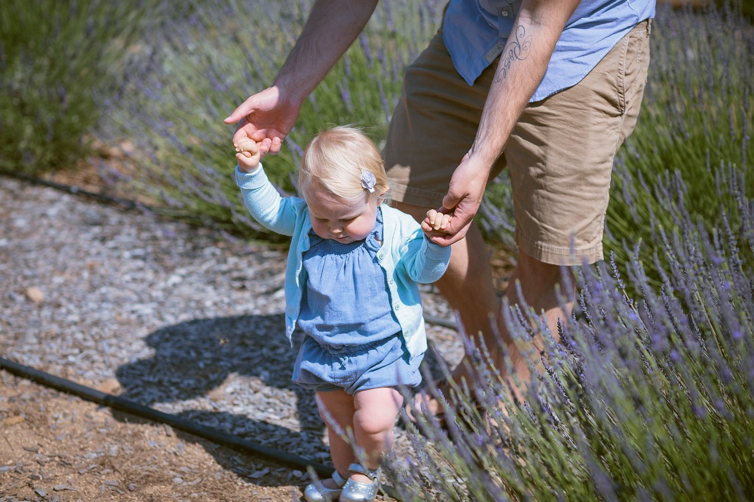
Before Supervision
Brief close eye exercise.
How do you want to show up to the supervisee learning journey?
Notes:
Close your eyes. Bring attention to your breathe. Bring to mind your supervisee. An image of them about to go into supervision. You have been in that position before in your own learning journey, so are familiar with that experience. Bring them to mind. They may be a student, or a resident. Imagine what they might be experiencing. What they might be bringing into the space. Hopes. Struggles. Vulnerabilities. Fears. As you observe what they may be about to bring into the room, ask yourself how would you like to show up to that? What would you want to bring to their learning journey? Gently let that image fade, and bring your attention back to your breathe, and then back to the room.

Slide 8

Next Meeting
2nd June 12 EST
Working with difficult internal experiences as a new or evolving supervisor
- Julia Sage

