Slide 2
Disclosures (support example):
Sally JohnsonX
Relevant Financial Relationships:
Employed in Private PracticeX
Adjunct faculty UCSX
Research partially funded by grant from the American Lung AssociationX
Receive royalties from New Harbinger publications for a book co-written on a topic similar to the subject of this presentation
Relevant Nonfinancial Relationships:
Advisory committee member - American Heart AssociationX

Slide 3
Disclosures (no-support example):
Sally JohnsonX
I have not received and will not receive any commercial support related to this presentation or the work presented in this presentation.

Slide 4
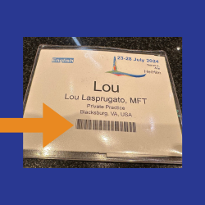
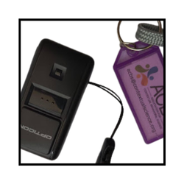
Please remind attendees to scan for CEs!
Reminder: If you have a barcode ON THE FRONT OF YOUR BADGE, please use the scanner to sign in and out of each session.

Slide 5
Name
Introduction Slide
Speaker Affiliation/ Credentials
Add Contact Details
Please update speaker photo and use on following slides that relevant speaker will present

Slide 6
Name Title
Introduction Slide
Speaker Affiliation/ Credentials
Add Contact Details
Please update speaker photo and use on following slides that relevant speaker will present

Slide 7
Header
Slide Text

Slide 8
Header
Slide Text

Slide 9
Header
Slide Text

Slide 10
Header
Consider offering live subtitle translation of your session during your presentation. To do that, in PowerPoint click on “Slide Show” then “Subtitle Settings”, then select English as your “spoken language” and another language as your “subtitle language”. ACBS encourages Spanish or Greek this year, but any ACBS member language would be useful if you prefer another. Then click “Always Use Subtitles”.
By default, the translated caption will appear over the bottom of your side. If you don’t want to rearrange your slides to accommodate it, just click “Subtitle Settings” and select “Below Slide” so that none of your slide is covered. Then click “From Beginning” to start your slide show. This translation will be captured in the recording for later viewing and improve access to your work. View a demonstration here: https://www.youtube.com/watch?v=0krv4NjZOaI&t=64s

