Slide 1
Using mobile technology to examine contextual predictors of outcomes in individuals experiencing psychosis following a hospital discharge
Ethan Moitra, Ph.D.
Brandon A. Gaudiano, Ph.D.
Carter H. Davis, B.F.A.
Michael F. Armey, Ph.D.

Slide 2
Disclosure of Commercial Support
Relevant financial relationship:
This study was funded by the National Institute of Mental Health (R21 #MH102000).
The authors did not receive and will not receive any commercial support related to this presentation or the work presented in this presentation.

Slide 3
OUTLINE
Treatment nonadherence in Psychotic Spectrum Disorders
Post-hospitalization is a critical period
Limitations in our current understanding of adherence predictors
Are antipsychotics a necessary treatment?
Psychological flexibility model of adherence
Using ecological momentary assessment (EMA) to study adherence
The present study
Aims
Design
Participants
Results
Lessons Learned & Future directions

Slide 4
Psychotic Spectrum Disorders & treatment nonadherence
Treatment costs $62.7 billion per year.
50% of patients are medication nonadherent.
Nonadherence predicts:
Relapse
Rehospitalization
Self- and other-harm
Homelessness
Improved adherence could save over $100 million per year in inpatient costs in Medicare.

Slide 5
Post-hospitalization is a critical period
Medication nonadherence, session nonattendance, and drop-out increase rehospitalizations.
Recent hospitalization predicts reduced adherence.
The transition from inpatient to outpatient holds the highest risk of nonadherence and drop-out.
Continuity of care in the transition from inpatient to outpatient care is limited.

Slide 6
Nonadherence predictors
What we know
What we don’t know
Treatment complexity
Patient-provider alliance
Treatment attitudes/beliefs
Cost/access
Side effects
Stigma
Forgetfulness
Stressors
Substance misuse
Symptoms
How do these variables fluctuate in real-time?
Which variables are more impactful on adherence?
Does context affect these barriers?
How do patients cope with these barriers?

Slide 7
Are antipsychotics necessary?
Limited impact on negative symptoms and functioning.
Numerous (long-term) side effects.
Some patients achieve better functioning after discontinuing antipsychotics under medical supervision.
30-40% of patients may do well with no/minimal antipsychotic pharmacotherapy.
CBTs can lead to improvements independent of antipsychotics.

Slide 8
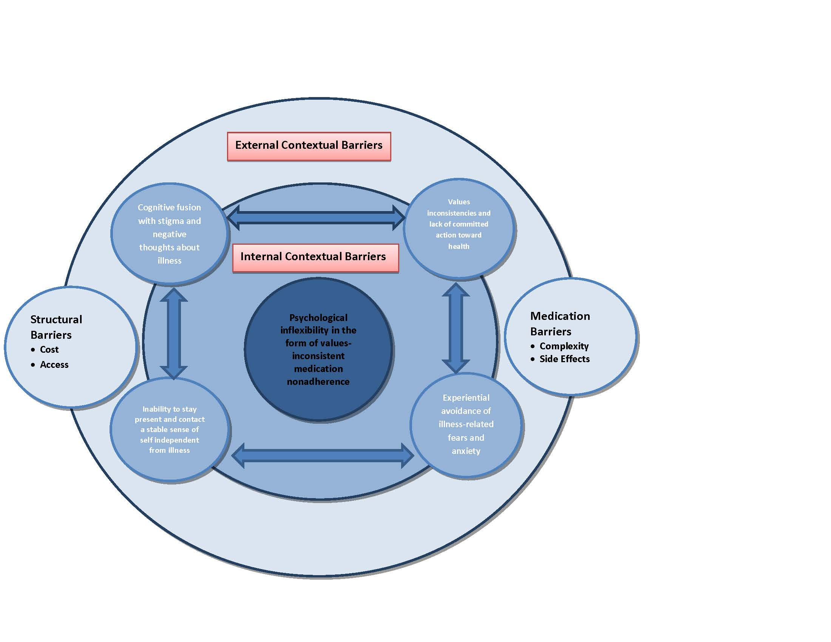
Psychological Flexibility model of medication adherence

Slide 9
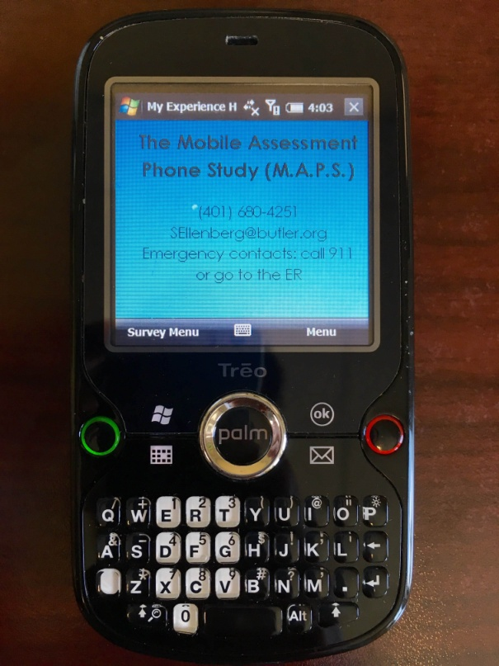
Using EMA to study adherence
Most studies have been cross-sectional or retrospective.
Retrospective assessment is problematic because memory bias may influence self-reporting.
EMA facilitates in vivo data collection.

Slide 10
Present Study: Aims
Aim 1: To assess the feasibility and acceptability of post-hospital EMA in patients with psychotic-spectrum disorders
Measured by:
Recruitment
Retention
Adherence to protocols
Patient feedback on acceptability
Aim 2: To identify ecologically-valid and potentially modifiable post-hospital adherence predictors

Slide 11
Design
Eligibility:
Adults (18+ years old)
Currently hospitalized at Butler Hospital in Providence, RI
Psychotic-spectrum disorder diagnosis (SCID-assessed and corroborated with medical chart)
Prescribed oral antipsychotic medication
Assessments:
Baseline interview/self-reports
1-month of EMA
MEMS caps
1-, 2-, and 4-month follow-up interviews/self-reports

Slide 12
EMA protocol
Random assessments:
Environmental variables
Substance use
Affect
Psychotic symptoms
Psychological coping
Stressful life events
Social support
Interference
Satisfaction with life
End-of-Day assessment:
Appointment attendance
Provider relationship
Medication adherence
Reasons for not taking medication
Medication side effects

Slide 13
Participant flow
N=65
Consented
(49% of patients approached)
Completed baseline
N=55
N=37
Completed ≥ 1 EMA survey

Slide 14
Participants characteristics
Sex: 54% female (n=35)
Age: mean=37.2 years old (SD=13.4)
Race: 79% non-Latino White (n=51)
Ethnicity: 89% non-Latino (n=58)
Education: mean=13.0 years (SD=3.0)
Marital status: 54% single, never married (n=35)
Income: mode <$10,000/year
Work status: 49% disabled (n=32)

Slide 15
Participant characteristics

Slide 16
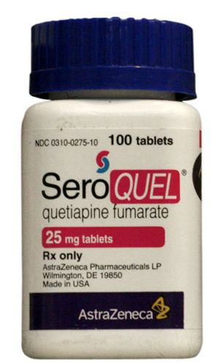
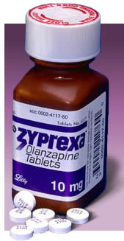
Participant characteristics

Slide 17
Acceptability and Feasibility Results
Acceptability:
Overall likeability/usability: mean=39.9 (SD=6.6; max=50)
Positive attitudes:
Pleasant overall experience: mean=4.0 (SD=1.2)
Would participate in a similar study in the future: mean=4.2 (SD=1.2)
Negative attitudes:
Difficulty operating the device: mean=2.4 (SD=1.5)
Beeps interfered with activities: mean=2.1 (SD=1.2)
Experience in the study was challenging: mean=2.3 (SD=1.4)
*Items adapted from Kimhy et al. (2006); Scale=1-5, with higher ratings meaning greater agreement with the item.

Slide 18
Acceptability and Feasibility Results
Qualitative feedback on acceptability:
“At first a little complicated, then I got used to it.”
“Added some structure to my day.”
“Kinda redundant.”
Feasibility:
89% owned a cell phone
65% of these were Smartphones
65% had unlimited texting
77% had internet access from their cell phones
Reported problems:
20% of problems related to not wanting to use the device
16% of problems related to the device not powering on/battery issues
4% of device were lost
4% of device were damaged

Slide 19
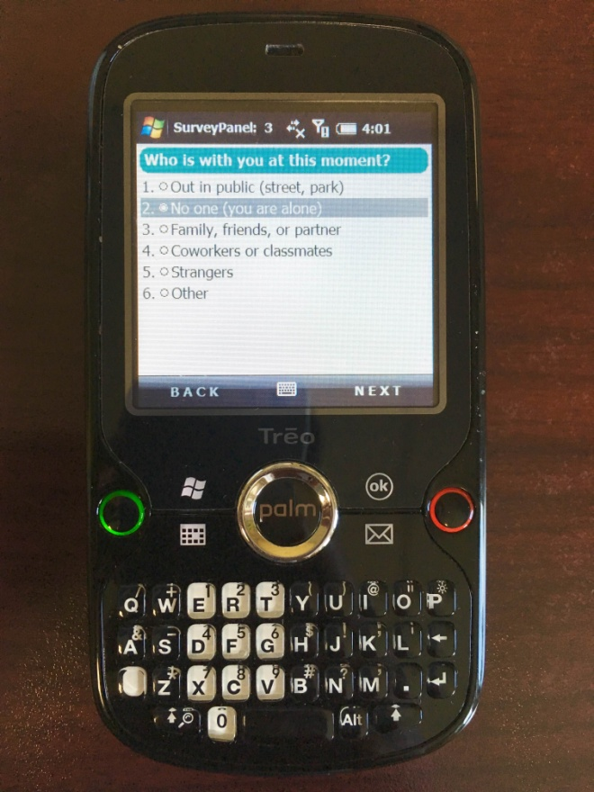
EMA results
37 patients completed ≥1 survey
Mean # of surveys completed=28.0 (SD=31.0)
Min=1; Max=76
931 total random assessments completed
345 end-of-day assessments completed
Environment:
65% completed “in my home”
44% completed “alone”
50% completed when “inactive”

Slide 20
EMA results

Slide 21
EMA results

Slide 22
EMA results
Outpatient appointment attendance
22 patients attended at least 1 appointment
49% were individual therapy sessions
34% were for medication management
Medication nonadherence
7 patients reported nonadherence
4 reported >1 nonadherence event
Side effects were reported in 58% of surveys

Slide 23
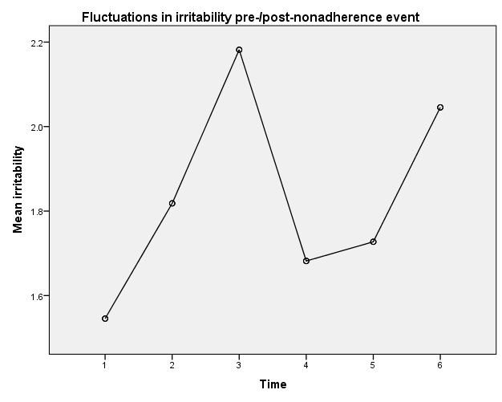
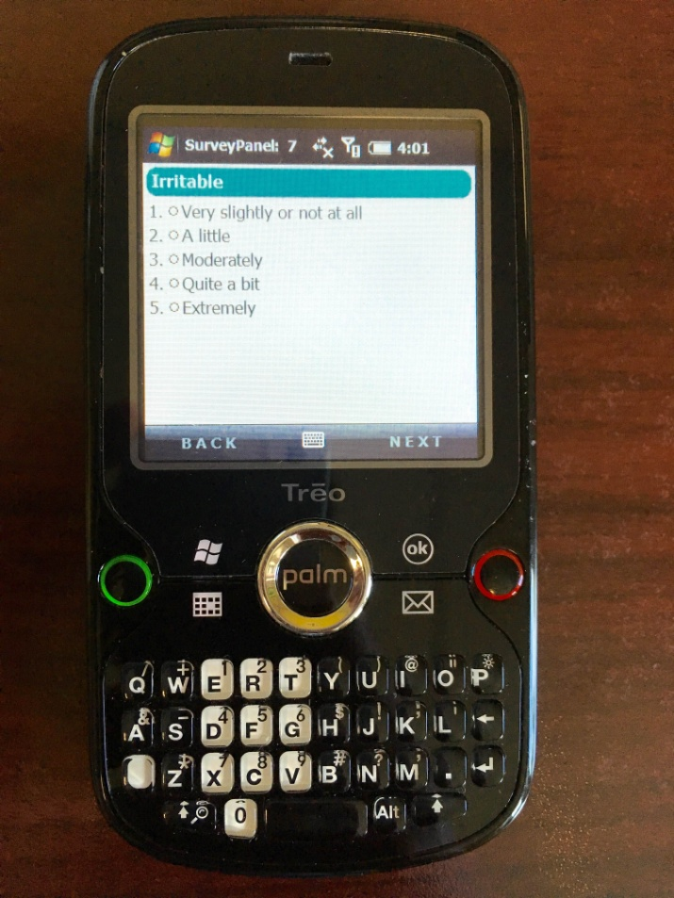
EMA results
X
X = Nonadherence event

Slide 24
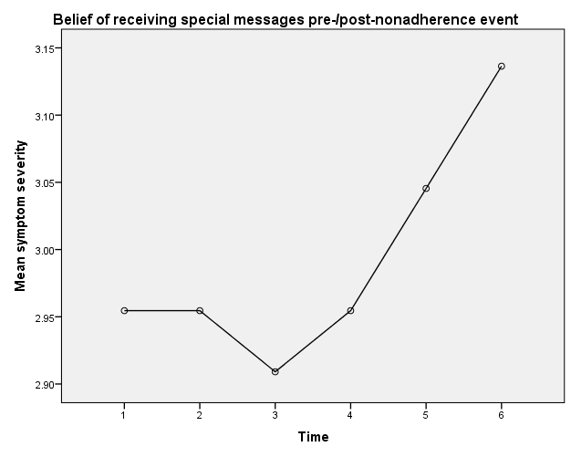
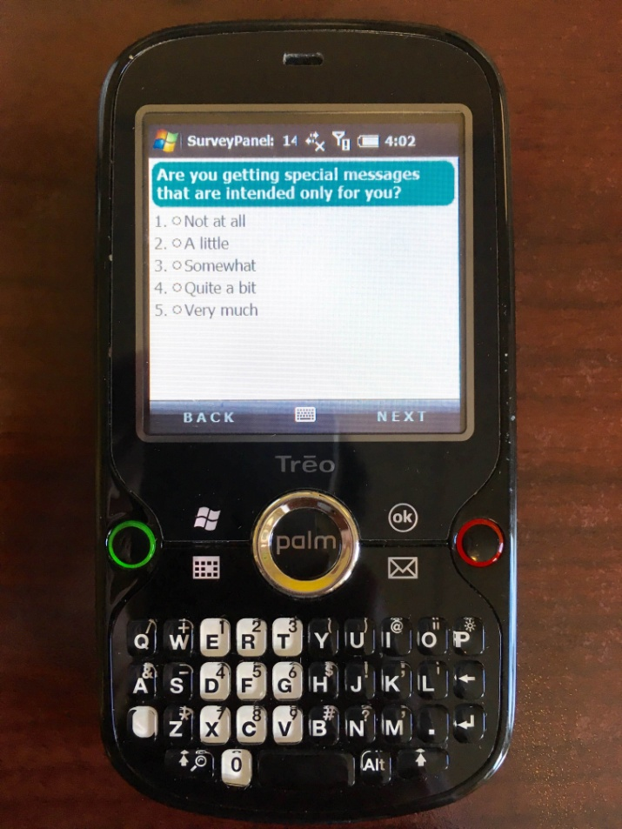
EMA results
X
X = Nonadherence event

Slide 25
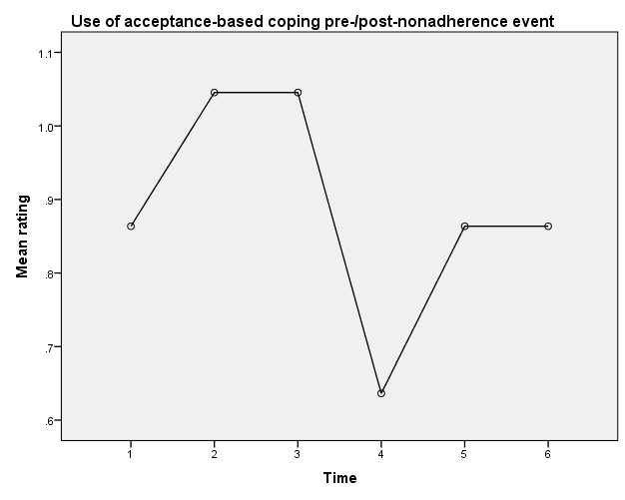
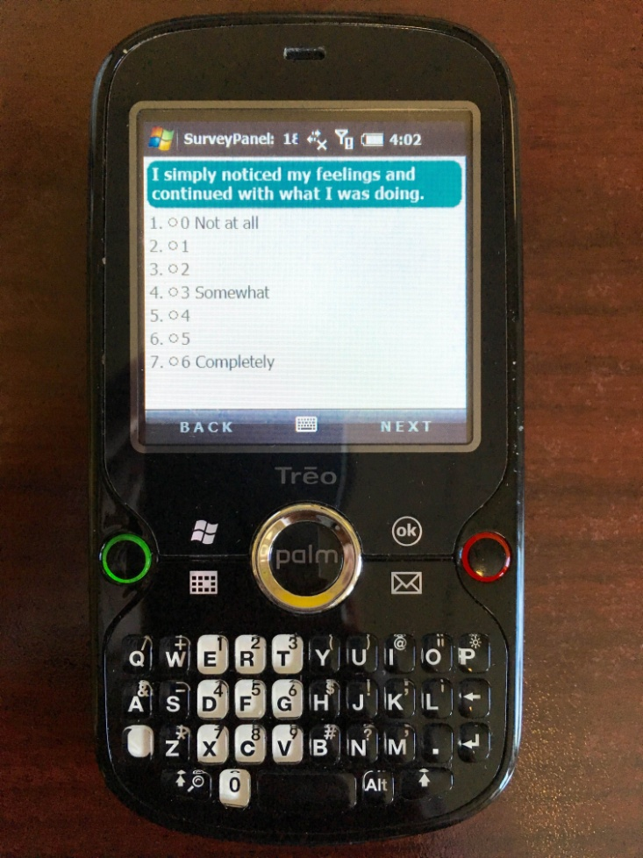
EMA results
X
X = Nonadherence event

Slide 26
Lessons Learned
Using technology
Working with “overwhelmed” patients
Cost and systemic considerations

Slide 27
Future Directions
Mobile device-based intervention?
Adjunctive support via patients’ mobile devices?

