Slide 1
“Smart Quit” App Trial: Testing a New Path to Quitting Smoking
Jonathan B. Bricker, PhD
Public Health Sciences, Fred Hutchinson Cancer Research Center
Psychology Department, University of Washington, Seattle, WA

Slide 2
Acknowledgments
Katrina Akioka, BS, Project Manager, FHCRC
Jessica Harris, MA, Research Therapist, FHCRC
Jaimee Heffner, PhD, Psychologist, FHCRC
Julie Kientz, PhD, Computer Scientist, UW
Brandon Masterson, CEO, 2 Morrow Inc.
Jo Masterson, COO, 2 Morrow Inc.
Laina Mercer, MS, Statistician, FHCRC
Roger Villardaga, PhD, Psychologist, UW
Nutrition Assessment Shared Resource, FHCRC
Hartwell Innovation Fund, FHCRC

Slide 3
The Journey Ahead
The problems of tobacco use & intervention
ACT by Smartphone: Addresses the low quit rate problem with novel intervention and technology
Overview of our ACT “Smart Quit” intervention
Live demonstration of Smart Quit
Design and Baseline Data on Randomized Trial

Slide 4
Today’s Tobacco Consequences
The leading cause of preventable death, killing 440K US (CDC, 2008) & 5 million worldwide (Hatsumaki et al., 2008).
Adult smoking: 19% in US (CDC, 2013).
Causes hypertension, CHD, stroke, and multiple cancers (USDHHS, 2004).
$193 Billion in US medical and lost productivity costs (CDC, 2008).
Notes:
Jonathan B. Bricker, PhD
jbricker@u.washington.edu
1/17/2008
4

Slide 5
US Cessation Treatment: Reach & Efficacy
30%
20%
10%
Individual
Group
Efficacy (% Quit at 12 months)
Telephone
Web
1m 2m 3m 4m
US Reach (# of million using modality annually)
Notes:
Jonathan B. Bricker, PhD
jbricker@u.washington.edu
1/17/2008
5

Slide 6
mHealth Smartphone Apps
44 million downloads in 2012 and 142 million expected in 2016 (Juniper Research, 2012)
Low cost, real time ways to assess and change behavior
Need to evaluate these new technologies for their efficacy (Francis Collins, NIH Director, 2012)

Slide 7
Quit Smoking Smartphone Apps
High Growth: Since 2007, growth from a few to over a thousand apps available
Unknown Efficacy: Never been tested before!

Slide 8
Smart Quit App User Design
Begin: An evidence-based quit plan
Ongoing: Push and pull ACT tips for quitting
Review: Tracking & Progress
Sharing: Inner Circle, Facebook, Twitter

Slide 9
Splash
Intro and How to Use App
Set up of
My Quit Plan
Overview of App Structure
Main Menu
Once My Quit Plan is set up, app will always open to Main Menu
Main
Tracking
My Quit Plan
Progress
Sharing
Staying Motivated
Reports
Having an Urge
Locations
I Slipped
Badges
Notes:
2MM Notes:
Slide #5 will go back to first page of my Quit Plan
Slide 31 – sharing – will use default sharing central set up
FHCRC Notes: Updated slide deck. Tracking moved to the front of row.

Slide 10
Usability Testing Revisions
Six Rounds of Testing: 4 internal/2 external
Identified 150 Total Revisions
Primary Revisions:
Logic/Flow Errors (e.g., buttons lead to wrong screen)
Content Changes (e.g., text too wordy)
Aesthetics (e.g., fonts too small/bad colors)

Slide 11
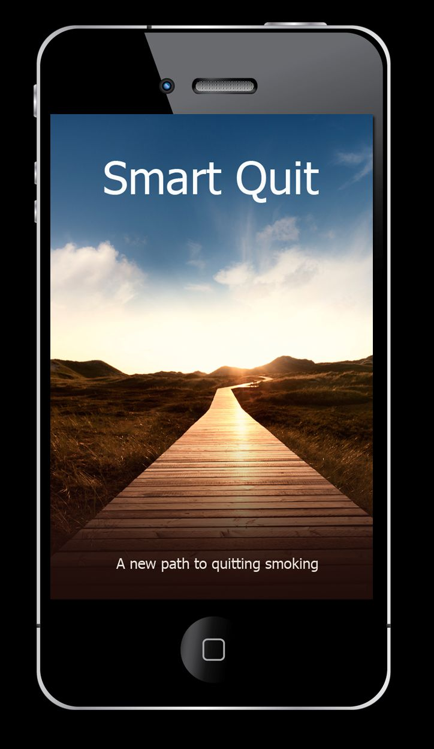
Notes:
Jonathan B. Bricker, PhD
jbricker@u.washington.edu
1/17/2008
11

Slide 12
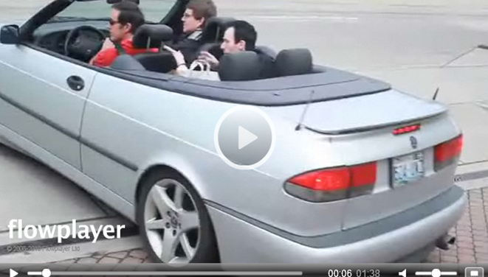
Intro Screen: Car Journey

Slide 13
Smart Quit Referral Sources
How did you find our website? | Overall (n=196)
Our Facebook Ad | 39%
Television | 13%
Radio | 10%
Website | 8%
Our Google Ad | 7%
Newspaper | 7%
“smartquit.org” in search results | 5%
Fhcrc.org | 4%
Doesn’t know source | 4%
Other | 3%
Notes:
Jonathan B. Bricker, PhD
jbricker@u.washington.edu
1/17/2008
13
Other: WA Quitline, Bing Ad, smokefree.gov, healthcare provider, hospital, conference.

Slide 14
Screened: 738
Eligible: 400
Smart Quit
Enrollment
Diagram
Consented: 340
Confirmed by phone: 205
Randomized: 196
Smart Quit: 98
Quit Guide: 98
Two-month
Follow-up Survey
Two-month
Follow-up Survey

Slide 15
Smart Quit Demographics
Baseline Characteristic | Smart Quit (n=98) | Quit Guide (n=98) | Overall (n=196)
Female | 53% | 51% | 52%
Caucasian/Non-Hispanic | 81% | 88% | 84%
Married | 37% | 46% | 41%
Working | 71% | 73% | 72%
Completed at least some college | 86% | 88% | 87%
Smokes within 5 min of waking | 30% | 28% | 29%
Smokes more than one pack per day | 28% | 21% | 24%
Consumes > 5 alcoholic beverages on typical day | 25% | 22% | 23%
Living with partner who smokes | 24% | 21% | 23%
Any 5 close friends who smoke | 74% | 73% | 74%
Notes:
Jonathan B. Bricker, PhD
jbricker@u.washington.edu
1/17/2008
15
Randomization stratification: 1) nicotine dependence (yes/no) and 2) commitment to quitting (high/low)

Slide 16
Smart Quit Outcomes
Engaged?: (a) # times app opened, (b) # times specific pages viewed, (c) length of page views
Does engagement predict quit rates?
Is SmartQuit better than Quit Guide?: Compare satisfaction, quit attempts, & quit rates

Slide 17
Conclusions
Quit smoking apps have high reach & consumer demand
Apps are untested
Smart Quit is now being tested to address consumer need for quality app

Slide 18
Many Thanks!
Contact: Dr. Jonathan Bricker
Email: jbricker@uw.edu
Notes:
Jonathan B. Bricker, PhD
jbricker@u.washington.edu
1/17/2008
18

