Slide 1
Gender & Contextual Behavioral Science

Slide 2
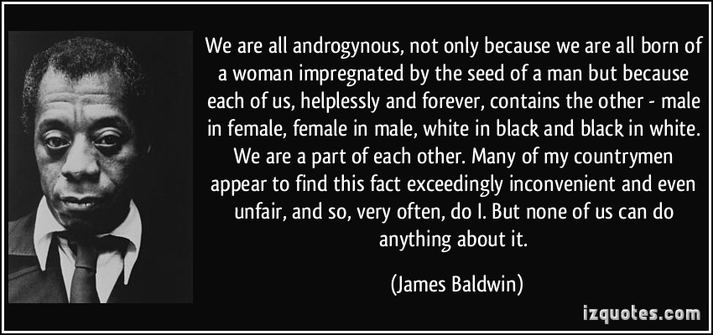
Notes:
All of these elements are parts of us, but we are more than this, aren’t we . . . . We know, here and now together , that by practicing acceptance and non-judgment of sexist and prejudiced thoughts (as simply thoughts, and not our fault, but our responsibility) and connecting with what really matters to us, we can increase our awareness and willingness to choose EFFECTIVE, non-violent, and non-sexist behaviors. More importantly, by accessing our universal need for one another, our interdependence, and our desire to be loved, perhaps we can find our way back to treating each other as unique equals, partners in compassion and ultimately, humanity.

Slide 3
Gender
While differences between individuals often outweigh those found between groups, empirical evidence supports variance in a number of dimensions among genders
These observed gender differences raise significant questions about the influence of gender on our behaviors and our experience of self.

Slide 4
Gender
Acts of injustice, violence and discrimination based on gender involve objectifying, dehumanizing and subjugating others (and sometimes ourselves).

Slide 5
Gender
There is a long history of cultural discussions about gender related rights violations and sexism – largely focused on blame.
These approaches are often centered in shame-based strategies and are critical by nature, focusing on perceived outcomes rather than processes.
Notes:
Framing gender in this way: creates distance over cooperation, fosters fear over forward motion & engenders hopelessness, stagnation, and resignation.

Slide 6
Gender has historically been used as a simplistic, categorical system
(Man or Women, Girl or Boy, Masculine or Feminine)
When we categorize, specify and stereotype gender, what are we missing?
What parts of ourselves and each other do we end up cutting off, ignoring or shaming?
What experiences are we robbing from each other, from ourselves?
Does our binary system exclude many individuals’ experiences of gender, inherently denying the full spectrum of human experience?
Notes:
LOVE AUTHENTICITY VULNERABILITY CONNECTION FREEDOM
Genuine experiencing

Slide 7
Gender is relevant as a performative spectrum
Influenced by the intersection of processes such as - culture, language, biology, & evolution.
Malleable with time & context.
CBS offers an essential pragmatic lens through which to view gender - highlighting the unique functions involved and increase awareness of the vast array of individual and contextual differences that may exist in ‘gendering’.
Notes:
Judith Butler
This may help us address problems of social stigma, economic oppression, socially sanctioned assaultive behaviour, and the maladaptive sequelae of rigid adherence to rule governed behaviour based on reified gender constructs, expressed at multiple levels of collective organization of human behaviour and species.

Slide 8
Dynamic Gender Terms
Neutrois
Non-binary
Pangender
Transgender (Trans Man, Trans Woman, Trans Female, Trans Male, Trans Person)
Trans* (Trans*Person, Trans*Female, Trans*Male, Trans*Man, Trans*Woman)
Transsexual person (Transsexual Woman, Transsexual Man, Transsexual Female, Transsexual Male)
Transgender (Transgender person, Transgender Female, Transgender Male, Transgender Man, Transgender Woman)
Transmasculine
Transfeminine
Two-spirit
Agender (a.k.a. “genderless” and “gender neutral”)
Androgyne/Androgynous
Bigender
Cis (Cis Female, Cisgender Female, Cisgender Woman, Cis Male, Cis Man, Cisgender Male, Cisgender Man)
Female to Male/ FTM
Gender Fluid
Gender Nonconforming
Gender Questioning
Gender Variant (a.k.a. “gender diverse” or “gender-nonconforming.”)
Genderqueer
Intersex
Male to Female/MTF
Neither

Slide 9
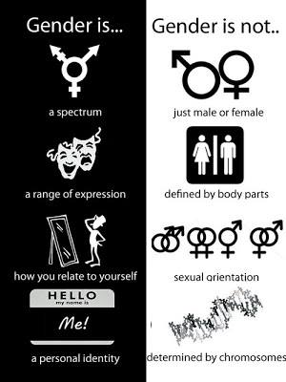

Slide 10
Questions For Our Panel:
What does Contextual Behavioural Science have to offer in crafting a new paradigm and understanding of gender?
What does a functional contextualist account of gender identity look like?

Slide 11
Questions For Our Panel:
How significant are gender differences in regards to ACT and RFT processes?
What is the role of gender in self and perspective taking?
How would one differentiate between “gender as content,” “gender as process” and/or “gender as context?”
How does “gender as a context” influence:
cognitive fusion
excessive dominance of rule governed behavior
liberation to pursue freely chosen values?

Slide 12
Questions For Our Panel:
What are the implications of addressing gender in ACBS (in our community? in our clinical work? in our research?)
Might a Functional Contextualist account of gender afford us a more effective approach in addressing:
prejudice
stigma
shame
trauma
challenges to cooperation

Slide 13
Questions For Our Panel:
What are the disadvantages or risks involved in pursuing this area of discussion and research?
What are the possible implications and future directions of gender related research and action?
Notes:
Is an approach to issues of gender, in the context of “intersectional solidarity” in accord with the ACBS mission statement?

Slide 14
“Even if our values are not racist or sexist, our minds sometimes are. It doesn’t matter your race or gender; we’re all swimming in this stream.”
~ Steven Hayes

Slide 15
One Truth . . .
All of these elements are parts of us, but we are more than this, aren’t we?
By practicing acceptance and non-judgment of sexist and prejudiced thoughts, and connecting with what really matters to us, we can increase our awareness and willingness to choose EFFECTIVE, non-violent, and non-sexist behaviors.
More importantly, by accessing our universal need for one another, our interdependence, and our desire to be loved, perhaps we can find our way back to treating each other as unique equals, partners in compassion and ultimately, humanity.

Slide 16
Notes:
All of these elements are parts of us, but we are more than this, aren’t we . . . . We know, here and now together , that by practicing acceptance and non-judgment of sexist and prejudiced thoughts (as simply thoughts, and not our fault, but our responsibility) and connecting with what really matters to us, we can increase our awareness and willingness to choose EFFECTIVE, non-violent, and non-sexist behaviors. More importantly, by accessing our universal need for one another, our interdependence, and our desire to be loved, perhaps we can find our way back to treating each other as unique equals, partners in compassion and ultimately, humanity.

Slide 17
Or can we?

Slide 18
Thank you
Laura Silberstein, Psy.D.
Silberstein.psy.d@gmail.com

