Slide 1
ACT Smartphone App for Quitting Smoking: Results from RCT
Jonathan B. Bricker, PhD
Public Health Sciences, Fred Hutchinson Cancer Research Center
Psychology Department, University of Washington, Seattle, WA

Slide 2
Scientific Collaborators & Project Partners
Jan Blalock, PhD, Psychologist, Univ of Texas/MD Anderson
Terry Bush, PhD, Psychologist, Alere, Seattle
Jaimee Heffner, PhD, Psychologist, FHCRC
Julie Kientz, PhD, Computer Scientist, UW
Jennifer McClure, PhD, Psychologist, Group Health
Roger Vilardaga, PhD, Psychologist, FHCRC/UW
2 Morrow Inc., Mobile Health, Seattle
Blink UX, Web Design, Seattle
Collaborative Data Services, Data ops, FHCRC
Harvard University Health Communications, Boston
Moby, Web Programming, Seattle
Nutrition Assessment Shared Resource, Data ops, FHCRC

Slide 3
Funding Sources
National Cancer Institute
R01-CA-166646 (PI: Bricker)
R01-CA-151251 (PI: Bricker)
R01-CA-120153 (PI: Blalock)
National Institute on Drug Abuse
R21-DA-030646 (PI: Bricker)
K23-DA-0265517 (PI: Heffner)
K99-DA-0037276 (PI: Vilardaga)
Hartwell Innovation Fund (PI: Bricker)
Fred Hutchinson Cancer Research Center (PI: Bricker)

Slide 4
mHealth Smartphone Apps
44 million downloads in 2012 and 142 million expected in 2016 (Juniper Research, 2012)
Low cost, real time ways to assess and change behavior
Need to evaluate these new technologies for their efficacy (Francis Collins, NIH Director, 2012)

Slide 5
Smartphone Apps for Cessation
Strong growth: Since 2007, growth from a few to over 400 apps (Abroms et al., 2013)
High reach: 780,000 downloads per month (Abroms et al., 2013)
Rich content capabilities: Audio, video, text
Interactive and engaging: Track and view progress
Accessible: On-the-spot coaching; no cell/wireless connection or repeated log-in required

Slide 6
Problem
Across delivery modalities, following US Clinical Practice Guidelines yields limited quit rates: 7-10% average quit rates for web or text messaging at one year follow-up. (e.g., Civljak, 2010; Whittaker, 2012)
To maximize the potential power of smartphone apps, we need to go beyond the US Guidelines: new intervention content

Slide 7
Acceptance & Commitment Lead to Life-Embracing Behavior Change
Mindfulness
Values
Acceptance
Commitment
Defusion
Self As
Context
Action
Life-Embracing Behavior Change

Slide 8
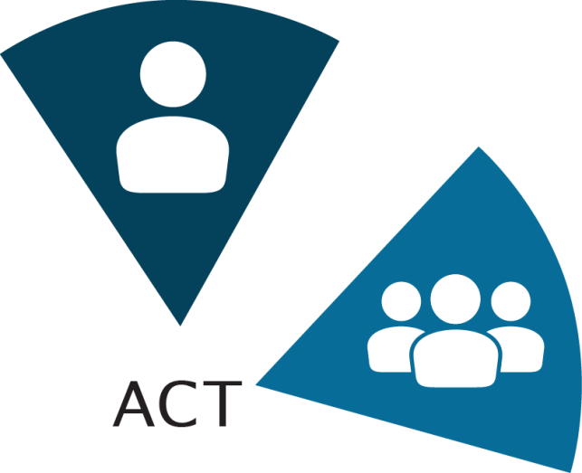
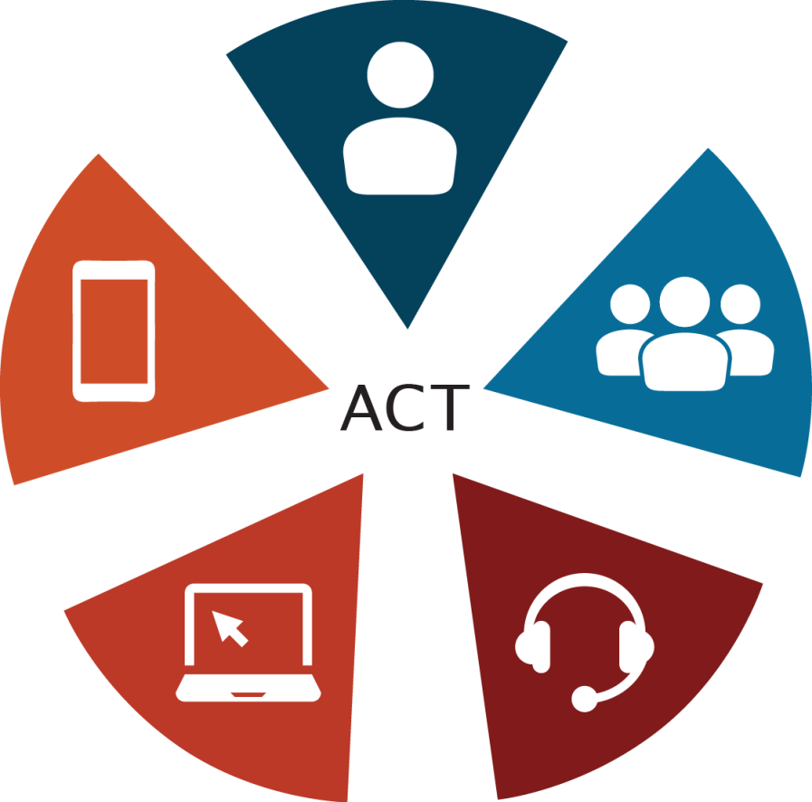
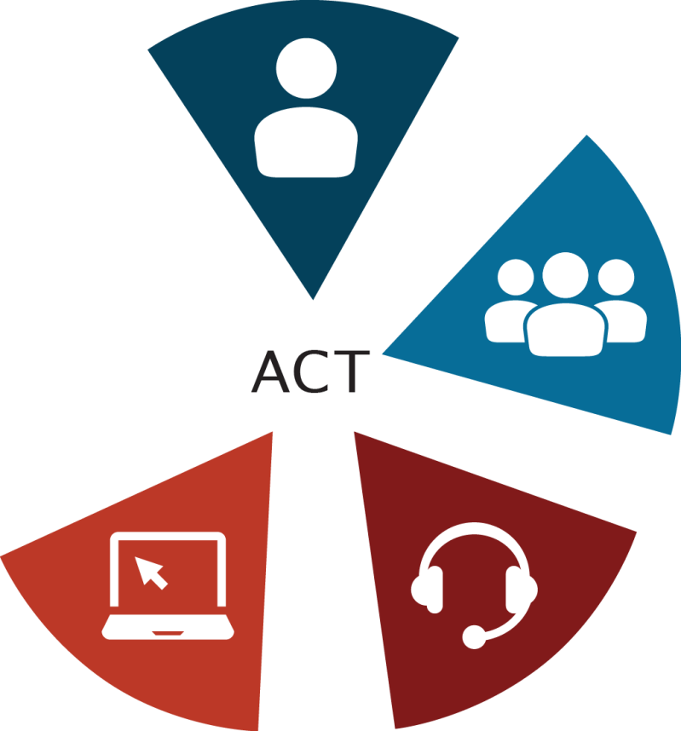
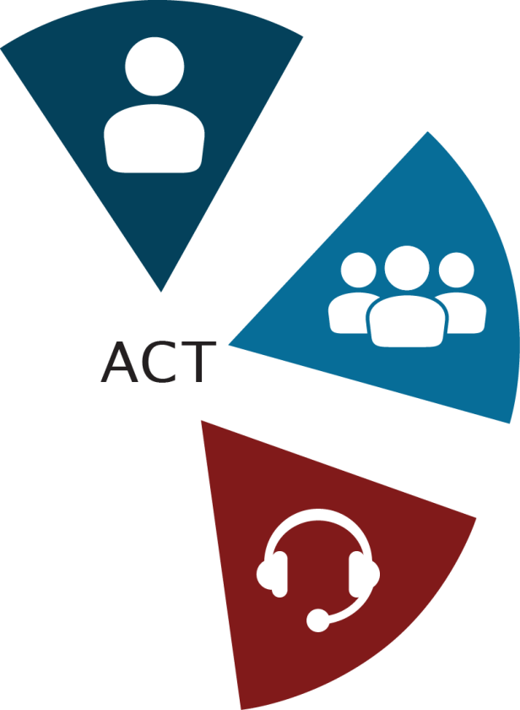
Our ACT Research Program
Notes:
Jonathan B. Bricker, PhD
jbricker@u.washington.edu
1/17/2008
8

Slide 9
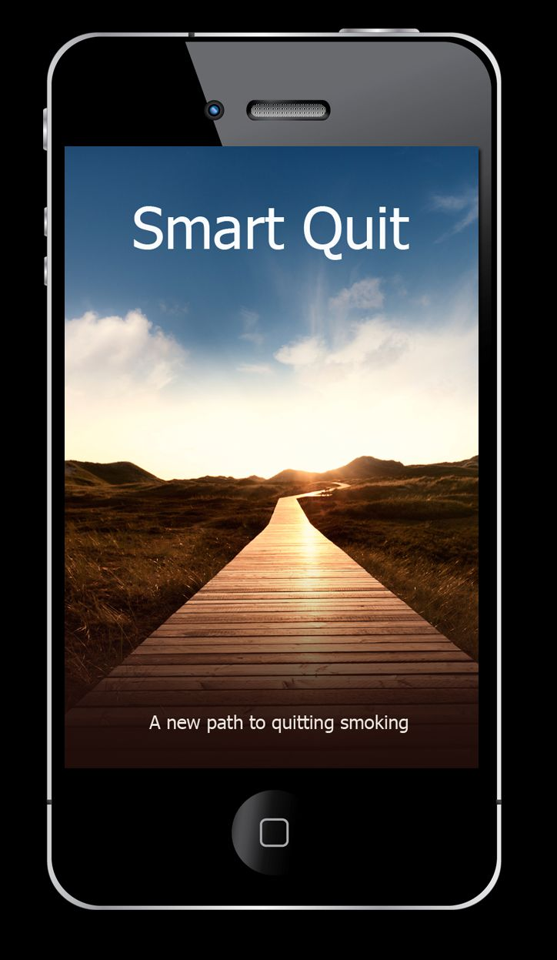
Notes:
Jonathan B. Bricker, PhD
jbricker@u.washington.edu
1/17/2008
9

Slide 10
Pilot Trial of Smartphone-Delivered ACT “SmartQuit” for Smoking Cessation
Primary Aim 1: App design & trial design feasibility: recruitment, balanced randomization, follow-up data retention.
Primary Aim 2: SmartQuit has trend toward higher utilization and satisfaction.
Primary Aim 3: SmartQuit has trend toward higher cessation and theory processes. Primary outcome: 30 pp at 70-days post randomization.
Notes:
Jonathan B. Bricker, PhD
jbricker@u.washington.edu
1/17/2008
10

Slide 11
SmartQuit App User Design
Begin: An evidence-based quit plan
Ongoing: Push and pull ACT tips for quitting
Review: Tracking & Progress
Sharing: Inner Circle, Facebook, Twitter

Slide 12
Splash
Intro and How to Use App
Set up of
My Quit Plan
Overview of App Structure
Main Menu
Once My Quit Plan is set up, app will always open to Main Menu
Main
Tracking
My Quit Plan
Progress
Sharing
Staying Motivated
Reports
Having an Urge
Locations
I Slipped
Badges
Notes:
2MM Notes:
Slide #5 will go back to first page of my Quit Plan
Slide 31 – sharing – will use default sharing central set up
FHCRC Notes: Updated slide deck. Tracking moved to the front of row.

Slide 13
Usability Testing Revisions
Six Rounds of Testing: 4 internal/2 external
Identified 150 Total Revisions
Primary Revisions:
Logic/Flow Errors (e.g., buttons lead to wrong screen)
Content Changes (e.g., text too wordy)
Aesthetics (e.g., fonts too small/bad colors)

Slide 14
Comparison: NCI’s Quit Guide
Solid Basis: NCI’s Smokefree.gov, with high reach (1 million visitors) & benchmark 7-10% quit rate.
Current practice: US Clinical Practice Guidelines
Standard content: Stages of quitting (Think, Prepare, Quit, Maintain)
Notes:
Jonathan B. Bricker, PhD
jbricker@u.washington.edu
1/17/2008
14

Slide 15
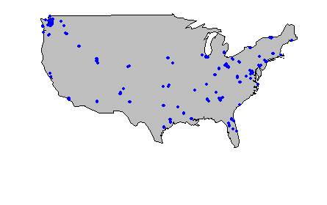
Recruitment
How did you find our website? | Overall (n=196)
Our Facebook Ad | 39%
Television | 13%
Radio | 10%
Website | 8%
Newspaper | 7%
Our Google Ad | 7%
“smartquit.org” in search results | 5%
Fhcrc.org | 4%
Doesn’t know source | 4%
Other | 3%
State Distribution
Notes:
Jonathan B. Bricker, PhD
jbricker@u.washington.edu
1/17/2008
15

Slide 16
Screened: 738
Eligible: 400
SmartQuit
CONSORT
Diagram
Consented: 340
Confirmed by phone: 205
Randomized: 196
Smart Quit: 98
Quit Guide: 98
70-Day
Follow-up: 80
70-Day
Follow-up: 84

Slide 17
Aim 1: Baseline Demographics & Retention
Demographic | Overall (N= 196) | Quit Guide (n=98) | Smart Quit (n=98) | Baseline p=value | Outcome p=value
Age, mean | 41.5 | 41.6 | 41.5 | 0.95 | 0.65
Female | 52% | 51% | 53% | 0.89 | 0.89
Caucasian | 84% | 94% | 85% | 0.07 | 0.33
Married | 41% | 46% | 37% | 0.25 | 0.93
Working | 60% | 62% | 58% | 0.66 | 0.92
HS or less | 13% | 12% | 14% | 0.83 | 0.01
Notes:
Jonathan B. Bricker, PhD
jbricker@u.washington.edu
1/17/2008
17

Slide 18
Aim 1: Baseline Smoking & Social Env at Baseline & Retention
Demographic | Overall (N = 196) | Quit Guide (n=98) | Smart Quit (n=98) | Baseline p=value | Outcome p=value
Smoking Behavior
At least-a-pack/day | 24% | 21% | 24% | 0.41 | 0.02
Smoked x>10 years | 74% | 77% | 72% | 0.62 | 0.71
Avoidant of Cravings (Mean) | 1.91 | 1.94 | 1.87 | 0.24 | 0.96
Social Influence
Close friends smoke, mean | 1.8 | 1.8 | 1.7 | 0.81 | 0.31
Partner smokes | 23% | 21% | 24% | 0.73 | 0.07
Notes:
Jonathan B. Bricker, PhD
jbricker@u.washington.edu
1/17/2008
18

Slide 19
Aim 2: Utilization
 | Quit Guide | Smart Quit | p-value
Number of times opened app | 15.2 | 37.2 | 0.0001

Slide 20
Aim 2: Satisfaction
 | Quit Guide | Smart Quit | p-value
App was organized | 67% | 85% | 0.006
App useful for quitting | 38% | 53% | 0.10
Satisfied overall | 45% | 59% | 0.14

Slide 21
Aim 3: ITT 70-Day FU Quit (30D PP)
Quit Guide | Smart Quit | OR (95% CI)
8% | 13% | 2.7 (0.8, 10.3)
Notes:
FU data retention was 67% with p=.18 on arm comparison.

Slide 22
Aim 3: ITT 70-Day FU Quit (30D PP): Key Baseline Subgroups
Baseline Subgroup | Quit Guide | Smart Quit | OR (95% CI)
At Least Pack-A-Day | 6% | 11% | 1.8 (0.1, 53.3)
Avoidant of Cravings | 8% | 15% | 2.9 (0.6, 20.7)

Slide 23
Aim 3: Change in Acceptance of Cravings
 | Baseline mean (SD) | Follow-up mean (SD) | p-value
Quit Guide | 1.94 (0.43) | 2.03 (0.53) | 0.15
Smart Quit | 1.87 (0.36) | 2.00 (0.57) | 0.04

Slide 24
Top 5 SmartQuit Features
Most Popular
Most predictive of quitting
ACT vs. CBT | Feature | # users | p (OR)
CBT | Viewed quit plan overview | 76 | .03 (11.1)
CBT | Viewed progress in calendar | 65 | .17 (2.8)
CBT | Opened sharing page | 64 | .23 (2.5)
CBT | Viewed progress in chart | 64 | .44 (1.7)
ACT | Tracked acceptance | 61 | .03 (10.5)
ACT vs. CBT | Feature | p (OR) | # users
ACT | Tracked ACT skills practice | (.01) (16.4) | 43
CBT | Viewed quit plan overview | .03 (11.1) | 76
ACT | Tracked acceptance | .03 (10.5) | 61
ACT | Viewed Staying Motivated video | .06 (4.1) | 15
ACT | Viewed Handling Urges video | .06 (4.1) | 15

Slide 25
Conclusions
First RCT of smartphone app for adult smoking cessation
Compared to National Standard App following US CP Guidelines, SmartQuit…
Was generally more satisfying
Was opened 2.5 times more often
Resulted in 60%-90% descriptively higher quit rates—but not statistically significant
A fully powered trial is now needed
Notes:
Jonathan B. Bricker, PhD
jbricker@u.washington.edu
1/17/2008
25

Slide 26
Next Steps
SmartQuit is now licensed: Fred Hutchinson Cancer Center licensed SmartQuit to programmer 2Morrow, Inc. Royalties go to support research.
SmartQuit 2.0: Launched by January 1, 2015. A state health dept & insurance company are the launch customers.
New research: NIH R01 grant now in review!
Notes:
Jonathan B. Bricker, PhD
jbricker@u.washington.edu
1/17/2008
26

Slide 27
Many Thanks!
Contact: Dr. Jonathan Bricker
Email: jbricker@uw.edu
Notes:
Jonathan B. Bricker, PhD
jbricker@u.washington.edu
1/17/2008
27

