Slide 1

Seeing it and
Feeling it
Making
ACT
metaphors visual and physical for young people
Timothy & Sandra Bowden, WC12 Minneapolis 2014

Slide 2
Metaphors
Can reinforce an abstract concept by comparing it to a formal concept- and by “grounding”the abstract in ways you can touch and see, makes it more directly understandable, more connected to direct experience- more “in the moment”.
Aid with understanding
May help with recall: A study on learning reported that the use of metaphors and other strategies can “increase retention by as much as 40%” (Earl, 1995)
Reduce the pressure of too much eye contact- can be very helpful with young people
Create choice
Create opportunity for behavioural change
Can be flexible enough to help create your own meaning
Are “stories and experiences that link the richness of what you already know to domains in which you are unsure what to do” (Hayes, 2013)

Slide 3
Metaphors in ACT aim to
Disrupt
    Unravel
    Deliteralise
    the verbal content of our beliefs and self-talk (ie. cognitive defusion): to weaken the dominance of literal language over direct experience…
  …and
  Facilitate a transfer of functions between one relational network and another.
Colleen Ehrnstrom, Mastering the Metaphor, WC X 2012
Notes:
Video is next.
3

Slide 4
The use of metaphors (such as the ‘monsters on the boat’) and experiential exercises (such as mindfulness activities) render ACT an appropriate treatment for young people, as concepts that would normally be too abstract to understand become accessible through experience, and children’s ability to think in less literal terms supports the use of metaphoric language (O’Brien, Larson, & Murrell, 2008).

Slide 7
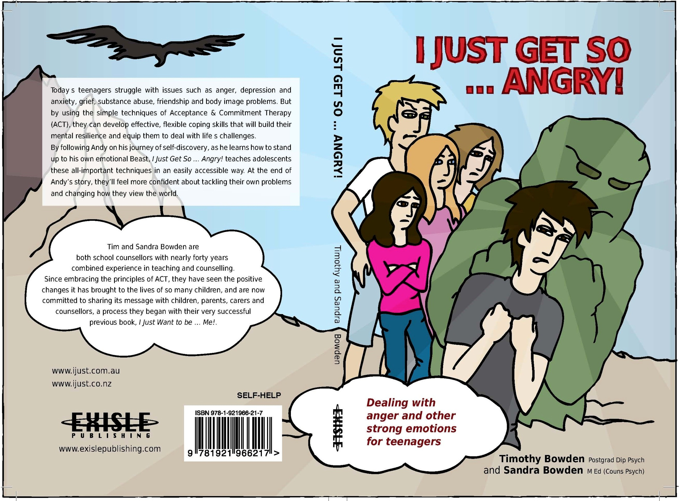

Slide 8
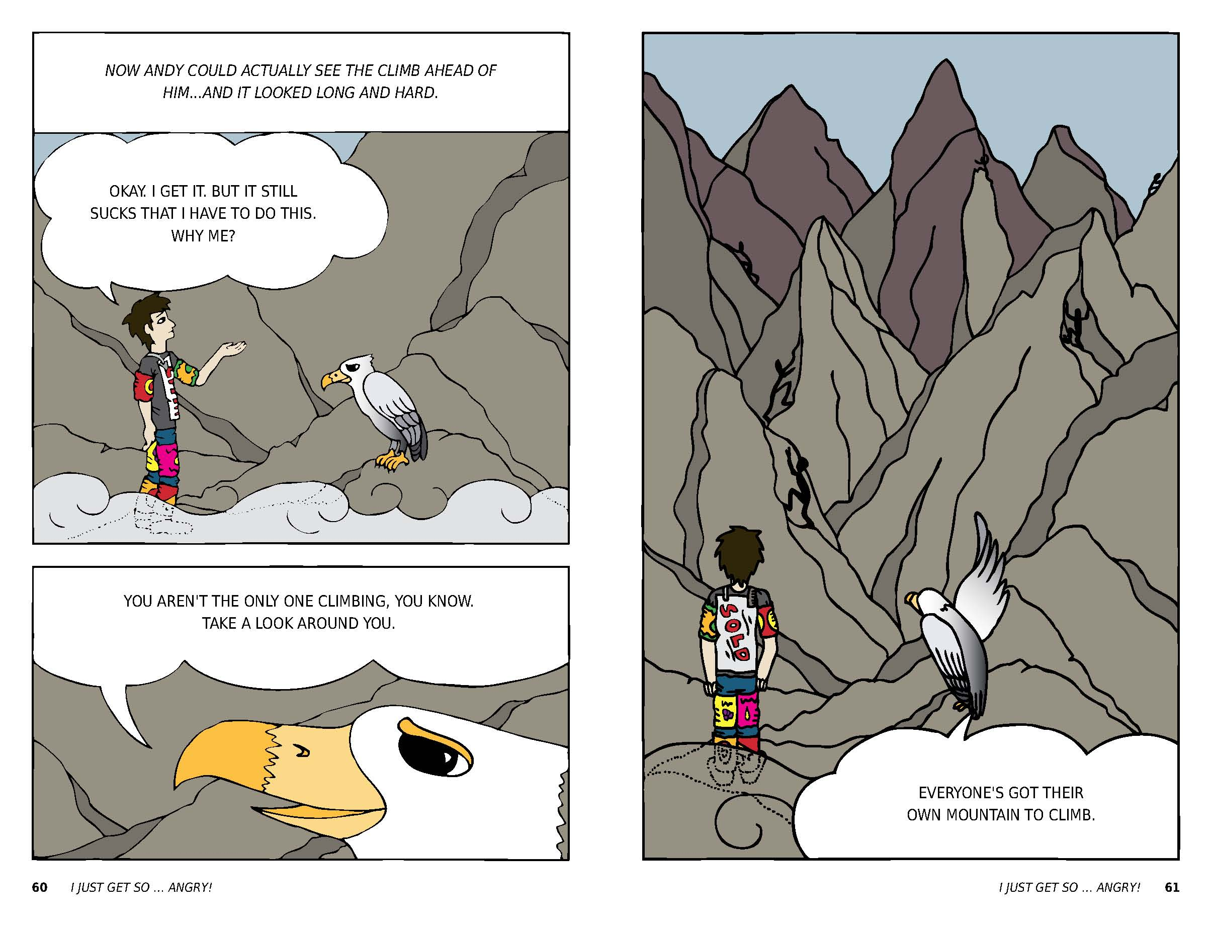

Slide 9
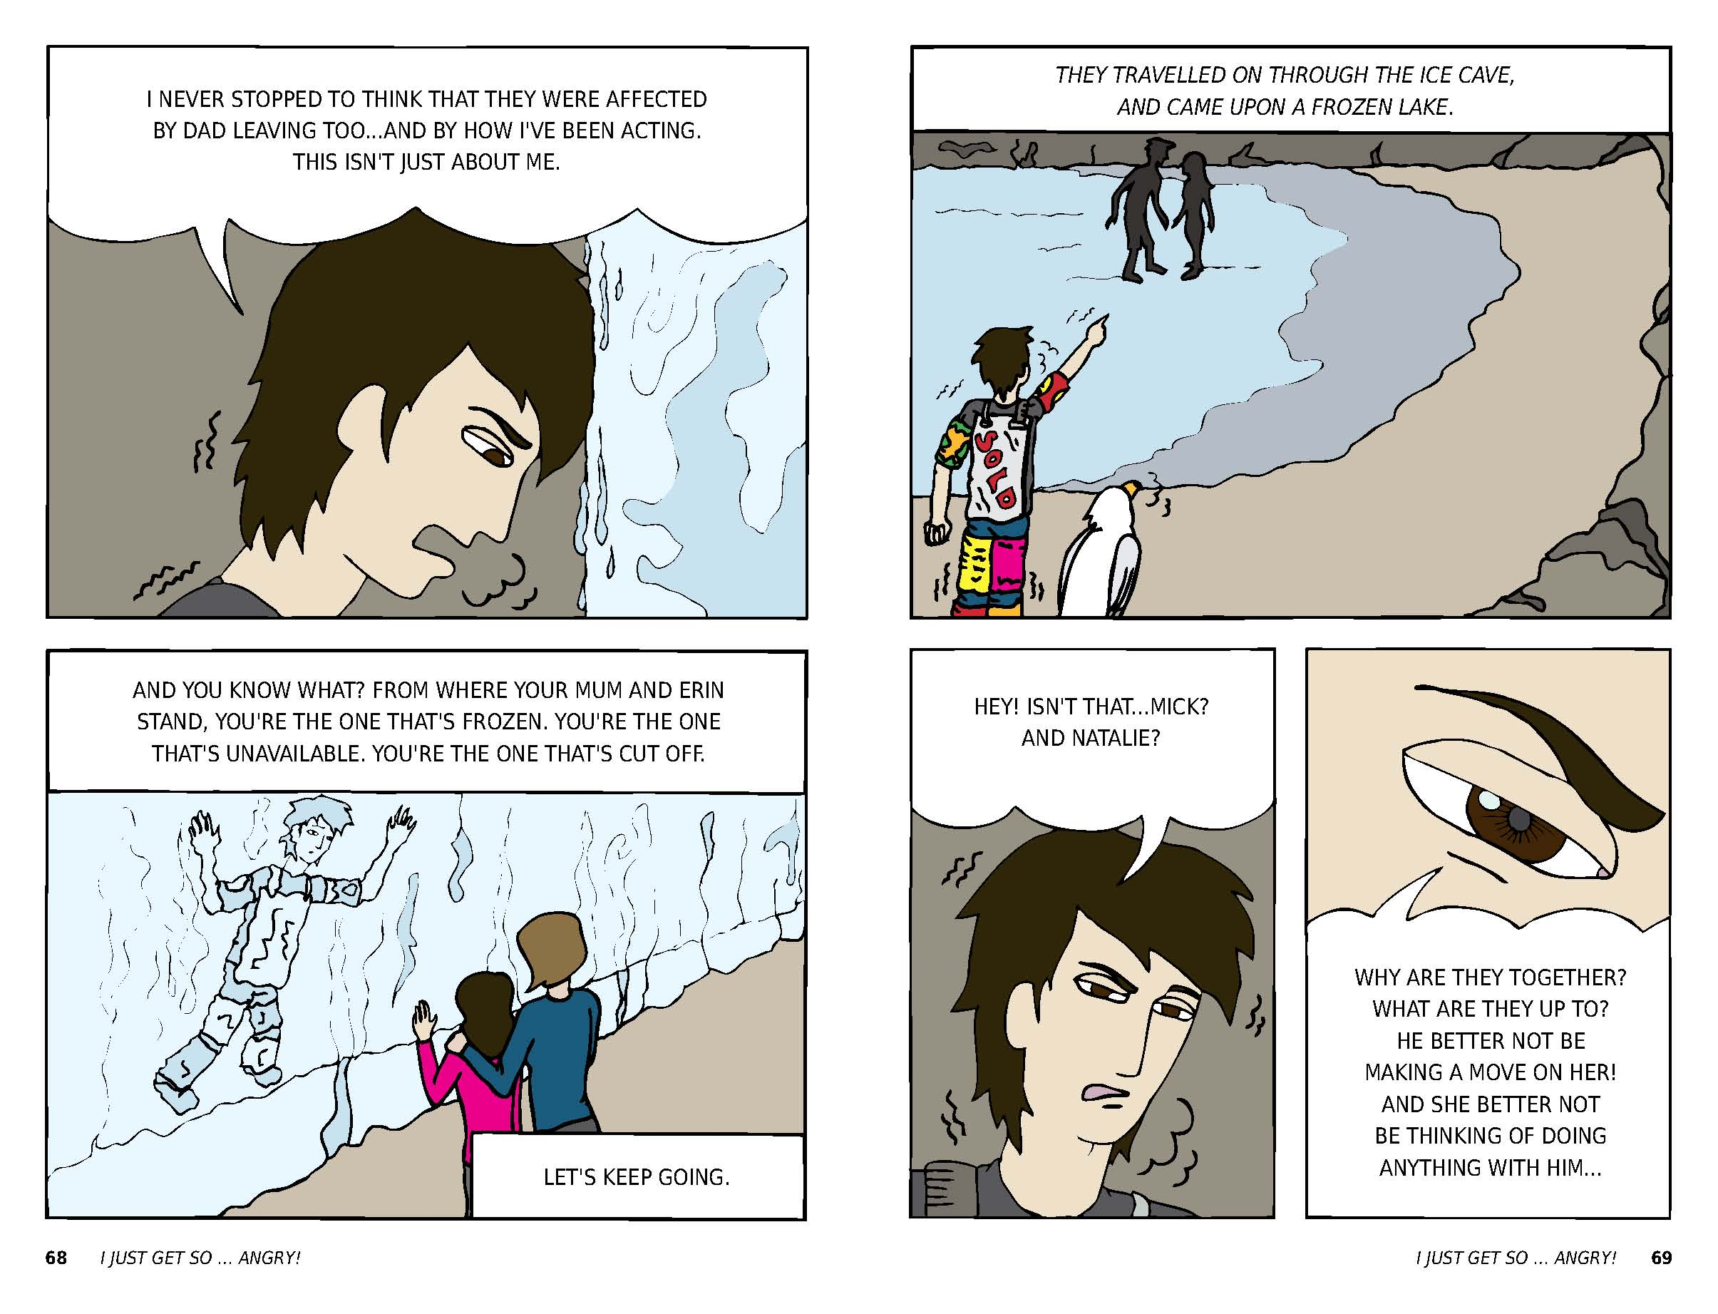

Slide 10
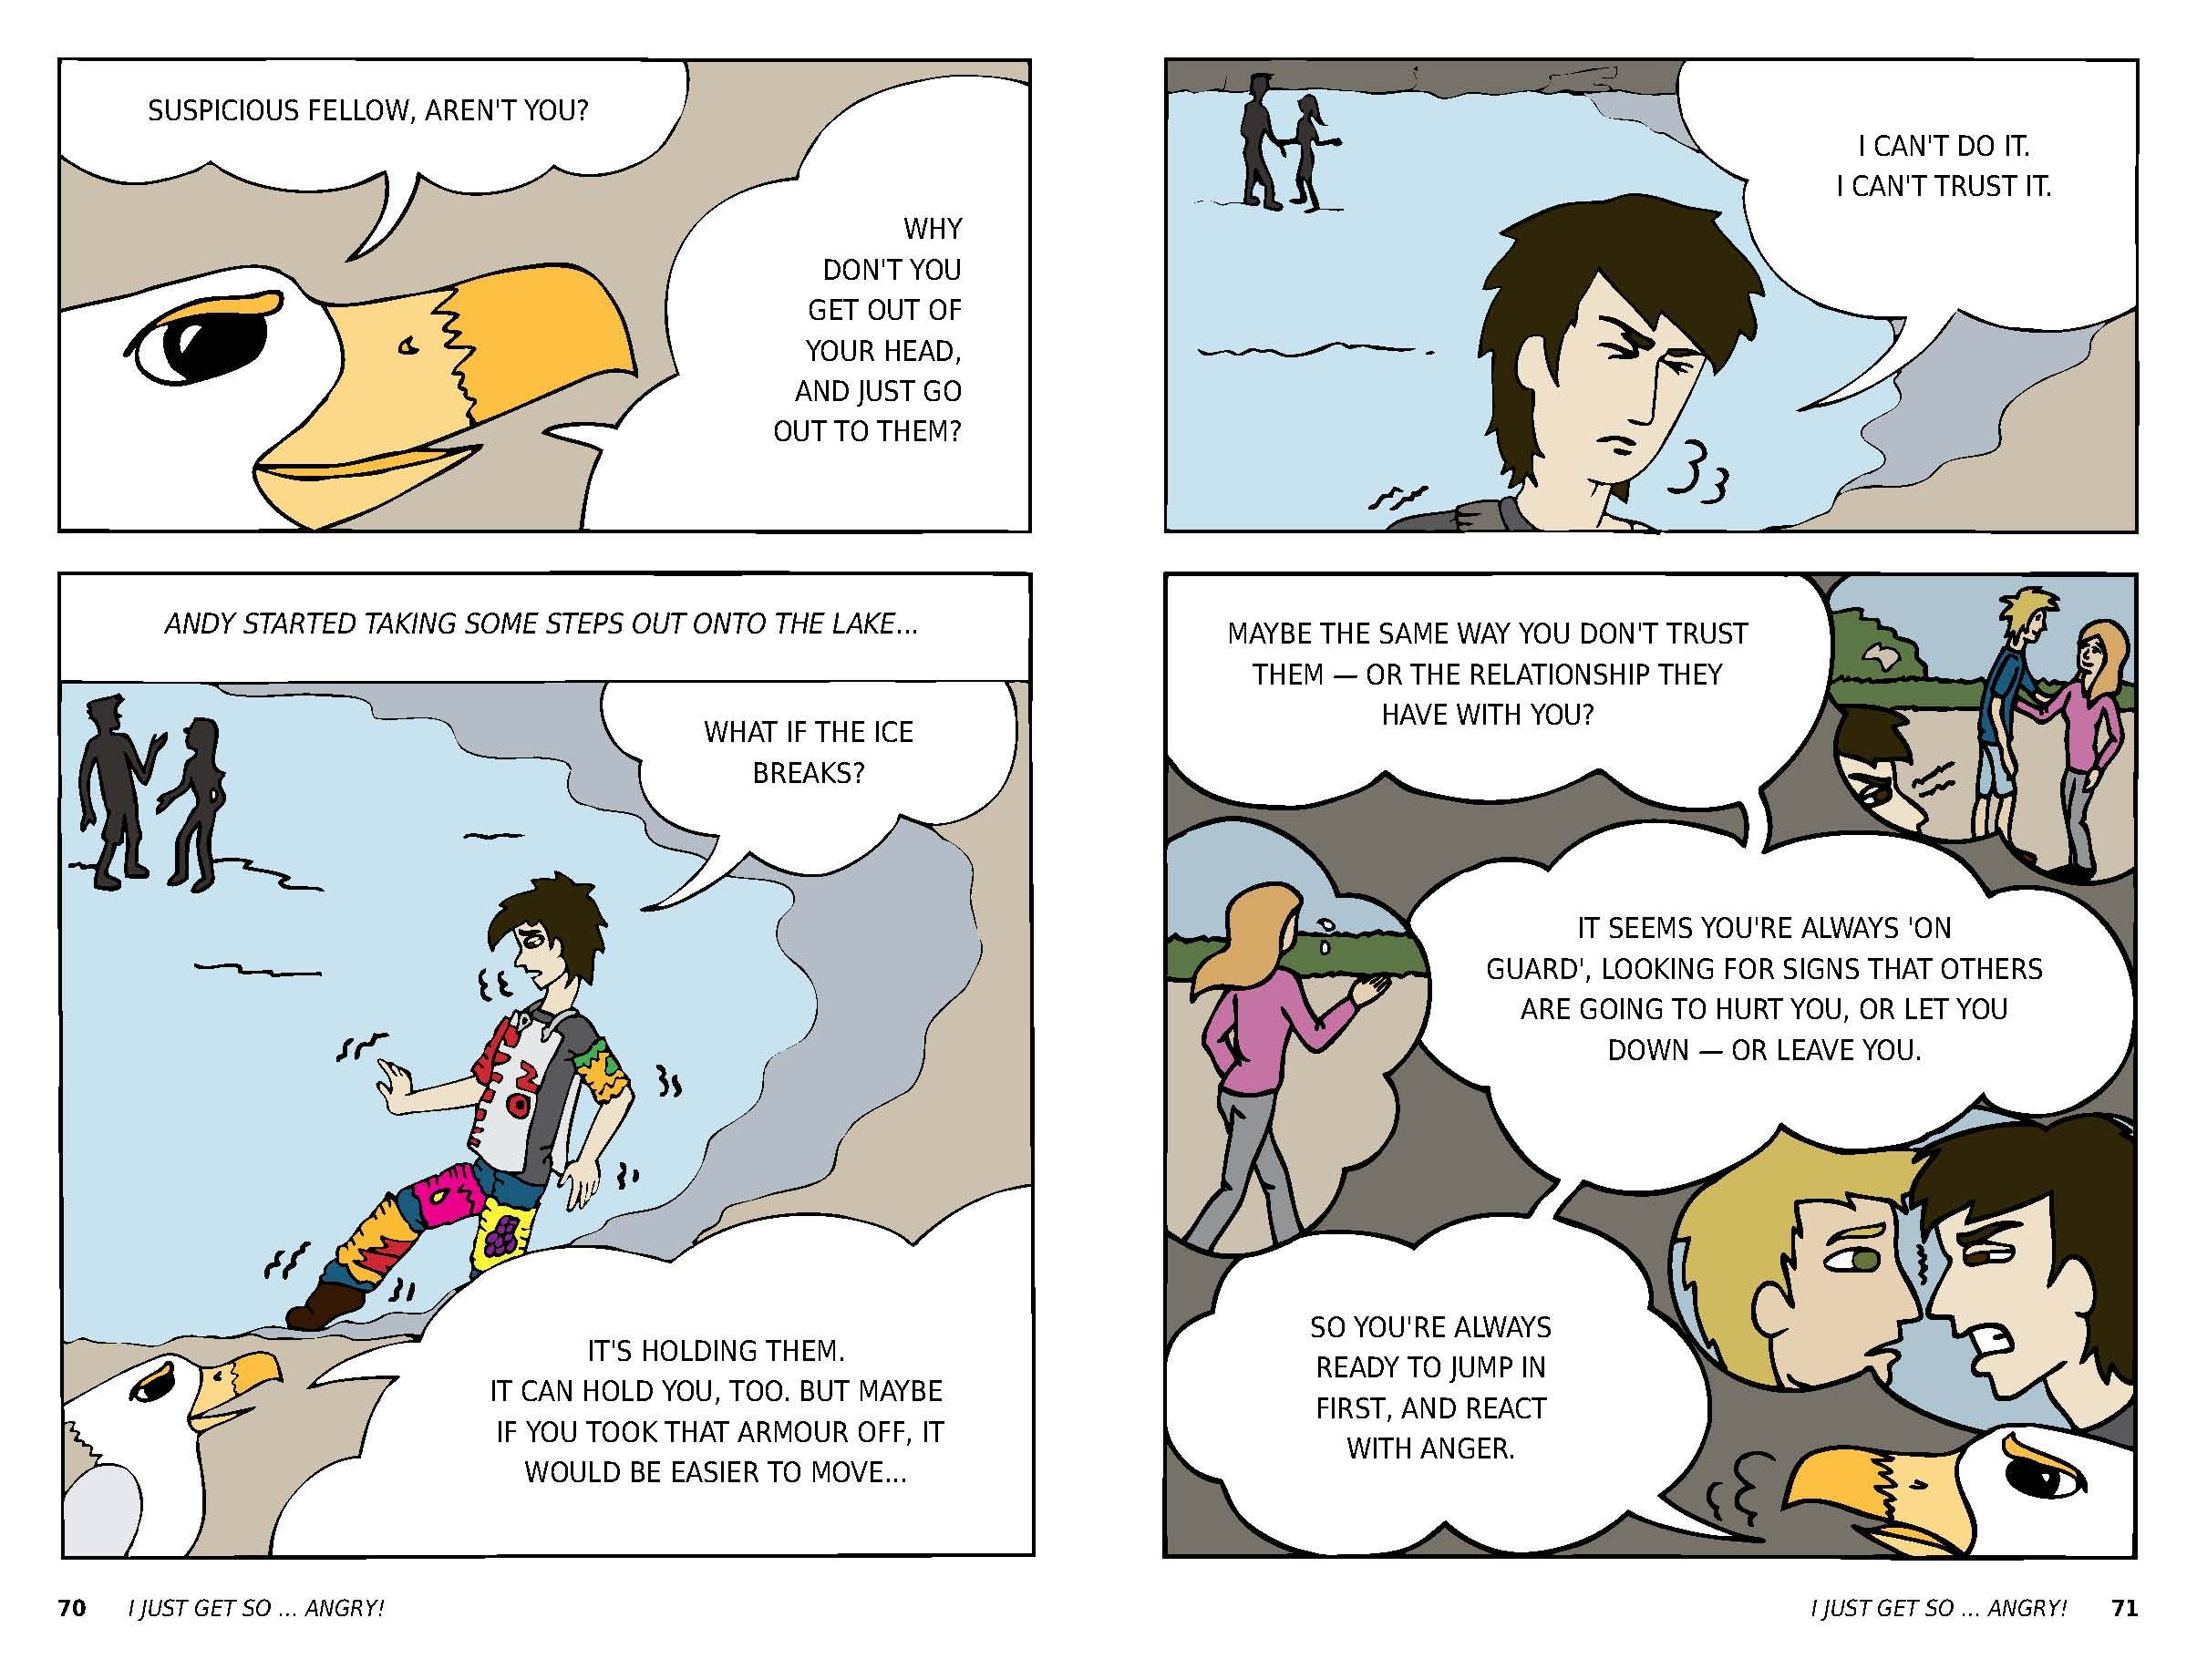

Slide 11
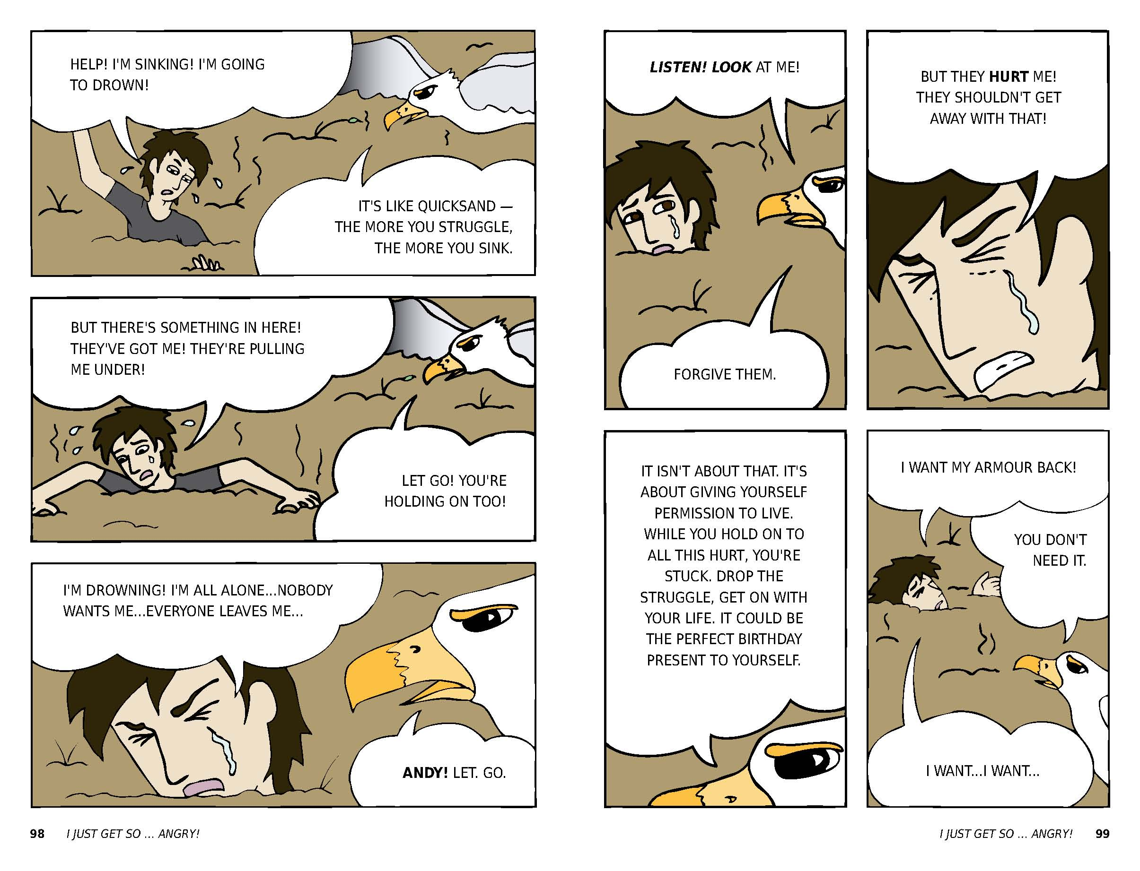

Slide 12

“these are a few of our favourite things…”

Slide 13
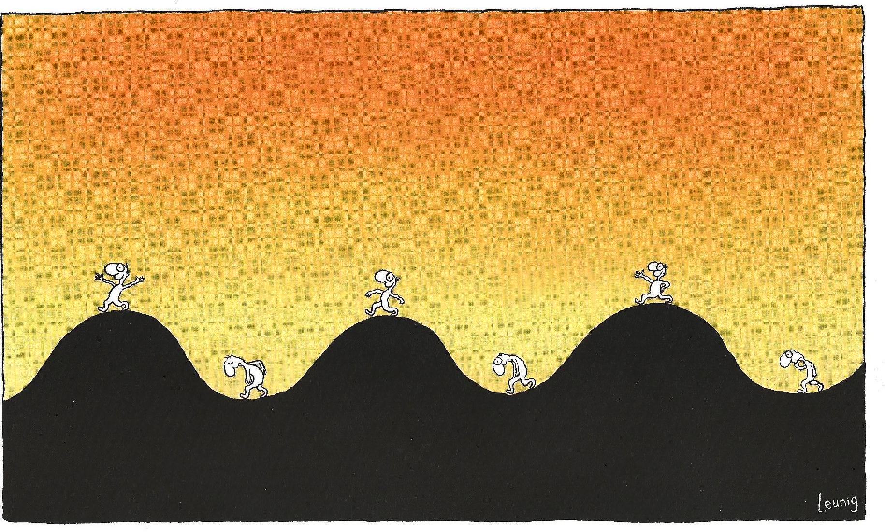

Does this look familiar?
How to make it worse for ourselves…
discount
Not be wholly present
Think about the
last time in the pit
Worry about the next pit
Dig deeper
Seek to avoid at all costs
Mentally draw all the pits together and say “this is what my life is all about”

Slide 14
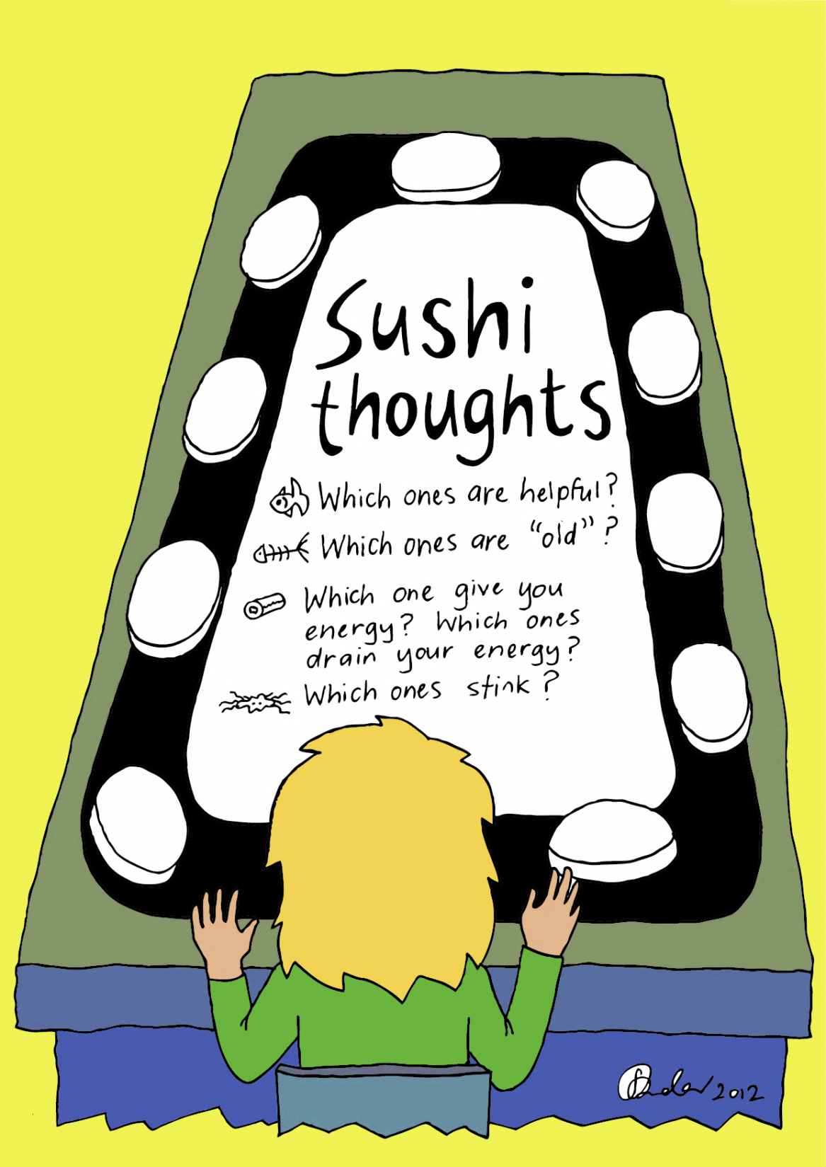

Slide 15
METAPHOR MATCHING
Bubbles (Gundy Cuneo, 2013)
The Invisibility Cloak (Bowden, 2011)
Eating an apple
(Ferriter, 2013)
Present Moment
Acceptance
Values
Defusion
Committed Action
Sushi thoughts
(Bowden, 2012)
Self as context
Passengers on the bus (Hayes et.al. 1999)
Weather board
(Bowden, 2010)

Slide 16
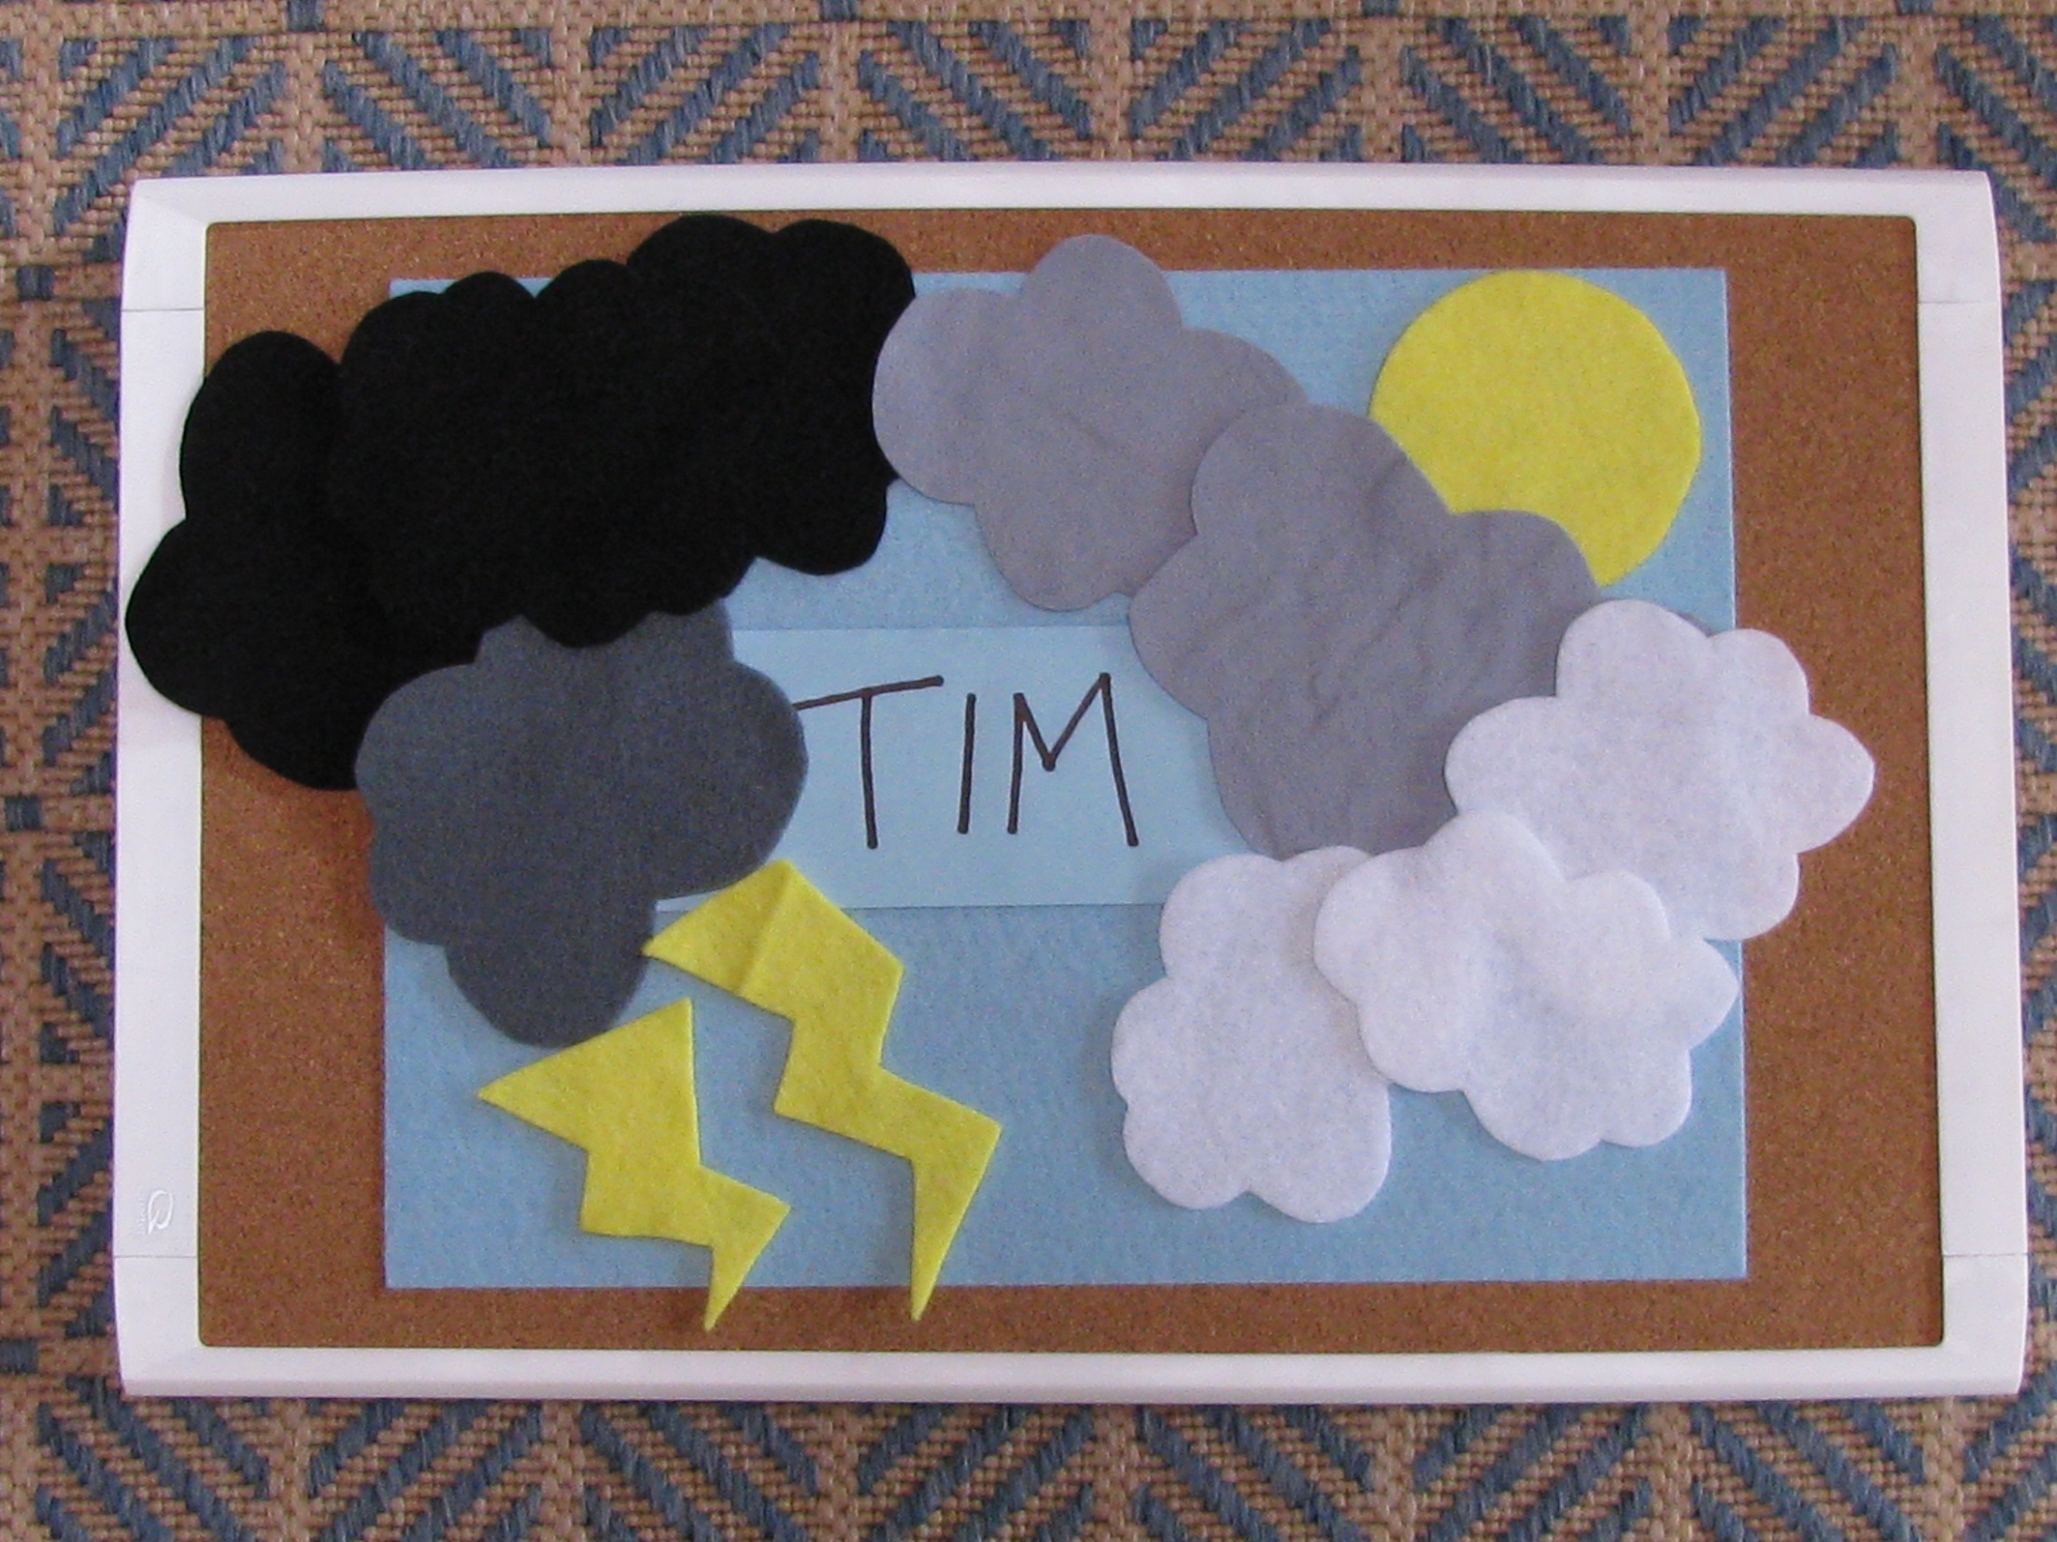

Slide 17
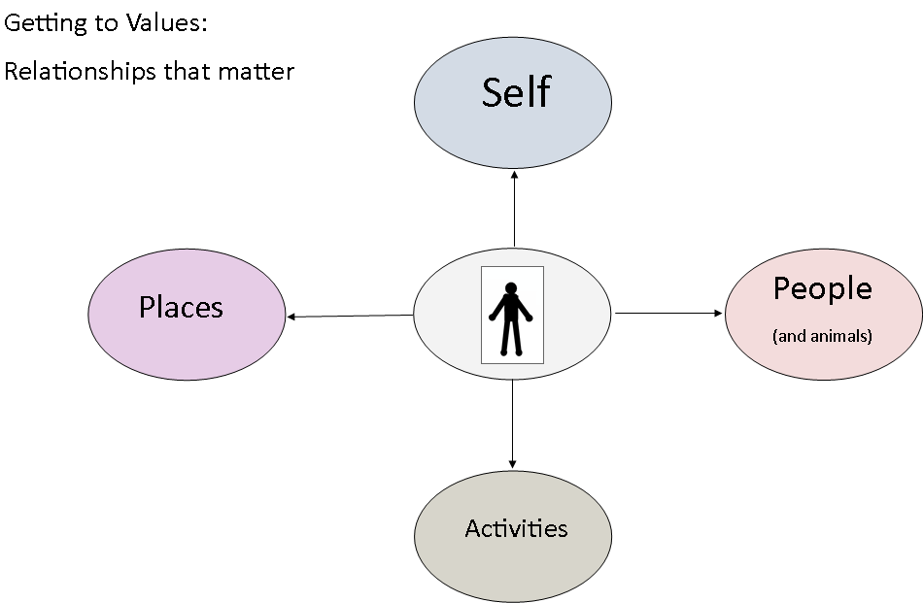
Connection, caring & contribution

Slide 18
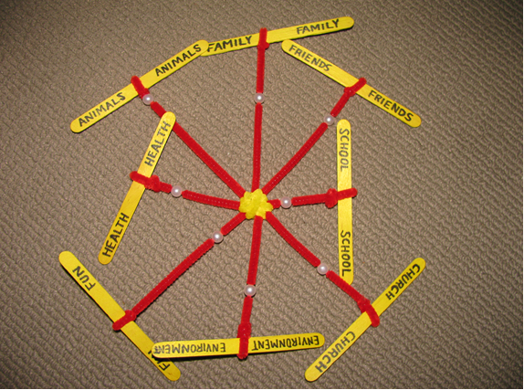

Slide 19
The complete picture

Slide 20
thinking outside the
CUBE
http://www.readwritethink.org/files/resources/interactives/cube_creator/

Slide 21
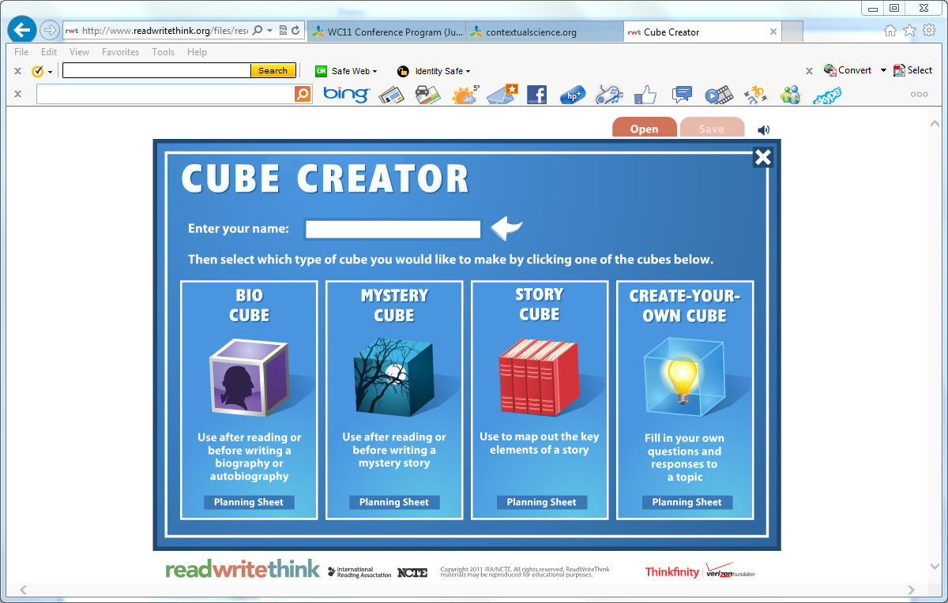

Slide 22
FFAMILY
FFRIENDS
AACTIVITIES
CCARING
EEDUCATION
SSELF

Slide 23
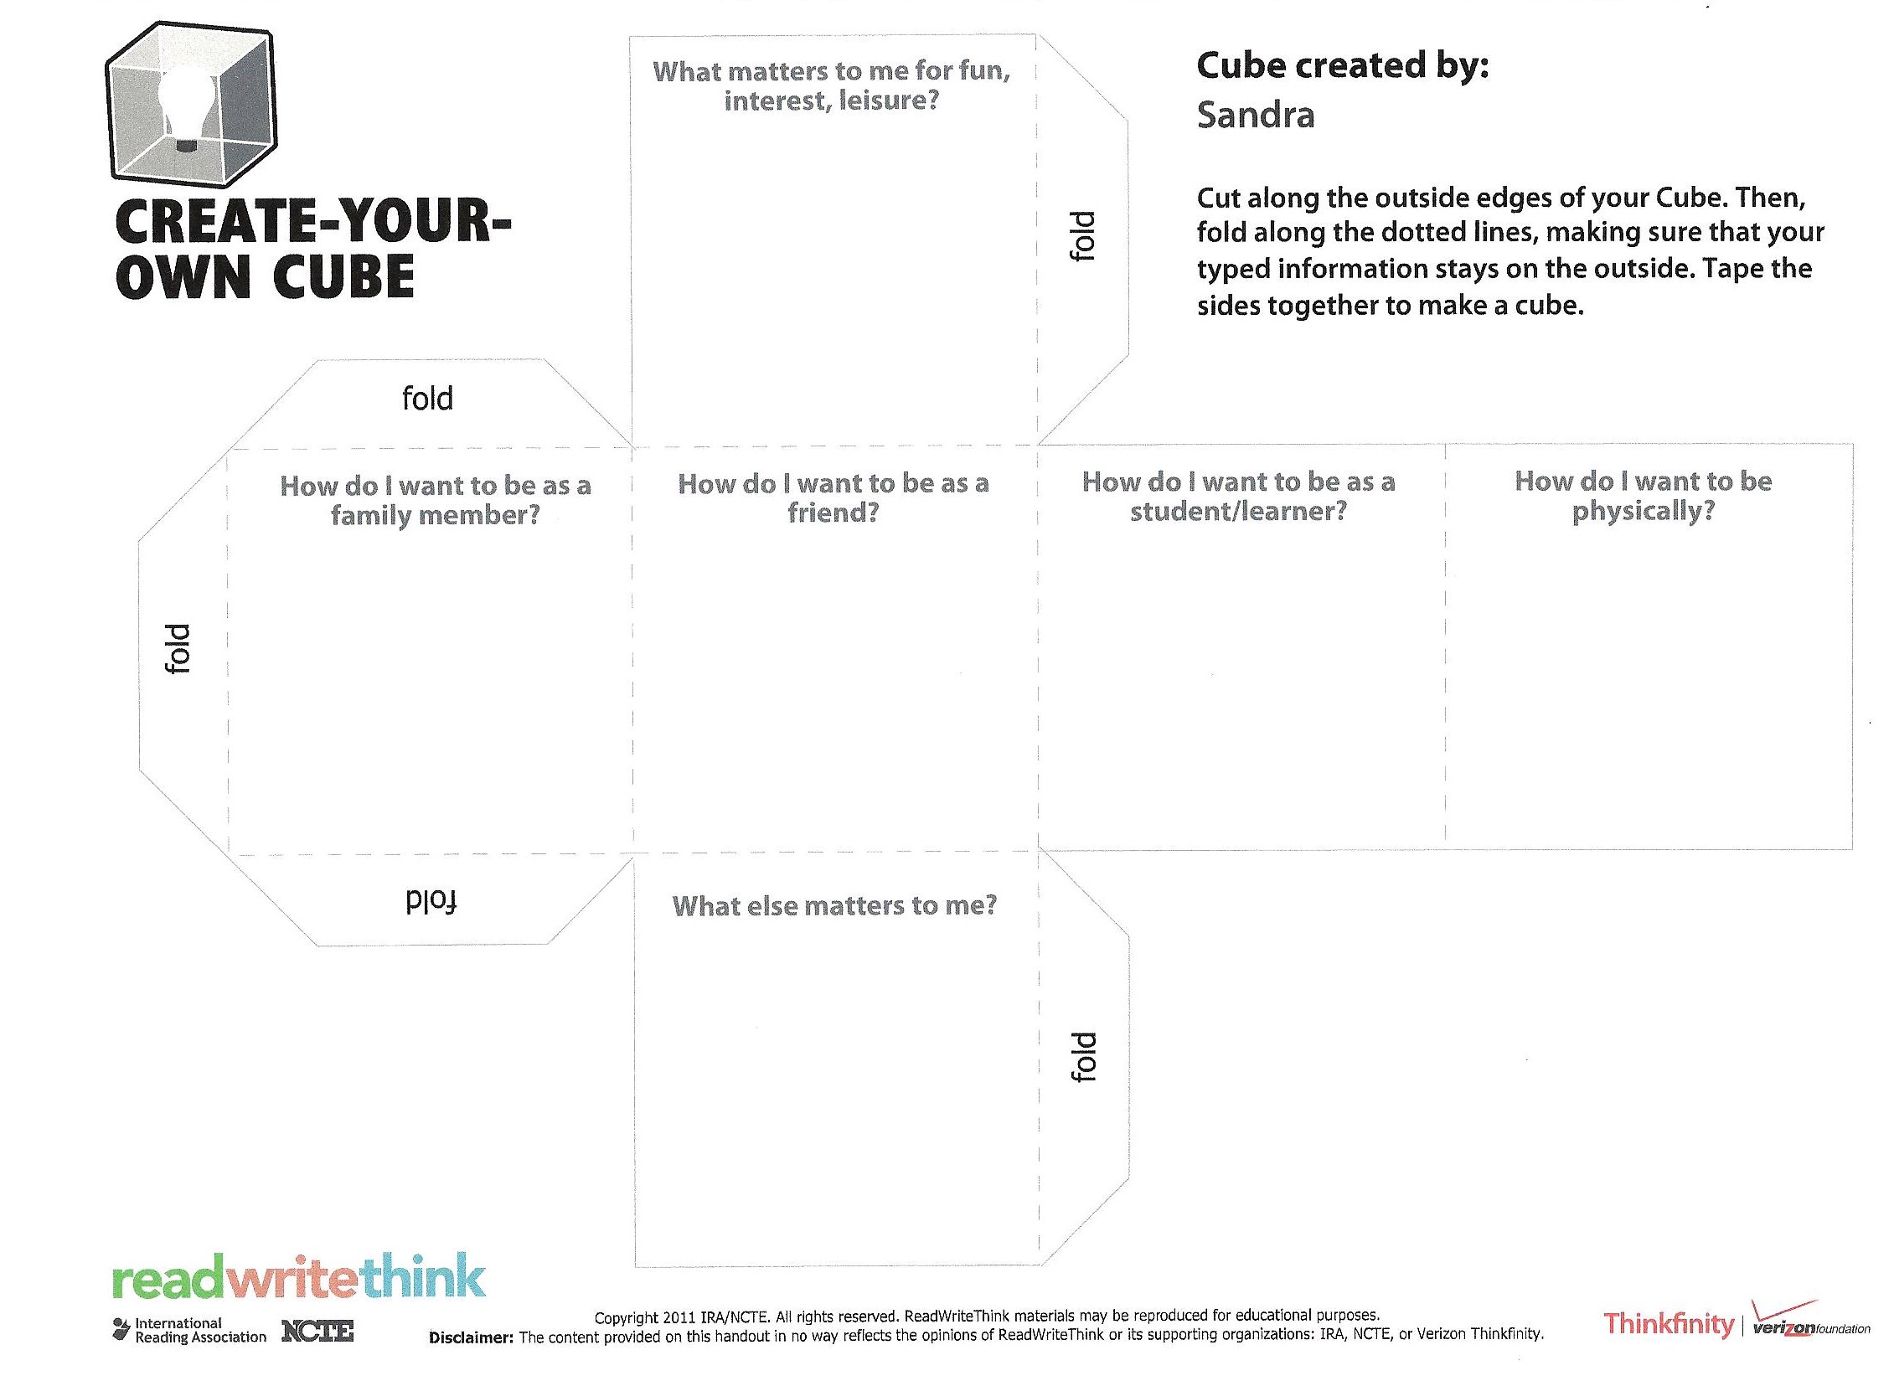

Slide 24
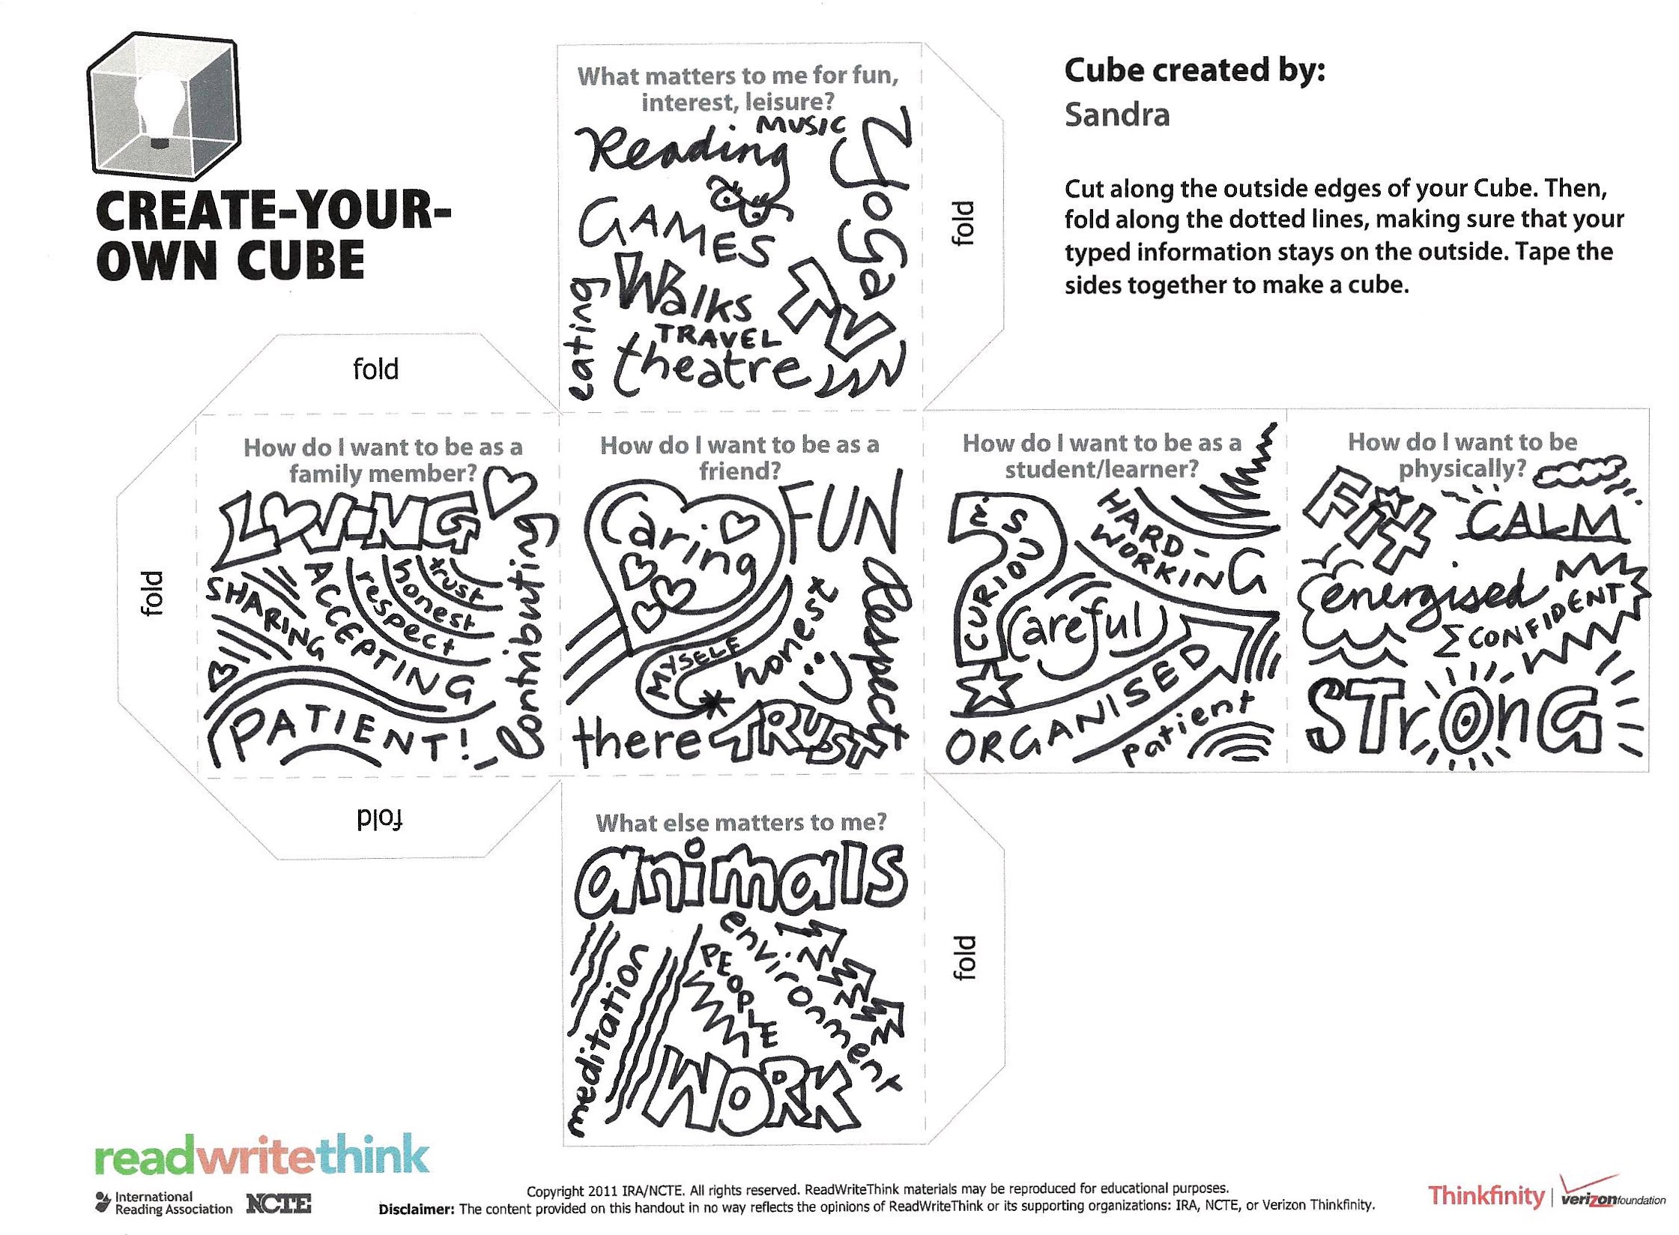

Slide 25
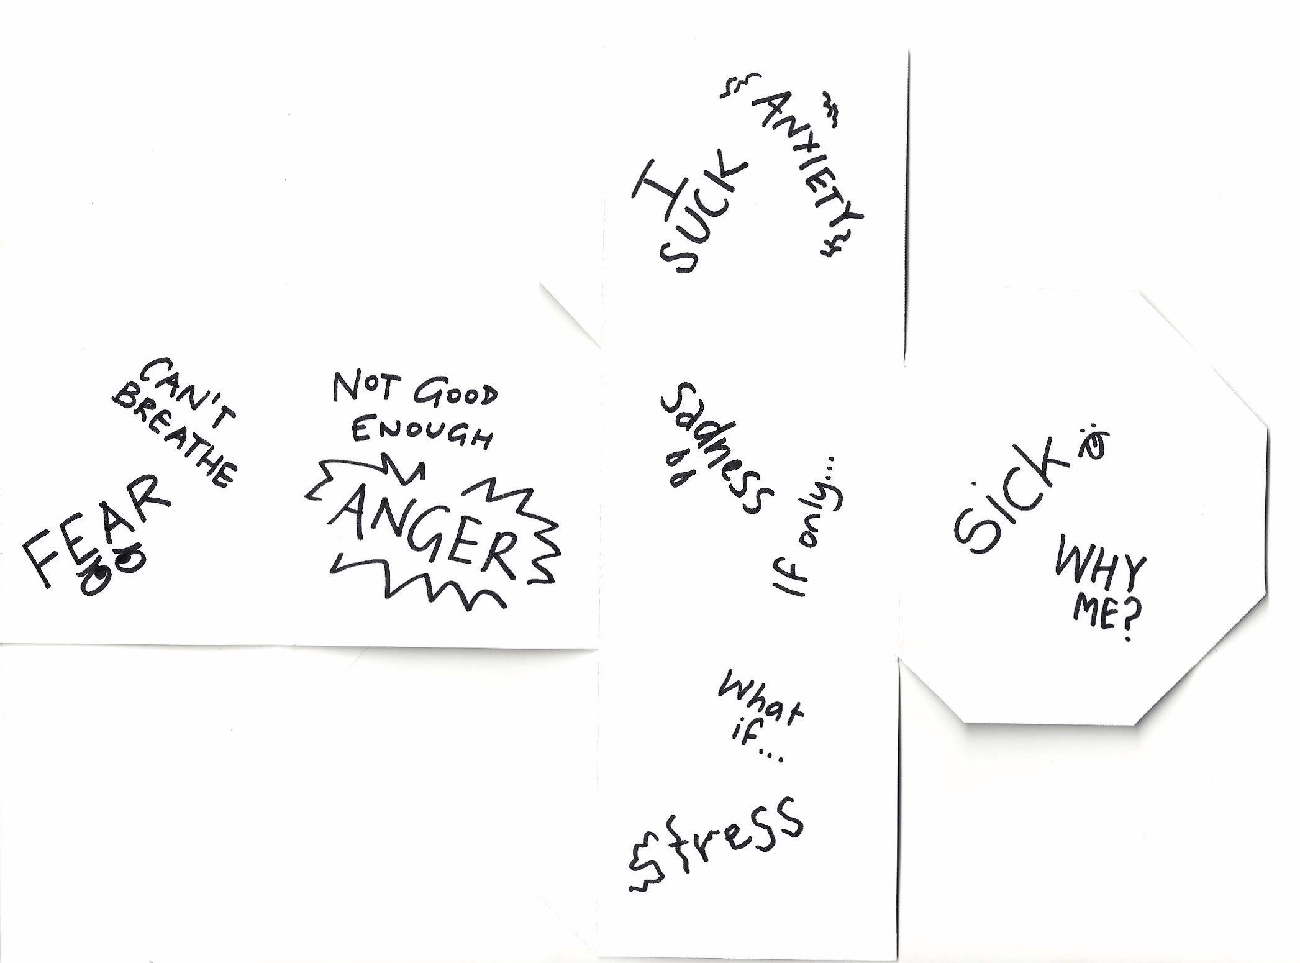

Slide 26
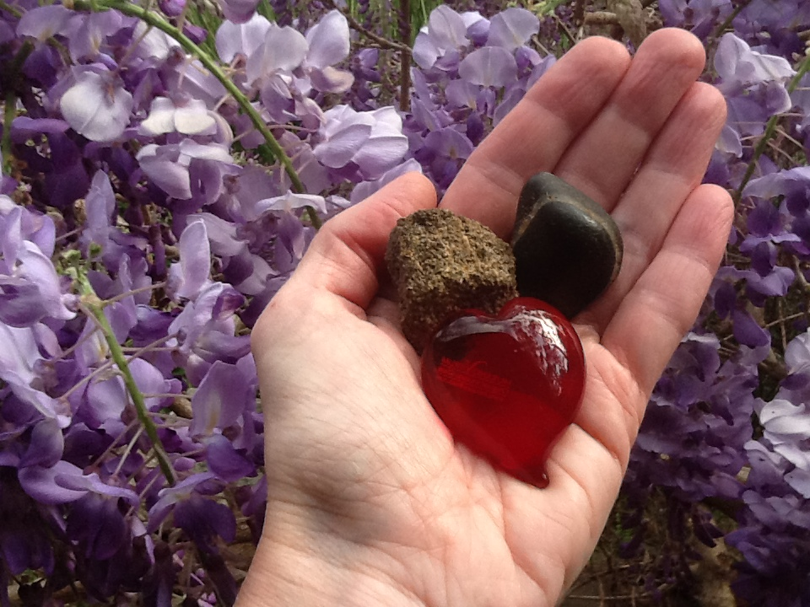

Slide 27
Feeling it
Using the experience of physical movement as metaphors for the core processes
Why?
Experience vs thinking about it, provide another way of visualising the process, may aid in recalling the process when needed
How?
Defusion via Wrist Escape: noticing, taking action, willingness
Acceptance via Yielding: moving toward, holding space lightly, making room
Self-as-Context & Present Moment via Stance & Push/Pull Games: tuning in to body, grounding self, responding appropriately, flexible vs inflexible responses to situations
Valued Direction & Committed Action via Ward Off & Gauntlet Run: coming into contact with compassion while moving in a valued direction, willingness, taking action despite what mind says

Slide 28
Making the Most of Metaphors
Match the metaphor to the situation the young person is facing as closely as possible (eg. Feeling disconnected from others like having the sound cord pulled out from the TV- can see but not hear/be heard).
Conducting a functional analysis of the young person’s difficulties ensures you are targeting the relevant ACT processes, and help facilitate understanding of the similarities between the consequences seen in the metaphor, and their own situation (e.g. if the problem is related to experiential avoidance, could use a metaphor like the Hungry Tiger; if the issue relates to disconnection from values, a metaphor around a journey, or the values compass could be used).
The metaphor needs to be something the young person truly understands- experience, age, cultural background, where they live (eg. A young person from the country might not relate to a surfing metaphor).
A metaphor aims to modify behavior; how does it illustrate the option of alternative behaviors (eg. If you’ve been struggling in a “tug of war”, choosing to “drop the rope”).
Metaphors need to be memorable, so they can be generalized and reused (Humor, relatability, bizarreness can help!).
Adapted from: Colleen Ehrnstrom, Mastering the Metaphor, WC X 2012; Matthieu Villate, Jennifer L. Villatte, Jean-Louis Monestès Bypassing the Traps of Language with Experiential Practice in Stoddard, J.A. & Afari, N. (2014) The Big Book of ACT Metaphors

Slide 29
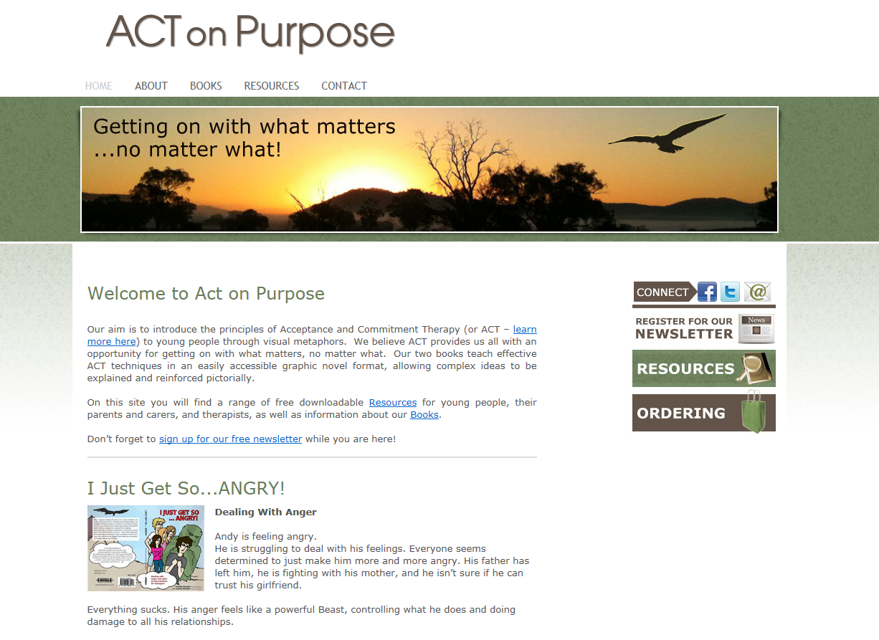
Contact us/free resources at
www.actonpurpose.com.au

