Slide 1
Schema Modes and Psychological Flexibility Processes: An Approach to Functional Integration and Initial Cross-Sectional Data
Robert Brockman, University of Western Sydney
r.brockman@uws.edu.au
Private Practice, Sydney
www.introspectpsychology.com.au

Slide 2
Aims of the Talk
Compare and Contrast the ACT and Schema mode models as they relate to personality disturbance.
Provide some initial empirical evidence of overlap in the constructs, and demonstrate that psychological flexibility processes are ubiquitous to the schema model.
Speculate as to some workable ways of using the mode construct in a functional approach to therapy with personality disorders.
Encourage the conversation around integration, what can both traditions learn from each other?

Slide 3
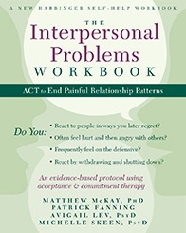
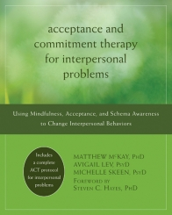
Integration of ACT and Schema Processes
My journey treating personality disturbance.
The Push from within Schema Therapy.
Excitement and interest on the list serve 2012
New harbinger Books
Notes:
This shows that chronic Interpersonal problems might be hard to conceptualise with a ‘pure’ ACT approach – may need integration
But no evidence of the relationship between Flex and schema processes!
And the schema people have themselves moved away from this model, towards a mode model

Slide 4
Mckay et al. (2012)
Mixes the construct of Schema’s or Core Beliefs with an ACT approach.
No direct challenging or restructuring.
Focus on awareness, mindfulness, defusing and values based behaviours.
Uses the construct of schema to build ‘schema awareness’, particularly as they are triggered by interpersonal patterns.
No published evidence, and no empirical studies relating schema processes and psychological flexibility.
Schema Therapy has moved on to the use of ‘modes’, particularly in the treatment of personality disorders.

Slide 5
ACT Approach to Personality Disorders/Psychopathology
From Morton et al (2012).
However very limited evidence for ACT with personality disorders despite over 50 ACT RCT’s.
Morton (2012) a notable exception (ES on BPD Sx of 1.38).
From the perspective of ACT, it is not intense negative affects per se that
are the problem, it is experiential avoidance (which tends to increase the intensity of the negative experiences), fusion with negative thoughts, and the unhelpful choices the person makes about action—particularly actions that are against the individual’s core values. Self-harm and drug or alcohol abuse can be seen as experiential avoidance strategies.
Notes:
ACT thus sees PDs as more extreme forms of PIF and experiential avoidance.
ES on BPD SX of ???

Slide 6
Jacob & Arntz (2013)
Notes:
Pooled effect size 2.38
There is something about schema therapy which works. The need to look at the effective components but from a functional perspective.

Slide 7
Schema modes
“A schema mode reflects a constellation of schemas and coping styles that are active in the present moment”
“An individual may shift from one schema mode into another; as that shift occurs, different schemas or coping responses, previously dormant, become active. ”
(Young et al., 2005)
- Research suggests that different disorders appear to be characterised by different constellations of schema modes
e.g. Lobbestael, van Vreeswijk & Arntz (2008).
- Consistent with current data and theories of personality which now emphasise state as well as trait variance in personality organisation (e.g. Cervone, 2005; Nezlek, 2011)
Notes:
In my opinion, the great contribution of this approach has been the construct of modes. It is here that I argue ST may make its greatest contribution to conceptualising and working with PDs

Slide 8
Schema Mode Categories | Modes (hypothesised Prototypical PDs)
Child Modes (underlying emotional vulnrability) | Vulnerable Child Angry Child Enraged Child Impulsive Child Undisciplined Child Happy Child
Maladaptive Coping Modes | Compliant Surrenderer (Dependant) Detached Protector (Borderline, Cluster B) Detached Self -Soother (Cluster B) Self-aggrandiser (Narcissistic) Perfectionistic Overcompensator (OCPD) Paranoid Overcompensator (Paranoid PD) Bully and Attack (Antisocial PD) Predator (Psychpaths)
Dysfunctional Internalised Parent Modes | Demanding Parent Punitive Parent
Healthy Adult Mode | Healthy Adult

Slide 9
Basic BPD Mode Model
Maladaptive Coping Modes (Experiential Avoidance ??)
Core Emotional Modes (Emotional Vulnerability)
Proposed Origins
Chronic Unmet Needs During Childhood Development:
Validation.
Care/ Emotional Connection.
Safety.
Autonomy.
Competence.
Critical/Demanding Parent
Angry Child
Detached Protector
Vulnerable Child
Healthy Adult (Flexibility??)
Notes:
Key Problem: A Persons Attempts at (ST) avoidance of emotionally vulnerable modes leads to further chronic unmet needs, thus maintaining the Core Emotional Modes, and ST attempts to cope through the use of the coping modes.

Slide 10
Basic BPD Mode Model
Maladaptive Coping Modes (Experiential Avoidance ??)
Core Emotional Modes (Emotional Vulnerability)
Proposed Origins
Chronic Unmet Needs During Childhood Development:
Validation.
Care/ Emotional Connection.
Safety.
Autonomy.
Competence.
Critical/Demanding Parent
Detached Protector
Angry Child
Vulnerable Child
Healthy Adult (Flexibility??)
Notes:
Key Problem: A Persons Attempts at (ST) avoidance of emotionally vulnerable modes leads to further chronic unmet needs, thus maintaining the Core Emotional Modes, and ST attempts to cope through the use of the coping modes.

Slide 11
Vulnerable (Child) Mode
Most clinically significant, implicated in all personality disorders (Lobbestael, van Vreeswijk & Arntz, 2008).
Related to a number of the core schemas including abandonment, deprivation, defectiveness, dependence etc.
Related to feelings of intense vulnerable emotions e.g. sadness, fear, anxiety, helplessness.
This mode provides a good contrast to the healthy adult mode as many individuals who are dominated by this mode show very low scores on healthy adult mode (Lobbestael, et al., 2010)

Slide 12
Healthy Adult Mode
Is characterised by higher functioning and healthy schemas of capability, strength etc.
Involves behaviours and cognitions that are required for the undertaking of appropriate adult functions such as taking responsibility, working, parenting, commitment etc.
Allows individuals to use adaptive approaches to meet their emotional needs.
Healthier, higher functioning people have a stronger Healthy Adult Mode.

Slide 13
Healthy Adult Mode (Roediger, 2012):
“mindful here-and-now perceptions, an interruption of spontaneous, maladaptive coping behaviour, an emotionally detached reappraisal of internalized parent mode cognitions and at least supportive self-instructions to induce and maintain functional coping.”

Slide 14
Functions of Healthy Adult Mode
Assists individual to meet previously unmet needs
Nurtures, affirms, and protects individual from destructive schemas
Instils self-discipline to set limits and boundaries on behaviour
Moderates other schema modes
Responds flexibly to difficulties.
Contrasts well with psychological flexibility.

Slide 15
Psychological Flexibility
“An ability to respond in a flexible way to unfolding psychological events. Such flexibility allows one to maintain or modify behaviour according to that which is personally important (values) and the opportunities available in the present moment”.
(Hayes et al., 2006)

Slide 16
Extended Mode Model (Bernstein, 2007)
Maladaptive Coping Modes (Experiential Avoidance)
Core Emotional Modes
Self-Aggrandizer
Critical/Demanding Parent
Bully & Attack
Angry Child
Detached Protector
Vulnerable Child
Healthy Adult
Notes:
Explains the dimensionality of PD’s, and the difficulties categorising patients into 1 PD.

Slide 17
Extended Mode Model
Core Emotional Modes
Coping Modes
Self-Aggrandizer
Critical/Demanding Parent
Bully & Attack
Detached Protector
Angry Child
Vulnerable Child
Healthy Adult
Flexibility?

Slide 18
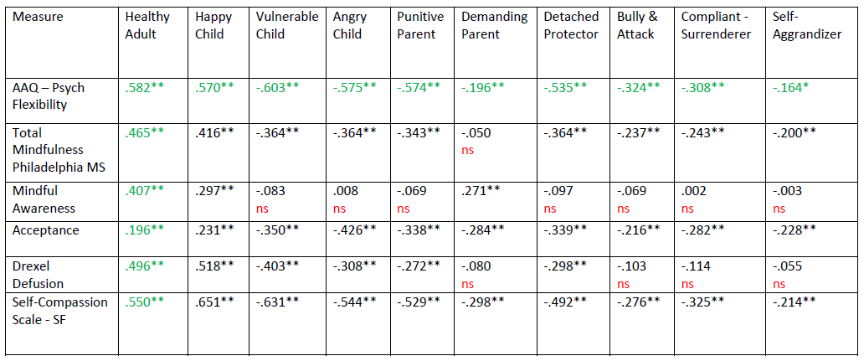
Masters Thesis in Preparation (Lazarevic, Brockman, & Hough, 2013)
Relationships (uncorrected) between schema modes and psychological flexibility processes

Slide 19
Mediation Models Psychological flexibility fully mediates the relationship between healthy adult mode and both vulnerable child and punitive parent modes (Baron & Kenny, 1986; with Sobel test)
Punitive Parent
Psychological
Flexibility
Healthy Adult
Psychological
Flexibility
Vulnerable Child

Slide 20
Extended Mode Model
Coping Modes
Core Emotional Modes
Self-Aggrandizer
Critical/Demanding Parent
Bully & Attack
Detached Protector
Angry Child
Vulnerable Child
Building Flexibility
ACT Techniques
Healthy Adult

Slide 21
Potential Benefits of Integration for Schema Therapy
Gives an explicit focus to building the healthy (flexible) mode, and a set of techniques specifically designed to do this.
Takes the focus of the change processes off the reducing of maladaptive processes, to the building of healthy states of being.

Slide 22
Potential Benefits to Using Mode Constructs in a Functional Approach
Empirical evidence that ST has large effect sizes for BPD
The need for ACT to evolve as an approach and take on board effective elements from other therapies – within a contextual-functional framework. (e.g. CBTp).
Ready made framework for dealing with many of the problems encountered in working with BPD.
Consistent with recent empirical literature showing that personality variables are made up of trait and state variance.
The potential for a range of (effective) techniques to be understood from a functional perspective.
Seems to have utility. The question is why, from an ACT/RFT perspective?
Notes:
Many consistencies with a functional approach which make integration possible.

Slide 23
Inconsistencies with a Functional Approach
The information-processing (Mechanistic) framework.
The focus on controlling/changing the emotional vulnerability including the dysfunctional parent modes.

Slide 24
A CBS Consistent Definition of Modes
“A mode reflects a constellation (repertoire) of cognitive, emotive, and behavioural responses that are active in the present moment”.
“An individual may shift from one mode into another; as that shift occurs, a different repertoire becomes active, influencing their behaviour in the present moment ”.
Brockman 2013 ;)

Slide 25
Moving to Mode Awareness in Building Flexibility in Personality Disordered Populations
Similar to the approach of Mckay et al (2012).
Can use the construct of modes within an RFT consistent definition to build mode awareness and psychological flexibility.
Can use the metaphor of ‘child’ modes, or ‘parent’ modes as an explicit metaphor if the patient finds it useful.
Using this structure, can apply all of the regular ACT techniques to build flexibility in personality modes.
Could lead to some creative innovations of using schema therapy techniques in a functionally consistent way.

Slide 26
References
Bernstein, D. P., Arntz, A., & Vos, M. d. (2007). Schema focused therapy in forensic settings: Theoretical model and recommendations for best clinical practice. International Journal of Forensic Mental Health, 6(2), 169-183.
McKay, M., Lev, A., & Skeen, M. (2012). Acceptance and Commitment Therapy for Interpersonal Problems: Using Mindfulness, Acceptance, and Schema Awareness to Change Interpersonal Behaviors: New Harbinger Publications.
McKay, M., Fanning, P., Lev, A., & Skeen, M. (2013). The Interpersonal Problems Workbook: ACT to End Painful Relationship Patterns: New Harbinger Publications.
Roediger, E. (2012). Basics of a dimensional and dynamic mode model. Schattauer, Stuttgart: Praxis der Schematherapie.
Young, J.E., Klosko, J.S., & Weishaar, M.E. (2003). Schema therapy: A practitioner’s guide. New York, NY: Guilford Press.

