Slide 1
Integrating Motivational Interviewing Into CBS
SEAN p. Wright
ACBS Worldcon 2016 (Seattle, WA)

Slide 2
Disclosure:
I have not received and will not receive any commercial support related to this presentation or the work presented in this presentation.

Slide 3


Need CE credit for this
session?
Please don’t forget to
scan in to have your
attendance tracked.

Slide 4



My Context
Community mental health agency
Clients with high needs and limited resources
Diversity with respect to culture, language, age, family system, SES, and reason for treatment
Dedicated clinicians who struggle to do everything needed
Within CBS’s reticulated model:
Clinical application
Practitioner-
Scientist

Slide 5
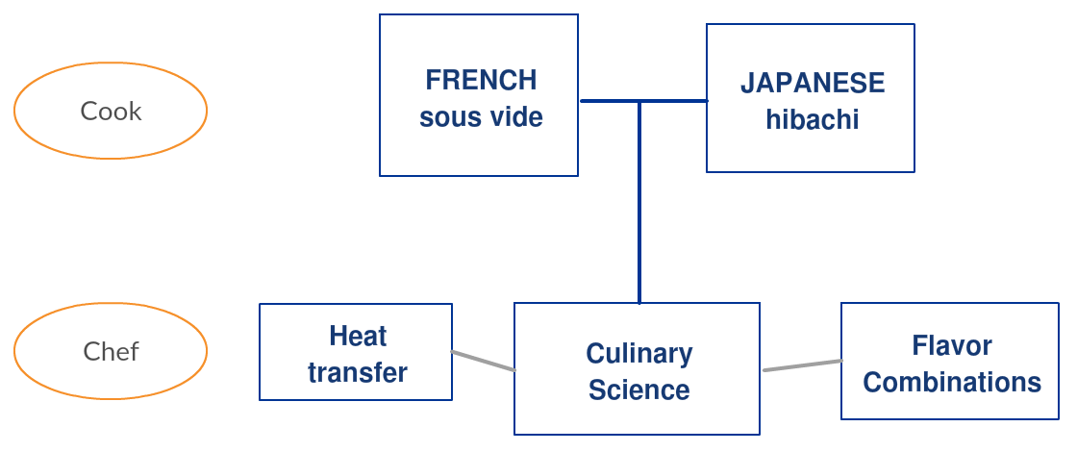
For metaphor fans: turning cooks into master chefs

Slide 6
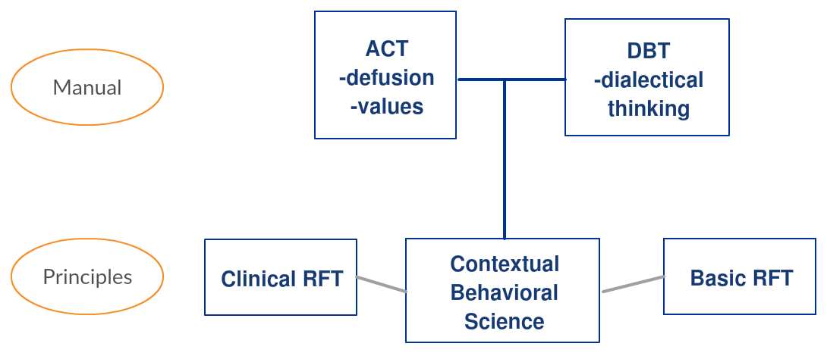
Practical Implementation needed to turn EBP-technique-driven clinicians into masters of clinical principles
Clinicians who focus on service delivery want to be improving their effectiveness but face significant barriers
  Workload & expectations
  Need for ongoing training
  Expectations to use only accepted models/techniques
  Stress/burnout which limits interest in going further with clinical skills
  Skepticism that research-derived interventions will best serve specific client populations
  Wright, Combs, and Kaufman (2016) - ACBS Poster

Slide 7

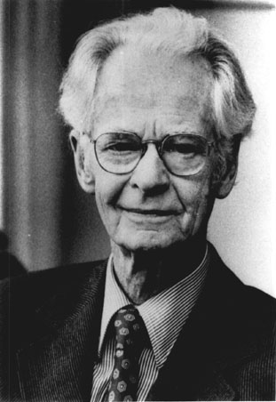








The confluence of two rivers
Skinner & Radical Behaviorism, Pepper & Contextualism
Rogers & Humanism
Reaction to confrontational approaches
Christopher & Dougher, 2009
Behavioral analytic account of MI
Amrhein, 2003
Linguistic analyses of MI
Bricker & Tollison, 2011, comparing ACT & MI

Slide 8
MI is broadly consistent with CBS
Contextual Behavioral Science (CBS, Zettle, Hayes, Barnes-Holmes, & Biglan, 2016) has a “pragmatic focus on prediction and influence of behavior as a shared goal and criterion for ‘truth’” (Levin, Twohig, & Smith, 2016, p. 31).
MI is distinct in its focus on the content of language
MI is grounded in a mechanistic philosophy distinct from contextualism. It is designed to be functional, but it achieves function mainly through rules about how to respond to the topographical features (form) of client language

Slide 9
MI has evolved to become more contextually-focused
MI as a reaction to confrontational approaches for “addicts”
Develops techniques and spirit (“a way of being with people”) that allow client to resolve ambivalence and act on own motivation for change
MI views motivation as a state that can be influenced by the interpersonal context of the therapeutic relationship
Teaches clinicians to contingently respond to change talk vs. sustain talk
Continues to evolve (develop techniques like rulers, action reflections, omission reflections, etc.) in service of its value of helping people change
Major development by 3rd edition when “resistance” is replaced with “discord”

Slide 10
Perspective-taking (deictic framing) is the first great strength of MI
Reflections that emphasize deictic frame (clinician emphasizing the perspective of the client) reduce pliance and counterpliance and allow client to take self-perspective
Contextual cues for Client-perspective | Contextual cues for Clinician-perspective
“For you…” | “I think…”
“You are feeling…” | “What I see happening here…”
“You have the sense that…” | “Can’t you see that….”
“When you…” | “You need to understand…”

Slide 11
Fostering non-punitive functional analysis is the second great strength
In behavior-analytic terms, Christopher & Dougher (2009) argue:
“MI may be seen as a therapeutic strategy in which the therapist acts to reduce client counterpliance [resistance] to evoke and reinforce tacting [verbalizing] the full range of consequences (change talk and sustain talk) for the occurrence and nonoccurrence of the target behavior. This leads to elaborated self-mands [commitment language], which are correlated with subsequent changes in the target behavior.”
-Still need transformation of stimulus functions from RFT

Slide 12
Shaping effective clinician verbal behavior is the third great strength of MI
Eliminating MI-inconsistent responses may be more important than increasing MI-consistent responses
Eliminating “resistance” and adding focus on “discord”
  Transformation of stimulus functions that influence clinician verbal behavior:
  - Resistance = a problem with the client
  - Discord = a cue to attend to relationship & client perspective
Stage-matching guidelines give clinicians rules to deliver MI-consistent responses
Psycholinguistic approaches like Amrhein et al. (2003) allow refinement of ability to predict and influence client behavior (outcomes) through clinician verbal behavior

Slide 13
Main targets for client improvement in clinical RFT
Sensitivity to Context | Functional coherence
Awareness of influences (physical or symbolic) on clinically-relevant behavior | How client symbolically relates to own experience
Sensitivity to antecedents | Increase fluency and flexibility of framings
Sensitivity to consequences | Build alternative symbolic networks
Workability = how well responses match client’s clinical goals | Hierarchically frame experiences with the self as the container
 | Accurately tracking effects of rule following -reduce pliance -reduce inapplicable tracking -reduce inaccurate tracking -overcome adaptive peaks
 | Decreased essential coherence
■ = Explicitly shared focus between Törneke (2010) & MCC (2016)
■ = Indirectly shared focus
■ = Unique to MCC

Slide 14
Explaining functional impact of MI techniques in RFT terms
Frames of coordination allow past or future consequences to be experienced in the present through transformation of stimulus functions
  Saying “car accident” ↔ feeling of shame
Reflections generally use deictic framing to help client notice self-perspective as you collaborate on functional analysis of behavior
Complex reflections with metaphors cue analogical framing
Importance & Confidence ruler exercises cue
  distinction framing (e.g., high importance, low confidence)
  comparative framing (why did you rate importance at a 7 instead of a 4?), and
  conditional framing (what could you do to move your confidence from a 2 to a 3?)
MI
ACT
Adapted from Villatte & Villatte, 2013.

Slide 15
Proposal to train a contextually-informed Motivational Interviewing (CMI)
Modeled after FAP’s integrative approach to enhance Cognitive Therapy for depression (Kohlenberg, Kanter, Bolling, Parker & Tsai, 2002)
  Reasonable training: 6hr workshop + weekly supervision
Teach clinicians MI techniques
  Including OARS, differential reinforcement, MI spirit, rulers, decisional balance
Briefly teach clinicians behavior-analytic and RFT principles to give functional understanding of MI techniques
Train clinicians to choose verbal response based on observable in-session client behaviors that indicate moving toward or away from flexible sensitivity to the context and functional coherence
Test whether stage-matching rules increase or decrease therapist sensitivity to context

Slide 16
More experiential focus when using MI techniques
Bring client into contact with “felt sense” of contingencies by strongly evoking transformation of stimulus functions through equivalence (Christopher & Dougher, 2009)
  Ex: “My drinking has hurt my kids” – evoke the psychological functions of “hurt”
  Elaborate with other kinds of framings (conditional, now/then deictic, etc.)
More than describing The Top of the Mountain, bring it into the present
  ACT metaphors like the Sweet Spot, Your Own Eulogy, or Epitaph are examples
  Manipulating standard language conventions by slowing down, finding metaphors, or changing perspective (instead of client addressing clinician, client addresses young child, older self, etc.)
  Especially when the client gets caught up in content
  Intervening when the client plays “the tapes” - the familiar, coherent, public performance of tacts and self-mands.

Slide 17
Focus on appetitive, chosen goals and inexhaustibly reinforcing values
Sheldon, Ryan, Deci & Kasser (2004) reported intrinsic goals and freely chosen (not forced or pressured) goals were associated with well-being
Clinical RFT addresses this through
1) Hierarchically framing goals and actions as part of values = inexhaustible reinforcement
  Asking: What value could this action/goal be in the service of?
2) Augmenting to create new symbolic consequences that allow reinforcement even if difficult private events are encountered or if actions do not lead to goal achievement
  Asking: “What if your disappointment is a signal that you are trying for something very important?”
3) Decreasing socially-reinforcing effects influencing behavior to get at client’s self-chosen values
  Asking “If no one would ever know that you did or didn’t do it…?” OR “If everyone would approve of whatever choice you would make, what would be important to you?”

Slide 18
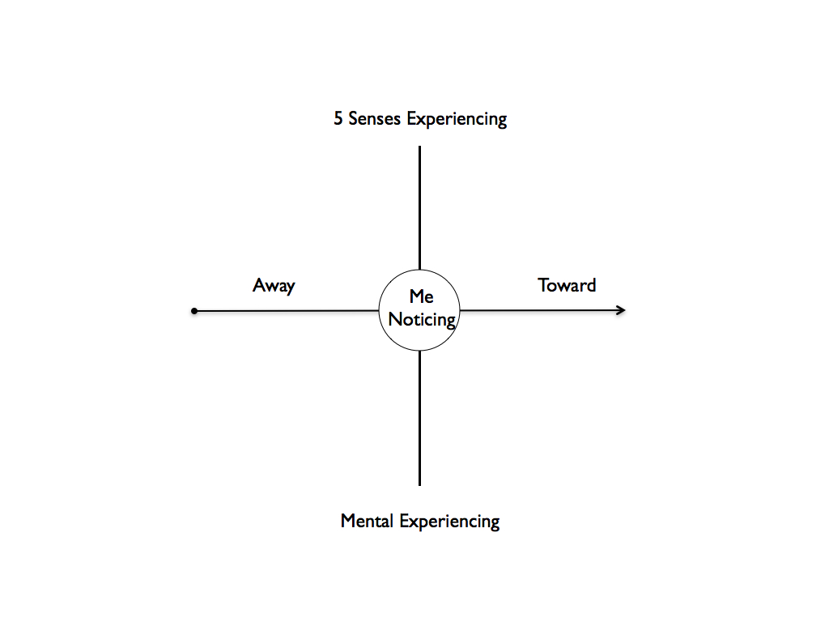
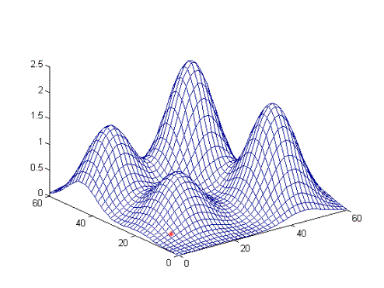
Need to bring workability criterion of success into MI
Success is measured by improving client awareness and manipulation of workability, not on specific public behavior change (e.g., alcohol use).
  Staying in pre-contemplation or contemplation is not necessarily a failure of intervention, especially if workability is increased
  Even no changes in workability can be a success if clients can tact full range of contingencies and willingly choose to accept the status quo
ACT Matrix
Life Compass
Bullseye
Combine MI’s Top of the Mountain with clinical RFT’s Adaptive Peaks

Slide 19
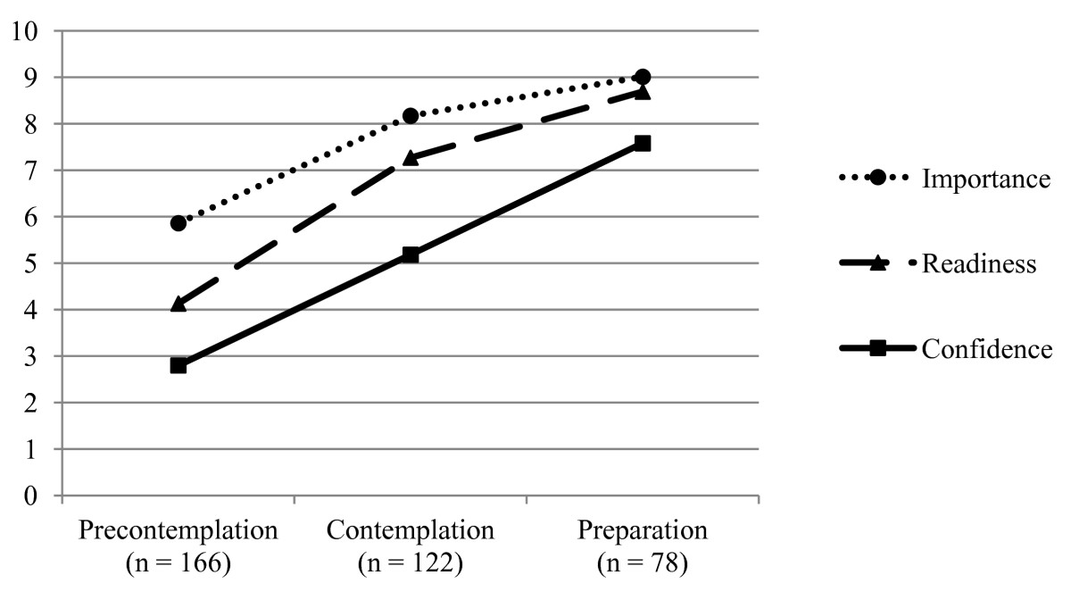
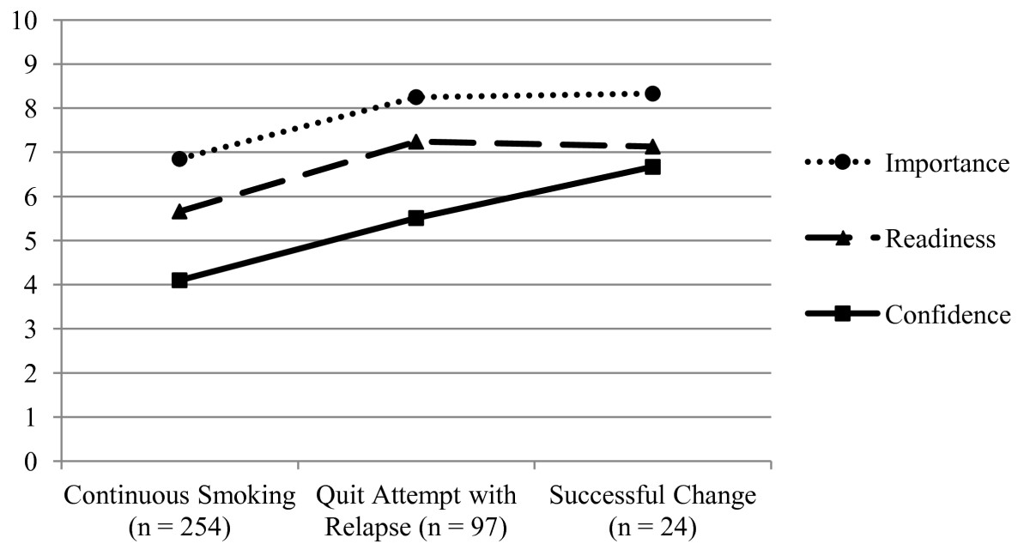
Add Workability to MI Rulers
Boudreaux, Sullivan, Abar, Bernstein, Ginde & Camargo Jr (2012) assessed predictive ability of MI rulers (without use of MI skills) for smokers in various stages of change
Ratings were predictive of subsequent behavior change
What if we added a ruler rating workability?
  Globally
  For target clinically-relevant behaviors

Slide 20

Clinical RFT needs self-contained training for dissemination to agencies.
Goal: teaching clinicians how to “read the process” and assess for improvements in real-time
Mastering the Clinical Conversation contains several indicators to monitor progress in client development of sensitivity to the context and functional coherence
Online training and consultation is available in clinical RFT
BUT to make clinical RFT sustainable in agency settings, training materials (both on skill building and “coding” of therapist behavior) for use in peer groups and supervision should be disseminated
A coding system would allow comparison to psycholinguistic and dismantling studies of MI (showing validity by predicting the past)

Slide 21
Thanks!
Feel free to contact me:
Sean P. Wright
MrSeanWright@gmail.com

Slide 22
References
Amrhein, P. C., Miller, W. R., Yahne, C. E., Palmer, M., & Fulcher, L. (2003). Client commitment language during motivational interviewing predicts drug use outcomes. Journal of Consulting and Clinical Psychology, 71(5), 862-78.
Boudreaux, E. D., Sullivan, A., Abar, B., Bernstein, S. L., Ginde, A. A., & Camargo, C. A. (2012). Motivation rulers for smoking cessation: a prospective observational examination of construct and predictive validity. Addiction Science & Clinical Practice, 7(8), 1-9.
Bricker, J., & Tollison, S. (2011). Comparison of motivational interviewing with acceptance and commitment therapy: A conceptual and clinical review. Behavioural and Cognitive Psychotherapy, 39(05), 541-559.
Christopher, P. J. & Dougher, M. J. (2009). A behavior-analytic account of motivational interviewing. The Behavior Analyst, 32(1), 149-161.
Kohlenberg, R. J., Kanter, J. W., Bolling, M. Y., Parker, C. R., & Tsai, M. (2002). Enhancing cognitive therapy for depression with functional analytic psychotherapy: Treatment guidelines and empirical findings. Cognitive and Behavioral Practice, 9(3), 213-229.
Miller, W. R., & Rollnick, S. (2012). Motivational interviewing: Helping people change. Guilford.
Sheldon, K.M., Ryan, R. M., Deci, E. L. & Kasser, T. (2004). The independent effects of goal contents and motives on well-being: It’s both what you pursue and why you pursue it. Personality and Social Psychology Bulletin, 30, 475-486.
Törneke, N. (2010). Learning RFT: An introduction to relational frame theory and its clinical application. New Harbinger Publications.
Villatte, M. & Villatte, J. L. (2013). Clinical RFT: Fostering a flexible sense of self. Presentation at the World Conference of the Association of Contextual Behavioral Science, Sydney, Australia. Available at: https://contextualscience.org/files/75%20Clinical%20RFT%20Self%20-%20Villate%20&%20Villatte.pdf.
Villatte, M., Villatte, J. L. & Hayes, S. C. (2016). Mastering the clinical conversation: Language as intervention. Guildford.
Zettle, R. D., Hayes, S. C., Barnes-Holmes, D. & Biglan, A. (Eds.) (2016). The Wiley handbook of contextual behavioral science. Wiley-Blackwell.
Wright, S. P., Combs, S. & Kaufman. M. (2016). Diffusion of defusion: A mixed-methods approach to longitudinally measure the implementation of ACT in a community mental health center. Poster session presented at the World Conference of the Association of Contextual Behavioral Science, Seattle, WA.

Slide 23
Need credit for this session?
Please don’t forget to
scan out.
What did you think?....
complete the 3 question quickeval
for this session at
https://contextualscience.org/quickeval
This was presentation was session # 108

