Slide 1
ACTive Birthing

Slide 2
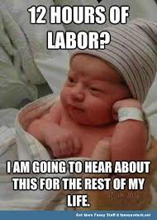
ACTive Birthing

Slide 3
Some say giving birth is no fun...

Slide 4
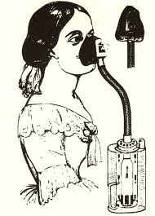
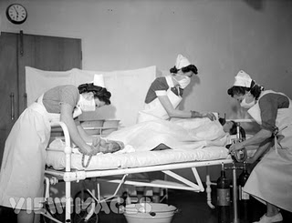
Some have even said
it would be better to forget the whole thing.

Slide 5
This arguably goes back a long time...

Slide 6
Other options do exist.
Hypnobirthing
Mindfulness Based Birthing

Slide 7
Hypnobirthing
Pain = fear
Focus on words
Relaxation

Slide 8
Mindfulness Based Childbirth Education
Based on MBSR
Relate to pain and anxiety
Relaxation

Slide 9
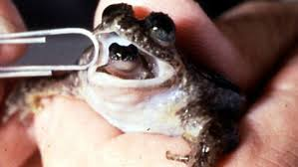
What about another option?
No, not that. ACT Birthing!

Slide 10
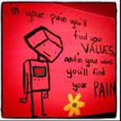
This is where ACT-ive Birthing
could come in

Slide 11
ACT Birthing is not...

Slide 12
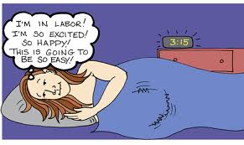
It's not...

Slide 13
It could be:
Clarifying values
Workable relationship with pain

Slide 14
It could be:
Working with verbal preconceptions
Exploring expectations
Extending postpartum work

Slide 15
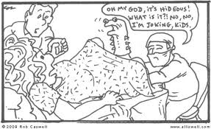
And it could be:

Slide 16
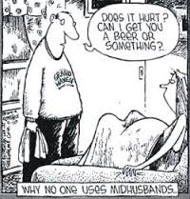
And it might:

Slide 17
Who knows?
The data is yet to be collected.

Slide 19
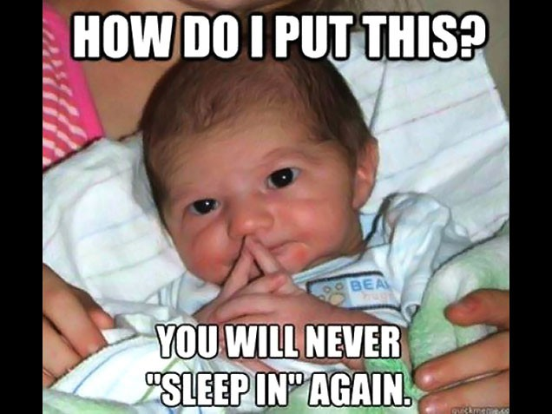

Slide 20
References
Fisher C, Hauck Y, Bayes S, Byrne J. Participant experiences of mindfulness-based childbirth education: a qualitative study. BMC Pregnancy Childbirth. 2012 Nov 13;12:126.
Greco, L. A., Heffner, M., Ritchie, S., Polak, M., Poe, S., & Lynch, S. K., (2005). Maternal adjustment following preterm birth: Contributions of experiential avoidance. Behavior Therapy, 36, 177-184.
Vieten, C. (2009). Mindful Motherhood: Practical Tools for Staying Sane During Pregnancy and Your Child’s First Year. Oakland, CA: New Harbinger.
"Nonpharmacological Means of Pain Relief for Labor and Delivery". International Anesthesiology Clinics 40 (4): 103–114. 2002.
Phillips-Moore, Julie (2012). "Birthing outcomes from an Australian HypnoBirthing programme". British Journal of Midwifery 20 (8): 558–564.

