Slide 1
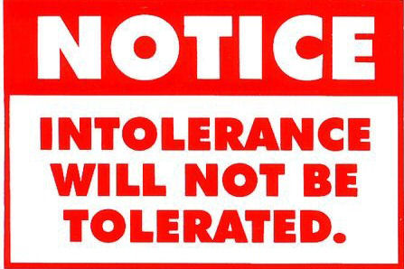
Why Groups Are Not Designed To Be Tolerant – and, why we as contextual scientists might care.
Jonathan Rhodes, PsyD

Slide 2
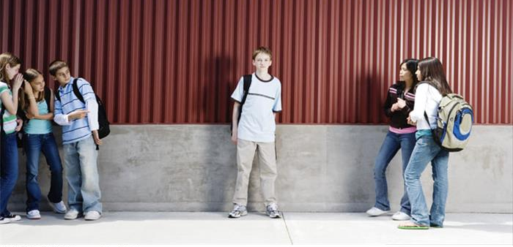
Self-segregate Based on Rewards & Punishments
Intolerance is behaviorally reinforced at much higher rate; Tolerance is often punished.
Presence of contextual, interpersonal factors - as well as the functions these behaviors serve.
And, propose some group-level changes that may indicate tolerance.

Slide 3
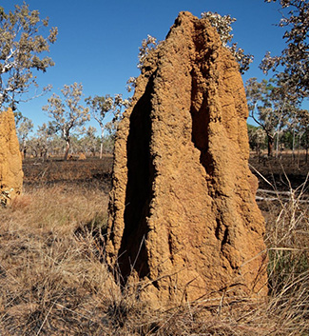
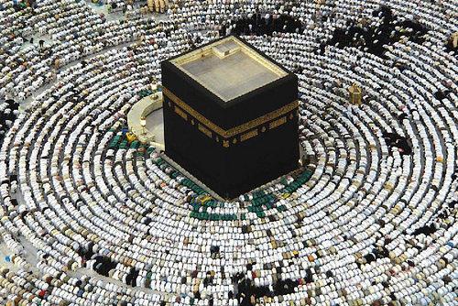
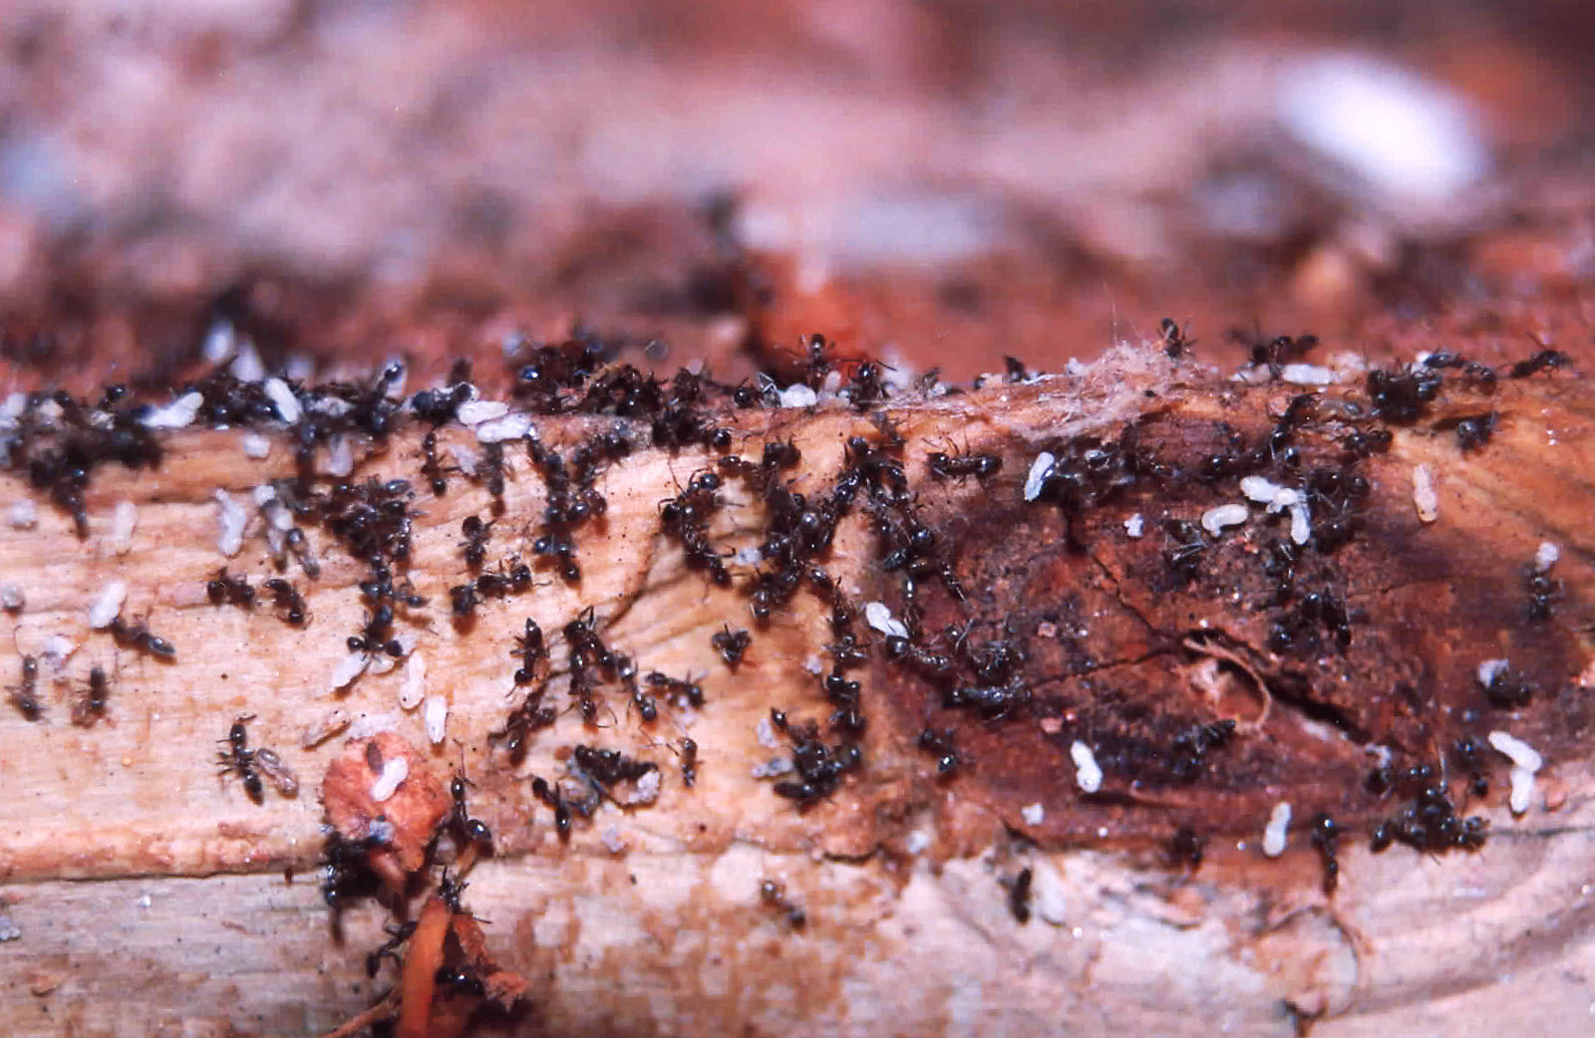
Ultra-Social & Symbolic

Slide 4
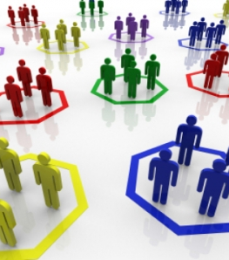
Empathy/Intolerant Behaviors
Not ("Evil") an aberration of group behavior
They are the glue that holds groups together

Slide 5
Stereotype (Verbal) Behavior
Make us feel connected with "like-me" (e.g. Clark & Kashima, 2007)
Low in information; faster/more efficient processing

Slide 6
Stereotype (Verbal) Behavior
When "others" believe stereotypes (e.g. literality), likely to conform - even when it decreases performance (Leander et al., 2011).

Slide 7
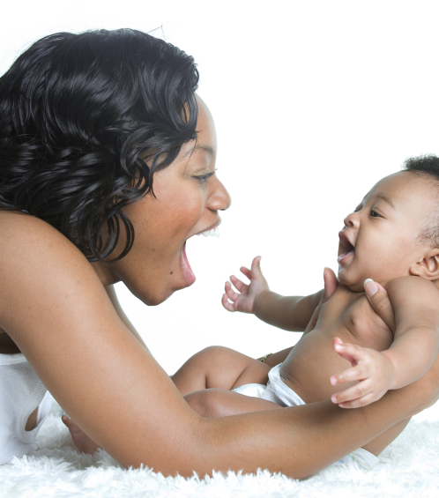
Behavioral Mimicry: the interpersonal dance
"You smile, I smile."
Makes us feel connected
Facilitates interpersonal behaviors on an implicit level

Slide 8
Behavioral Mimicry: the interpersonal dance
We dance more with "like-me" & less with "other"
E.g. Same First Name (Guéguen & Martin, 2009)
Absence for "others" causes stress & impairs performance (Dalton et al., 2010)

Slide 9
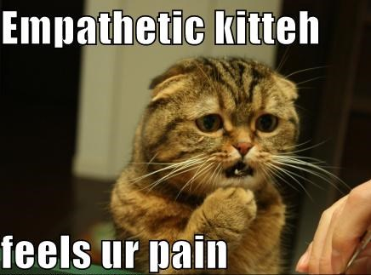
Motor-Resonance: the brains empathy song
Somatosensory response when you see others experience
Decreased empathy for "others"

Slide 10
Motor-Resonance: the brains empathy song
Decreased ability to feel pain of "other" (e.g. Avenanti et al., 2010; Gutsell & Inslicht, 2010)
Power also decreases motor resonance (Hogeveen et al., 2014)

Slide 11
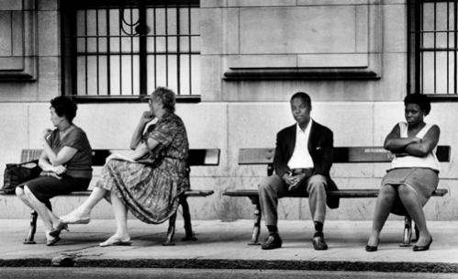
Rigidly, Reinforced Relational-Responding
"If an "other" falls in pain in a forest of group-actors - AND, no mirror-neurons are there to register it - did it really happen?"

Slide 12
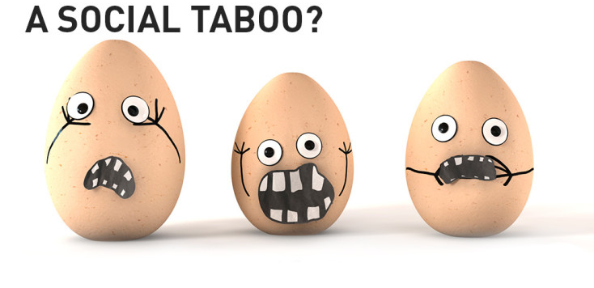
Rigidly, Reinforced Relational-Responding
Deviation from dominant, Relational-Framing causes anxiety (e.g. Mendes et al., 2007)
Increased HR; decreased performance

Slide 13
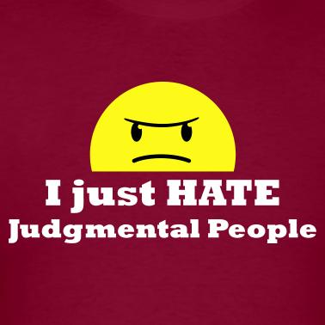
Rigidly, Reinforced Relational-Responding
People often respond defensively/aggressively to symbolic behavior of "other" (e.g. Brandt et al., 2013)

Slide 14
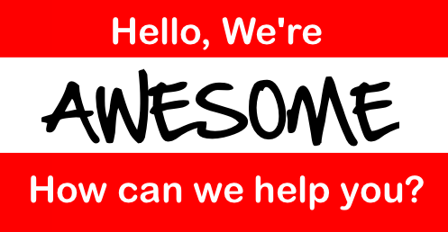
Rigidly, Reinforced Relational-Responding
"Group"-As-Content
"If it weren't for ?????, our society would be a lot better off."
"We're nothing like them. We're..."

Slide 15
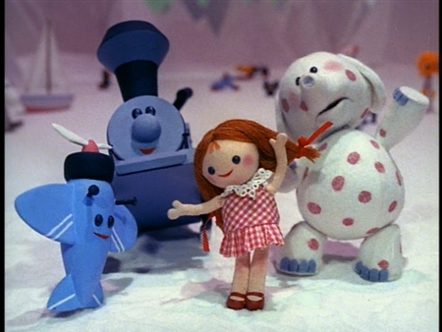
Rigidly, Reinforced Relational-Responding

Slide 16
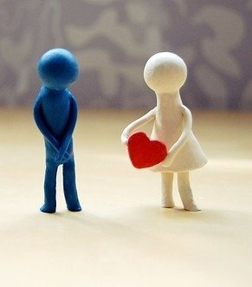
Build In Empathy
Behavioral mimicry of "others" increased empathy and understanding (e.g. Inzlicht et al., 2012)

Slide 17
Build In Empathy
Perspective taking reduces stereotype maintenance (Todd et al., 2012)

Slide 18
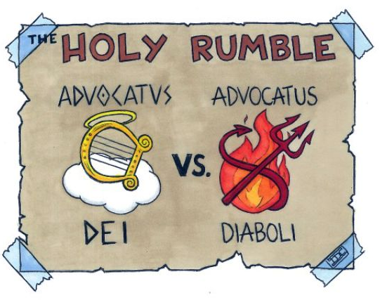
Build In Rewards
The Devil's Advocate
Making Saints vs. Information Gathering

Slide 19
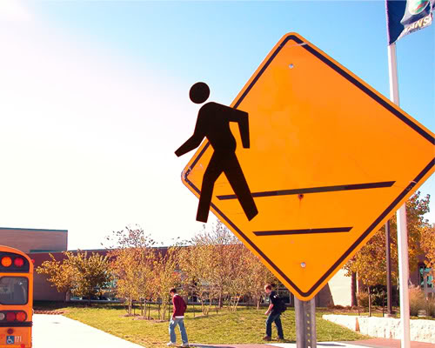
Build In Rewards
Provide reinforcers for the devil's advocate (Schulz-Hardt et al, 2002)
Give that person influence/prominance within the group

Slide 20
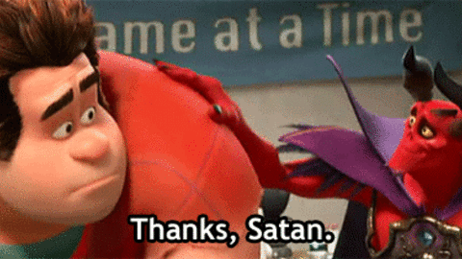
Build In Rewards
Bring in exemplars to weaken relational-repsonding (e.g. Joy-Gaba & Nosek, 2010)

Slide 21
References
Avenanti, A., Sirigu, A., & Aglioti, S. M. (2010). Racial bias reduces empathic sensorimotor resonance with other-race pain. Current Biology, 20, 1018-1022.
Brandt, M. J., Wetherell, G., & Reyna, C. (2013). Liberals and Conservatives Show Similarities in Negativity Bias: Evidence from Intolerance, Psychological Threat, and Motivated Reasoning. Behavior and Brain Science (May 21, 2013).
Clark, A. E., & Kashima, Y. (2007). Stereotypes help people connect with others in the community: a situated functional analysis of the stereotype consistency bias in communication. Journal of personality and social psychology, 93, 1028.
Dalton, A. N., Chartrand, T. L., & Finkel, E. J. (2010). The schema-driven chameleon: how mimicry affects executive and self-regulatory resources. Journal of personality and social psychology, 98, 605-617.
Guéguen, N., & Martin, A. (2009). Incidental similarity facilitates behavioral mimicry. Social Psychology, 40, 88.
Gutsell, J. N., & Inzlicht, M. (2010). Empathy constrained: Prejudice predicts reduced mental simulation of actions during observation of outgroups. Journal of Experimental Social Psychology, 46, 841-845.
Hogeveen, J., Inzlicht, M., & Obhi, S. S. (2014). Power changes how the brain responds to others. Journal of Experimental Psychology: General, 143(2), 755-763.
Inzlicht, M., Gutsell, J. N., & Legault, L. (2012). Mimicry reduces racial prejudice. Journal of Experimental Social Psychology, 48, 361-365.
Joy-Gaba, J. A., & Nosek, B. A. (2010). The surprisingly limited malleability of implicit racial evaluations. Social Psychology, 41, 137-146.
Leander, N. P., Chartrand, T. L., & Wood, W. (2011). Mind your mannerisms: Behavioral mimicry elicits stereotype conformity. Journal of Experimental Social Psychology, 47, 195-201.
Mendes, W. B., Blascovich, J., Hunter, S. B., Lickel, B., & Jost, J. T. (2007). Threatened by the unexpected: physiological responses during social interactions with expectancy-violating partners. Journal of personality and social psychology, 92, 698-716.
Schulz-Hardt, S., Jochims, M., & Frey, D. (2002). Productive conflict in group decision making: Genuine and contrived dissent as strategies to counteract biased information seeking. Organizational Behavior and Human Decision Processes, 88, 563-586.
Todd, A. R., Galinsky, A. D., & Bodenhausen, G. V. (2012). Perspective taking undermines stereotype maintenance processes: Evidence from social memory, behavior explanation, and information solicitation. Social Cognition, 30, 94-108.

