Slide 1
Using an implicit measure of attitude
to investigate the Stigmatisation
and Locus of Control
of Psychological Suffering
Ciara McEnteggart
Department of Psychology
NUI Maynooth

Slide 2
Psychological Suffering
A key feature of psychological suffering is the power of the related label (Timimi, 2011)
All labels carry related evaluations (Fernando, 2005)
This influences the attitudes held towards the sufferer (Corrigan, 2004)
And how the sufferer evaluates themselves (Link et al., 2006)

Slide 3
Stigmatisation
Labels and their related evaluations are readily attributed to others in both personal and professional contexts (Link, 2006)
They are now part of the fabric of how we talk about ourselves and others
They likely comprise both explicit and implicit attitudes (Reeder & Pryor, 2008)
And they are not always helpful (Timimi, 2012)

Slide 4
Labels & Stigma
For example, stigma, regarding any domain:
Reduces life chances of sufferers
Reduces access to mental health services
Limits advances in treatment.
Reinforces differences in socio-economic status
exacerbates stress
delays help-seeking
causes treatment termination
There is only a few existing studies that have explored implicit attitudes to mental health labels (Stier, & Hinshaw, 2007; Teachman et al., 2006)
This might be an important area of application for the IRAP

Slide 5
Study 1 Method
Depression Anxiety Stress Scale (DASS 21)
Implicit Measure: Three separate IRAPs
Depression IRAP (N= 20)
Anxiety IRAP (N= 20)
Mental Illness IRAP (N= 20)
Explicit Measures:
Community Attitudes to Mental Illness (CAMI)
Stigmatising Attitudes Believability (SAB)

Slide 6
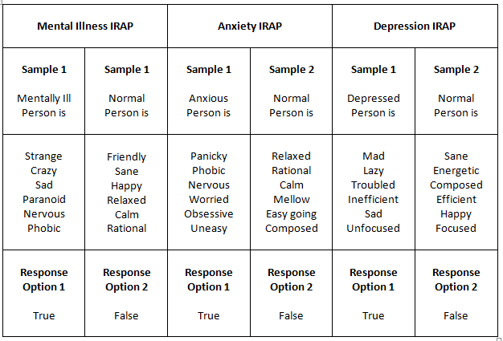
IRAP Stimuli
Psychological Labels
Negative psychological states, feelings and emotions associated with the psychological label

Slide 7
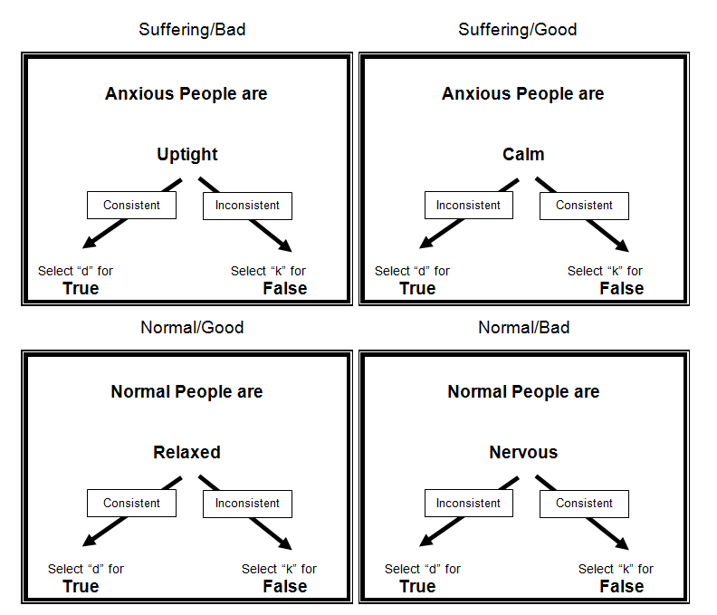
Depression IRAP

Slide 8
Results
Pro-Normal Bias
Stigmatising/
Pro-Normal Bias
Stigmatising Bias
Mean D-Scores
Pro-Suffering Effect
Suffering-Bad
Suffering-Good
Healthy-Bad
Healthy-Good
Anti-Stigmatising/
Pro-Suffering Bias
= Significant effect

Slide 9
Results
Stigmatising attitudes were equally evident in the Suffering-Bad trial-type
Large Pro-Normal effect in Normal-Good trial-type
Pro-Suffering Bias in the Suffering-Good trial-type, strongest effect in Anxiety IRAP
Explicits:
CAMI depicted positive attitudes towards people with mental illness
SAB indicated no evidence of stigmatising attitude believability
No significant correlations between explicit and implicit results

Slide 10
Conclusions
Strong Pro-Normal Bias evident on all three IRAPs when relating positive stimuli to being normal
Stigmatising attitudes demonstrated on all three IRAPs towards depression, anxiety and mental illness in the Suffering/Bad trial-type (i.e. more readily able to relate negative stimuli with suffering)
Interestingly, participants still related positive stimuli to suffering in the Suffering-Good trial-type despite evident stigmatising bias when relating negativity to suffering, strongest effect in Anxiety IRAP
No differences across the three IRAPs
No stigma on explicit measures

Slide 11
Locus of Control
Existing literature suggests that attributions in terms of the locus of control may play an important role in implicit bias
External locus of control: suffering is attributed to external sources (e.g. “It’s not my fault I’m ill, it’s a medical problem”)
Internal locus of control: suffering is attributed to internal sources (e.g. “It’s my own fault that I feel this way”)
In Study 2, we used the IRAP to explore the locus of internal vs. external control with regard to mental health categories by contrasting illness with weak-mindedness

Slide 12
Study 2 Method
Depression Anxiety Stress Scale (DASS 21)
Implicit Measure: Two separate IRAPs
Illness IRAP (N= 20)
Weak-mindedness IRAP (N= 20)
Explicit Measures:
Community Attitudes to Mental Illness (CAMI)
Stigmatising Attitudes Believability (SAB)

Slide 13
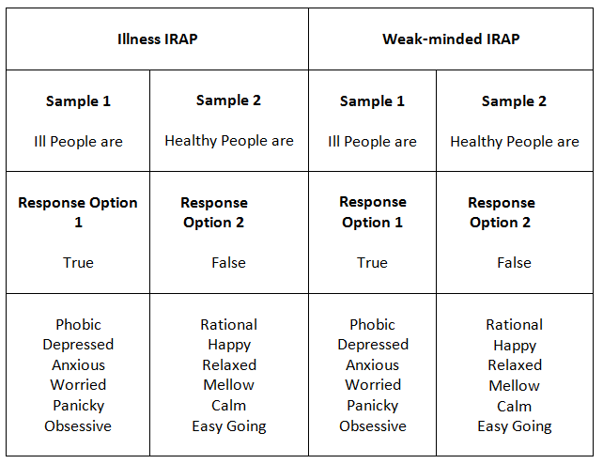
IRAP Stimuli
Negative psychological states
often used as a Psychological Label
Positive psychological states, feelings & emotions

Slide 14
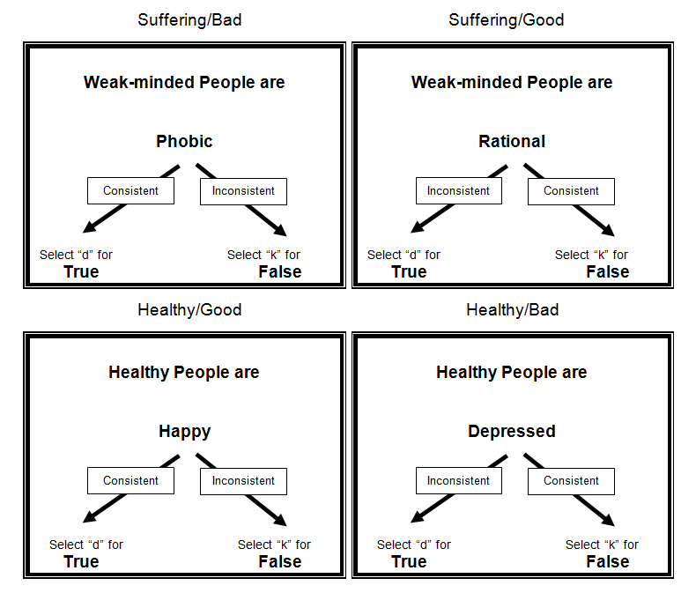
Weak-minded IRAP

Slide 15
Results
Pro-Healthy Bias
Pro-Healthy/
Stigmatising
Stigmatising Bias
Mean D-Scores
Weak Pro-Suffering Effect
Pro- Illness/
Weak-mindedness
Suffering-Bad
Suffering-Good
Healthy-Bad
Healthy-Good
= Significant effect

Slide 16
Results
Stigmatising biases were evident towards both illness and weak-mindedness in the suffering/bad trial-type.
Strong Pro-Healthy Bias in Suffering-Good and Suffering-Bad trial-types
Slight Pro-Suffering Bias in Suffering-Good trial-type
No differences between the two IRAPs
Explicits
CAMI depicted positive attitudes towards people with mental illness
SAB indicated no evidence of stigmatising attitudes believability
No significant correlations between explicit and implicit results

Slide 17
Conclusions
Stigmatising Bias evident when participants related negative psychological states to illness or weak-mindedness
Strong Pro-Normal Bias evident when relating positive psychological states to being healthy. Also, participants were reticent to relate negative psychological states to being healthy
Again, participants more readily related positive psychological states than negative to Ill suffering despite evident stigmatising biases. Although this effect was weak.
Suggests slightly positive attitude towards sufferers
No differences across IRAPs
No stigma on explicit measures

Slide 18
Overall Conclusions
No explicit stigmatising attitudes reported on any measure
Pro-Normal/Healthy Biases found in all 5 IRAPs
Similar Stigmatising Bias towards anxiety, depression, mental illness and weak-mindedness on all IRAPs, but only when relating negative psychological states to suffering (i.e., Suffering-Bad trial-type) – This trial-type is key when measuring Stigma
Data from Study 2 indicated that participants were equally stigmatising towards illness as weak-mindedness, suggesting that both sources of the locus of control were operating

Slide 19
Overall Implications
Current programme of research is the first to use the IRAP to explore categories used to label psychological suffering
The data showed some evidence of stigmatising bias towards the labels, but additional IRAPs may expand upon these effects
All data here were recorded with undergraduates, so there may well be differences with sufferers and with professionals

Slide 20
Ciara.McEnteggart@nuim.ie

