Slide 1
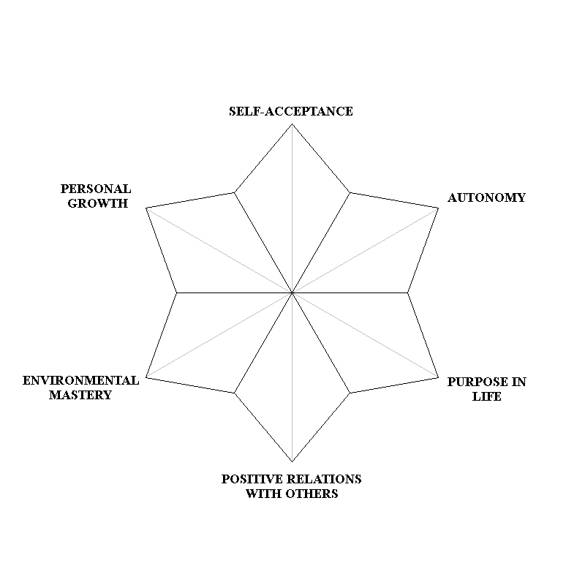
An Acceptance and Commitment Therapy Approach to Increase Well-Being in Spinal Cord Injury Survivors
Sophia Serpa, M.S., Alexia Holovatyk, B.S. & Barry Nierenberg, PhD, ABPP
Nova Southeastern University
Abstract
Purposes
Results
The purpose of this exploratory pilot study was to use participatory action research to further develop an intervention for Spinal Cord Injury (SCI) survivors aimed at increasing well-being, hope, and quality of life using a well-being based Acceptance and Commitment Therapy (ACT) approach. Five executive board members of a Spinal Cord Injury Support group volunteered to participate in 8 eight group sessions and provided qualitative feedback on the intervention. Pre- and post- assessments were administered to identify changes within the group in the domains of mindfulness, post-traumatic growth, depression, anxiety, well-being, quality of life, hope and psychological flexibility.
To receive feedback from a SCI group and further develop the “Living Well” intervention with SCI survivors
To determine whether an intervention including aspects of Acceptance and Commitment Therapy, Well-Being Therapy and other positive psychology domains such as Post-Traumatic Growth and hope can increase well-being and valued living in a SCI population
A paired samples t-test was conducted to determine if there were statistically significant mean differences between pre- to post-intervention scores of acceptance, post-traumatic growth, depression, anxiety, well-being, quality of life, hope, and acceptance. All dependent variables were normally distributed with skewness and kurtosis z-scores falling between the accepted range of +/- 2.58. Bonferroni adjustments were not used because of the small size and the exploratory nature of the study. Statistically significant improvements were observed in psychological well-being, quality of life, and hope. However, due to the small sample size it is useful to put an emphasis on effect sizes. Results are presented below in order of effect from largest to smallest.
*Psychological well-being, t(4) = 4.12, p = .02, d = 1.84
*Quality of life, t(3) = 3.36, p = .04, d = 1.68
*Hope, t(4) = 2.98, p = .04, d = 1.33
Anxiety, t(4) = 1.47, p = .22, d = -.66
Depression, t(4) = 1.09, p = .34, d = -.49
Post-traumatic growth, t(4) = .77, p = .48, d = -.35
Mindfulness, t(4) = .35, p = .75, d = .16
Acceptance, t(4) = .22, p = .83, d = .10
*indicates a statistically significant result
Background
Participants
It is not surprising that although about 5% of Americans become depressed every year, the rates of depression among those surviving spinal cord injury (SCI) are even higher ranging from 11% to 37% (North, 1999; Pollard & Kennedy, 2007). Although it is necessary to study interventions that alleviate depressive symptoms in the short term, it is not sufficient. Previous studies have found that the challenge of treating depression lies in the prevention of relapse rather than in the alleviation of initial symptoms. A study by Fava & Ruini (2004) found that while 70% of patients remitted following a treatment for depression, 90% of people in a clinical management group relapsed at least once over a 6-year period compared to only 40% of people who completed a well-being based intervention.
Ryff and Singer (1996) have suggested that the absence of well-being creates conditions of vulnerability to possible future adversities and that the route to enduring recovery lies not exclusively in alleviating the negative, but in also engendering the positive. In an effort to focus on moving past this state of depression to a state of well-being, we have utilized an intervention similar to Fava & Ruini’s Well-Being Therapy (WBT) outlined in their 2003 article to explore the potential benefits such interventions can have with survivors of SCI. WBT is a cognitive-behavioral approach based on Carol Ryff’s multidimensional model of psychological well-being. We chose to add components of Acceptance and Commitment Therapy (ACT) to our group intervention in hopes to add the concept of living according to your values to this intervention. To our knowledge, no other study has attempted to replicate this finding in a group of people with chronic physical disabilities. This study seeks to further this line of study by hypothesizing that a well-being based ACT intervention will be a significant predictor of lower depression scores at 0 and 6 months following the intervention in a group of people with spinal cord injury.
Aspects of Well-Being
Five members of the executive board of a Spinal Cord Injury Support Group
Age | Gender | Time since injury & Type of injury | Race | Annual Income | Marital Status
36.80 ± 4.87 | Male – 3 Female – 2 | 12.4 ±7.5yrs. paraplegia-4 quadriplegia-1 | White – 2 Black – 1 Latino (a) – 2 | < $60.000 – 2 $60.001- $ 70.000 – 1 $100.000+ – 1 | Single – 2 In a relationship – 1 Married – 1 Divorced – 1
Methods
Discussion
An 8-week group oriented program (Living Well with SCI) that was led by a licensed psychologist and two doctoral-level students which spanned over a seven month period. Meeting dates were adjusted to participants’ availability which, along with holiday breaks, accounts for the drawn out intervention period.
Sessions lasted one hour, and took place every other week
Psychometric questionnaires were administered pre- and post-intervention
Qualitative feedback on participants’ reception of the program was obtained halfway through and at the completion of the program
Measures administered:
Acceptance and Action Questionnaire (AAQ)
Mindful Attention Awareness Scale (MAAS)
Patient Health Questionnaire-9 (PHQ-9)
Post-Traumatic Growth Inventory (PTGI)
Psychological Well-Being Scale (PWB)
Quality of Life Index, SCI version (QOL-SCI)
State Trait Anxiety Inventory – 6 (STAI-6)
Trait Hope Scale (HS)
Results indicate that the “Living Well” group intervention demonstrates initial promise in increasing positive constructs (e.g. psychological well-being) and reducing negative constructs (e.g. anxiety) resulting in a more adaptive psychological profile in a group of people with spinal cord injuries. However, the results should be interpreted with caution given that there are numerous limitations to this pilot study. Limitations include the small sample size (n=5), the lack of a control group which leaves the results of the study open to alternative explanations such as history, maturation, testing and statistical regression. Also, the smallest observed effect was in acceptance, one of the main focal points of the intervention, which potential calls the construct validity of the program into question. Finally, because the pilot study was carried out with executive board members of a spinal cord injury support group, it is unknown how the results would generalize to people who are newly injured or less proactive in regards to their injury. Future research should include larger, more diverse samples as well as comparison groups to fill in the gaps of this promising new line of research.
Fava, G. & Ruini C. (2003). Development and characteristics of a well-being enhancing
psychotherapeutic strategy: well-being therapy. Journal of Behavior Therapy and Experimental Psychiatry, 34, 45-63. doi:10.1016/S0005-7916(03)00019-3
North, N.T. (1999). The psychological effects of spinal cord injury: A review. Spinal Cord,
37,10, 671-679.
Ryff, C. D. & Singer, B. (1996). Psychological well-being : meaning, measurement, and implications for
psychotherapy research. Psychotherapy and Psychosomatics 65, 14–23.
Pollard, C., & Kennedy, P. (2007). A longitudinal analysis of emotional impact, coping
strategies, and post-traumatic psychological growth following spinal cord injury: A 10-year review. British Journal of Health Psychology, 12, 347–362.
References
Analyses
A paired samples t-test was used to analyze differences among group means pre- and post- intervention. The data was interpreted through the Statistical Package for the Social Sciences (SPSS).

