Slide 1
Experiential Approach: Efforts to Control Positive Emotions By Jeffrey Swails M.A. & Robert Zettle, Ph.D. Wichita State University
Disclosure
Jeffrey Swails
I have not received and will not receive any commercial support related to this presentation or the work presented in this presentation.
Robert Zettle
I have not received and will not receive any commercial support related to this presentation or the work presented in this presentation.

Slide 2
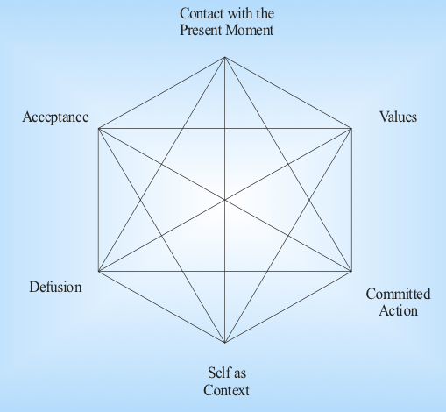
Hayes, S.C. (nl), Introduction to the Hexaflex. Image Accessed via ACBS website
Notes:
Here is the Cross of the ACT world, the Hexaflex. For this presentation I would like to hone in on acceptance. Its converse, experiential avoidance or the unwillingness to contact unpleasant emotions has dominated attention in the ACT literature.

Slide 3
Pacific, T. (2013). Learning to Live with the Monster, Illustration found at askmagazine.org
Notes:
We have several measures in several languages… proposals to use experiential avoidance as a diagnostic tool as opposed to the current categorical DSM-5.

Slide 4
Our minds = “Don’t get eaten” machine
Notes:
It makes sense that we focus on the negative emotions, or at least how we relate to them. Our mind, afterall is a do not get eaten machine.

Slide 5
Notes:
I argue as researchers and clinicians that we expand our scope of experiential control to also include how we interact with positive emotions. How do we react when we are happy? Excited? Serene?

Slide 6
Notes:
What is the outcome of trying to control positive emotions? Does it increase them? Or decrease Them? Consider a butterfly garden. It’s a garden filled with butterflies and many hope that the butterfly lands on them.

Slide 7
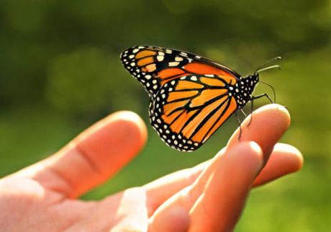
Notes:
What then? Do you try to grab it? Does that crush it or somehow decrease the experience of it? Do you allow it to sit there and try to enjoy it? You know the butterfly will eventually leave? How do you deal with that knowledge.

Slide 8
Experiential Approach
Efforts to contact or sustain desired affective and mood states (Swails, Zettle, Burdsal, & Snyder, under review).
Notes:
Well, my mentor, Dr. Zettle and I have coined the term experiential approach to refer to efforts to contact or sustain desired Affective and mood state. And we conceptualize it

Slide 9
Experiential Approach
Efforts to contact or sustain desired affective and mood states (Swails, Zettle, Burdsal, & Snyder, under review).
Experiential Control
Experiential Avoidance
Experiential Approach
Notes:
We cconceptualize experiential approach as one type of experiential control alongside of experiential avoidance. We conceptualize experiential control as the opposing inflexible process to acceptance.

Slide 10
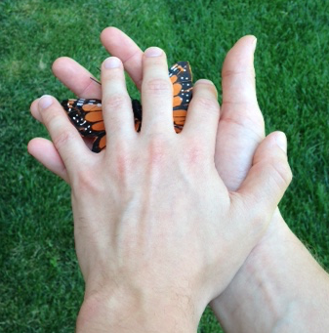
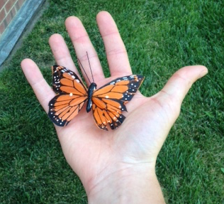
Experiential Approach Scale
anxious clinging
experience prolonging
Notes:
We created an 18-item scale to explore this process and we found something unexpected. A two-factor solution. We appeared to create a scale that measured two types of experiential approach, that behave differently.

Slide 11
Anxious Clinging subscale
Example items…
“When I’m in a good mood I worry that something will spoil it.”
“When things are going well, I expect something bad to happen.”
Notes:
Participants respond to 11 items on a 7point likert scale. For example When I’m in a good mood I worry that something will spoil it. When things are going well, I expect something bad to happen.

Slide 12
Experience Prolonging subscale
Example items…
“I try to hang on to feelings I enjoy.”
“I do my best to stay happy all the time.”
Notes:
Participants respond to 8 items on a 7point likert scale. For example I try to hang on to feelings I enjoy. I do my best to stay happy all the time.

Slide 13
High in Anxious Clinging
Correlated with…
higher experiential avoidance (r = .67)
higher depressive symptoms (r = .55)
lower subjective happiness (r = -.57)
Notes:
Anxious Clinging is correlated with experiential avoidance, depressive symptoms, and lower subjective happiness

Slide 14
High in Experience Prolonging
Correlated with
higher experiential avoidance (r = .27)
higher happiness (r = .17)
Notes:
Experience Prolonging correlated with experiential avoidance and mildly correlated with happiness

Slide 15
Structural Model
Experiential Control
.90
.56
.81
AAQ-II
anxious clinging
experience prolonging
Model Confirmed
Notes:
A structural analysis of experiential avoidance as measured by the AAQ-II and Experiential Approach as measured by these two subscales empirically supports our conceptualization as these two processes being facets of the super ceding construct experiential control.

Slide 16
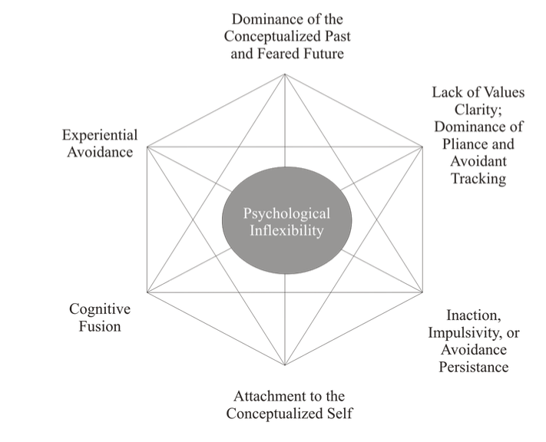
Perhaps a change is in order…
Hayes, S.C. et al. 2006. Acceptance and Commitment Therapy: Model, processes, and outcomes. Figure found in manuscript
Notes:
What if we change our language on the hexainflex? I submit that the inverse of acceptance be referred to as experiential control.

Slide 17
Applications…
Behavioral Activation…
Go for a walk!
Socialize with a friend!
Engage in an old hobby!
Notes:
A reconceptualization of the counterpart to acceptance could better coach up acceptance. Consider behavioral activation as a treatment for depression. We coach the client to engage in activity but for what purpose? To feel better or to follow values?

Slide 18
?
?
Notes:
Let’s say the client engages in an activity to feel better. When do we urge caution as a therapist? We often look to outcomes but what if the Experiential Approach Scale could identify more pernicious processes before waiting for the adverse outcome.

Slide 19
Potential utility…
Risk factor?
Predictor of relapse in depression?
Other thoughts?
Notes:
How could this scale be used? I certainly have some ideas. Perhaps as a risk factor. A predictor of relapse? Or even more fully inform the potential diagnostic system of experiential avoidance.

Slide 20
Interested?
And come to the ACT for Depression Workshop on Sunday Morning with Robert Zettle and myself
Notes:
This paper is currently under review and we are close to publishing. Upon publication I can send out versions of the EAS and share ideas

