Slide 1
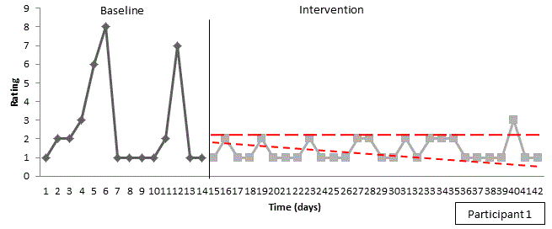
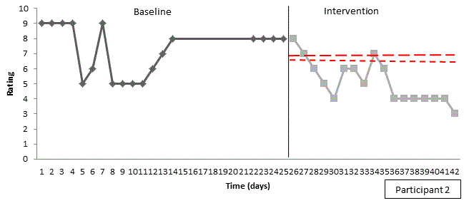
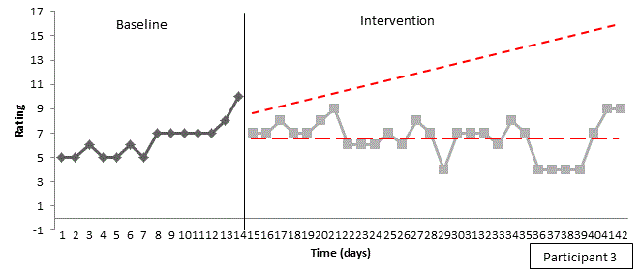
A Case Series on the Effects of Yoga for Generalized Anxiety Disorder
Jessica R. Morgan & Page L. Anderson, Georgia State University
Introduction
Method
Discussion
Is yoga associated with change in worry behavior and cardiovascular functioning in three individuals with generalized anxiety disorder?
In an AB design, participants provided worry ratings daily across baseline and intervention phases
Yoga was delivered twice-weekly for four weeks
Pre- and post-treatment, participants also completed:
EKG examining high-frequency (parasympathetic heart rate variability)
Measures of GAD severity (PSWQ¹⁰), mindfulness (FFMQ¹¹), and psychological flexibility (AAQ-II¹²)
Two of three participants showed decreased daily worry ratings
The third showed decreased trend – worry did not increase as expected
Qualitatively, participants indicated improvement.
Participant 1: “I can let thoughts or stress just come and go now.”
Participant 2: “I use yoga when I’m stressed now, like a coping strategy.”
Secondary aims showed trends in therapeutically desirable directions for all variables
Caution – these effect sizes are indicators of trends, not valid statistically
Interestingly, increases in mindfulness didn’t correspond to worry reduction
They did correspond to changes in HF-HRV
May be that new emotion regulation strategies don’t lead to immediate reductions in worry behavior.
Generalized anxiety disorder (GAD) is characterized by excessive worry.
Worry functions as avoidance.¹
It reduces short-term cardiovascular responding to aversive stimuli² but worsens long-term cardiovascular health³
Worry may result in long-term emotion dysregulation⁴
Mindfulness:
combats avoidance and improves emotion regulation⁵
Yoga increases mindfulness⁶ and may be a mindfulness activity in itself⁷
Improves cardiovascular health associated with emotion regulation⁸
Associated with more reductions in anxiety than other exercise⁹
Not yet examined in GAD
Results
References
Participants
Borkovec, T. D., Alcaine, O. M., & Behar, E. (2004). Avoidance theory of worry and generalized anxiety disorder. In R. Heimberg, C. Turk, & D. Mennin (Eds.), Generalized anxiety disorder: advances in research and practice (pp. 77–108). New York, NY, US: Guilford Press.
Wells, A., & Papageorgiou, C. (1995). Worry and the incubation of intrusive images following stress. Behaviour Research and Therapy, 33, 579-583.
Hoehn-Saric, R., McLeod, D.R. & Zimmerli, W.D. (1989). Somatic manifestations in women with generalized anxiety disorder. Archives of General Psychiatry, 46, 1113–1119.
Mennin, D. S., McLaughlin, K. A., & Flanagan, T. J. (2009). Emotion regulation deficits in generalized anxiety disorder, social anxiety disorder, and their co-occurrence. Journal of Anxiety Disorders, 23(7), 866-871.
Hayes, A. M., & Feldman, G. (2004). Clarifying the construct of mindfulness in the context of emotion regulation and the process of change in therapy. Clinical Psychology: Science and Practice, 11, 255-262.
Shelov, D. V., Suchday, S., Friedberg, J. P. (2009). A pilot study measuring the impact of yoga on the trait of mindfulness. Behavioral and Cognitive Psychotherapy, 37(5), 595-8.
Salmon, P., Lush, E., Jablonski, M., & Sephton, S.E. (2009). Yoga and mindfulness: Clinical aspects of an ancient mind/body practice. Cognitive and Behavioral Practice, 16, 59–72.
Khattab, K., Khattab, A.A., Ortak, J., Richardt, G., & Bonnemeier, H. (2007). Iyengar yoga increases cardiac parasympathetic nervous modulation among healthy yoga practitioners. Evidence Based Complementary and Alternative Medicine, 4, 511-517.
Berger, B. G., & Owen, D. R. (1988). Stress reduction and mood enhancement in four exercise modes: Swimming, body conditioning, hatha yoga, and fencing. Research Quarterly for Exercise and Sport, 59, 148–159.
Startup, H.M. & Erickson, T.M. (2006). The Penn State Worry Questionnaire (PSWQ). In: G.A. Davey & A. Wells (Eds.). Worry and its psychological disorders: Theory, assessment, and treatment (pp. 101–119). Hoboken, NJ: Wiley & Sons.
Baer, R. A., Smith, G. T., Hopkins, J., Krietemeyer, J., & Toney, L. (2006). Using self-report assessment methods to explore facets of mindfulness. Assessment, 13, 27–45.
Bond, F. W., Hayes, S. C., Baer, R. A., Carpenter, K. C., Guenole, N., Orcutt, H. K., Waltz, T. and Zettle, R. D. (2011). Preliminary psychometric properties of the Acceptance and Action Questionnaire – II: A revised measure of psychological flexibility and acceptance. Behavior Therapy, 42, 676-68
Participant 1:
19 year old African American female
GAD and Social Anxiety Disorder
Participant 2:
21 year old Indian American male
GAD, PTSD, Social Anxiety Disorder
Participant 2:
32 year old African American female
GAD, hx of severe MDD
Effect sizes:
HF-HRV (parasympathetic tone): d = -1.93
PSWQ (worry): d = 3.23
FFMQ (mindfulness) : d = -0.46
AAQ-II (psychological inflexibility): d = 1.47

