Slide 1
Applying contextual behavioural science to meet the needs of people with intellectual disabilities
Dr Nick Gore

Slide 2
Welcome!
Nick Gore – Researcher/C-Psychologist, Tizard Centre University of Kent, England N.J.Gore@kent.ac.uk
Janet Harrison - Nurse Behaviour Therapist, BAIT, Northumberland, Tyne & Wear NHS Foundation Trust Janet.Harrison@ntw.nhs.uk
Mark Oliver - Principal Clinical Psychologist, LD Psychological Services,
Northumberland, Tyne & Wear NHS Foundation Trust
Matt Selman - Principal Clinical Psychologist, LD Psychological Services,
Northumberland, Tyne & Wear NHS Foundation Trust
Steve Noone – Consultant Clinical Psychologist, LD Psychological Services, Northumberland, Tyne & Wear NHS Foundation Trust

Slide 3
The Context
People with Intellectual Disabilities are:
People – with uniquely human potential for joy, greatness and suffering who………..
are often more likely than those without ID’s to experience adversities – physical health difficulties, economic disadvantage, abuse, stigmatisation, bullying, isolation, exclusion……
as likely and sometimes more likely to develop mental health and emotional difficulties and more likely to display behaviours that challenge throughout the life-course
…….often require additional support from other people (who also share in the uniquely human potential for joy, greatness and suffering) to learn, develop and maintain independence

Slide 4
Winterbourne View Scandal 2012
A host of official recommendations………a little action
A relatively small dedicated community driving the resurgence of Positive Behavioural Support with greater recognition of the role and needs of the system and the potential for inclusion of other evidence-based practices……
ACT workshop – Bangor 2004
A partially overlapping, small and dedicated community – driving use of ACT within field of intellectual disabilities:
Staff
Noone & Hastings (2009/10)
Smith & Gore (2012)
Bethay, Wilson, Schnetzer, Nassar & Bordieri (2013)
McConachie, McKenzie, Morris & Walley (2014)
Families
Blackledge & Hayes (2006)
Reid, Gill, Gore & Brady (2015)
People with intellectual disabilities
Pahnke, Lundgren, Hursti & Hirvikoski (2014)
Brown & Hooper (2009)
3 presentations describing ongoing work to support individuals with IDD and ways to understand and influence the wider support system
Discussions to support the next steps
Thank you and enjoy!

Slide 5
Contacts
Nick Gore N.J.Gore@kent.ac.uk
Janet Harrison Janet.Harrison@ntw.nhs.uk
Mark Oliver Mark.Oliver@ntw.nhs.uk
Matt Selman Matthew.Selman@ntw.nhs.uk
Steve Noone Steve.Noone@ntw.nhs.uk

Slide 6
Adapting ACT interventions for adults with intellectual disabilities
Dr. Mark Oliver
Clinical Psychologist
Northumberland Community Team for People with Learning Disabilities

Slide 7
Overview
Background to Intellectual Disability
ID and psychological distress
ID and ACT
Case study

Slide 8
Intellectual Disability
Intellectual Disability goes by different names in different healthcare jurisdictions:
Mental Retardation
Learning Disability
Developmental Disability
Mental Handicap
Mental Disability
Mental Deficiency
Mental Subnormality
World Health Organization (2007). Atlas: Global resources for persons with intellectual disabilities. Geneva, World Health Organization.

Slide 9
Learning Difficulties
Learning Difficulties (in UK terminology) is a term used in educational settings to describe issues affecting how information is learned and processed:
Dyslexia
Dyscalcula
Dyspraxia
ADD / ADHD
These problems are independent of people’s intellectual ability.
British Dyslexia Association website: www.bdadyslexia.org.uk

Slide 10
ID Criteria
Intellectual Disability is “a condition of arrested or incomplete development of the mind … characterized by impairment of skills manifested during the developmental period which contribute to the overall level of intelligence, i.e cognitive, language, motor and social abilities”. ¹
Three elements must be present: ²
Intellectual impairment
Associated social or adaptive dysfunction
Early Onset
¹ World Health Organization. (1992). ICD-10.
² British Institute for Learning Disabilities (BILD). (2011). Factsheet: Learning Disabilities.

Slide 11
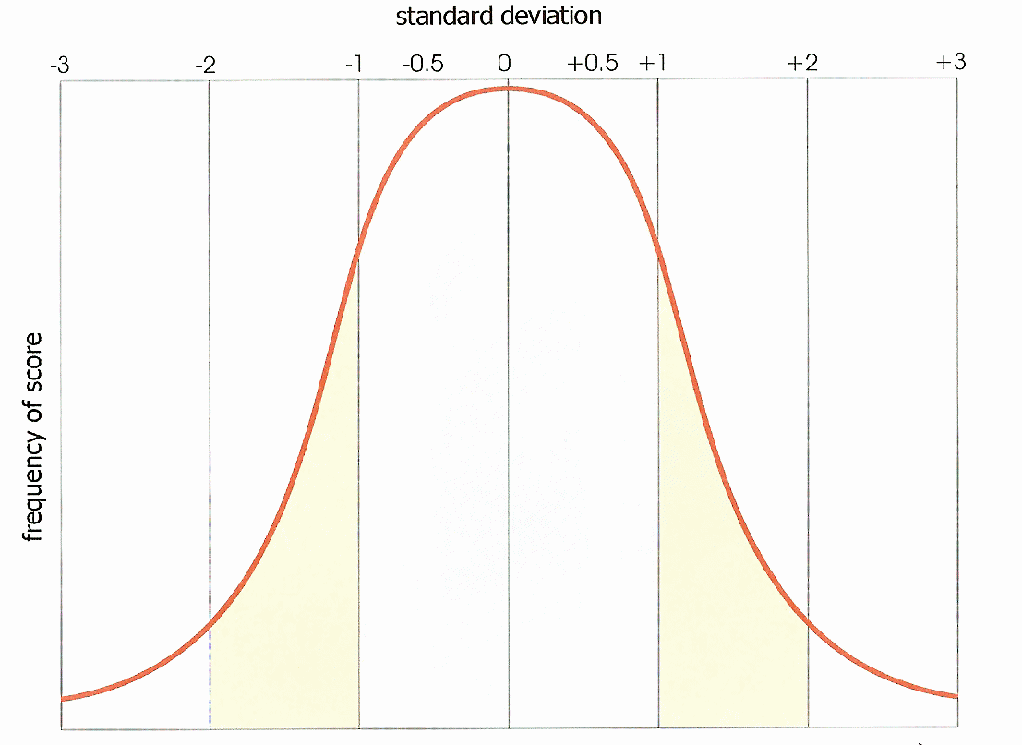
Impairment of IQ

Slide 12
Levels of ID
Mild = 50 - 69
Moderate = 35 - 49
Severe = 20 - 34
Profound = lower than 20
World Health Organization (WHO). (1992). ICD-10.

Slide 13
Life Challenges
“People with intellectual disability … are at significantly increased risk of facing discrimination, social exclusion, and abuse. Children with intellectual disability are much more likely than their non-disabled peers to experience child poverty. As adults, people with intellectual disabilities are significantly less likely than their non-disabled peers to move out of their family home, have long-term intimate relationships, be employed, have friends and participate in the life of their communities. They are also more likely to live in poor health, have poorer mental health and to die young. These inequalities transcend national boundaries.”
Eric Emerson
Carr et al. (Eds). (2014). The Handbook of Intellectual Disability and Clinical Psychology Practice. Routledge.

Slide 14
Psychological distress
People with ID experience mental ill-health and psychological distress at least as much as the typically-developing population does.
Within the ACT model, verbal process contribute to psychological distress through psychological inflexibility.
Although people with ID have impairments in the verbal language skills, there is no reason to suspect that verbal processes and psychological inflexibility are not implicated.
The broad challenge is to intervene at the level of these processes in an effective way.

Slide 15
ID & ACT - challenges
Attention span likely to be limited
Verbal ability likely to be reduced
Ability to use metaphor likely to be reduced
Deictic framing likely to be underdeveloped
Impulse control and emotional regulation may be impaired
Ability to engage with meta-cognitions may be limited
Influence over what they do with their lives will frequently be compromised through the presence of paid and unpaid carers

Slide 16
Flexible Attention to the Present Moment
?
Acceptance
Values
?
Defusion
Committed Action
?
Self-As-Context

Slide 17
System
Carer
Carer
Client
Carer
Carer
Notes:
This slide, with the elements appearing one at a time, is to illustrate that the PWID is experiencing their own struggles with psychological inflexibility, and requires the support of their care staff. However, as the PWID communicates their distress , it is likely that each member of the support staff will be experiencing their own struggles with their own verbal language traps. In addition, all of them are living within demands from a range of external systems (some positive, i.e. PBS, some negative, i.e. organizational rules that constrain staff behaviour).

Slide 18
ID & ACT
The evidence base for ACT within ID is limited.
Jackson Brown and Cooper (2009) successfully applied the ACT model in the treatment of a young woman with ID who was experiencing anxious and obsessive thoughts.
Sarah was assessed as having a full-scale IQ of 44 (moderate to severe ID).
Process required adaptation but Sarah was able to work with language and metaphor. She experienced a reduction in her distress at her thoughts.
Jackson Brown & Hooper (2009). Acceptance and Commitment Therapy (ACT) with a learning disabled young person experiencing anxious and obsessive thoughts. Journal of Intellectual Disabilities, 13(2): 195-201.

Slide 19
Case Study
Amanda
29 years old
Down Syndrome
Moderate ID
Living at home with her mother
Referred for obsessive thoughts about “bad weather”.

Slide 20
Problem
Referral triggered by Amanda’s day service, who were worried about her presentation. She would not engage with activities, was preoccupied with looking out of the window monitoring the weather, and would fall asleep.
A previous referral to mental health services for the same problem had resulted in a decision to not provide intervention.
GP referred to Psychiatry, who then referred to the Community Team for People with Learning Disabilities.
She had a three-year history of being troubled by ruminative thoughts about “bad weather” and would generally appear “anxious” and “constantly worried”.

Slide 21
Amanda’s ruminative thoughts were around:
“Bad weather”
“Blackouts”
“Power cut”
“Rain”
“Wind”
“Snow”
“Thunder and lightning”
She would seek reassurance from her mother throughout the day and would continuously play with her “twirly” (a shoe-lace).
Amanda said she was scared of “bad weather” because it would lead to power cuts and black-outs. She had a life-long fear of the dark.
Her sleep pattern was disturbed.
Her level of worry appeared constant regardless of the weather conditions.
Notes:
She would reassurance from her mother throughout the day about current and future weather and would continuously play with her “twirly” (a shoe-lace).
Her sleep pattern was disturbed as she would stay awake at night talking to herself. Her mother would often find her in the morning sitting on the floor.
If the weather was bad, she wouldn’t sleep at all.
Her level of worry appeared constant regardless of the weather conditions.

Slide 22
Amanda attended day centre five days a week, and had been attending this since she was 19.
The staff at the centre had observed a difference in her lately - she spent a lot of her time at the day centre looking out of the window, and would sometimes become tearful.
There had been a change in the focus of the day centre, and Amanda didn’t enjoy it as much as she used to. She still enjoyed baking, drumming, and taking part in their drama group. Mum said she would like Amanda’s anxieties and repetitiveness to improve.

Slide 23
Formulation
“Thunder and Lightning”
“Wind”
“Snow”
“Bad Weather”
“Rain”
Arbitrarily Applicable Derived Relational Responding
“Black Out”
“Power Cut”
Fear of the Dark
Respondant?
Notes:
My understanding of Amanda’s case was that she had a pre-existing fear of the dark and since childhood had always slept with a particular, plug-in nightlight. When she experienced power cuts she would be plunged into darkness with an associated fear response.
Through relational framing, a transfer of stimulus function saw the fear response move to the verbal stimuli associated with this state, and thereafter to other verbal stimuli associated with it.
With the words themselves now functional for distress, she could experience worry about blackouts even at noon on a summer’s day.

Slide 24
With the words themselves now functional for distress, she could experience worry about blackouts even at noon on a summer’s day.
Notes:
With the words themselves now functional for distress, she could experience worry about blackouts even at noon on a summer’s day.

Slide 25
Intervention
“Thunder and Lightning”
“Wind”
“Snow”
“Bad Weather”
“Rain”
Arbitrarily Applicable Derived Relational Responding
“Black Out”
“Power Cut”
Defusion
Fear of the Dark
Exposure
Respondant?

Slide 26
Defusion Exercises
Sessions 2 and 3
“Milk Milk Milk” (60 seconds, each word)
Singing her “worry words”:
Frere Jacques, Eastenders, Mrs Brown’s Boys
Saying the words in her dog’s voice
“Power Cuts” produced an instant fear response – she held her sides, looked anxious and said she could “feel it in my heart”.
This was reduced by defusion work.

Slide 27
Defusion + Exposure
Sessions 4-8:
We would darken Amanda’s room by increments (difficult in June and July)
She would display a startle response, would verbalise her concerns (“it’s dark”, “oh no”), and her pulse would increase.
She would quickly get used to it (10 seconds?) “I feel good now”.
Defusion exercises in the darkened room.
Repeat the whole process three times per session.

Slide 28
Between-session work
Encouraged to practise the exposure and the defusion work.
Engagement was patchy at first. Amanda and her mother would alternate between not doing any practise and being too ambitious, upsetting her if it was too threatening.

Slide 29
Ongoing Progress
Session 6
Amanda had woken up and said “I’m not going to talk about power cuts, blackouts, candles, I’m not, I’m not”.
Session 7
Amanda: “I feel different”, “I feel good”, “Not so worried”
Session 8
Mum: “She’s less anxious in herself”, “she’s calmer and happier”.
No phone calls from the day centre.
Amanda (when asked about the dark), “I’m getting used to this.
No fear response to her most powerful worry words.

Slide 30
Follow-up
Session 9
Changed her night-time routine to turn the house lights out before retiring to bed (with night-light on, but hidden by her karaoke machine).
No concerns from day centre.
Mum: Mood and night-times both improved.
Would still ask about the weather but without any associated distress.
Session 10 (Final session) – one month later
As above.
Seven month follow-up (April 2015)
Improvement maintained.
Sleep continues to be good.
Feedback from day service positive.

Slide 31
Discussion
A three-year problem of ruminative thoughts was successfully addressed using an adapted ACT approach.
Formulating at the level of verbal operants and relational framing was helpful.
Gains have been maintained over several months.
Both Amanda and her mother are satisfied with the outcomes.
Supports the suggestion that the same psychological processes are operating with this client group.

Slide 32
Criticisms
Outcome data is broadly anecdotal.
The between-session work could have been managed better.
Other elements of Amanda’s presentation were not addressed – she was attending a day centre that she appeared bored with and we weren’t able to address wider aspects of her quality of life.

Slide 33
Thanks to Amanda and her mother for allowing me to discuss their case.
Contact:
Mark.Oliver@NTW.NHS.UK

Slide 34
Building psychological resilience in those who care for people who challenge
Janet Harrison
Dr Mark Oliver
MSc 2015

Slide 35
Acknowledgements
Dr Carl Hughes
Dr Steve Noone
Dr Mark Oliver
Professor Richard Hastings
Dr Paul Flaxman

Slide 36
Mental health and learning disability staff
Healthcare staff among the most stressed professions. (Office for National Statistics, 2014)
Within the NHS, mental health organisations consistently present with the second-highest sickness absence rates (after the ambulance service).
(Health and Social Care Information Centre, 2013)
Learning Disability staff frequently report substantial workplace distress.
(Skirrow & Hatton, 2007; Devereux, Hastings & Noone, 2009)

Slide 37
Presenteeism
When distressed individuals continue to attend for work ,in a diminished capacity due to their ill-health.
(Flaxman, Bond, & Livheim, 2013)
NHS information centre survey (2011) looked at attitudes to mental illness, staff report concern over stigma correlated to stress and wellbeing with 50% saying they feel uncomfortable talking about their mental health at work.
Notes:
indicated that staff have become increasingly concerned about the potential stigma in the workplace correlated to stress and mental health wellbeing

Slide 38
Our trust stats
Current organisational support- Stress and Muscular Skeletal problems trigger- Fast track system to our Employee Health and wellbeing Service providing a support response within 48 Hours.
Notes:
Other’ category includes various reasons such as skin disorders, eye problems, headache/migraine etc

Slide 39
Staff are our biggest asset & their wellbeing is important to quality of care.
The direct stressors such as challenging behaviours and complex health needs are not easily removed,
Need to promote staff wellbeing by preparing staff to understand the processes through which stress develops.

Slide 40
The current study
The current study sought to apply ACT training to mental health and learning disability staff to see if their wellbeing (mental health, burnout and stress levels) could be improved.
The study tests four hypotheses:

Slide 41
Hypotheses Act Training will:-
H1:
Lead to lower workplace distress scores compared to baseline
.
H2:
Lead to increased levels of cognitive flexibility.

Slide 42
H3:
We have no significant changes in the scores of participants in the waiting list condition.
H4:
Those participants showing higher levels of distress as measured by the General Health Q-12 and the Maslach Burnout Inventory will show the most improvement at post-test.

Slide 43
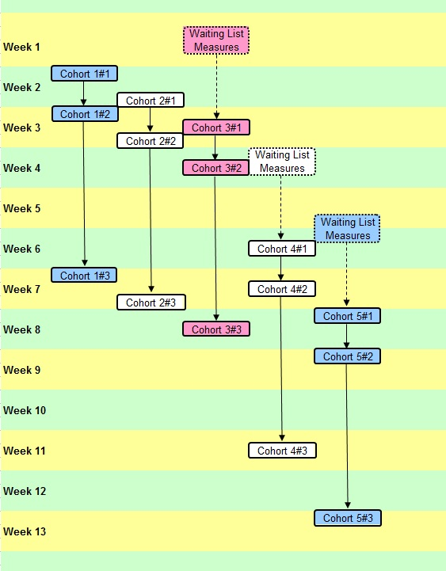
Method- 5 Cohorts self elected by best fit

Slide 44
Two skills model
Mindfulness
Present moment awareness training
Noticing and untangling from internal barriers
Strengthening your resilient self
Values-Based Action
Defining your values
Mindfully engaging in values-based actions
Using values as a guide to goals and daily behaviour

Slide 45
Training Phase workshop1 |  | Key Intervention
PART 1
Welcome and Introductions |  | Mindfulness or Values warm up exercise
Overview of the training |  | Presentation of two skills organizing diagram
PART II
Introduction to Mindfulness |  | Raisin exercise: brief mindfulness of body and breath
Introduction to values- based action |  | Value card sort: compass metaphor; define one value and translate into specific actions for next week
PART III
Presentation of rationale for program |  | Two sheets of paper technique
Discussion of home practice |  | Home practice handout; environmental reminders

Slide 47
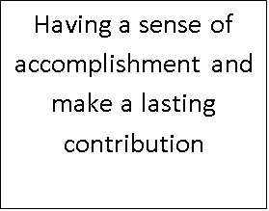
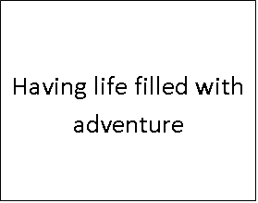
Defining Values-
Dash Poem
Values sort cards – choose 1

Slide 48
VALUE
GOALS
ACTIONS
Short-term goals: Next 1 weeks
1.Spend more time with my family
2.Cover my Dads shopping trip
3.
4.
Mindfulness practice goals- formal & Informal
Mindful breathing every day – 3 mins Mindful walking daily
LIFE AREA: health/relationships/ work/leisure/personal growth; Relationships
VALUE-BASED ACTIONS FOR THE NEXT WEEK
Say” I love you” to my Husband
VALUE REMINDER WORDS;- Loving Kindness , family first
2 Arrange a family meal, invite my daughters.
VALUE REMINDER SYMBOLS
3Ask my sister to cover Dads shopping.
INTERNAL BARRIERS: Record any “unhelpful” thoughts, feelings, urges, or moods that might interfere with value-based actions in this area of your life. Feel guilty, feel I burden others

Slide 49
Training Phase workshop 2 |  | Key Intervention
PART 1
Opening mindfulness practice |  | Mindfulness of breath; noticing thoughts and feelings and allowing them to come and go
Home practice review |  | Pairs and group discussion
Presentation of training rational |  | Passengers on the bus metaphor, role play , common control strategies discussion
PART II
Untangling from thought barriers to valued action |  | Self –reflection on unhelpful thought content; cartoon voices technique; physical demonstration of fusion/defusion thoughts on screen exercise
Mindfulness of mood/ emotion |  | Physicalizing exercise
PART III
Defining values and values-based goal and action planning |  | Construction of four –week values- based goal and action plan
Discussion of home practice assignments |  | Home practice handout; environmental reminders’; public commitment to one values-based goal

Slide 50
Role play – familiar passengers and coping, struggle is the problem ,

Slide 51
Training Phase workshop3 |  | Key Intervention
PART 1
Welcome back |  | Two skills diagram
Opening Mindfulness practice |  | Mindfulness of body and breath
Home practice review |  | Pair and group exercise
Assessing value consistency |  | Self- reflection on values-consistent and inconsistent actions over the past two weeks
PART II
Mindfulness of thought and feeling |  | Thoughts on Clouds exercise; Physicalizing exercise; contacting the resilient observer self
PART III
Values –based goal and action planning |  | Short term, medium term, and long term values-based goal setting exercise; values-based action plan
Recommendations’ for continued practice |  | Home practice handout ; top tips for building a valued life
Final personal reflections on the training

Slide 52
Participants
Mental Health and Learning Disability staff, recruited opportunistically.
73 signed up to take part
65 turned up for session 1
51 completed all three workshops
(Attrition rate of 22%)

Slide 53
Demographics
Age | 43 (23 - 62)
Sex | 80% female
Area of Work | LD = 61% LD+MH = 31% MH = 8%
Qualifications | Unqualified = 45% Qualified = 41% Training = 14%
Time | 54 months median (2 – 360)

Slide 54
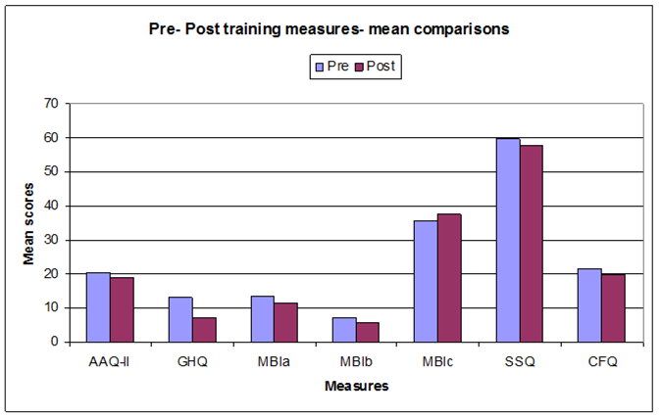
Statistical analyses

Slide 55
Measure | Pre | Post | t Test | Effect Size | Sig
GHQ-12 | 13.04 | 7.06 | t(50)=6.15, p<.001 | 0.9 | **
MBIa | 13.49 | 11.63 | t(50)=1.78, p=.04 | 0.2 | *
MBIb | 7.08 | 5.65 | t(50)=2.29, p=.013 | 0.3 | *
MBIc | 35.69 | 37.47 | t(48)=-1.84 p=.036 | 0.3 | *
SSQ | 59.67 | 57.88 | t(48)=1.30, p=.201 | 0.2
AAQ-II | 20.43 | 19.06 | t(48)=1.46, p=.076 | 0.2
CFQ | 21.66 | 19.55 | t(46)=2.14, p=.019 | 0.3 | *
GHQ-12 = General Health Questionnaire (general mental health)
MBIa = Maslach Burnout Inventory (burnout)
MBIb = Maslach Burnout Inventory (depersonalisation)
MBIb = Maslach Burnout Inventory (personal achievement)
SSQ = Staff Stressor Questionnaire
AAQ-II – Acceptance and Action Questionnaire (Cognitive flexibility)
CFQ = Cognitive Fusion Questionnaire (Cognitive flexibility)

Slide 56
Waiting list
No significant differences between waiting list measures and pre-workshop measures.

Slide 57
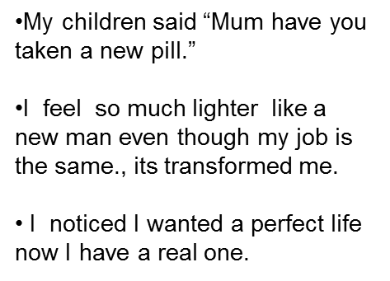

Slide 58
Limitations
Effect sizes were modest.
ACT processes not measured –amount of behaviour spent on valued living, amount of mindfulness practiced.
These need to be evaluated more systematically in future studies.

Slide 59
Limitations
Our waiting list control where short, only one to two weeks long.
No active control group to compare with.

Slide 60
Conclusion
Results indicate :
Significant benefits for staff
(lower GHQ, CFQ, and MBI b s).
Training is accessible for all grades of staff.
Training is maybe especially beneficial for high scoring participants.

Slide 61
Conclusion cont
Stress still present but how it is perceived changes.
Generalisation of mindfulness and values based goals to home practice /real life situations after 2+ 1, three hour sessions
AAQ-II- indicates a trend towards improvement but may require further testing in this population.

Slide 62
Any questions?

Slide 63
Working with the System – Individual Agency, Staff Teams, Organisations and Culture
Dr Matt Selman
Principal Clinical Psychologist

Slide 64
A bit of thinking!
ACT
Systems
RFT
ACT
PBS

Slide 65
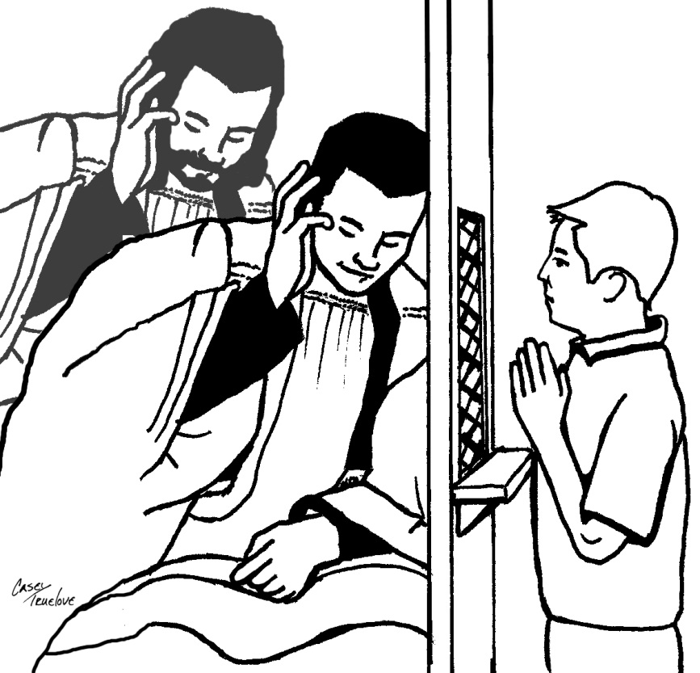
A Confession!
Not ABA trained!
Systemic Family Therapist!
Systems Thinking!
But I am a contextualist

Slide 66
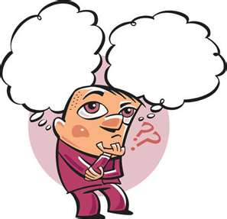
It’s an ACBS conference. Are you thinking…
WTF

Slide 67
Where’s The Functionalism
Pepper’s Worldview - Contextualism
Functional
Prediction & Influence
Descriptive

Slide 68
So…
ACT
Working together shared language in CBS
Understanding and developing practice

Slide 69
Bronfenbrenner (1979)
Cultural discourses
Neighbours
Family
Health Services
Media
School/College
Paid Carers
Peers
Notes:
Postive Behavioural Support offers a framework for working with challenging behaviour. Within its development is an ecosystems model (Bronfenbrenner) which helps consider the role the system plays in the challenging behaviour. Contemporary Systems Theory offers further development and models of understanding but for the purposes of this presentation will use this idea of levels of centextual influence to help our thinking.

Slide 70
Service User

Slide 71
Staff
Service User
Notes:
Conceptualised self, other and group

Slide 72
Organisation(s)
Notes:
Organisation and rule driven behaviour - Patient choice, no physical contact.

Slide 73
Culture
Notes:
“You can’t let people get away with stuff” “They need consequences” (Read popular culture – you hurt me I’ll hurt you back) “There must be a deep seated problem they need to get sorted out”

Slide 74
Notes:
Challenging behaviour – context of a someone who when distressed responds to physical comforting from learning history in family… BUT company rules are no contact – increasing distress until lashes out then staff come in and escort out (physical contact, staff attention and reduced distress)

Slide 80
Organisation(s)

Slide 81
Behavioural Scientist

Slide 84
Externalising (White & Epston,1990)
“the person is not the problem, the problem is the problem”

Slide 85
Externalising the problem

Slide 86
Additional
relational
frames

Slide 87
Defusion

Slide 88
Debriefing

Slide 89
Contextual
influence

Slide 90
Perspective
changes

Slide 91
Perspective
changes

Slide 92
Perspective
changes

Slide 93
Final Thoughts
We could explore many other relational frames and access ACT hexaflex processes
Hopefully a taste of how practice from descriptive contextual informed approaches can be used and enhanced*
*Other perspectives are available

Slide 94
References
Bronfenbrenner, U. (1979). The Ecology of Human Development: Experiments by Nature and Design. Cambridge, MA: Harvard University Press
Burnham, J. (2011) 'Developments in Social GRRRAAACCEEESSS: Visible-invisible and voiced-unvoiced', in I.-B. Krause (ed.) Culture and Reflexivity in Systemic Psychotherapy: Mutual Perspectives, London: Karnac Books, pp. 139-160.
Roche et al (2001) Social Processes in Hayes, S.C., Barnes-Holmes, D. & Roche, B. Relational Frame Theory: A post-Skinnerian Account of Human Language and Cognition. New York; Plenum. p197-209.
White, M. & Epston, D. (1990). Narrative means to therapeutic ends. New York: Norton.

