Slide 1

ACTing With Technology Panel
July 12 2013

Slide 2
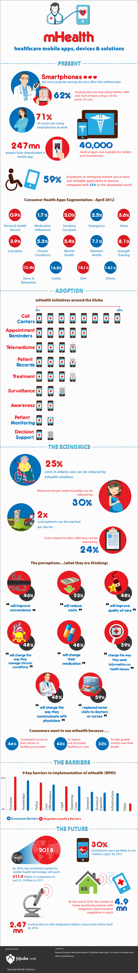
mHealth
The practice of medicine and public health, supported by mobile devices

Slide 3
mHealth Smartphone Apps
44 million downloads in 2012 and 142 million expected in 2016 (Juniper Research, 2012)
Low cost, real time ways to assess and change behavior
Need to evaluate these new technologies for their efficacy (Francis Collins, NIH Director, 2012)
Source: Jonathan Bricker

Slide 4

Health Apps Segmentation (2012)

Slide 5
Discussion Questions
Panel Member Intros
Example ACT Web/Apps
How web/mobile technology can be used to overcome clinical challenges
Conducting research into interventions using web/mobile technology
Looking forward
  Likely technology trends
  How can you stay in touch with new developments
  How can we foster research collaboration
Anything else?

Slide 6
Panel Member Introductions
Chris Horan (Canberra)
  D.Psych. student, Australian National University, Resilience Training
Joseph Ciarrochi (Sydney)
  Ph.D., University of Western Sydney
Robyn Walser (San Francisco)
  Ph.D., National Center for PTSD & TL Consultation Services
Tim Batink
  Ph.D. student, Maastricht University
Neli Martin (Brisbane)
  Private Practice
Stefano Picozzi (Sydney)
  Ph.D. student, Australian National University
Jacqueline Pistorello (Reno)
  Ph.D., University of Nevada, Reno Counseling Services
Louise Hayes (Melbourne)
  Ph.D., Orygen Youth Health & Private Practice
4:45pm

Slide 7
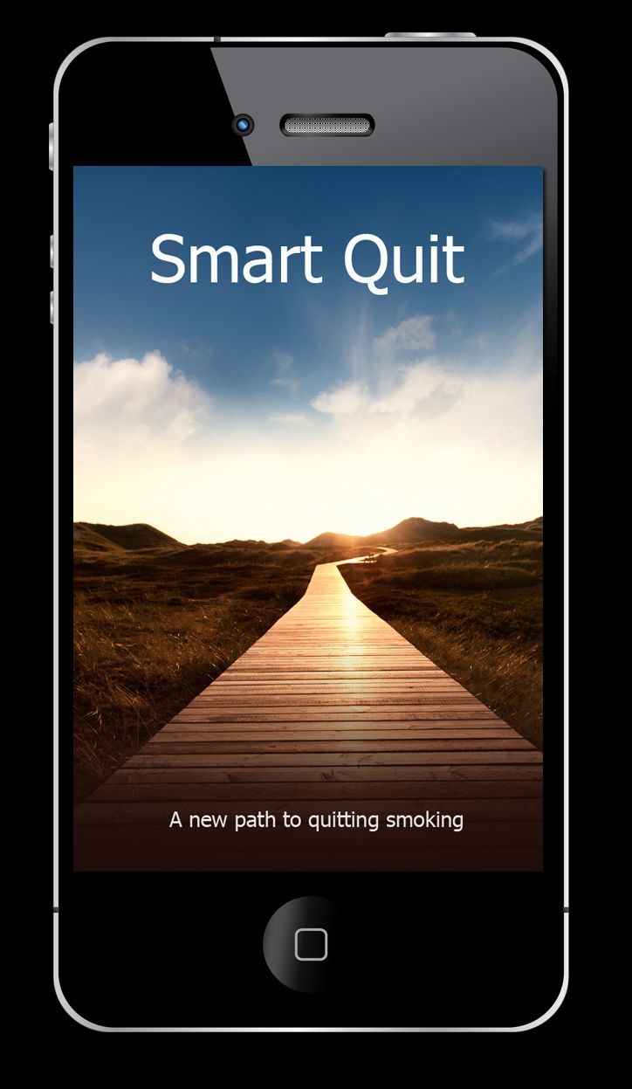


ACT Web/Mobile Apps available
4:55pm

Slide 8
ACT on College Life:
A Guided Self-Help Program for College Counseling Centers
Michael Levin, Jacqueline Pistorello,
Steven C. Hayes, John Seeley, & Crissa Levin
This research was supported by two Phase I Small Business Innovation Research grants from the National Institute of Mental Health, R43MH085336 (PIs: Levin, Pistorello, & Hayes) awarded to Contextual Change LLC

Slide 9
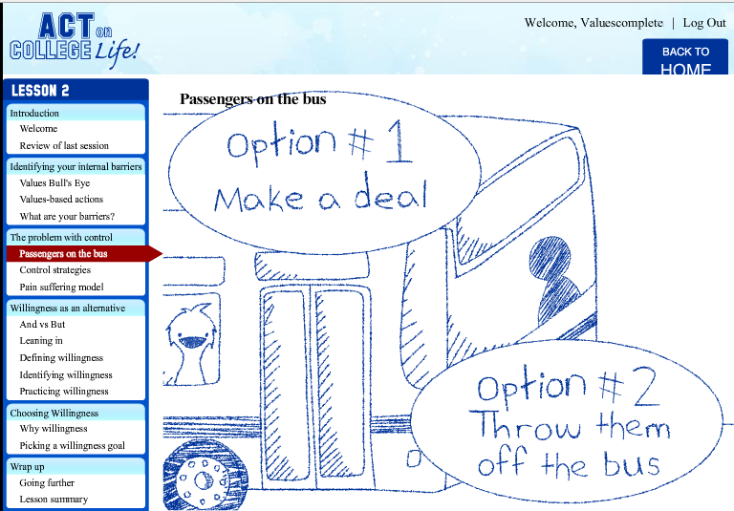
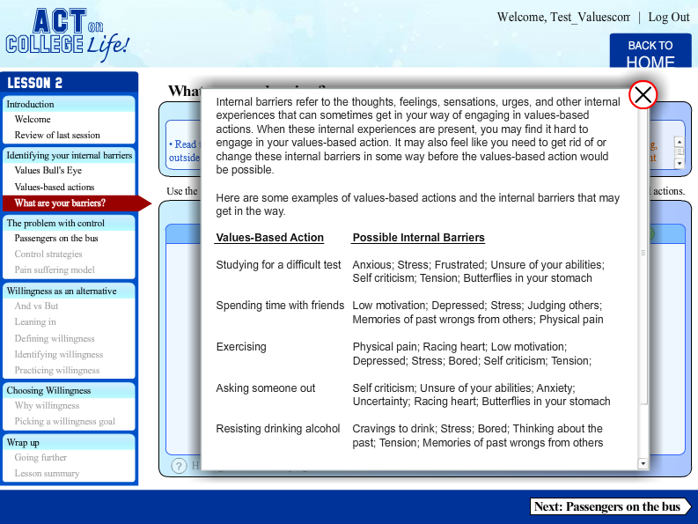
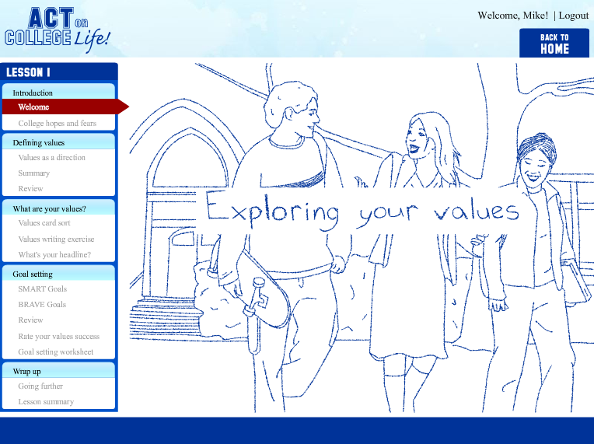
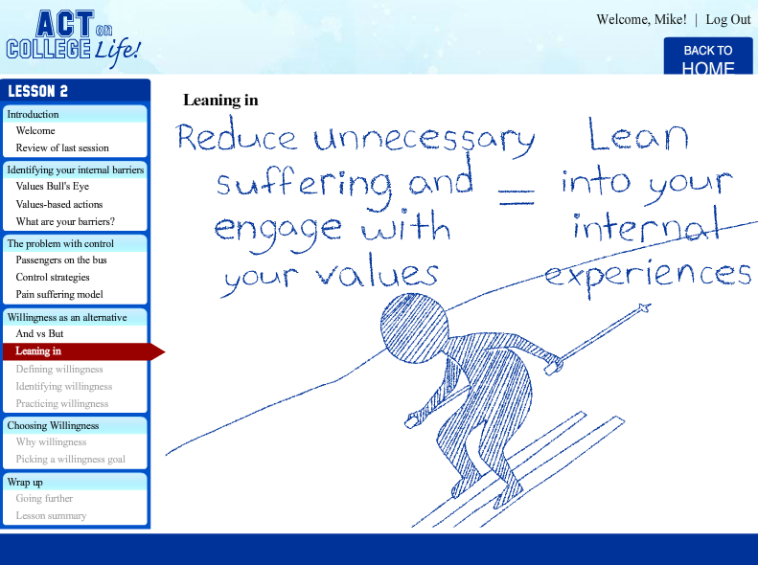
Self-Help Modules: Multimedia
Notes:
Heavy use of audio narration with supplementing text (tried to avoid text heavy pages)
Tried to keep audio as short and clear as possible (which can be challenging)
Animations to illustrate ACT metaphors
Sought for simple, but appealing animation style for students
Animations targeted to college students such as in this example where drawings of students are provided in the background to coincide with text and audio narration introducing the lesson
Optional popup windows and rollover features were used throughout the program so that users can learn more about a concept or receive further clarification on an exercise, while avoiding excessive information for users who do not require such information. In this example from lesson 2, users can click on “Having trouble identifying internal barriers” to see a number of examples of the types of internal barriers that sometimes get in the way of values-based actions. This information can be instrumental for users in creating their own list of internal barriers.

Slide 10
Counselor Dashboard: Training

Slide 11
Counselor Dashboard: Clients

Slide 12
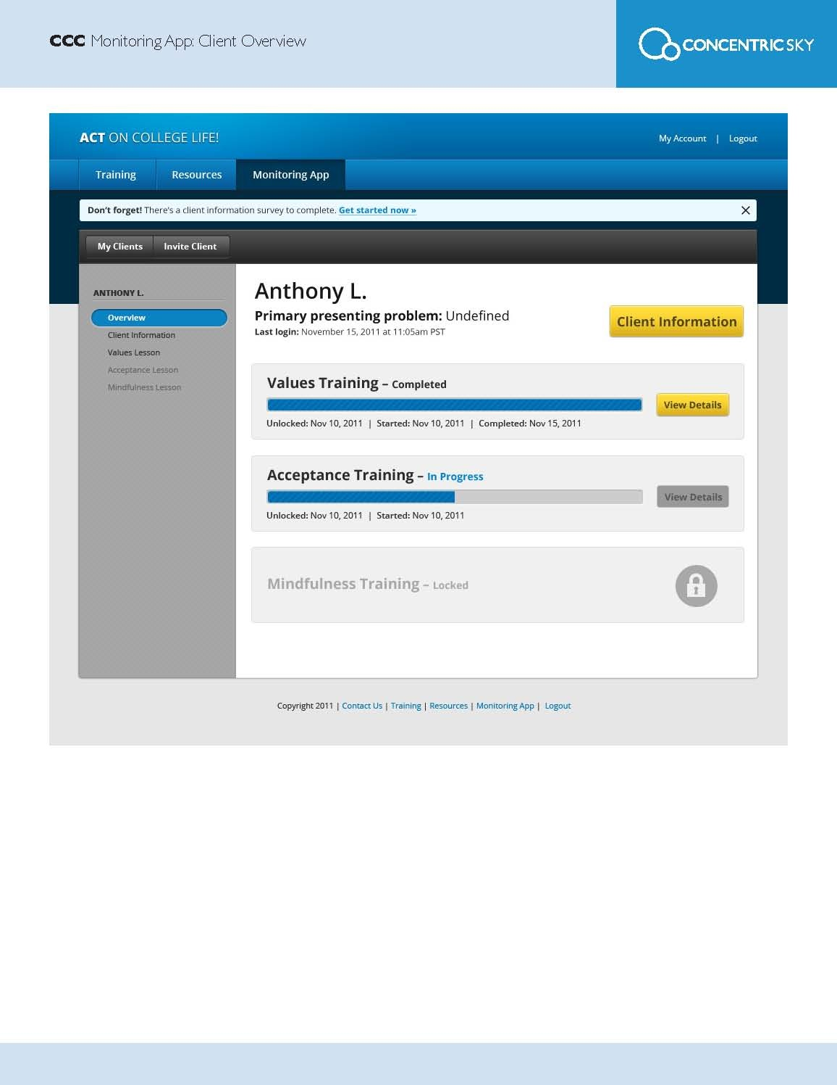
Counselor Dashboard: Specific Client

Slide 13
How web/mobile technology can be used to overcome clinical challenges
ACCESSIBILITY/REACH
  In what ways could web/mobile technologies expand the accessibility of psychological interventions?
  Are there any populations that are more/less suitable for web/mobile interventions?
5:10pm

Slide 14
How web/mobile technology can be used to overcome clinical challenges
EFFECTIVENESS
  In what ways can web/mobile technologies improve the effectiveness of traditional psychological services?
5:20pm

Slide 15
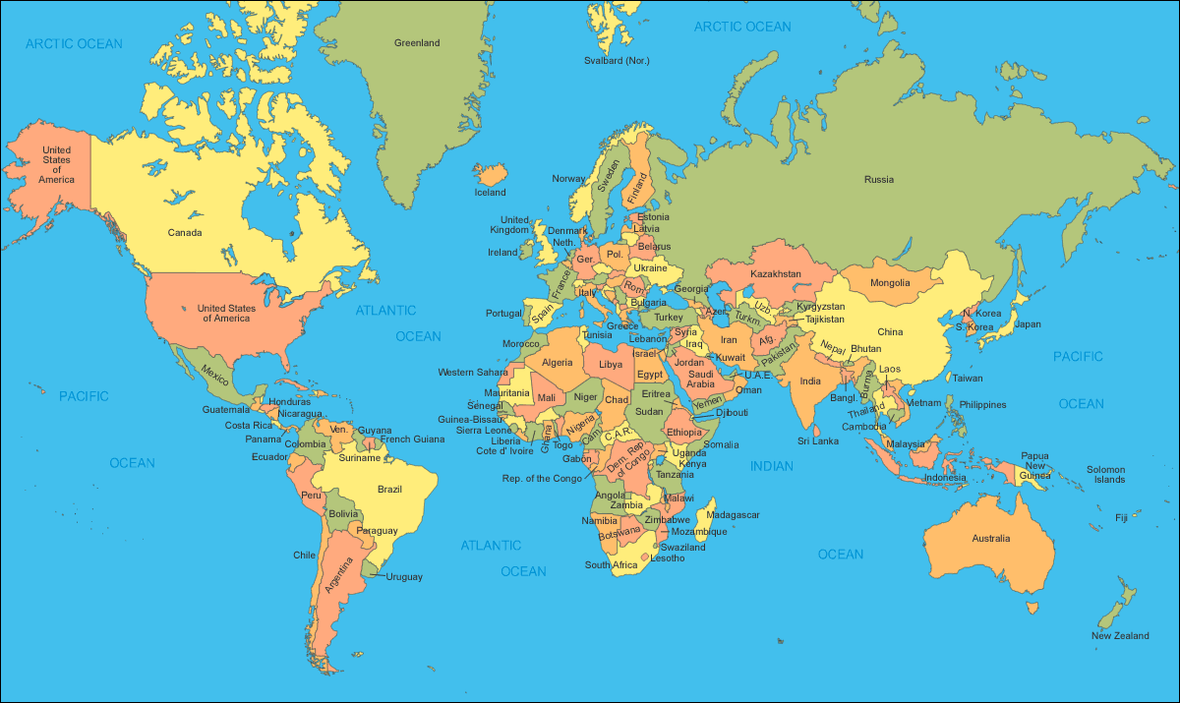
Who is doing research in this area?
Maria Karekla
Kien Hoa Ly
Tim Batink
Gerhard Andersson
Eric Morris
Jonathan Bricker Jacqueline Pistorello Roger Vilardaga
Robyn Walser
Sara Boucher
Joseph Ciarrochi
Chris Horan
Stefano Picozzi
Research Contact List will be available on the ACBS Conference Website (Thanks Sara Boucher)

Slide 16
Research incorporating web/mobile technology
  What does the literature say about the effectiveness of web/mobile interventions?

Slide 17
Research incorporating web/mobile technology
What are some pitfalls and risks of conducting research incorporating web/mobile interventions?
5:30pm

Slide 18
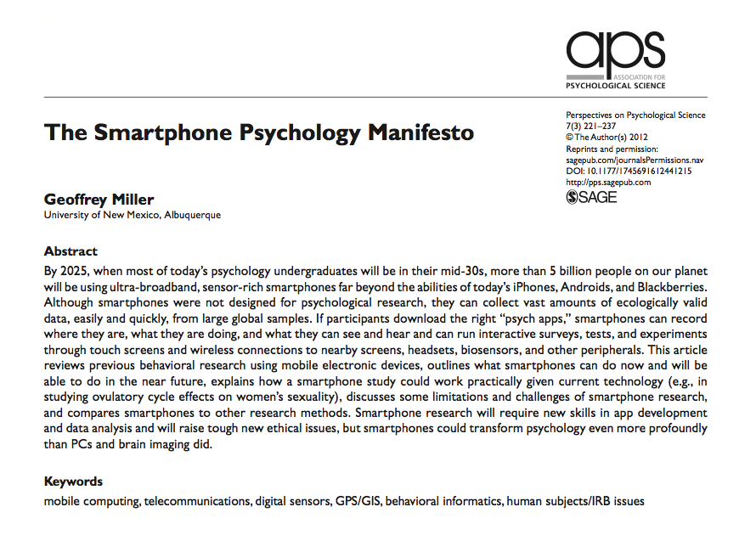
Research Ideas

Slide 19
Looking forward - Converging trends
Wireless Sensors and Devices
Social Networking
Mobile Connectivity and Bandwidth
Health Information Systems
The Internet
Increased Computing Power and the Data Universe (Big Data)
AND IN Psychology/Mental Health
  Increased demand for evidence-based interventions
  Increased awareness of mental health issues

Slide 20
Looking Forward
How can we foster research collaboration?
5:40pm

Slide 21
Looking Forward
How can clinicians stay in touch with new developments?
5:45pm

Slide 22
Thank You!
And Goodbye☺

