Slide 1
Integrating ACT into an Interdisciplinary Team Approach on an Inpatient Adolescent Unit
Reflecting on a 3 Year Process

Slide 2
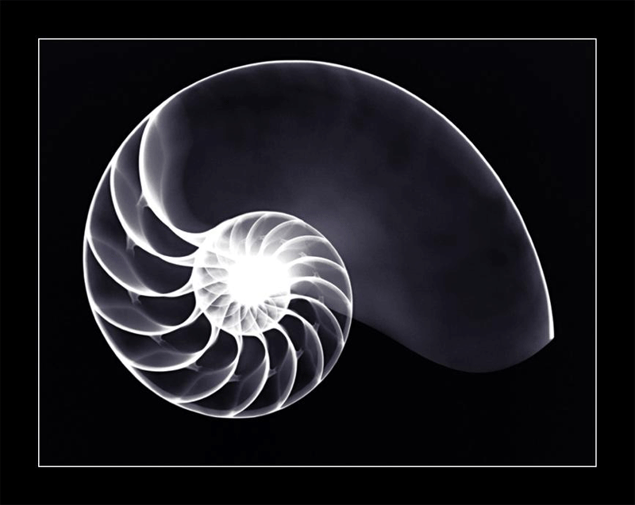
Adolescent Inpatient Unit
Average LOS: 10 Days
Predominantly Treat Kids with Affective Disorders
Open Group Design with 6-12 Kids

Slide 3
OT Group
Decision
And
Planning
Curriculum Development
And
Training
Launch
And
Staff Support
Competence
5 Major Stages

Slide 4
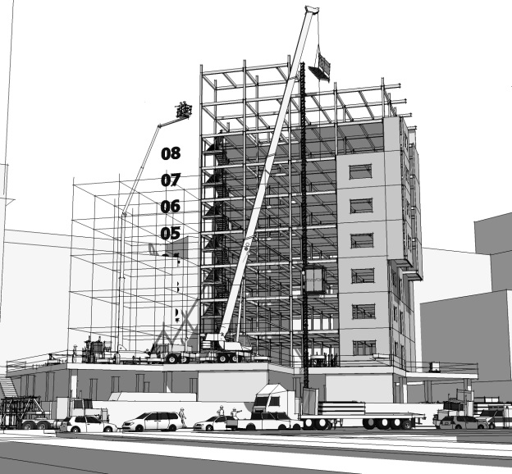
OT Group Development
Group Structure
Avoidance and Fusion
Questionnaire for Youth (AFQ-Y)
5 Minute Mindfulness
Review Umbrella Concepts
Morita Therapy
Lecture / Metaphor / Experiential on Focused Concept (Hexaflex)
5 days a week Monday - Friday
Workbook
Initial Curriculum Design and Testing (1 year)

Slide 5
Morita Therapy (basic concepts)
Uncontrollable
Controllable
THOUGHTS
FEELINGS
BODY SENSATIONS
Accept these things exactly as they are without attempting to manipulate or alter them.
ACTIONS
Act to achieve your purpose
What needs doing
What has value

Slide 6
Decision & Planning (Selling It)
Medical Director
Patient Response, Workbook, & Evidence
Unit Director (Director of Nursing)
Medical Director
Nursing Administration
ACBS Website & Evidence
Unit Staff
Team Work for Improving Systems and Treatment (TWIST) Meeting, Inclusion, & 1st Responders

Slide 7
Decision & Planning
Soft Roll Out / Hard Roll Out
TWIST Committee (Weekly)
Medical Director, Unit Director and Nursing Administrator, Occupational Therapist & Supervisor (Psychologist, AT, Teacher, Unit Staff)
Set Curriculum
Facilitate Collaboration

Slide 8
Curriculum Development & Training
Curriculum
Clearly Defined Goal
2-4 Sessions (less is more)
Training
5 YouTube Lectures (Mindfulness, RFT, ACT, Morita Therapy, Learning and Group Planning)
3 hour experiential overview of hexaflex concepts (Leaky Canoe,Unwanted Party Guest, Mind Field)

Slide 9
MINDFULNESS
Communication
AT
Bullying
Journal
Self-Image
1:1
Healthy Habits
RT
Self-Harm
Processing
Trauma
Substance Use
Distress Tolerance
Education
Occupational Therapy: Core ACT Concepts

Slide 10
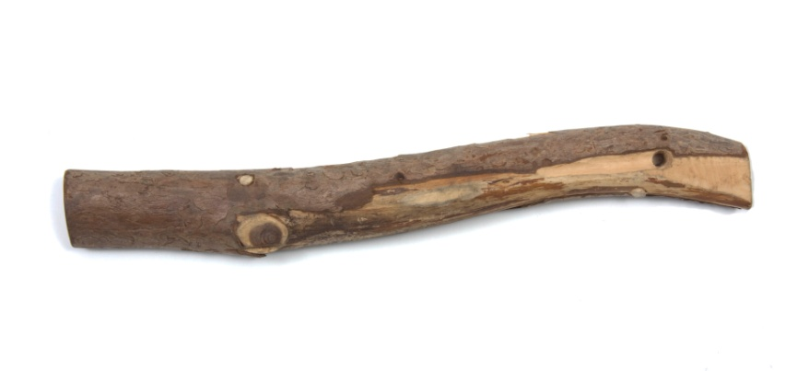
Launch & Staff Support
Soft Launch
Nursing Leadership (Stick)
Ensure Groups Happen
Evaluation Sheets
OT Presence (Carrot)
Consultation
Informal Supervision
Respond to Feedback

Slide 11
Competence
Ongoing Challenge
O.T. Core Concept Group Observation
O.T. continues to provide frequent informal consultation and supervision.
Self-Evaluation (ACT Learning Tool)
Intermittent Formal Supervision & Training

Slide 12
ACT Learning Tool
ACT consistent interventions
ACT inconsistent interventions
Defusion
Willingness & Acceptance
Creative Hopelessness, Workability, Control is the Problem
Values and Goals
Committed Actions
Challenging Thoughts
Experiential Avoidance Strategies
Cognitive Rational
Thoughts / Feelings Cause Actions
Emphasis of Compliance over Value-Based Actions

Slide 13
Patient Questionnaire: What skills did you learn?

Slide 14
AFQ-Y SCORES 2011-2013 (N=536)

Slide 16
Conclusions: Trends in Mean AFQ-Y scores
Patients show a variety of patterns.
Some have stable, increasing, or oscillating scores.
Overall patients show statistically significant improvements.
Mean scores decrease fairly steadily but tend to level off as treatment continues.
When averaged across all patients receiving the same number of interventions, mean scores decrease with time and treatment, and overall (post minus pre) decreases in mean score of between 13% and 34% of baseline are statistically significant for every group with sufficient sample size for the test to be valid.
Oscillations seen in mean scores for 9- and 8-intervention groups are likely due to the random variability of small samples.
Standard error for the final mean score of the 9-intervention group (n=16) is 3.08, for instance.

Slide 17
Mean AFQ-Y Data
assessment # | 1 | 2 | 3 | 4 | 5 | 6 | 7 | 8 | 9 | change | % decrease | P-value*
9 interventions (n=16) | 19.13 | 16.94 | 16.69 | 16.63 | 16.00 | 17.06 | 15.69 | 17.19 | 16.13 | -3.00 | 15.7% | 0.148
8 interventions (n=29) | 22.07 | 19.97 | 19.83 | 18.38 | 18.66 | 17.45 | 18.66 | 17.79 |  | -4.28 | 19.4% | 0.015
7 interventions (n=33) | 22.42 | 20.12 | 20.42 | 17.97 | 15.48 | 15.61 | 14.76 |  |  | -7.67 | 34.2% | 9.32E-04
6 interventions (n=53) | 18.28 | 16.57 | 16.08 | 15.04 | 13.64 | 13.60 |  |  |  | -4.68 | 25.6% | 3.19E-04
5 interventions (n=83) | 20.01 | 18.25 | 16.63 | 14.77 | 14.66 |  |  |  |  | -5.35 | 26.7% | 7.61E-07
4 interventions (n=101) | 18.45 | 17.37 | 15.66 | 14.14 |  |  |  |  |  | -4.31 | 23.3% | 8.51E-05
3 interventions (n=79) | 19.25 | 16.08 | 14.76 |  |  |  |  |  |  | -4.49 | 23.3% | 4.35E-08
2 interventions (n=50) | 19.88 | 17.32 |  |  |  |  |  |  |  | -2.56 | 12.9% | 0.0016
*Two-tailed matched pair t-test.

