Slide 2
Stop Thinking and Start ACTing?
The Effectiveness of Acceptance and Commitment Therapy in an Inpatient Sample of a Psychiatric Department
Pleger, M.*, Treppner, K.*, Diefenbacher, A., Schade, C., Dambacher, C., Fydrich, T.
*Joint 1st authors

Slide 3
Aims of the study
ACT vs. CBT
ACT as a young third wave approach
Varying research results
Mainly RCTs
Effectiveness of ACT in a naturalistic setting
possible influencing factors

Slide 4
Hypotheses
1. Superiority of ACT
Impairment in
life functioning
Symptom reduction
Subjective benefit
2. Mindfulness & Valued living
Correlation with
Symptom reduction
Increase
3. Influencing factors
Sociodemografic characteristics
Clinical characteristics
Age
Education
Pretreatments
Chronicity
Gender
Working status
Possible PD

Slide 5
Methods: Institution
Ward P09: Mood disorders and comorbid disorders
Notes:
Treatment of
Mood disorders
Comorbid disorders
Emphasis of treatment
Multimodal behavioral therapy focused group program (ACT/CBT)
Other active treatments
Medication
Occupational therapy
Physiotherapy
Psychoeducation
Sports
…

Slide 6
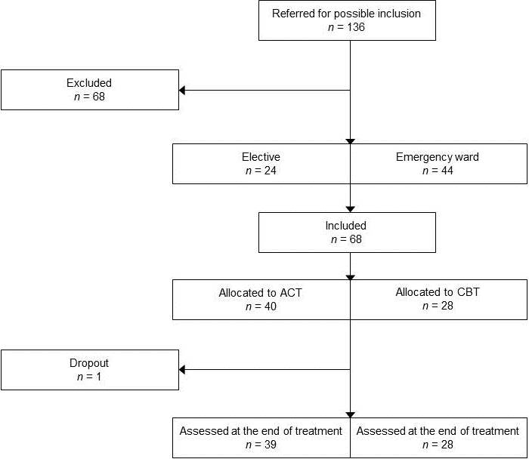
Results
t1
t2
Total sample size:
n = 67

Slide 7
Primary Outcome
1. Superiority of ACT
Impairment in
life functioning
Symptom reduction
Subjective benefit
2. Mindfulness & Valued living
Correlation with
Symptom reduction
Increase
3. Influencing factors
Sociodemografic characteristics
Clinical characteristics
Age
Education
Pretreatments
Chronicity
Gender
Working status
Possible PD

Slide 8
Primary Outcome
Depression (BDI-II)
Depression (MADRS)
ACT
CBT
ACT: p < .001, dz = .79
CBT: p < .001, dz = 2.28
ACT: p < .001, dz = 1.92
CBT: p < .001, dz = 3.10
→ 38 patients reliably recovered
Notes:
shift from BDI-score ≥ 14 to BDI-score < 14 and RCI ≥ 1.96.

Slide 9
Primary Outcome
General Syndroms (ISR)
ACT
CBT
ACT: p < .001, dz = 1.36
CBT: p < .001, dz = 1.30
→ 16 patients reliably recovered
Notes:
shift from ISR-score ≥ .6 to ISRscore < .6 and RCI ≥ 1.96.

Slide 10
Primary Outcome
Impairment of life
functioning
ACT
CBT
ACT: p < .001, dz = .65
CBT: p < .001, dz = 1.16

Slide 11
Primary Outcome
Subjective benefit
ACT: X = 3,46 (SD = 0.64)
CBT: X = 3,41 (SD = 0.47)
CBT

Slide 12
Hypotheses
1. Superiority of ACT
Impairment in
life functioning
Symptom reduction
Subjective benefit
2. Mindfulness & Valued living
Correlation with
Symptom reduction
Increase
3. Influencing factors
Sociodemografic characteristics
Clinical characteristics
Age
Education
Pretreatments
Chronicity
Gender
Working status
Possible PD

Slide 13
Secondary Outcome
Mindfulness (FFA)
Valued Living (VLQ)
ACT
CBT
ACT: p < .001, dz = -.89
CBT: p < .001, dz = -.79
ACT: p < .001, dz = -.63
CBT: p = .051, dz = -.39
Notes:
Mindfulness korrelierte für beide Gruppen mit Symptomreduktion, Werte nur bei ACT

Slide 14
Hypotheses
1. Superiority of ACT
Impairment in
life functioning
Symptom reduction
Subjective benefit
2. Mindfulness & Valued living
Correlation with
Symptom reduction
Increase
3. Influencing factors
Sociodemografic characteristics
Clinical characteristics
Age
Education
Pretreatments
Chronicity
Gender
Working status
Possible PD

Slide 15
Influencing Variables
Sociodemografic Variables:
Significant effects for ISR only
R² = .18, p < .05
Working status as the only sig. predictor
β = .38, p < .005
Clinical Variables:
No sig. effects were found

Slide 16
Limitations
Quasi-Randomization
Only 1 therapist per treatment
Use of screening-instruments
Low internal validity (due to setting)
Notes:
Zu 3): especially SKID II-Screening, rather superficial → z.B. Life functioning; also: no statements for different diagnoses, only for general psychological strain

Slide 17
Discussion
No between-group differences
Mindfulness increases for both groups
Setting?
Validity of the ACT-measurements?
Notes:
Zu 1) Different reasons: Statistical bias → sample size and: no difference doesn’t mean equivalenz automatically!
Zu 2) Setting: How useful is an explicit mindfulness training?

Slide 18
Take home message
ACT and CBT seem to be equally effective for inpatients (in our ward)
Valued living and mindfulness influence therapeutic outcome
Differentiation between active components of both therapies remains unclear
Combine both therapies instead of opposing them?

Slide 19
ACT for psychotic inpatients and staff
Past, present, future
Mårten Tyrberg, M Sc, Tobias Lundgren, Phd, Per Carlbring, Professor
Stockholm University/Karolinska Institutet

Slide 20
Past
Ambition to improve inpatient care
More content, different content
Small pilot RCT, graduate thesis
Aim to replicate Bach & Hayes/Gaudiano & Herbert

Slide 21
Past
Can a brief ACT intervention reduce need for inpatient care in a group of psychotic patients?
Will the intervention improve quality of life?
Will it work in Sweden, as it has in the US?
21 inpatients, psychosis spectrum
ACT or ACT + TAU
Notes:
Began when completing postgraduate diploma in psychotherapy

Slide 22
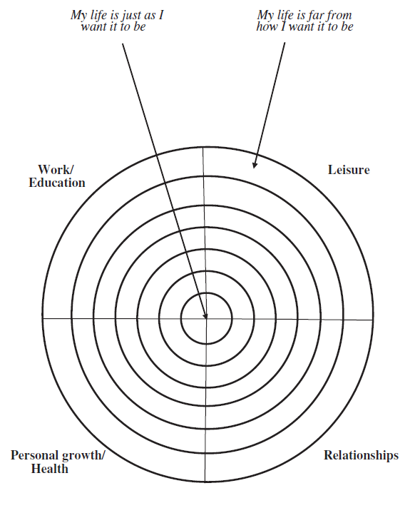
Past
Quality of life/values-measure

Slide 23
Past
Percentage rehospitalized during the follow-up period (4 months).
9% in the ACT group, 40% in the TAU group.
Odds ratio 6,7.
Difference not significant, based on Fisher’s exact test.

Slide 24
Past
Mean Bull’s-Eye-scores over the three measurement points, ITT data.
Within group effect size in the ACT group d=1.63, between group at follow-up d=1.58.
Difference in mean change shown significant.

Slide 25
Present
Training staff
Supervising staff on a weekly basis
Will it affect work-related acceptance?
Will it increase actual ACT-consistent behavior?

Slide 27
Present
Workshop content
Day 1: Introduction to ACT as a general model.
Day 2: Applying ACT in daily work on the ward.
Based on open-aware-active throughout.
Focus on both patient assessment and self assessment.

Slide 28
Present
Weekly supervision
Case presentations, reflections, questions.
Ambition to connect back to open-aware-active.

Slide 29
Future
Training ward staff therapists.
Recruiting patients for RCT.
ACT 4 session protocol vs TAU + attention.

Slide 30
Future
The protocol
Session 1: Open
Session 2: Aware
Session 3: Active
Session 4: Summary

Slide 31
Future
The protocol
Ambition to keep it simple yet ACT consistent
Is it possible to speed-train non-therapists and make them effective?
Ambition to release therapeutic potential.

Slide 32
Future
Even more general ambition:
Discussing what psychotherapy is and could be?
What are the boundaries, what are the possibilities?

Slide 33
Take home message
Co-operation is everything?

