Slide 2
ACT for psychotic inpatients and staff
Past, present, future
Mårten Tyrberg, M Sc, Tobias Lundgren, Phd, Per Carlbring, Professor
Stockholm University/Karolinska Institutet

Slide 3
Past
Ambition to improve inpatient care
More content, different content
Small pilot RCT, graduate thesis
Aim to replicate Bach & Hayes/Gaudiano & Herbert

Slide 4
Past
Can a brief ACT intervention reduce need for inpatient care in a group of psychotic patients?
Will the intervention improve quality of life?
Will it work in Sweden, as it has in the US?
21 inpatients, psychosis spectrum
ACT or ACT + TAU
Notes:
Began when completing postgraduate diploma in psychotherapy

Slide 5
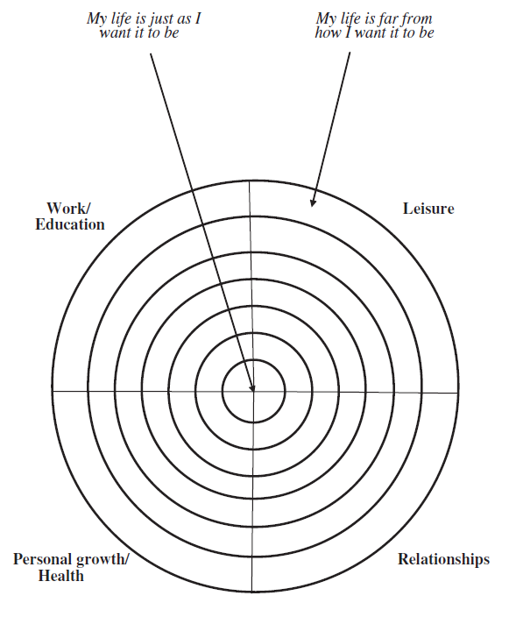
Past
Quality of life/values-measure

Slide 6
Past
Percentage rehospitalized during the follow-up period (4 months).
9% in the ACT group, 40% in the TAU group.
Odds ratio 6,7.
Difference not significant, based on Fisher’s exact test.

Slide 7
Past
Mean Bull’s-Eye-scores over the three measurement points, ITT data.
Within group effect size in the ACT group d=1.63, between group at follow-up d=1.58.
Difference in mean change shown significant.

Slide 8
Present
Training staff
Supervising staff on a weekly basis
Will it affect work-related acceptance?
Will it increase actual ACT-consistent behavior?

Slide 9
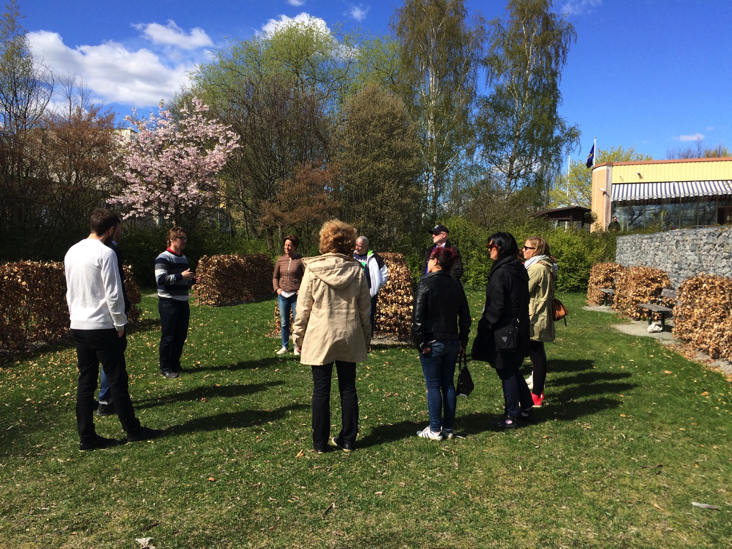

Slide 10
Present
Workshop content
Day 1: Introduction to ACT as a general model.
Day 2: Applying ACT in daily work on the ward.
Based on open-aware-active throughout.
Focus on both patient assessment and self assessment.

Slide 11
Present
Weekly supervision
Case presentations, reflections, questions.
Ambition to connect back to open-aware-active.

Slide 12
Future
Training ward staff therapists.
Recruiting patients for RCT.
ACT 4 session protocol vs TAU + attention.

Slide 13
Future
The protocol
Session 1: Open
Session 2: Aware
Session 3: Active
Session 4: Summary

Slide 14
Future
The protocol
Ambition to keep it simple yet ACT consistent
Is it possible to speed-train non-therapists and make them effective?
Ambition to release therapeutic potential.

Slide 15
Future
Even more general ambition:
Discussing what psychotherapy is and could be?
What are the boundaries, what are the possibilities?

Slide 16
Take home message
Co-operation is everything?

