Slide 1
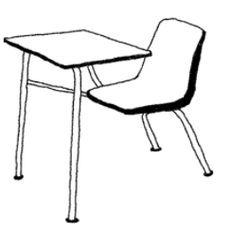
Showing up for class:
Examining a doctoral level course on Acceptance and Commitment Therapy
Danielle N. Moyer, MS
Daniel S. Steinberg, MA
Melissa L. Connally, MS
Amy R. Murrell, PhD

Slide 2
The growth of ACT has lead to an increased need for quality training
Workshops
Supervision
Conferences
Books
Graduate coursework
Notes:
Over 75 RCTs
Empirically supported treatment with moderate support in depression and strong support in pain - Psychological Association Division12
The United States Substance Abuse and Mental Health Services Administration also recognizes as EST
3.325 out of 4 for research evidence and 4 out of 4 for dissemination
65 peer reviewed ACT trainers and many more qualified practitioners and trainers
There are several avenues for receiving training

Slide 3
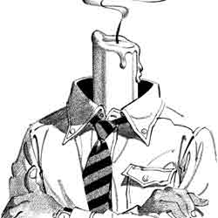
ACT workshops have been empirically shown to have several positive outcomes
Improved knowledge
Increased psychological flexibility
Decreased burnout
Notes:
ACT workshops in particular have several positive benefits that have been empirically shown
Attended by a wide variety of students and practitioners
Counselors and clinicians (masters and doctoral level), graduate students, some advanced undergraduate students
One consistent element of ACT workshops is that they are predominantly experiential

Slide 4
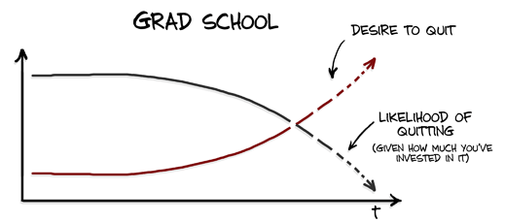
Less is known about the specific outcomes of graduate school training in ACT
Notes:
There are a growing number of graduate programs across the country that offer training and supervision in ACT
Research is limited/non-existent
To our knowledge there is no published research on proficiency or beneficial outcomes

Slide 5
Dr. Amy Murrell’s ACT class at UNT
Advanced psychotherapy series
Clinical, counseling, and clinical health graduate students
Mixed-methods learning class
PASSENGERS ON A “UNT” BUS
Notes:
UNT offers an alternating advanced psychotherapy class
Taken by students in three different programs
Students excited to take this class with Amy – the only peer reviewed ACT trainer in Texas
Mixed-methods learning class with both didactic and experiential components
Readings and review of readings that were very didactic, and in class exercises more experiential
Student presentations – syllabus left description vague but experiential based presentations seemed to have bigger impact
Access to WATCHING therapy live and roundtable discussion with teenage client

Slide 6
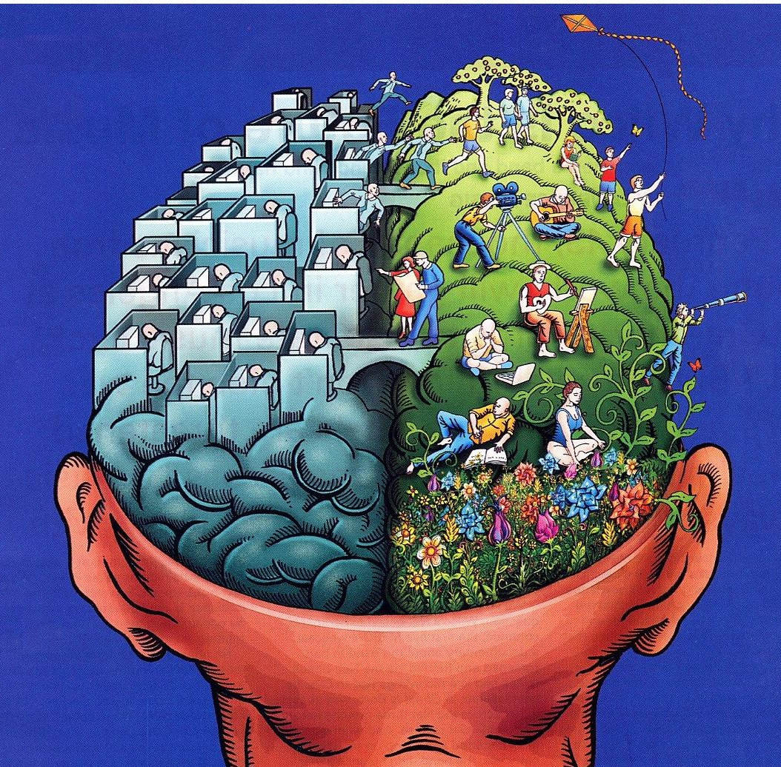
Some advantages to teaching an ACT course:
Dissemination of knowledge
Behavior analysis and RFT
Introduction to community
Dispelling rumors
Treatment selection discussion
Live therapy observation
Notes:
For those whose main interest is functional contextualism as well as those who are interested in CBT more broadly
Dissemination: more in depth introduction than a workshop provides
Students really appreciated introduction to community and history and comparison to CBT
Dispelling rumors: Based in science, Not a cult
Discussion of the appropriateness of treatment selection
*Especially in this type of program – not everyone can have supervision from all the supervisors they like, so this way, all students had an opportunity to get some exposure to ACT from the only ACT trainer in Texas

Slide 7
But this type of experience is unique!
Different from other graduate courses on therapy
Different from other ways of teaching ACT
Notes:
Amy described this as a very different experience
Meant to be a mix of didactic and experiential learning because that component has been shown to be so important
Although this is an optional course and students are told there is an experiential component, not everyone knows what that feels like (not everyone has been to a Kelly workshop, and the first time is a surprise for everyone)
So it was also very different from other venues for learning ACT
Students were demanding of didactic learning
Students like to show what they know, desperately in need of approval, grading component
different from how she teaches practicum – lasts a year, more intimate, one on one supervision gives opportunity to ask permission
different from how she decides what goes into workshops – no need for assessment of knowledge, come in with more knowledge
both involve more motivation to to engage in service of clients
Envisioned slightly different than outcome

Slide 8
Some major obstacles to teaching an ACT course:
Didactic versus experiential
So much to cover
Limited practice
Loud minds!
Ethical considerations
Notes:
Balancing didactic and experiential learning in a course is intrinsically more difficult due to the evaluation component
Covering philosophical and theoretical foundations in ONE semester; many students don’t have a strong background in behaviorism
(Undergrad professors still say often that behaviorism died with the cognitive revolution *cringe!)
Not all supervisors are comfortable letting students practice; could discuss de-identified cases in class, but without much context; live client viewing helpful, but still limited
Student expectations and evaluations were a major obstacle
First time taught, so important, and so obvious that there were frustrations
Wanted more structure, Forgetting to ask for permission to do experiential ;etc
Ethics: Workshops always come with the disclaimer because it can sometimes feel like therapy, but it isn’t
Always ask permission/language around willingness
Asking about process/functions are different from asking about content – disclosure never required during training
Dr. Georgescu will go more in depth into this discussion

Slide 9
An opportunity to collect data!
AFQ
MASS
VLQ
PSS
Pre
Mid
Post
Follow up
Notes:
We realized this was a great opportunity to collect data
Amy asked for informal permission before anything was formalized
Self-report measures, including flexibility, mindfulness, values, and perceived stress
No demographic data because of the small size of the class in order to maintain anonymity
Completed online; Amy never in contact with any data, and they were in no way connected to grades
But we ran into some difficulty collecting data . . . Lots of difficulty
Many students did not fill out data (and they didn’t have to!); those who completed only completed sparsely

Slide 10
AFQ: Psychological Inflexibility
*
Notes:
AFQ – Avoidance and Fusion Questionnaire
Positive scores indicate more inflexibility
Par 6 and 8 increased, par 4 sig decreased
Par 1 – pre to follow up
Par 2 – pre to post
Par 3 – pre to follow up
Par 4 – pre to post
Par 5 – pre to mid
Par 6 – pre to mid
Par 7 – post to follow up
Par 8 – post to follow up

Slide 11
MAAS: Mindfulness
*
*
Notes:
MAAS –
Positive scores indicate more skilled mindfulness
Par 1, 3, and 6 decreased; Par 2 and 4 sig increased
Par 1 – pre to follow up
Par 2 – pre to post
Par 3 – pre to follow up
Par 4 – pre to post
Par 5 – pre to mid
Par 6 – pre to mid
Par 7 – post to follow up
Par 8 – post to follow up

Slide 12
VLQ: Valued Living
Notes:
VLQ – Valued living questionnaire
Positive scores indicate more valued living
Par 2, 5, and 8 decreased
Par 1 – pre to follow up
Par 2 – pre to post
Par 3 – pre to follow up
Par 4 – pre to post
Par 5 – pre to mid
Par 6 – pre to mid
Par 7 – post to follow up
Par 8 – post to follow up

Slide 13
PSS: Perceived Stress
*
Notes:
PSS – Perceived stress scale
Higher scores indicate more perceived stress
Par 6 increased; Par 7 significantly decreased
Par 1 – pre to follow up
Par 2 – pre to post
Par 3 – pre to follow up
Par 4 – pre to post
Par 5 – pre to mid
Par 6 – pre to mid
Par 7 – post to follow up
Par 8 – post to follow up

Slide 14
So many questions yet to answer!
Barriers to research
Structured data collection
Comparison groups
Competency
Notes:
Please, if you have the opportunity to do this type of research!
This is not the easiest research to conduct
Grad students are not undergrads; deidentification; busy graduate students; classes not offered that often
So how can we improve it?
Structured data collection, times, on paper, a more in depth introduction to the importance of this type of research
Would be interesting to compare to other similar/different psychotherapy courses, workshops, supervision
With proper deidentification it would be interesting to see if improvements in flexibility and decreased stress are related to knowledge
Amy would also like next time to have an outside person come in and collect data so that deidentification can be more lax
Like to match quantitative data with qualitative information about each student. Ex: par 4 consistently got better and 6 got worse
In a workshop you can say, well it’s clear why this person hated it and also why they got nothing out of it, but in a classroom there’s that evaluative component
And you have prior knowledge of your students, so an outside person could better examine patterns in the data in small studies like this one

Slide 15
There are many opportunities for improvement
Informed consent
Improving efficiency around foundations
More experiential activities
Know yourself!
FLEXIBILITY
Notes:
The best thing about paying attention to this type of stuff is learning how to improve
Informed consent: Disclosure about how much this matters and how hard that makes it; said, but maybe not early and clear enough
We’re going to talk about RFT and you’re probably going to be frustrated, but just notice that and be patient with yourself
Speaking of talking about foundations: tie into values; in the service of being a better clinician; allude to hexaflex during that stuff
More specific instructions early on about presentations, including reminders about asking permission for experiential stuff
Structure to support unstructured
Know your own behaviors – Amy personally knows to watch her own story-telling behavior, especially self-disclosure
Dr. Georgescu will say more on this

Slide 16
Course Structure
“First half of course (theory) was very difficult for me to understand. Second half was much more digestible. I wonder if the class would be better if these were flipped.”
“I would have liked to learn about values earlier in the semester.”
“Coming in with little understanding of the material it was too much to soak in all of these terms all at once. Instead, perhaps addressing the elements of the hexaflex first, and then talking about FC and RFT?”
“The next time this course is offered, it might be best to start the ACT processes with values.”
“I felt the structure of the first half of the class was very difficult. I LOVED the second half of the class.”
Notes:
We also thought you might be interested in hearing what the students thought
The feedback on course structure was pretty unanimous – ACT stuff first, and values specifically
Amy has tried things in the opposite order and it just doesn’t work
Possible compromises: peppering in hexaflex with foundations work; start hexaflex with values
Qualitative data predominantly good, only 8 students gave feedback

Slide 17
Course Content
“I loved the course material; I tried to apply what I learned in the therapy room.”
“Overall, I enjoyed the subject matter. I was happy to have taken the class and to learn more about ACT. I think it will be helpful in the therapy I provide in the clinic. I think more emphasis on what it looks like in the room would have been fun.”
“If time had allowed, more discussion on ACT conferences and workshops may have been appreciated.”
Notes:
Course content:
Folks generally liked the content
Wanted a little more “what does it look like”
And wanted to learn more!

Slide 18
Instructor
“At first I thought the instructor shared too much personal information. Later, I interpreted such behavior as modeling multiple aspects of psychological flexibility. Ultimately, I find your self-disclosure inspiring.”
“While I appreciated the reasons for self-disclosure, it sometimes seemed unnecessarily detailed and long-winded. Nonetheless, the instructor’s passion for the subject was evident, and I appreciated how she conveyed the importance of the course, and her dedication to doing a good job for the sake of students’ learning and living consistently with her own value of being a good educator.” ☺
“I felt a bit uncomfortable during some of the instructor’s self-disclosures.”
“I appreciate the instructor’s openness and passion for the subject.”
“I thought that the instructor shared a lot of difficult personal content that eventually led to students feeling as though they could do the same.”
Notes:
As Amy expected, students consistently had evaluations of her own disclosures
But with varying degrees of understanding of the purpose and utility of these disclosures
Some students suggested being more straight forward about the purpose, but just as we expect our clients to reach some conclusions on their own rather than just giving them the answer, students can probably stand to be flexible about this

Slide 19
Self Evaluation
“I put in significant effort during this course. I don’t know if there’s anything I could have done to improve my learning except be more present during those times when class got boring.”
“My effort this semester was the best I could have given. I have no regrets and am presently happy with what I have accomplished.”
“I worked hard to get as much as I could out of this class.”
“I have learned so very much from this course and I am incredibly grateful to have been able to participate.”
“I do feel that I have worked hard and been able to integrate my studies into my therapeutic work effectively.”
“I could have utilized other students to understand the material better. I did a good job of reading all of the material assigned in trying to understand the course material.”
“At times I was under-prepared for class discussion with respect to completing the readings. However, I sought to be emotionally and intellectually present and engaged within every class session.”
Notes:
Students were also asked to evaluate the quality of their own work in the course – I mostly just find this entertaining

Slide 20
Thank you!
Danielle N. Moyer, MS
University of North Texas
daniellemoyer@my.unt.edu

