Slide 1
Welcome to the Medical Paediatric Psychology Service! (We don’t know how many of us are in our service, but we do know we are liberating our worlds!).
Dr Jim Lemon
‘IGNITE’ ACBS WORLD CONFERENCE
BERLIN 2015
Notes:
This presentation is about how we are evolving and engaging with the networks of people around us to grow and nurture a service and community

Slide 2
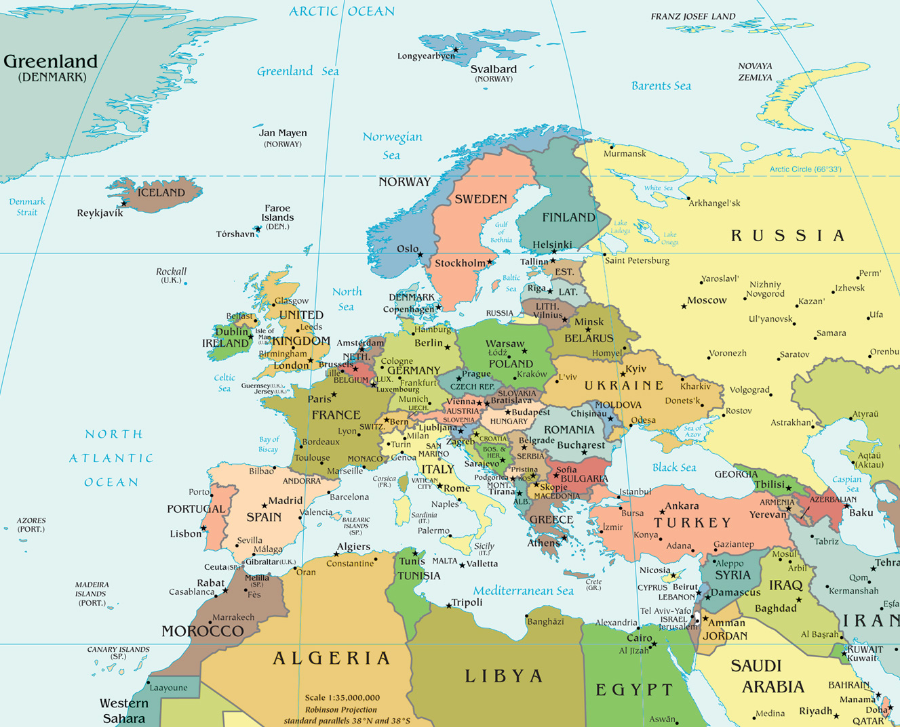
Notes:
We’ll join this journey in South West Scotland
This is area where are I live. It’s a largely rural area, with a population of about 150,00 people spread out over approx 2,500 square miles
60 people per square mile (wikipedia has Berlin at 10,000)
Main town is Dumfires and this is where our hospital is

Slide 3
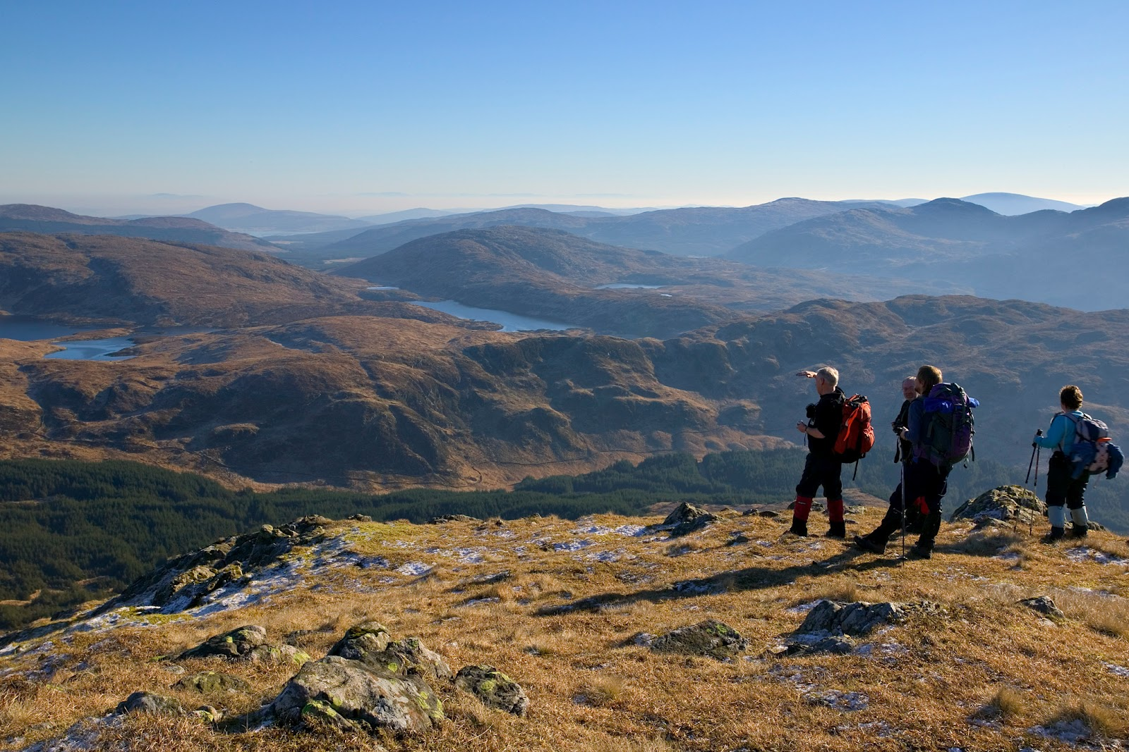
Notes:
One post
Prior to 2012 there was no medical paediatric psychology service. Families would either have to travel up to the big hospitals up in Glasgow or Edinburgh or else be seen in local mental health services.
In 2012 we managed to get one post to cover well, whatever we could!

Slide 4
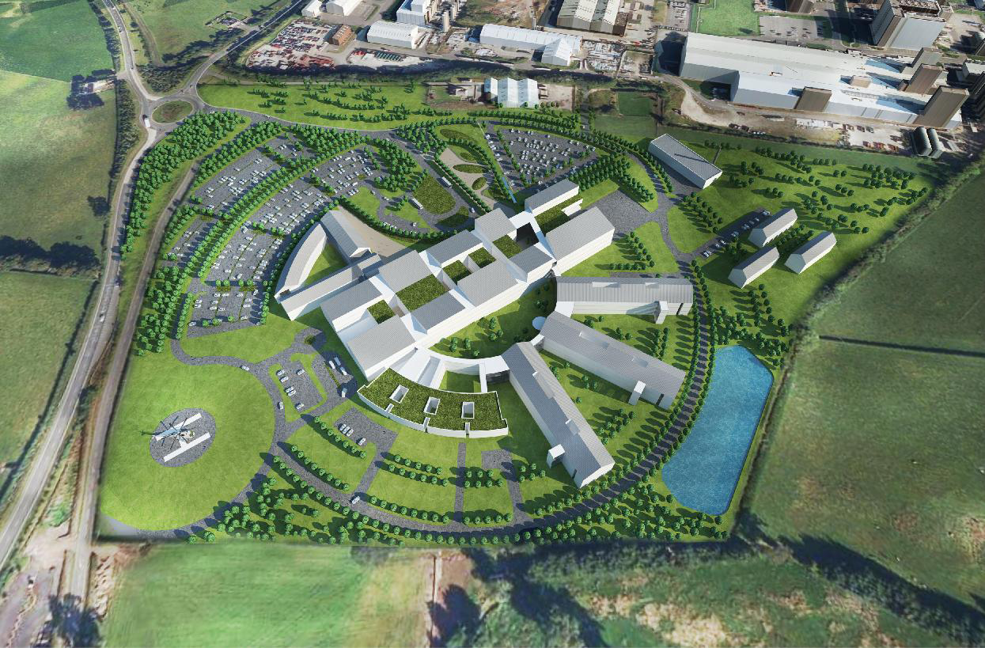
Notes:
Local services
6 consultant paeds 6 now 2 ccns
Conditions.,..

Slide 5
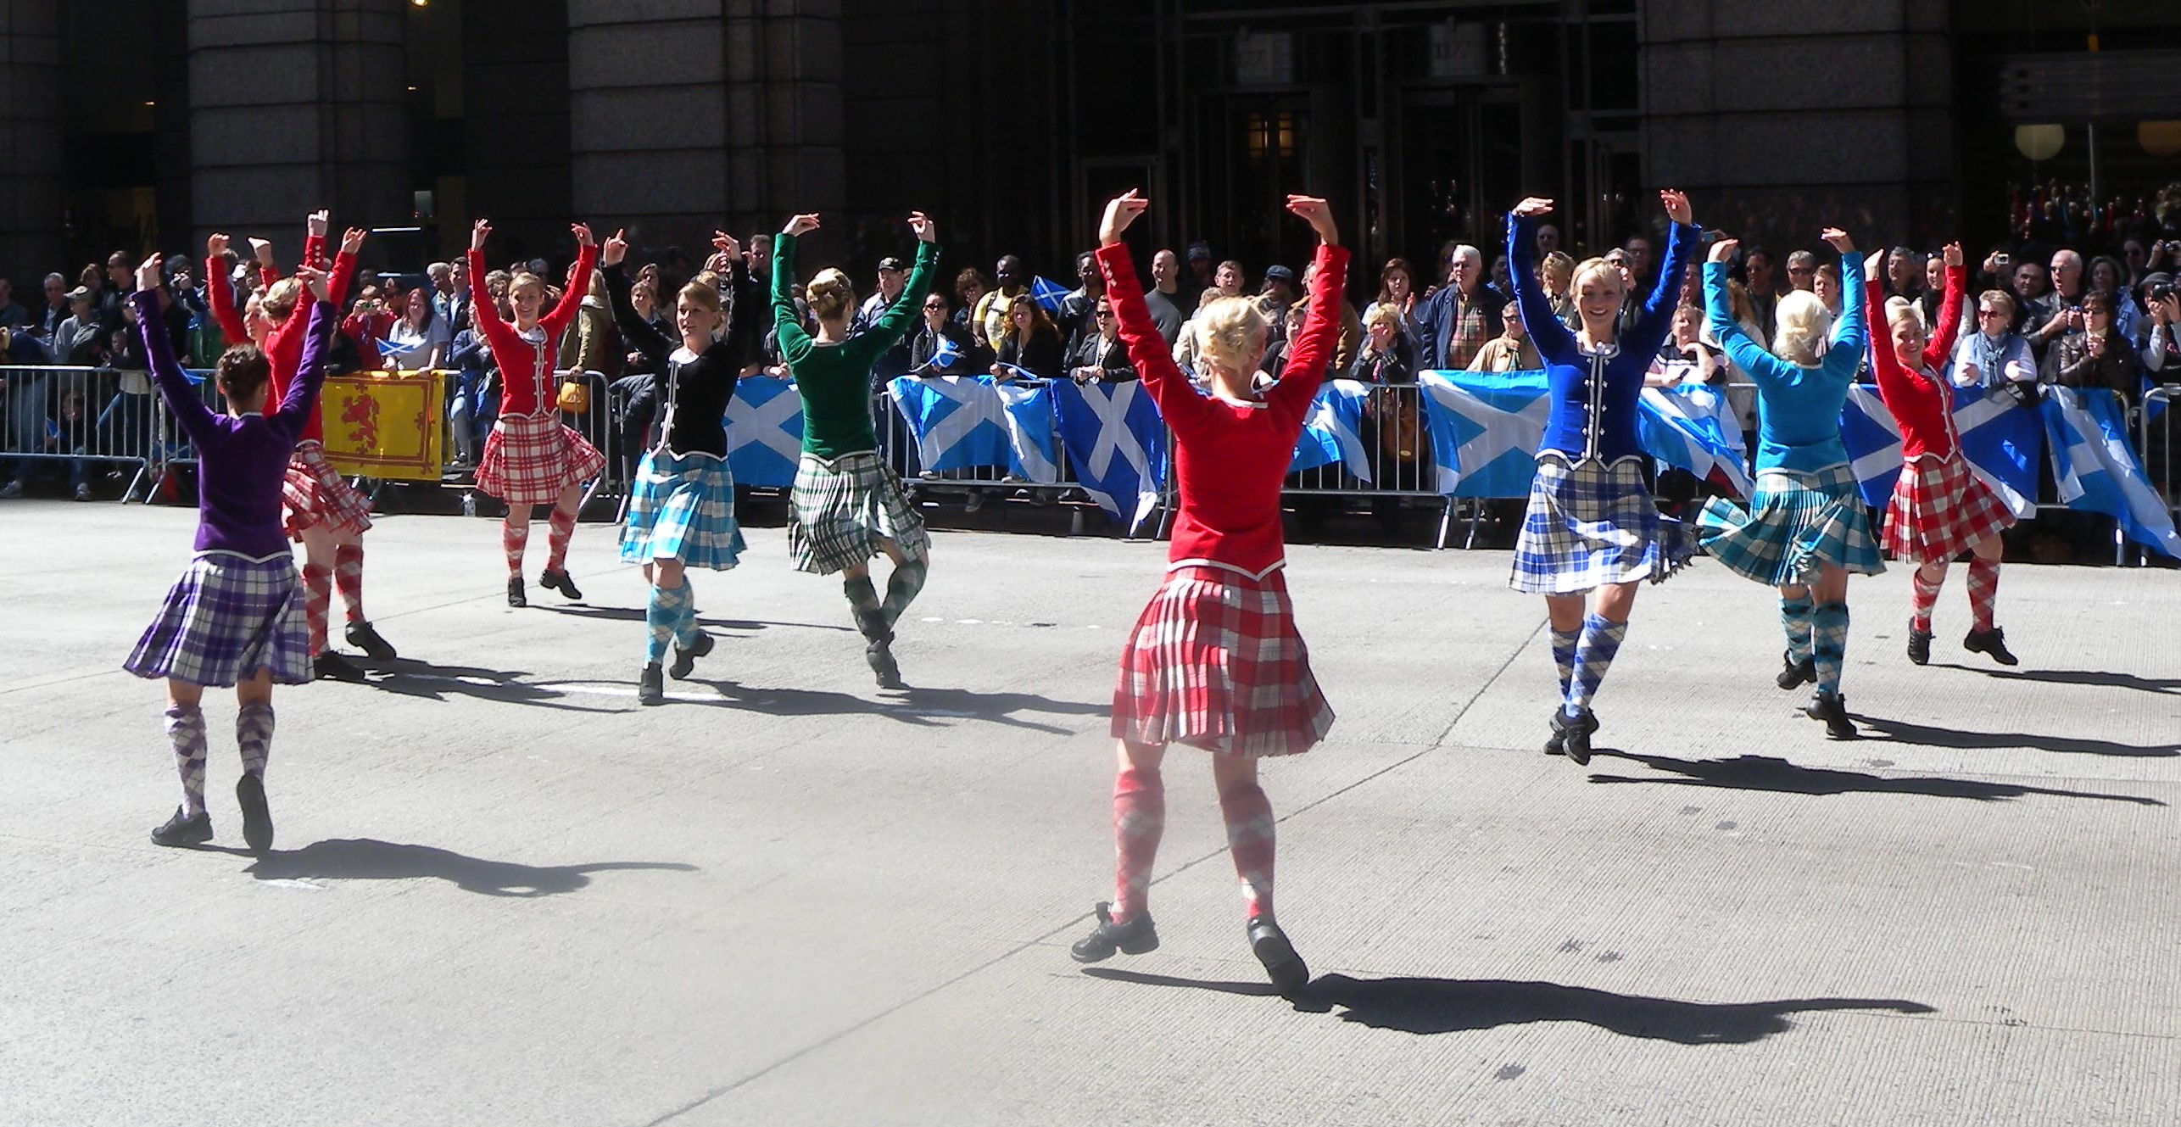
Notes:
Links with sppn

Slide 6
Notes:
A new dawn – what would it look like – our vision

Slide 7
“
Notes:
Nurturing environment – across whole system

Slide 8
David Gillanders
Nuno Ferreira
Louise Hayes
Russ Harris
And more and more!

Slide 9
Notes:
1:1 work adherence etc

Slide 10
Notes:
Patients improved

Slide 11
Clinicians were interested!
Notes:
Clinicians became interested in how

Slide 12
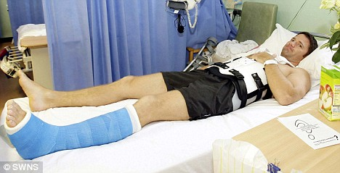

Slide 16
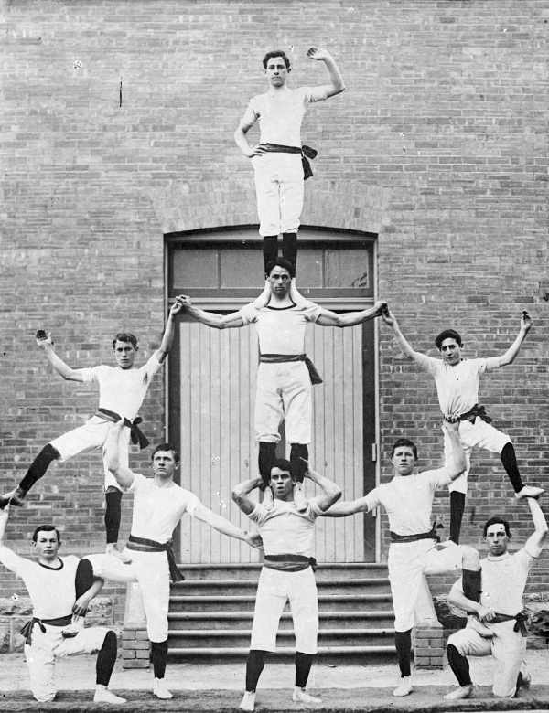
Notes:
No resources
But people

Slide 17
Notes:
The matrix

Slide 18
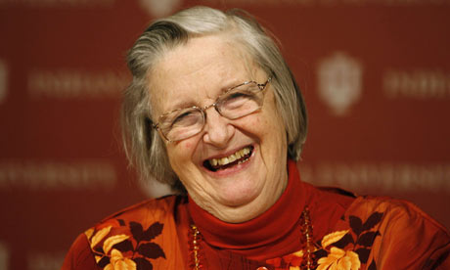

Slide 19
"Internet map 1024" by The Opte Project - Originally from the English Wikipedia. Licensed under CC BY 2.5 via Wikimedia Commons
Notes:
Power of networks

Slide 20
Where to now?

