Slide 1
El Gajiev, M.A.
ACBS World Conference 13 – Berlin (July, 2015)
Notes:
Good afternoon ladies and gentlemen. My name is El Gajiev and welcome to Mustaches for Mental Health: A New Vision for Breaking the Silence of Stigma & Redefining Masculinity.

Slide 2
Notes:
In the spirit of Ignite, my aim today is to ignite you all – to ignite you to begin thinking of how we may stretch the reaches of contextual behavioral science beyond the boundaries of our offices, clinics, hospitals, and classrooms.
And to do so, I’ll be using a very simple tool: the mustache.

Slide 3
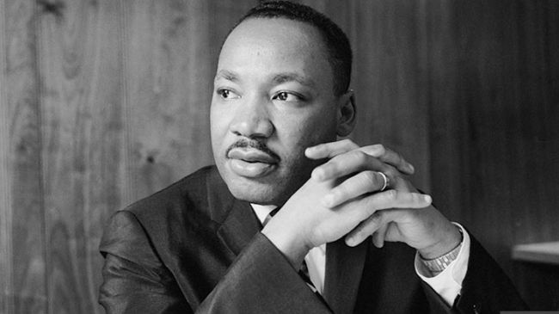
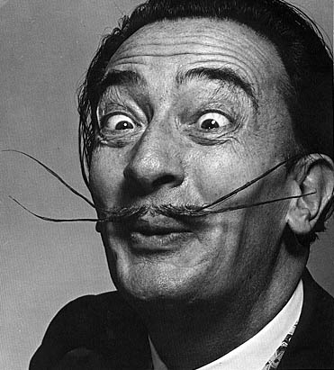
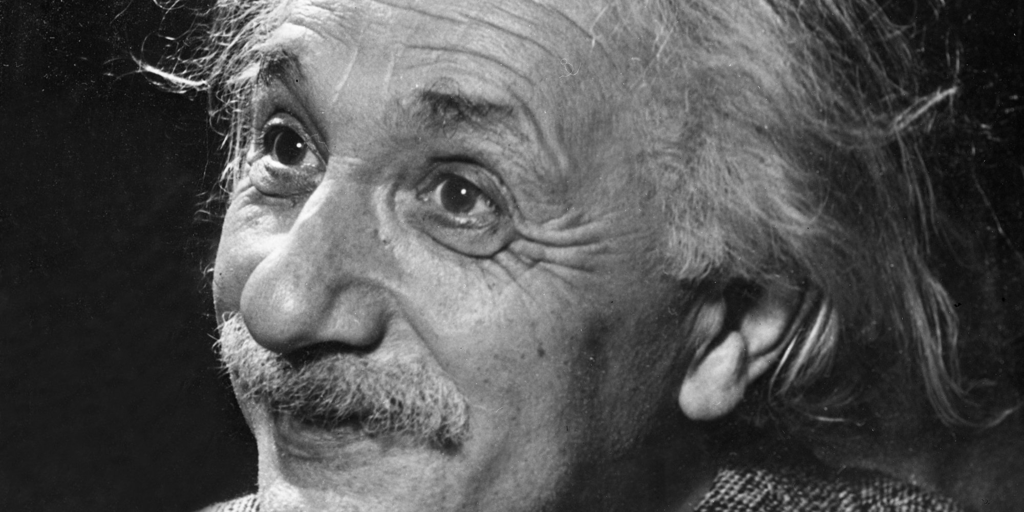
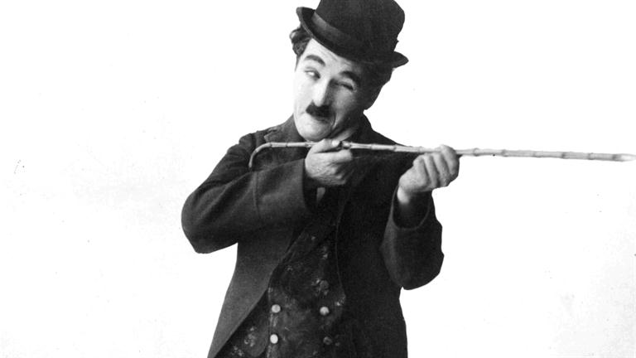
Notes:
You see the mustache has long been considered a symbol of both sophistication and of masculinity. From Dr. Martin Luther King Jr to Albert Einstein; from Charlie Chaplin to Salvador Dali - the mustache has granted men passage to levels of greatness that might not have otherwise been possible without such fine facial hair.

Slide 4
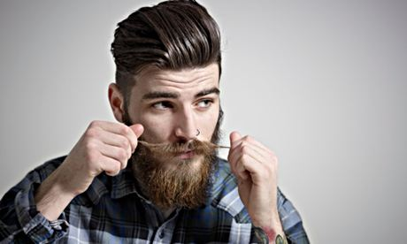
Notes:
In recent times even, the mustache has made a revival of sorts, with younger populations beginning to don mustaches for fashion, for fun, and most fascinatingly of all, for friends & family.

Slide 5
Notes:
Those of you in the audience with a man in your life might know what I'm talking about, especially around the time of November. I’m speaking of course of Movember - an international movement in which men, or mo’bros, grow out their mustaches for the month of November in an effort to raise money and awareness for men’s health issues.

Slide 6
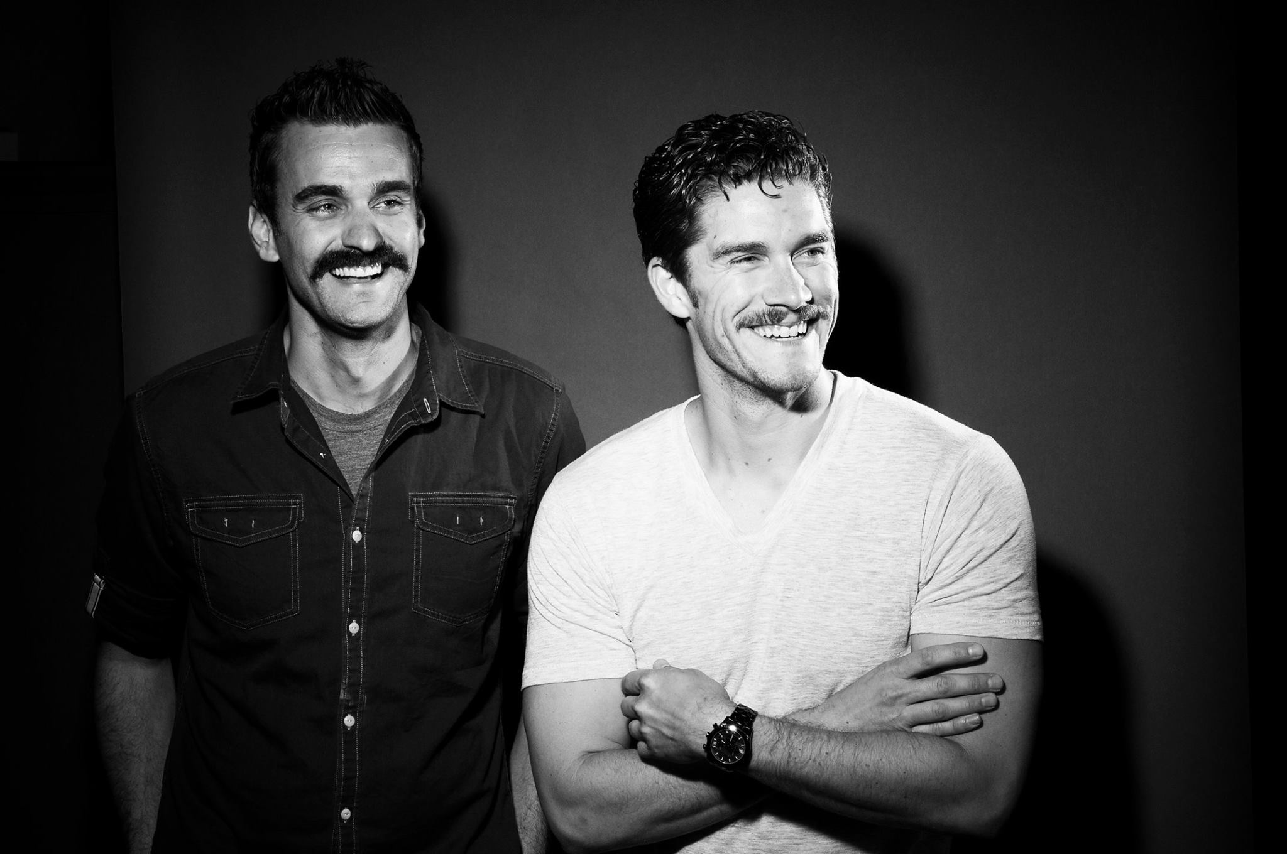
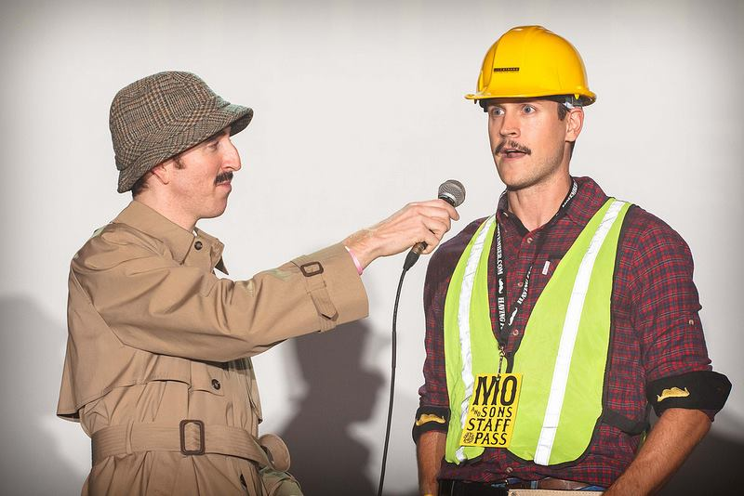
2014 Statistics
~ 3 million individual donations.
2.3 billion conversations about men’s health.
99% of participants talked to someone about their health.
75% of participants reported they were more likely to refer someone they knew to seek professional help.
Notes:
In 2014 alone, Movember reached approximately 3 million individuals around the world, with a total of 2.3 billion conversations had about men’s health, and about 75% of these participants reported that they were more likely to tell someone they knew to seek professional help if they thought they needed it.

Slide 7
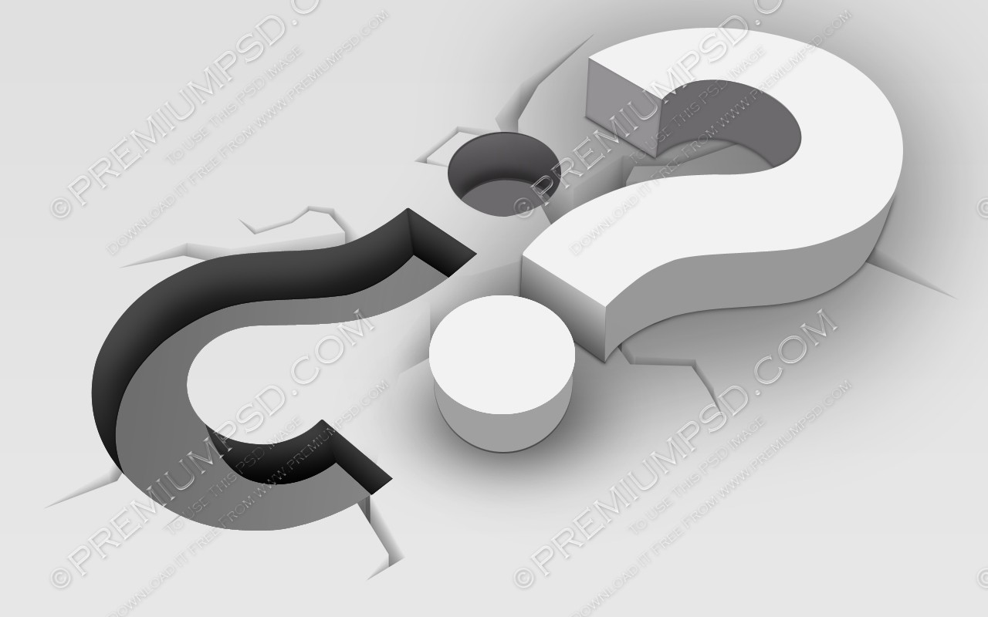
Notes:
Yet in light of the growing awareness of men’s health issues, there still remains a gaping hole in the domain that we all here focus on: mental health. Or as a former professor, and founder of ManTherapy.com, called it: Gentlemental Health.

Slide 8
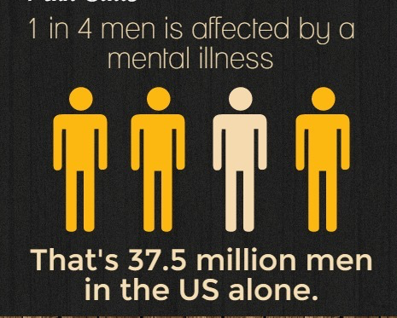
Notes:
I invite you to take a quick look to your left and then to your right. Now you wouldn’t know it by looking, but one in four men is dealing with a mental health issue of some sort. In the U.S. alone, that’s over 37 million men. But how many of them make it to our offices, to our clinics? How many seek the help that is available? Unfortunately, only a slim margin.

Slide 9
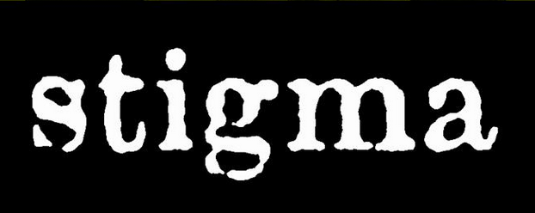
Notes:
Why is that? Well the research lays out quite a bit of potential barriers to treatment. Yet what it ultimately boils down is stigma and the silence that comes with it. You see, stigma clouds our eyes, it bonds our lips shut, and chains our hands at our sides, where we cannot reach out or utter words for help.

Slide 10
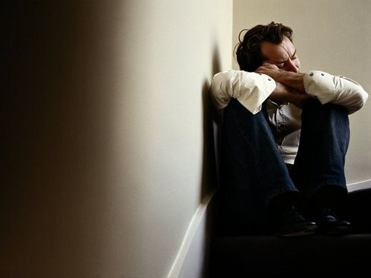
Notes:
In my time, I have come across far too many men suffering great psychological pain - pain which they fear more than anything else in the world to share with those around them, especially loved ones who they feel rely on them for strength and steadfastness.

Slide 11
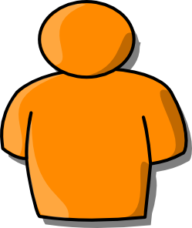
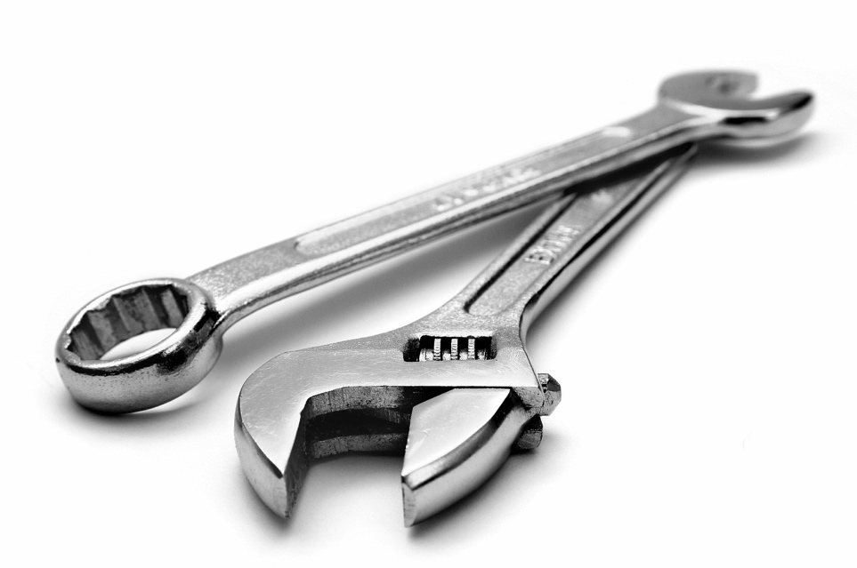
Notes:
As men, we have certain tools with which we deal with the problems of the world. I use my hammer for the nails, my screwdriver for the screws, and so on. But what happens when I come across a bolt that needs a wrench? My toolkit, or behavior repertoire, can only get me so far.

Slide 12
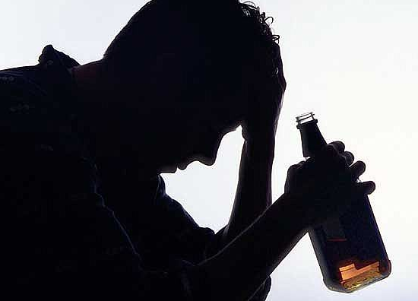
Psychological Inflexibility
Notes:
And if I’m taught by society to not ask for help - that asking for help is akin to weakness, well then, I will remain silent. I will go back to my tools and try them again and again and again. I will pound on the bolt with my hammer until either the bolt breaks or my hammer breaks or I break, and then turn to behaviors such as drinking, drugs, violence, and suicide.

Slide 13
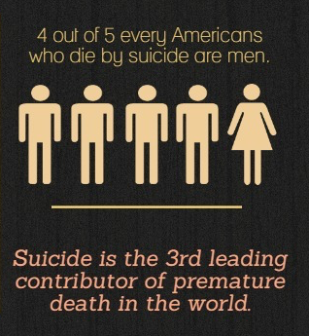
Notes:
You see, it is in this silence that we lose our men, our sons - our fathers, our brothers. In the U.S. alone, 4 out of every 5 people who die by suicide are men.

Slide 14
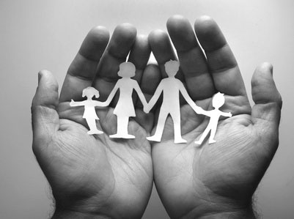
Notes:
This silence that men face is the most resounding stigma of all, and its impact ripples on every level of society, from families to communities to schools, workplaces, and governments.

Slide 15
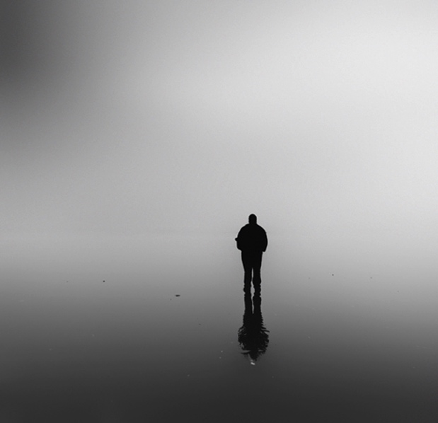
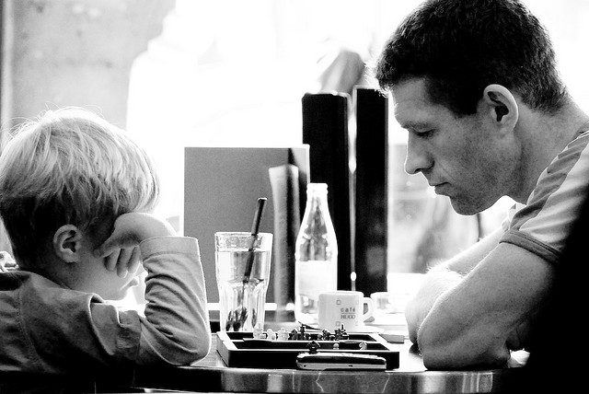
?
Notes:
So what do we do about it? How do we affect this stigma, this silence? How do we reach men when it seems so many of our efforts have deemed them unreachable? How do we demonstrate a collective acceptance for the psychological suffering of men and boys, and simultaneously provide an accessible forum for seeking resources and help?

Slide 16
Notes:
Well I believe there is great wisdom in the age-old adages of our field, and if there is one that resounds quite thunderously among them all, it is this: Meet them where they are.
It is this that asks us to stretch outside the boundaries of traditional psychotherapy (which I think us ACT folk do pretty well already).

Slide 17
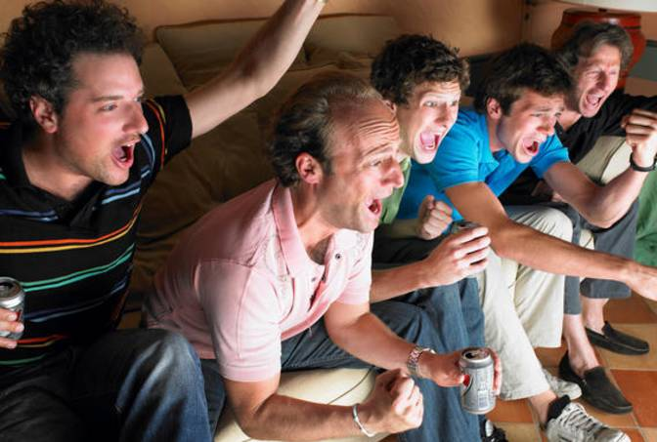
Notes:
What medium reaches millions upon millions of men worldwide on a regular basis?
Well professional sports, of course.

Slide 18
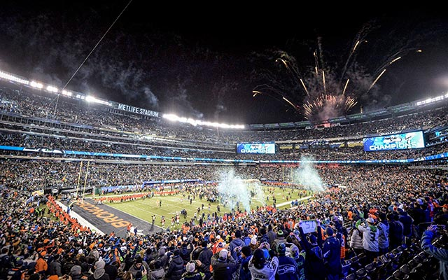
Notes:
In the States alone, the last Superbowl reached 167 million people, the vast majority of whom were men and boys. Thinking more locally, the 2014 World Cup final between Germany and Argentina attracted the largest audience in German television history. How many of them do you think were men?

Slide 19
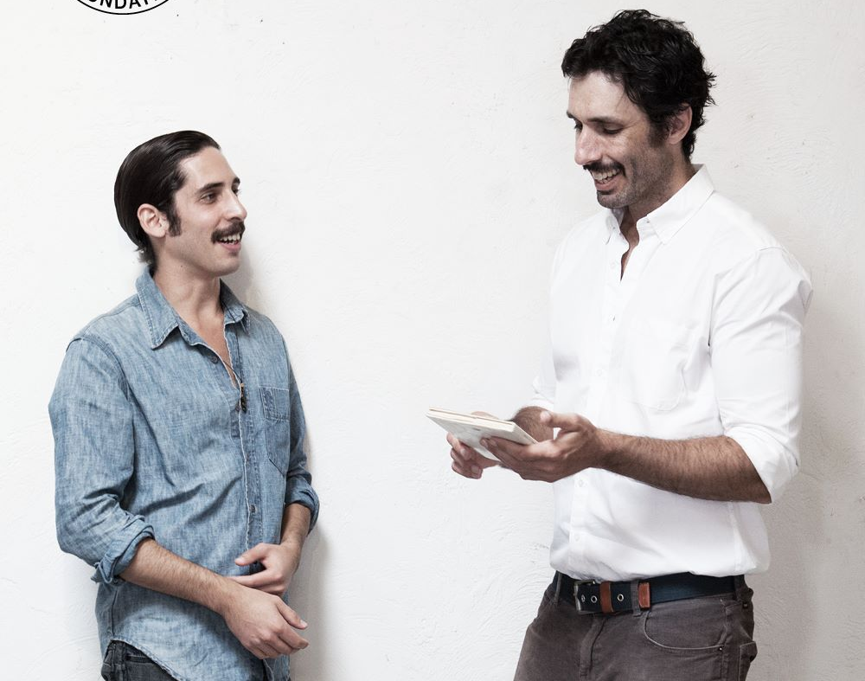
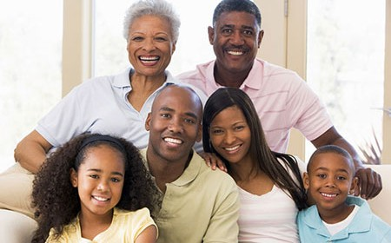
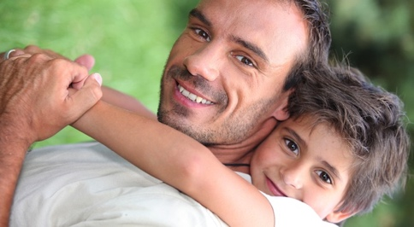
Notes:
You see, the way to break the silence is to embed ourselves into a conversation that men are already engaged in, and to do it with that very tool we began this talk with: the mustache. We’ve seen this work incredibly with the Wear It Pink campaign for breast cancer in fostering awareness and conversation. Why not copy a working formula for success and put it to use where success is imperative?

Slide 20
mustaches4mentalhealth@gmail.com
Notes:
As an initiative, we are currently reaching out to many leaders in marketing, sports, psychology, technology, philanthropy, and more. But I realize the limits of two doctoral students and the ambitiousness of redefining masculinity on our own terms; and so I am very, very open to any ideas, suggestions, connections, feedback, or mustaches of your own that you would like to share with me. Thank you so very much for your time and your attention.

