Slide 1
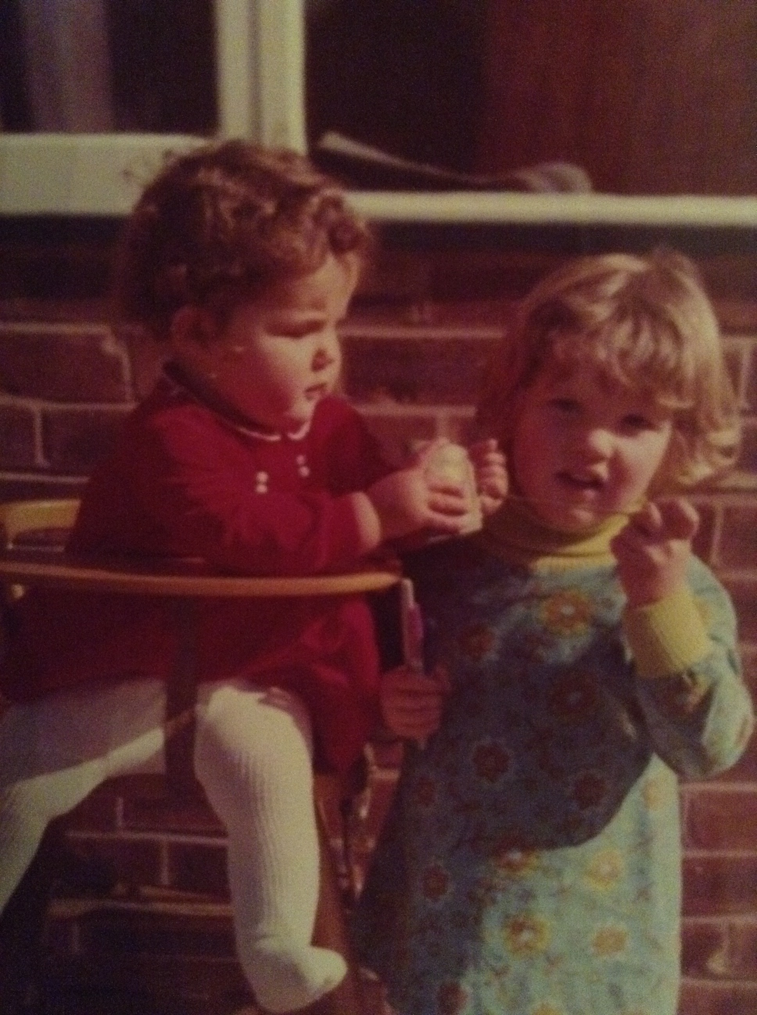
Notes:
We are sisters
L: I’m Louise and I’m a clinical psychologist
R: And I’m Rachael and I’m a school counsellor
L: There are many ways in which we’re the same – curly hair, tall, we both have 3 kids.
R: And there are also many ways in which we are different

Slide 2
Notes:
L: I have huge feet
R: Mine are small.
L: I’m really disorganised
R: and I’m a bit anal!
R: But one thing we definitely share, is we are both passionate about ACT. So guess what 2 sisters who are into ACT call themselves…

Slide 3
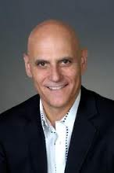
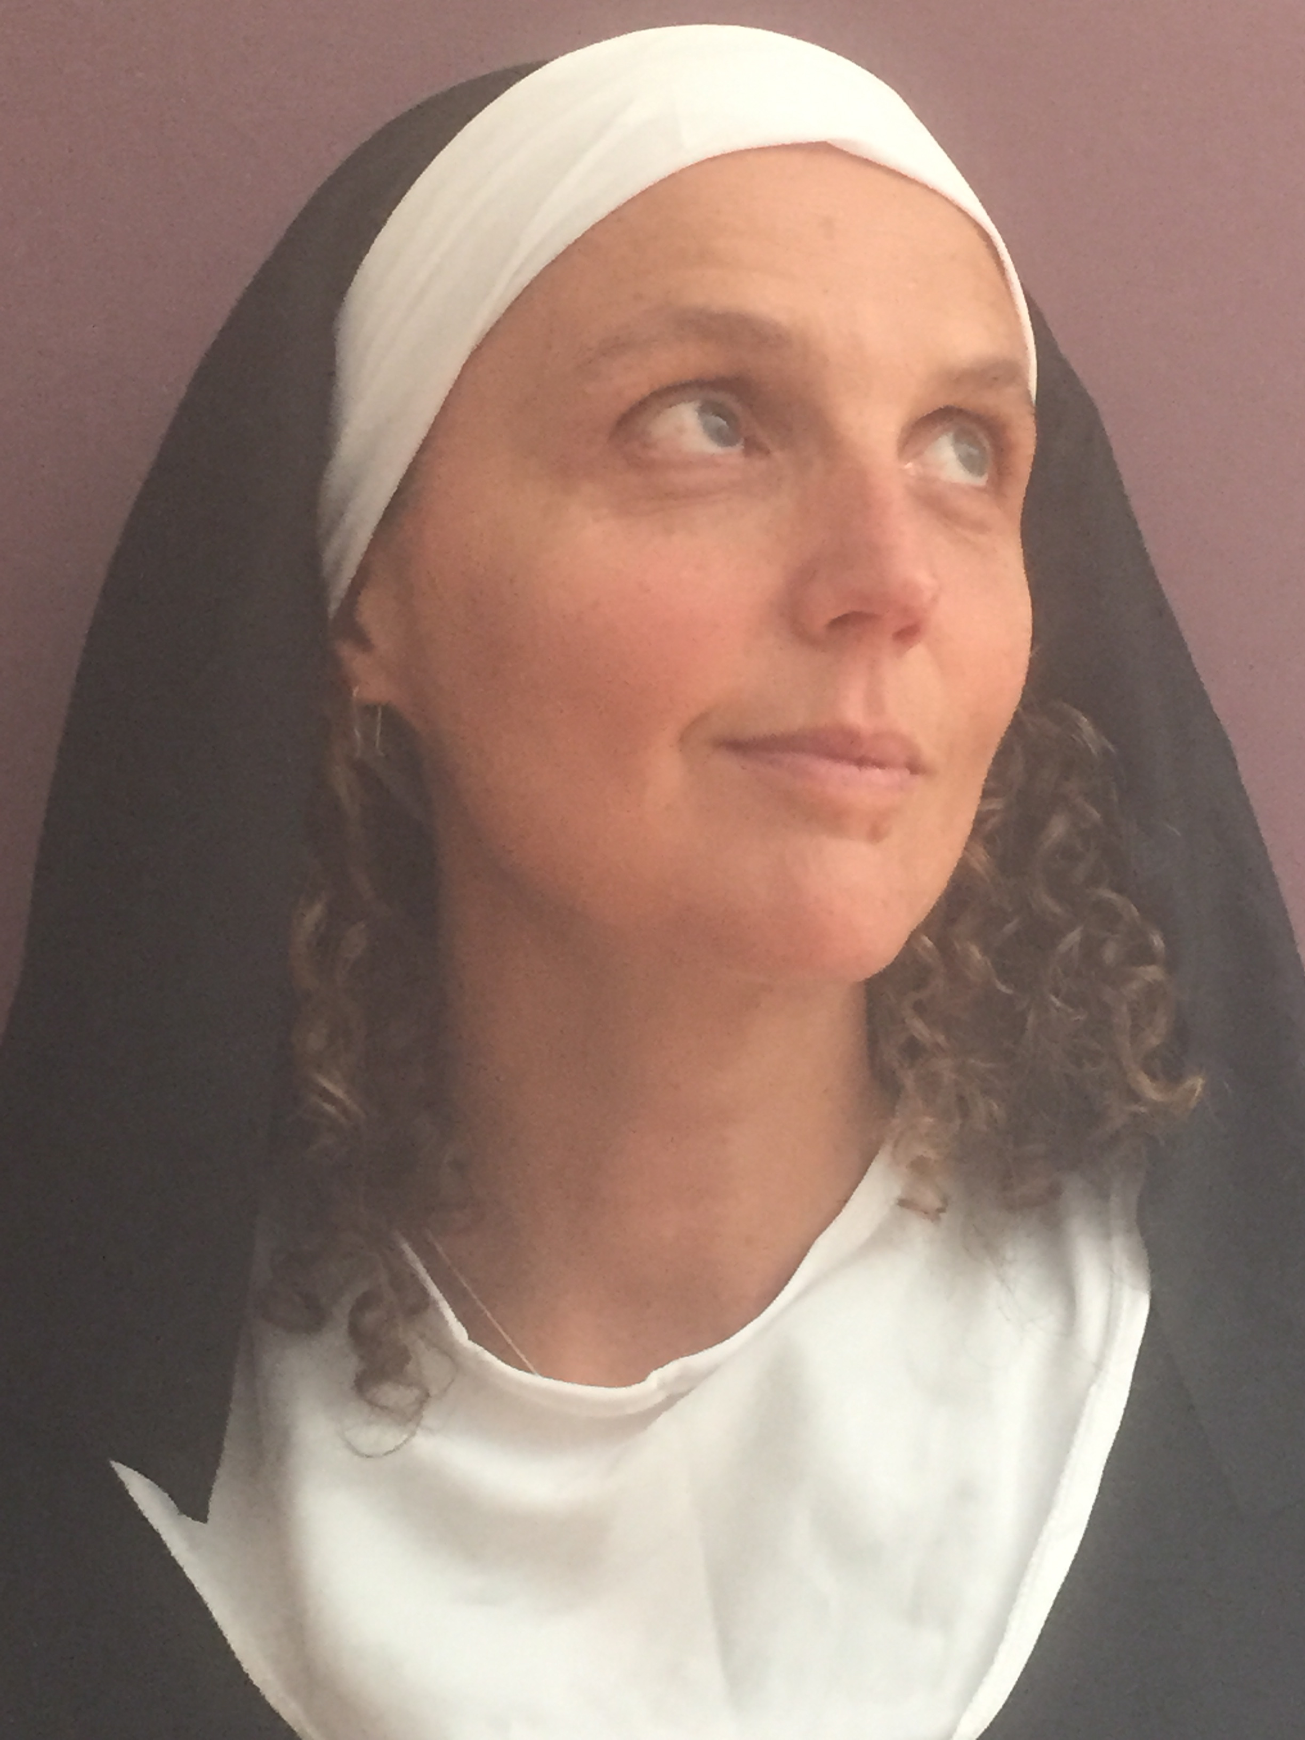
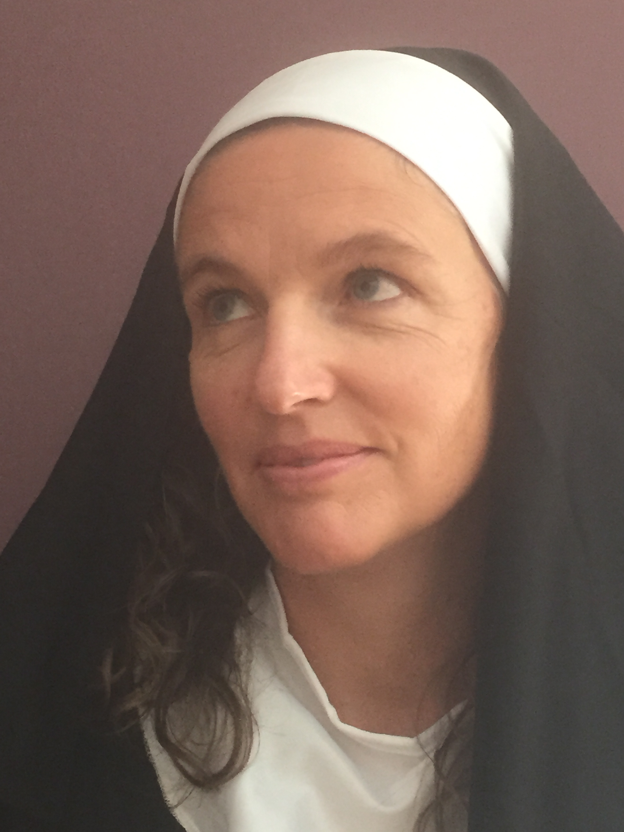
Notes:
LR: SISTER ACT
We’re here to share with you our work on bringing mindfulness and values into 3 schools in the UK, in a way that is meaningful and lasting

Slide 4
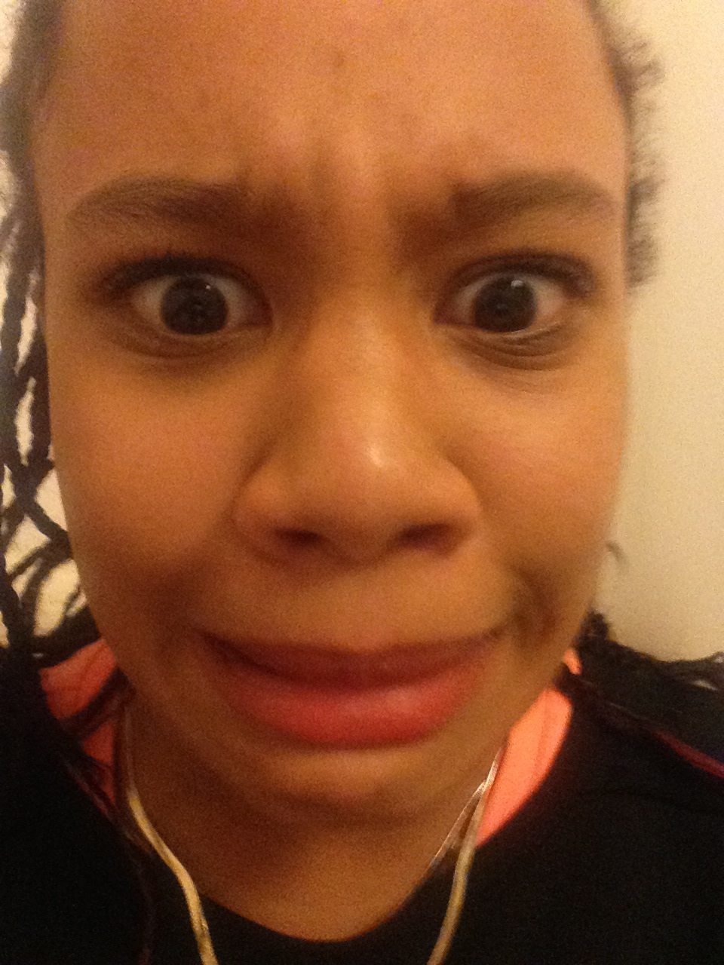
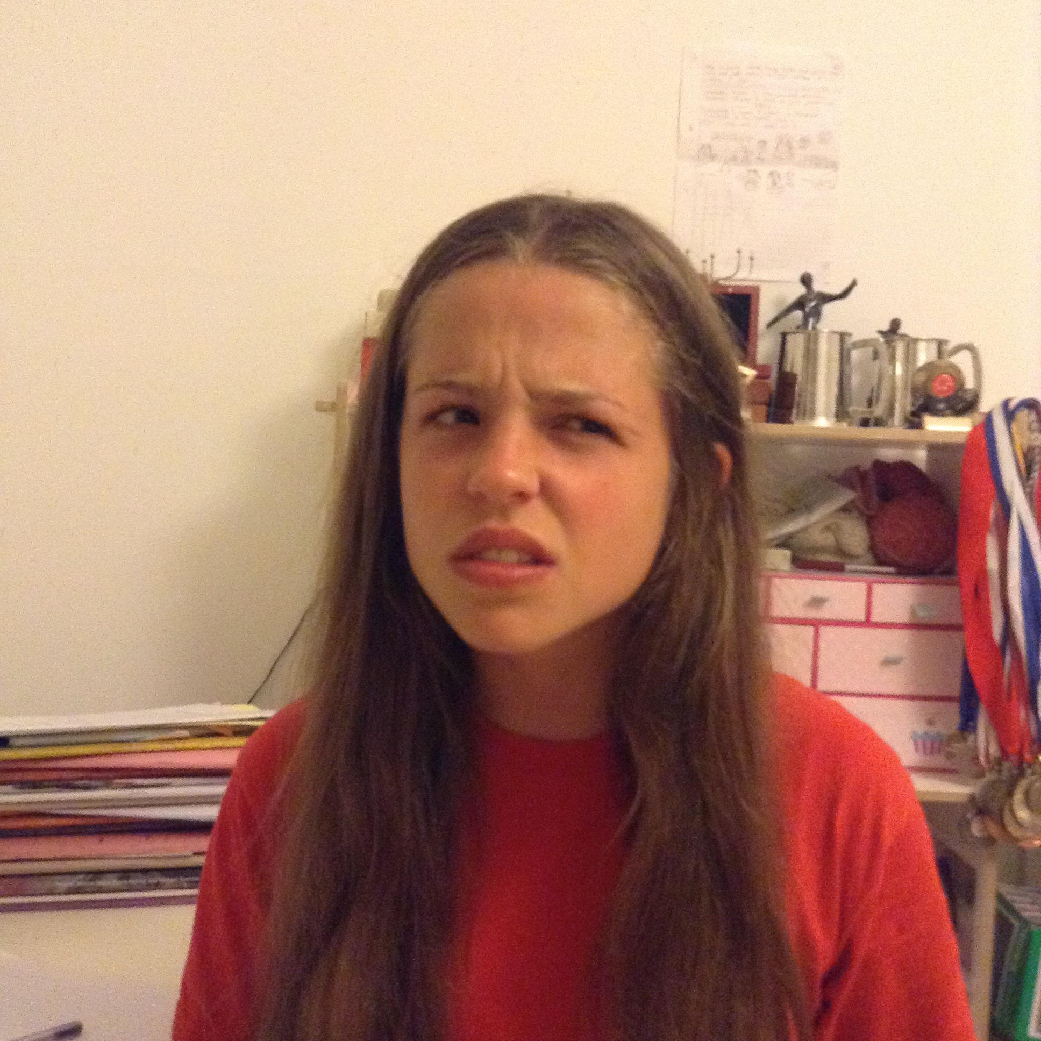
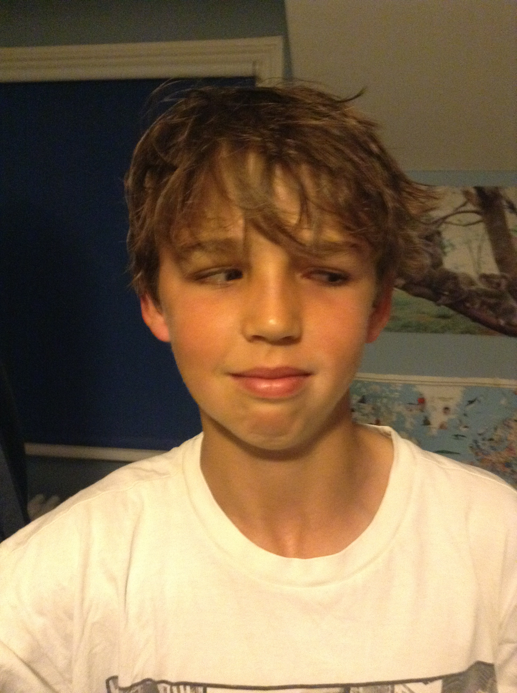
Notes:
When we started, the schools had 4 values that have been around for decades – and they are ‘good’ values, for example ‘honesty’ and ‘integrity’. But staff hated having to rate kids on these values, and the students didn’t really know what they meant!

Slide 5
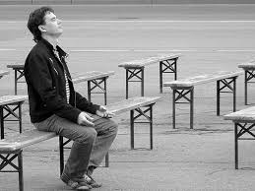
Notes:
In terms of mindfulness, there were one or two staff who already had their own practices, but they didn’t know how best to start to offer this to the wider school community. It was also being delivered in 1:1 sessions with students who had sought counselling. So it was going on, but in isolation.

Slide 6
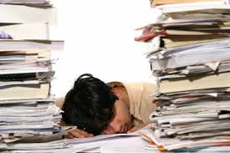
Notes:
The last thing we wanted was for our work to lead to yet another document, or another list of targets which then sit idle.
It was essential that our partners at the school didn’t want this either. We all wanted this to evolve, not to be imposed

Slide 7
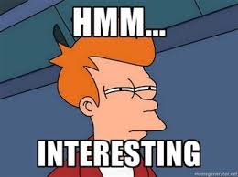
Notes:
So – how have we set out to achieve our goal of bringing values and mindfulness to these schools.
I was already delivering ACT in my 1:1 work, and I did an information session for the school leaders, about “What is ACT’. They were interested.

Slide 8
Notes:
We also delivered Fredrik Livheim’s ‘I Here Now’ group to all staff. This 12 hour protocol was about building resilience for staff, and it provided a way for them to start to understand ACT from the inside – encouraging staff to ‘do’ and ‘live’ according to these principles, not just to understand them on an intellectual level.

Slide 9
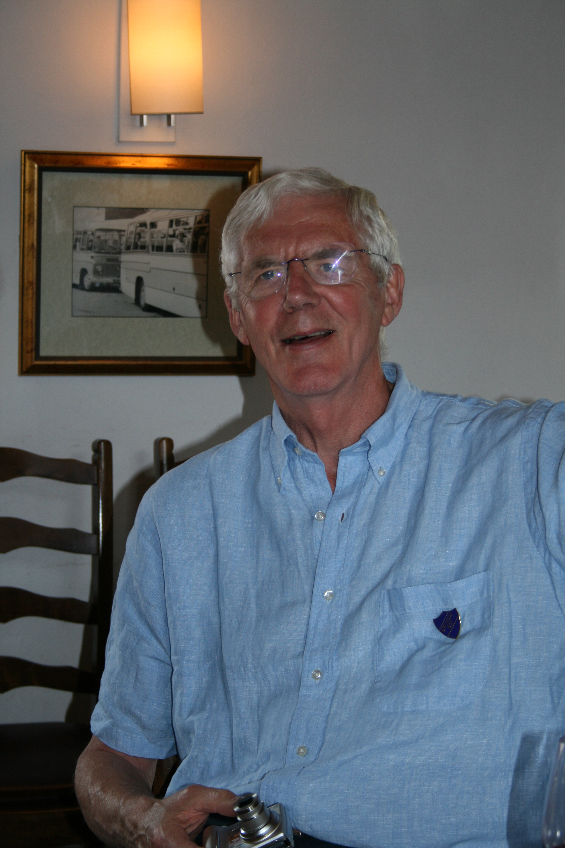
Notes:
Just as we feared there may be only one person in the audience today – our father – we feared the uptake for a voluntary course, for stressed out over-worked teachers, would be low. But it wasn’t, and we had between 25 and 40 staff at each session.

Slide 10
Notes:
We were advised by Fredrik Livheim and others to work from the top down, and we were pleased to have all of the school’s pastoral heads on our course.
Charlie and Eric here, were able to come up close to their values and discomfort during this course, for all to see, which we knew would really help.

Slide 11
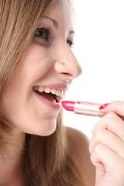
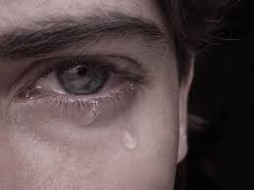
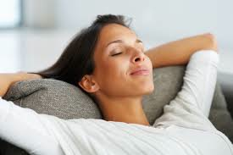
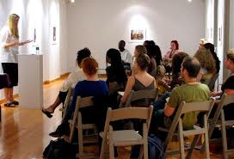
Notes:
The sessions were fun, and also quite powerful at times – feelings showed up! What’s really exciting is seeing how staff are bringing ACT into their personal lives, and also exploring ways of bringing ACT into the classrooms, to enhance learning.

Slide 12
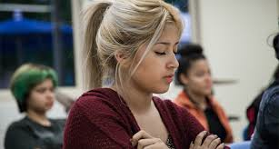
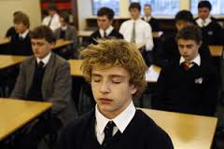
Notes:
With mindfulness, we are seeing signs that we are successfully bringing it in by the back door – letting everyone find it for themselves. For example, some staff are doing lunchtime mindfulness practice, and an art teacher is offering ‘free flow’ art sessions for students.

Slide 13
5 senses experiencing
Away
Towards
Mental experiencing
Notes:
At the group follow-up in September, we will be introducing the Matrix to staff. We will start by looking at how they can use this tool for themselves, in terms of staying on track with their teaching, but then we want to move on to helping them use it with students

Slide 14
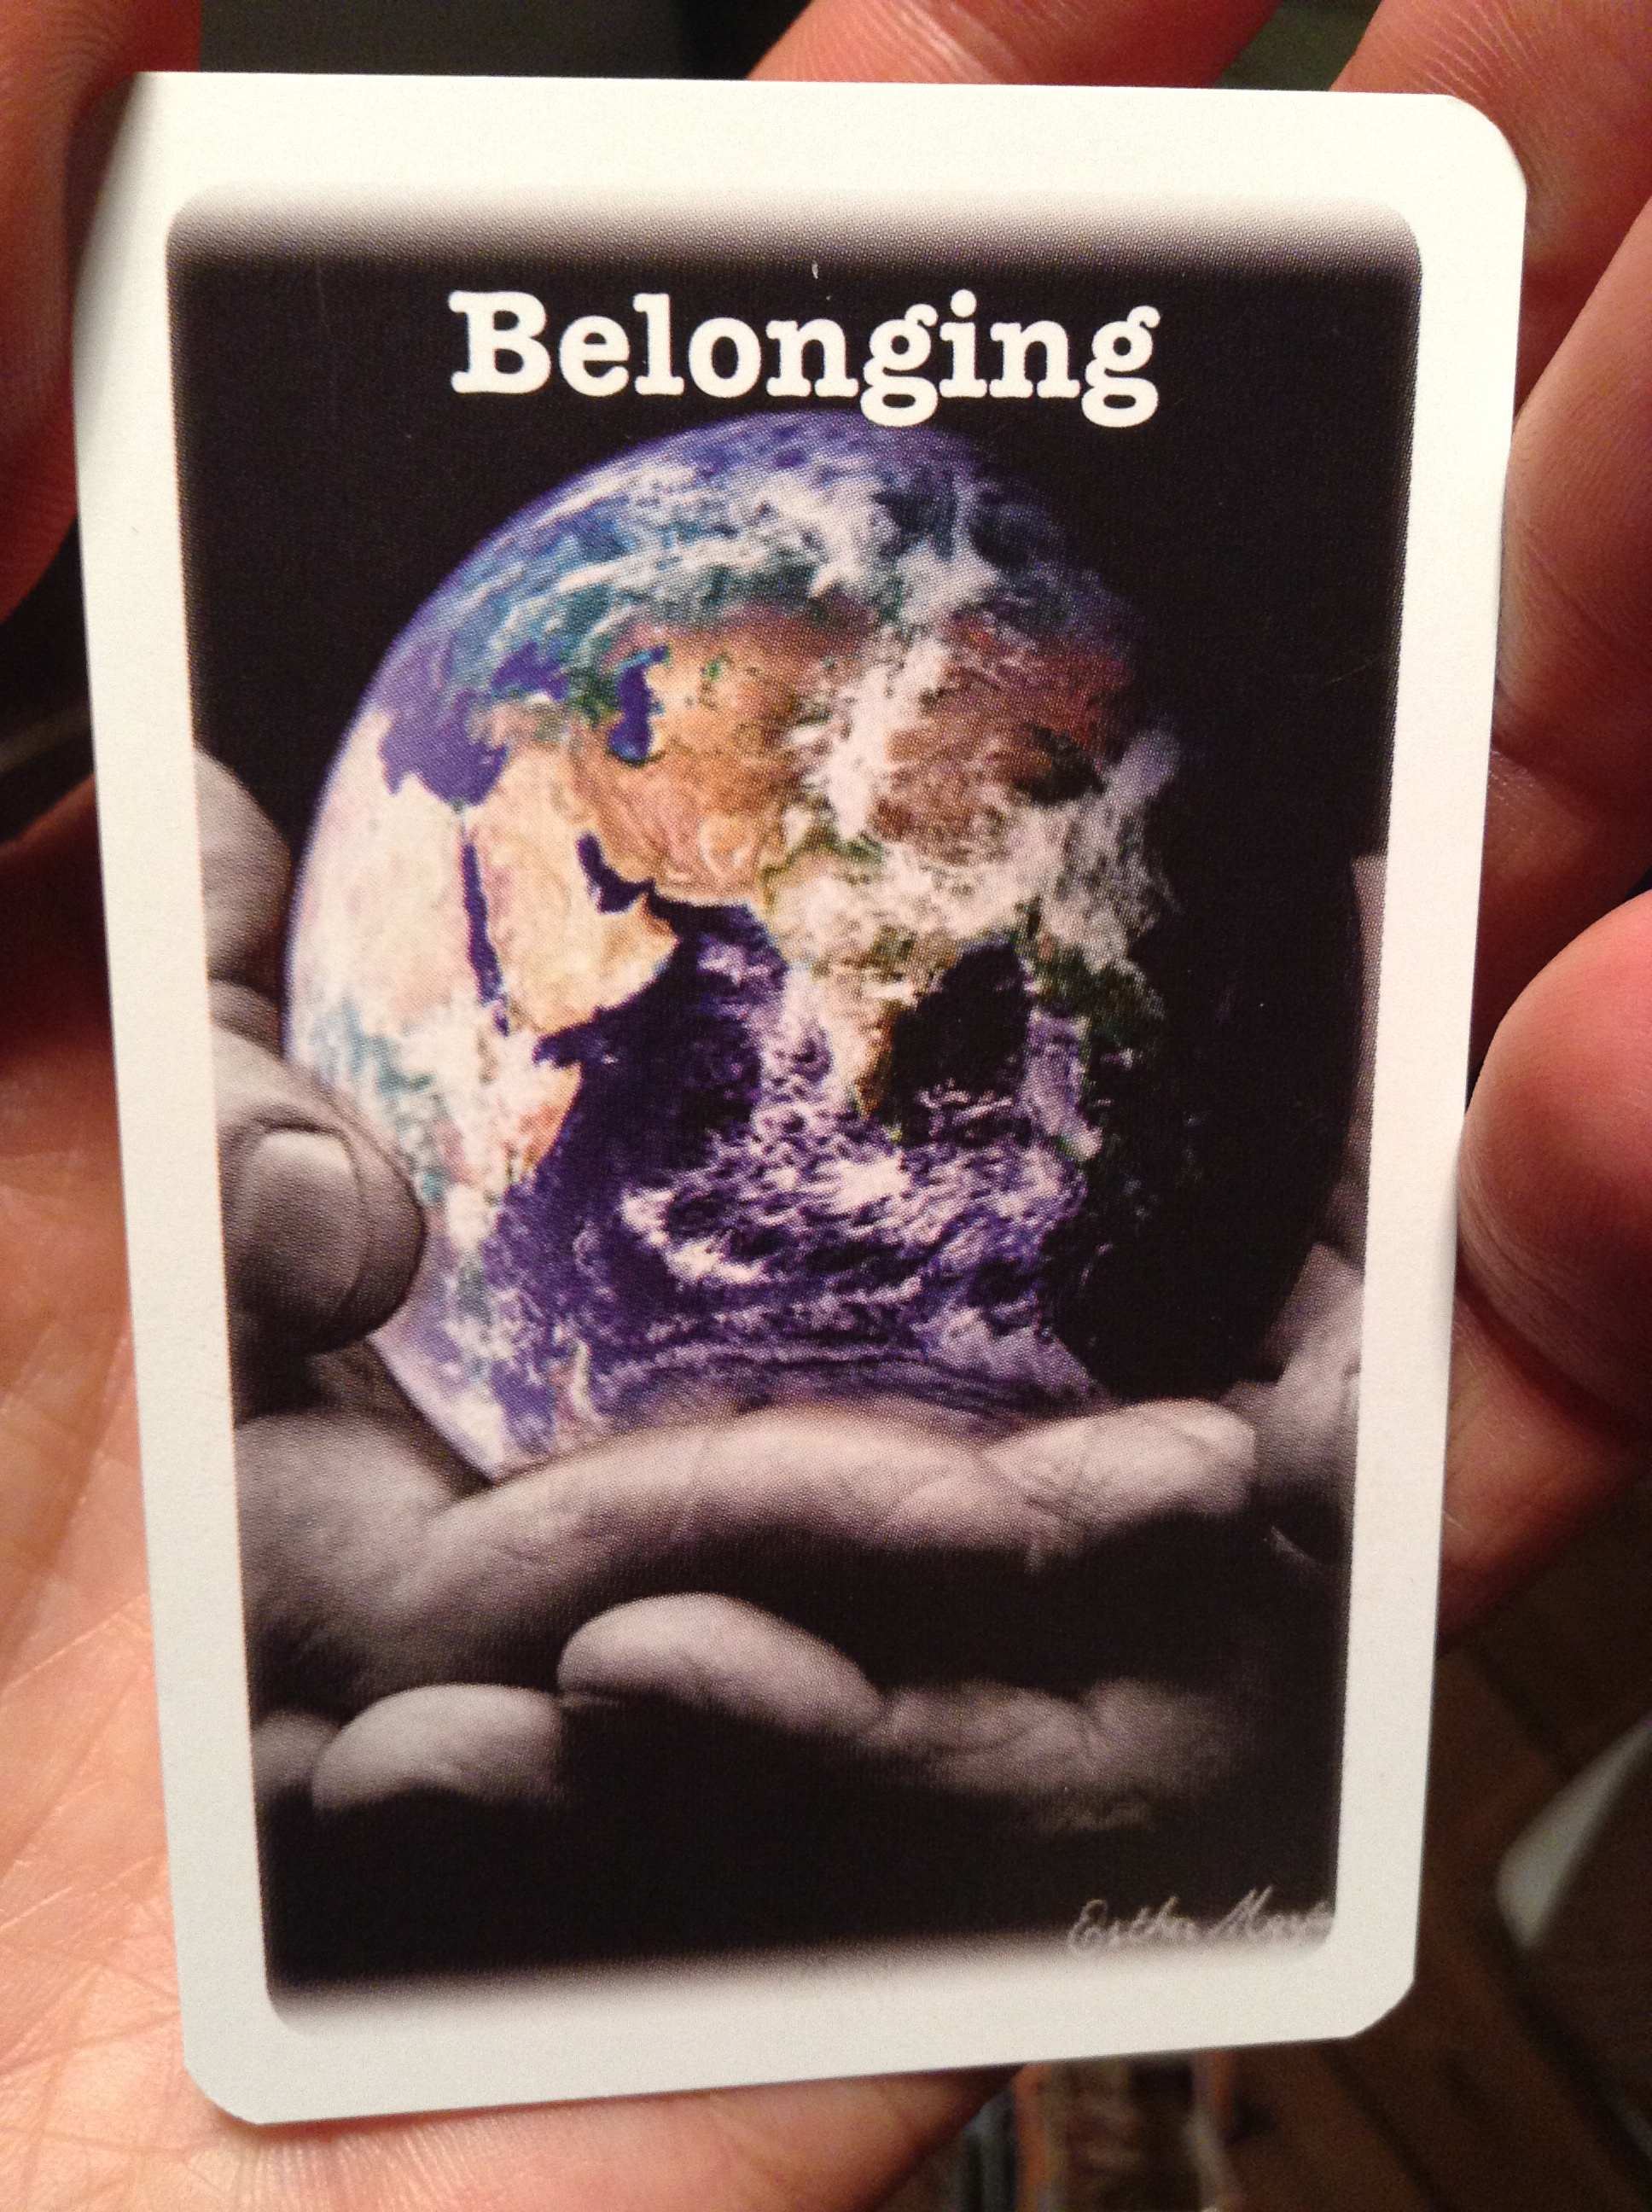
Notes:
With values, there is one I see students choose, again and again – Belonging, and we are starting to explore this further with teachers. We are looking at ways to ensure this is a verb…and to imagine what the school would look like, if everyone in there felt that they belonged; what would they then be doing for the school community?

Slide 15
Notes:
We have joined PROSOCIAL – our group includes ourselves all the pastoral heads and some students. Our hope is that we can create an environment in which prosocial behaviour can flourish - an environment in which it is safe for everyone to be the sort of student / friend / teacher, they want to be.

Slide 16
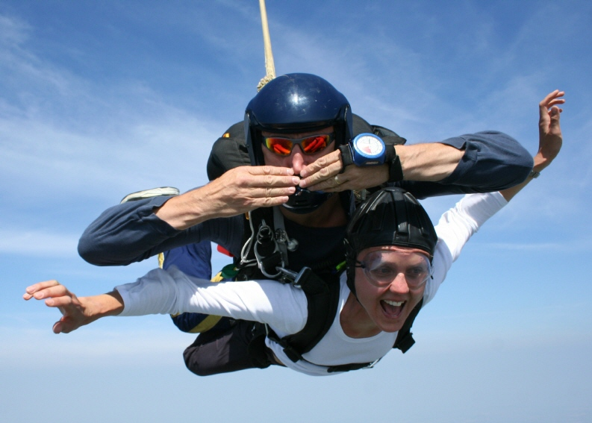
Notes:
What has kept us on track…
Our enthusiasm and our willingness to give this whole thing a go, to ‘jump’, alongside the willingness and passion from the staff. We are also learning to be firm - We have had to resist pressure to push things out in a hurry.

Slide 17
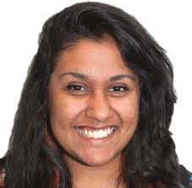
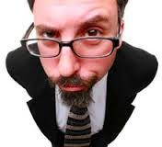
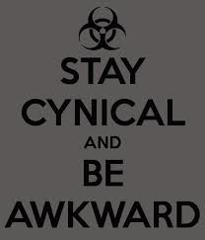
Notes:
What has got in the way…
Not every member of staff buys into this. Some do totally, others do a bit, some are not interested, and others don’t like it at all. You can’t make teachers do additional training, or conform to a practice they don’t buy into.

Slide 18
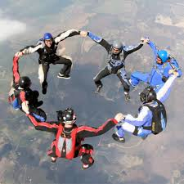
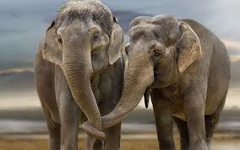
Notes:
Moving forward we are offering ongoing mentoring and support to staff, and helping to ensure consistency as new things are introduced.
It’s important that the schools own this – it’s not another thing they have to do, but a learning path they are on, and we are simply guides. We learn so much from them too!

Slide 19
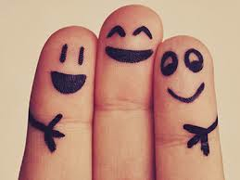
Notes:
Internet wisdom told us that an IGNITE should have just 3 messages, so:
1: If there’s something you really want to do, do it
2: Find willing partners
3: Don’t go for long dog walks with your sister, or you might end up doing something you’ve never done before, making it up as you go along, and presenting it at a world conference!

Slide 20
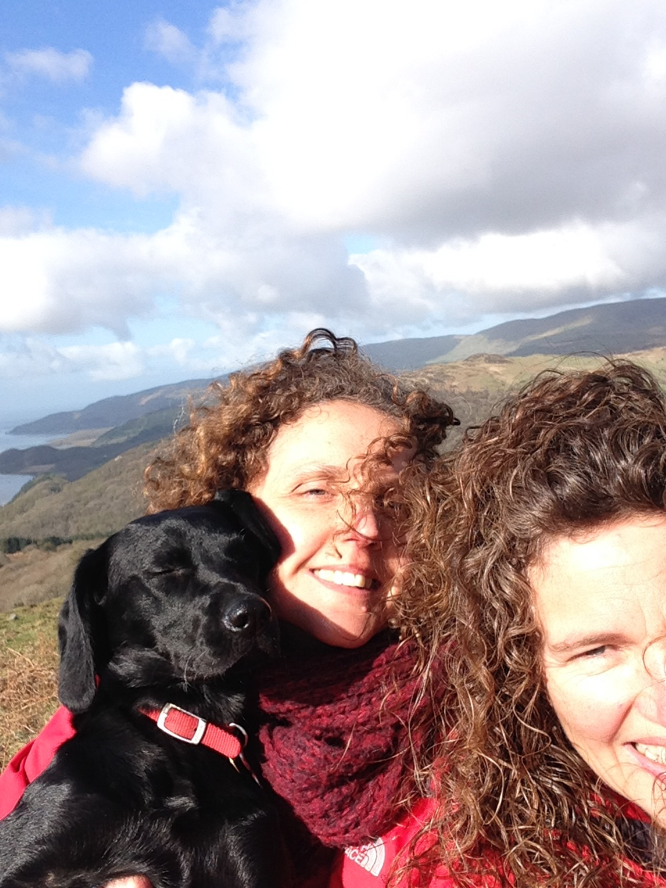
Notes:
Or even worse, you might end up NOT doing any of that.
And then Sister Act may never have happened.
We’re grateful we’ve been able to overcome our differences and work together – and we’re grateful to you all for listening – THANKYOU

