Slide 1
The relationship between cognitive flexibility and psychological flexibility after acquired brain injury
Whiting, Diane^{1,2}; Deane, Frank²; Ciarrochi, Joseph³; McLeod, Hamish⁴; Simpson, Grahame^{1,5,6}
1. Liverpool Brain Injury Rehabilitation Unit, Sydney, Australia
2. School of Psychology, University of Wollongong, Australia
3. School of Social Sciences and Psychology, University of Western Sydney, Australia
4. Institute of Health and Wellbeing, University of Glasgow, Scotland
5. Rehabilitation Studies Unit, University of Sydney, Australia
6. Inghams Institute Applied Medical Research, Liverpool, Australia
ACBS, Sydney, July 2013

Slide 2
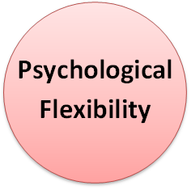
Aim
Explore the interaction between cognitive flexibility and psychological flexibility after an acquired brain injury
Cognitive Flexibility

Slide 3
Why?
Psychological flexibility is proposed to be necessary for well being
Psychological flexibility desired treatment outcome of contextual behaviour therapies such as ACT
A component of psychological flexibility is cognitive flexibility
After a brain injury people experience cognitive impairments including impairments in their cognitive flexibility
Therefore can those who demonstrate cognitive inflexibility achieve psychological flexibility?

Slide 4
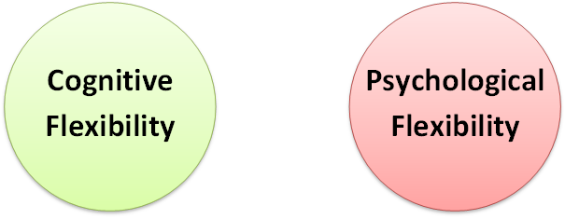
Separate Constructs

Slide 5
Overlapping
Cognitive Flexibility
Psychological Flexibility

Slide 6
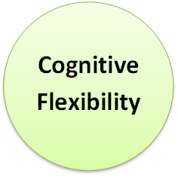
Is one a component of the other?
Psychological
Flexibility

Slide 7
Cognitive Flexibility
Cognitive flexibility is an aspect of executive functioning
It is the ability to change behaviour such as a thought or action in response to situational demands (Lezak, 2004)
Individuals with ABI often demonstrated impairments in their executive functioning, including their cognitive flexibility.

Slide 8
Psychological Flexibility
Psychological flexibility refers to an individuals ability to stay in contact with the present moment and to change or persist with behaviour that is consistent with their values (Hayes et al., 2006)
Component of psychological flexibility is proposed to be cognitive flexibility (Chawla & Ostafin, 2007; Kashdan & Rottenberg, 2010)
The goal of ACT is to increase psychological flexibility within the context of a values guided life.

Slide 9
Measures
Psychological flexibility
Acceptance & Action Questionnaire II (AAQ-II) (Bond et al., 2011)
Acceptance & Action Questionnaire–Acquired Brain Injury (AAQ-ABI-R) (Sylvester, 2011)
Mood
Depression Anxiety and Stress Scales–21 (DASS21)
Positive and Negative Affect Schedule (PANAS)
Appraisal Threat and Avoidance Questionnaire (ATAQ)
Cognitive flexibility
Similarities (Subtest of WAIS-IV)
Wisconsin Card Sort Test (Perseverative errors, failure to maintain set)
Trail Making Test (A/B%)
Stroop
Alternate Uses Test (AUT)
COWAT (post hoc)

Slide 10
Participants
75 ABI clients of Liverpool Brain Injury Rehabilitation Unit
Inclusion criteria
Sustained an acquired brain injury (ABI) after the age of 17 years
Aged between 17 and 65 years
Adequate language skills & cognitive ability to complete measures
Exclusion criteria
Malingering on neuropsychological assessment
ABI is from a dementia or neurological illness

Slide 11
Demographic Variables
Variable | Mean (SD)/Number (%) N = 75
Gender - Male - Female | 58 (77.3) 17 (22.3)
Age | 38.7 (14.5)
Injury Type - TBI - ABI | 58 (77.3) 17 (22.3)
PTA (days) (n=58) [median] | 24.6 (34.3) [14]
Time since injury/dx (months) [median] | 20.8 (27.0) [14]

Slide 12
Results Relationships between Psychological flexibility and measures of mood – Spearmans Rho (n=75)
 | AAQ-II | DASS-Depr | DASS- Anx | DASS- Stress | PANAS -ve | PANAS +ve | ATAQ- threat | ATAQ- Avoid
AAQ-ABI 9-item | .70** | -.67** | -.63** | -.64** | -.74** | .35** | -.66** | -.72**
AAQ-II |  | -.66** | -.52** | -.56** | -.72** | .33** | -.60** | -.63**
DASS: Depression Anxiety and Stress Scale – 21; PANAS: Positive and Negative Affect Schedule; ATAQ: Appraisal Threat and Avoidance Questionnaire
**p < .01;

Slide 13
Results Relationships between psychological flexibility and cognitive flexibility– Spearmans Rho (n=75)
 | Sim | WCST PR | WCST FTMS | Stroop C/W % | Trails A/B % | FAS | AUT
AAQ-ABI 9-item | .26* | -.21 | -.26* | .33** | .04 | .42** | .32**
AAQ-II | .23* | -.06 | -.08 | .28* | -.003 | .49** | .24*
**p < .01; *p < .05
Sim: Similarities (WAIS-IV), WCST PR – Perseverative Responses, WCST FTMS: Failure to maintain set, Stroop C/W %: Colour Word Percentile, Trails A/B%: Percentage ration between trail A & B, FAS: Controlled Oral Word Associate Test, AUT: Alternate Uses Test.

Slide 14
Results Relationships between psychological flexibility and cognitive flexibility FSIQ (WIAS-IV & III) Spearmans Rho (n=51)
 | AAQ-II | Sim | WCST PE | WCST FTMS | Stroop C/W% | Trails A/B% | FAS | AUT
AAQ-ABI 9-item | .62** |  | NA | -.09 ns | .35* | NA | .27 p=.055 | .20 ns
AAQ-II |  |  | NA | NA | .13 ns | NA | .39** | .09 ns
**p < .01; * p < .05
Similarities excluded as it is a subtest of WAIS-IV

Slide 15
Results Relationships between psychological flexibility and memory, working memory and processing speed Spearmans Rho (n=51)
 | Arith | Coding | Symbol Search & Digit Span | CVLT-II 1-5 | CVLT Short delay | WMS LM I | WMS LM II | WMS VR I & VRII
AAQ-ABI 9-item | .32* | .32* | ns | .24* | ns | .27* | ns | ns
AAQ-II | .28* | .26* | ns | .30* | .25* | .27* | ns | ns
p < .05
Working Memory: Arithmetic & Digit Span
Processing Speed: Coding & Symbol Search

Slide 16
Results Relationships between psychological flexibility and memory, working memory and processing speed Spearmans Rho Partial correlation with FSIQ (WAIS-IV &III) (n=48)
 | Arith | Coding | Symbol Search & Digit span | CVLT-II 1-5 | CVLT Short delay | WMS LM I | WMS LM II | WMS VR I & VRII
AAQ-ABI 9-item |  |  |  | ns | ns | ns | ns | ns
AAQ-II |  |  |  | ns | ns | ns | ns | ns
Arithmetic, Coding, Symbol Search & Digit span excluded as all subtests of FSIQ

Slide 17
Results Relationships between psychological flexibility and cognitive flexibility partial correlation with 1. Working memory (Arithmetic) 2. Processing speed (Coding) Spearmans Rho (n=51)
 | 1. Wording Memory (Arithmetic) |  | 2. Processing Speed (Coding)
 | Stroop C/W% | FAS Verbal Fluency | Stroop C/W% | FAS Verbal Fluency
AAQ-ABI 9-item | .35** | .25 | .35** | .30*
AAQ-II | .13 ns | .34* | .13 ns | .37**
**p < .01; * p < .05

Slide 18
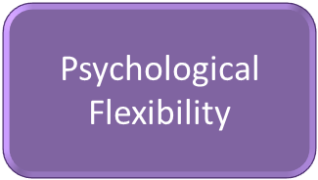
Cognitive Flexibility
Psychological Flexibility
Accounting for
General Intelligence
Verbal & Visual Memory
Working memory
Processing Speed
COWAT (FAS)
Verbal generativity
Stroop C/W
Verbal inhibition

Slide 19
Conclusions
Components of cognitive flexibility are associated with psychological flexibility
A large number of the relationships can be explained by general intelligence
The ‘ability to shift’ a commonly used measure of cognitive flexibility demonstrated no association
Higher level verbal flexibility such as verbal generativity and verbal inhibition indicated a moderate positive relationship
This association remained even accounting for general intelligence, working memory and processing speed.

Slide 20
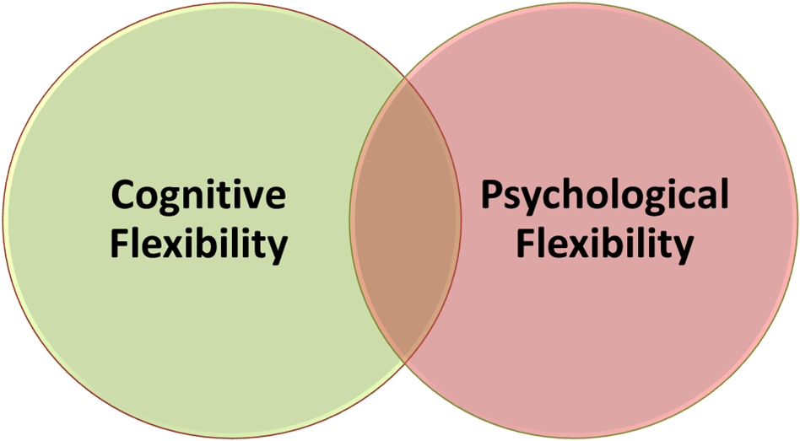
Final Message
Higher levels of psychological flexibility are associated with good verbal generativity and verbal inhibition
Therefore, there does appear to be some overlap between the constructs of cognitive flexibility and psychological flexibility but …
You don’t necessarily have to be cognitively flexible in order to be psychological flexible but it probably helps!

Slide 21
References & Questions
Bond, F. W., Hayes, S. C., Baer, R. A., Carpenter, K. C., Guenole, N., Orcutt, H. K., Waltz, T., Zettle, R. D. (2011). Preliminary psychometric properties of the Acceptance and Action Questionnaire–II: A revised measure of psychological flexibility and acceptance. Behavior Therapy, 42, 676-688.
Chawla, N., & Ostafin, B. (2007). Experiential avoidance as a functional dimensional approach to psychopathology: An empirical review. Journal of Clinical Psychology, 63(9), 871-890.
Hayes, S. C., Luoma, J. B., Bond, F. W., Masuda, A., & Lillis, J. (2006). Acceptance and Commitment Therapy: Model, processes, and outcomes. Behaviour Research and Therapy, 44(1), 1-25.
Kashdan, T. B., & Rottenberg, J. (2010). Psychological flexibility as a fundamental aspect of health. Clinical Psychology Review, 30(4), 467-480.
Lezak, M. D. (2004). Neuropsychological assessment: Oxford University Press, USA.
Sylvester, M. (2011). Acceptance and commitment therapy for improving adaptive functioning in persons with a history of pediatric acquired brain injury. Doctor of Philosophy in Clinical Psychology Dissertation, University of Nevada, Reno.

