Slide 1
There’s No One Right Answer
Using the Matrix to Support Gender Diverse clients in counseling
Lauren Grousd, MA, LCPC
Portland, Maine, USA
Lauren@LaurenGrousdlcpc.net
www.laurengrousdlcpc.net

Slide 2
Objectives
Identify common experiences and dilemmas that gender diverse clients bring into counseling
Describe how the 6 core ACT processes can manifest in work with gender diverse clients
Utilize the ACT Matrix and related ACT exercises to support gender diverse clients in clinical practice

Slide 3
Group Agreements
Confidentiality
Notice our assumptions
Honor and respect each other’s experience
Take care of ourselves
Help each other understand – ask for clarification on language, etc.
What do you need in order to feel safe in this workshop?

Slide 4
Raise Your Hand…
If you’ve worked with at least 1 Trans* client
If you regularly work with trans* clients
If you use the matrix in your practice
If you have personal experience with gender diversity (family, friend, partner, self)
If you work in Europe
North America
South America
Australia or New Zealand
Asia
Africa

Slide 5
A Note (or Several) On Language…
Trans* = Transgender and Gender-Nonconforming
Gender-Nonconforming
Non-Binary
Genderqueer
Genderfluid
Pangender
Agender
Bigender
Androgynous
Cisgender (Cis)
Transman/Transwoman
MtF/FtM or M2F/F2M
Transsexual
Pre-Op/Post-Op/Non-Op
Assigned Female/Male at Birth
“Tranny”
“Hermaphrodite”
Notes:
Terminology is constantly evolving
This is not an exhaustive list
Some terms are currently considered offensive – “tranny,” “hermaphrodite”

Slide 6
A Note (or Several) On Language…
Medical Transition
Diagnosis & Other Terms
Top or Bottom Surgery
Sex Reassignment Surgery (SRS)
Gender-Affirming Surgery
Gender Confirmation Surgery (GCS)
Cross-Sex Hormone Therapy
Feminizing or Masculinizing Hormones
“T” or Testosterone
Puberty Blockers
Gender Identity Disorder – DSM-IV-TR
Gender Dysphoria – DSM 5
Passing
Stealth
Misgendering
Notes:
Estradiol and Spironilactone – feminizing hormones

Slide 7
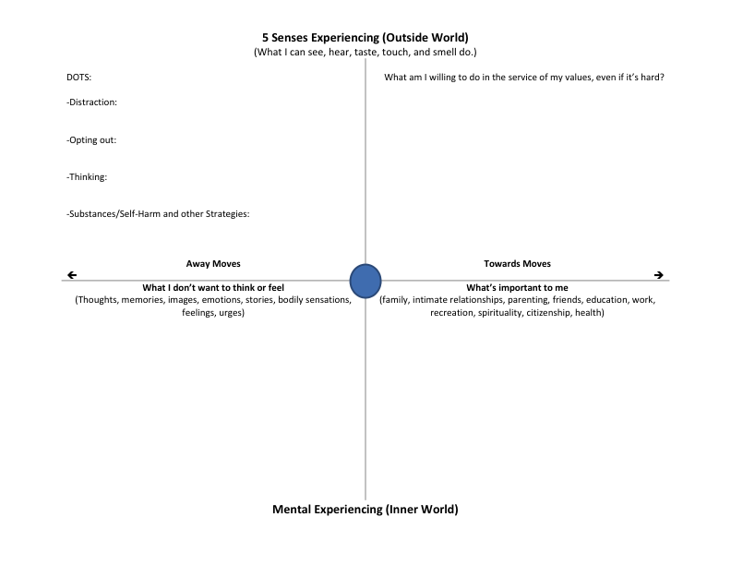
Adapted from Asling Curtin, MSc, The Matrix, Polk and Schoendorff, ed.
Notes:
The version that I use – not the only or the best!

Slide 8
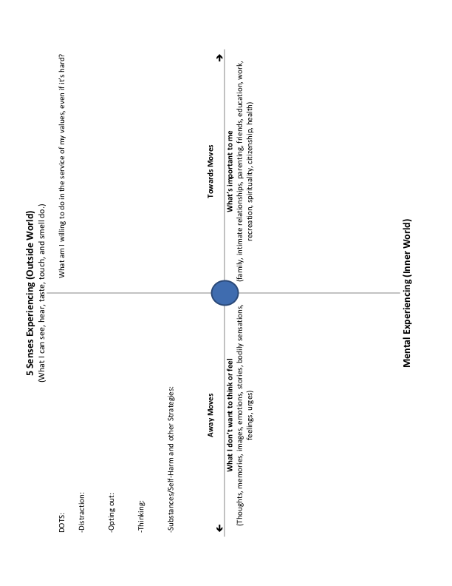
Matrix Highlights
Noticing the Difference
Facilitates Self as Context and Defusion
“Towards” and “Away” Moves = Experiential Avoidance vs Committed Action
Vortex of Doom
Concretizes Values
Mindfulness and Acceptance strategies as a bridge; Values as a reason to cross over
Notes:
Main points about the Matrix:
Sorting task – “noticing the difference”
Facilitates Self as Context – sets up perspective taking
Highlights the differences between Experiential Avoidance and Committed Action – “Towards” and “Away” moves
Vortex of Doom = getting hooked – going in circles that perpetuate getting stuck, feeling stuck, BEING STUCK
Values translated into contextual action – what values look like in a specific context
Mindfulness and Acceptance strategies facilitate a shift from the Away side to the Towards side
Values as the “why?”

Slide 9
Trans* Experience #1
Relationships and Transition
Matrix It!
“I don’t see a relationship in my future anytime soon. Right now I feel like I am going through puberty all over again. I have to get comfortable in my body and gender presentation before I can even think about involving someone else.”
Trans Bodies, Trans Selves, p. 344
Notes:
If you were this client, where would you sort this content?
What questions would you want to ask this client to help them explore the other quadrants of the Matrix?
What ACT metaphors or exercises would you use?

Slide 10
Adapted from Asling Curtin, MSc, The Matrix, Polk and Schoendorff, ed.
Notes:
Relationships and Transition

Slide 11
Trans* Experience #2
Disclosure
Matrix It!
“I’ve found that the more comfortable I am with my trans history when I’m disclosing, and the less nervous I seem, the more comfortable my date is. I say that it’s shaped who I am in many ways, and I want the other person to know and ask me about it – but it’s not a negative thing. I’ve had many dates where my disclosure has opened up an entirely new realm of conversation and has put my date at ease about sharing aspects of themselves with me.”
Trans Bodies, Trans Selves, p. 342
Notes:
If you were this client, where would you sort this content?
What questions would you want to ask this client to help them explore the other quadrants of the Matrix?
What ACT metaphors or exercises would you use?

Slide 12
Adapted from Asling Curtin, MSc, The Matrix, Polk and Schoendorff, ed.
Notes:
Disclosure

Slide 13
Trans* Experience #3
Parents & Culture
Matrix It!
I am a second-generation immigrant from Russia. It’s very difficult for me to talk to my mother (dad is an American) about this. She is still stuck in the mindset that even being gay is a mental imbalance, and so with any discussion of my identity I quickly become too tearful and disgusted to continue talking. I wish there was a way to approach it with her, but until I have become a bit more self-sufficient financially, that probably isn’t going to be an option.
Trans Bodies, Trans Selves, p. 46-7
Notes:
If you were this client, where would you sort this content?
What questions would you want to ask this client to help them explore the other quadrants of the Matrix?
What ACT metaphors or exercises would you use?

Slide 14
Adapted from Asling Curtin, MSc, The Matrix, Polk and Schoendorff, ed.
Notes:
Disclosure

Slide 15
Trans* Experience #4
Kate*: 50 y.o, assigned female at birth
Matrix It!
Identifies as a butch lesbian with a masculine gender presentation.
Seeking counseling to address chronic loss of libido in her long-term relationships, which has lead to her cis wife recently asking for a divorce.
Describes dissatisfaction with her body – dislikes own breasts, fantasizes about having sex as a male but dislikes using toys because “they feel fake.”
Strong ID as a butch lesbian – “it’s taken me such a long time to get to this place, I don’t want to have to do more work to figure out who I am.”
Notes:
If you were this client, where would you sort this content?
What questions would you want to ask this client to help them explore the other quadrants of the Matrix?
What ACT metaphors or exercises would you use?

Slide 16
Adapted from Asling Curtin, MSc, The Matrix, Polk and Schoendorff, ed.
Notes:
Disclosure

Slide 17
Trans* Experience #5
River*: 24 y.o., assigned male at birth
Matrix It!
Identifies as genderqueer with a feminine gender presentation
Seeks counseling to address anxiety, difficulty with organization and making decisions, and to access feminizing hormones
Moving back to hometown. Parents told River they can’t come out to 17 y.o. brother as trans* or present as feminine around him if they’re going to live at home while getting settled. River is 6 mo. into hormone therapy.
Unclear work/career goals; parents have always been very directive re:school & work
Tends to become fearful when faced with decisions, procrastinates and avoids difficult conversations, and has difficulty identifying behavioral options.
Notes:
If you were this client, where would you sort this content?
What questions would you want to ask this client to help them explore the other quadrants of the Matrix?
What ACT metaphors or exercises would you use?

Slide 18
Adapted from Asling Curtin, MSc, The Matrix, Polk and Schoendorff, ed.
Notes:
Disclosure

Slide 19
Trans* Experience #6
Jordan*: 17 y.o., assigned female at birth
Matrix It!
Identifies as male with a masculine gender presentation
Seeks counseling to address anxiety, depression, and to access masculinizing hormones. Significant gender dysphoria.
Parents refuse to use correct pronouns or acknowledge his gender identity. Jordan plans to live at home through initial years of college.
Out at school, girlfriend and her parents supportive. Played hockey until experiencing several concussions and needing to stop.
History of cutting, suicidal ideation, physical fighting. Jordan is at his 3rd high school after experiencing transphobia and then he reports being asked to leavehis 2nd high school following the discovery of his cutting.
Notes:
If you were this client, where would you sort this content?
What questions would you want to ask this client to help them explore the other quadrants of the Matrix?
What ACT metaphors or exercises would you use?

Slide 20
What comes up for you re: working with gender diverse clients?
Adapted from Asling Curtin, MSc, The Matrix, Polk and Schoendorff, ed.
Notes:
Matrix your own experience as a therapist/professional working with trans* clients
Silently or large group whip

Slide 21
Resources
WPATH – www.WPATH.org
Trans Bodies, Trans Selves by Laura Erickson-Schroth, ed.
Trans/Love by Morty Diamond and Julia Serano, eds.
My Gender Workbook by Kate Bornstein

