Slide 1
Brief ACT and Population-based Care

Slide 2
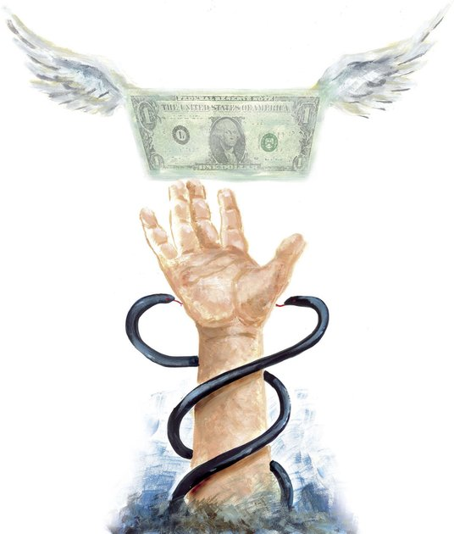
Setting the Stage
Integrated care is becoming increasingly prevalent
Managed care will be asking for shorter treatment lengths, and more concrete results
We have an ethical obligation to provide services to more people at their time of need

Slide 3
Population-Based Care Perspective
Population-based care:
Much is to be gained in clinical and cost outcomes when we focus resources on helping all people maintain optimal health as long as possible, rather than attending exclusively to people in acute need of services
Simultaneously, we may realize better outcomes by changing the way we care for people who are most disabled by health problems

Slide 4
Population-Based Care Perspective
Population-based care:
By saving money spent caring for the most vulnerable, we create a pot of money for intervening with members of the population who are still healthy or less impaired by disorder and disease than the most severely impaired members

Slide 5
Population-Based Care Perspective
Example: in CMHC clinic setting, targeting healthy weight and lifestyle for folks taking psychotropic meds
Ideally this would prevent secondary problems & more medical visits down the line

Slide 6
The PCBH Model
Primary Care Behavioral Health:
With increasing frequency, research findings indicate that behavioral health services delivered in the context of the PCBH model result in improved symptoms, better quality of life, and higher life satisfaction for most clients; that most clients benefit from an average of four or fewer visits; that gains made by clients are maintained for several years, and that clients and primary care providers prefer this model to usual care1

Slide 7
The PCBH Model: BHCs
The Behavioral Health Consultant (BHC) offers brief intervention services to children, youth, and adults, often on the same day of the client’s visit with the referring PCP or nurse
The BHC uses evidence-based interventions adapted to the brief context of primary care and translates these to even briefer versions that BHCs can teach PCP and nurse members of the team.
This allows the PCP, the BHC’s primary customer, to support client efforts to practice new strategies and skills over time and in this way sustain gains in functioning.
The BHC is considered to be a primary care provider rather than a specialist and charts in the medical record rather than a separate mental health record.
The BHC does not have a caseload, does not “open” or “close” cases, and is easily accessed by clients and family members on an intermittent basis over the course of their lifetime.

Slide 8
The PCBH Model: BHCs
The Behavioral Health Consultant (BHC) offers brief intervention services to children, youth, and adults, often on the same day of the client’s visit with the referring PCP or nurse
The BHC uses evidence-based interventions adapted to the brief context of primary care and translates these to even briefer versions that BHCs can teach PCP and nurse members of the team.
This allows the PCP, the BHC’s primary customer, to support client efforts to practice new strategies and skills over time and in this way sustain gains in functioning.
The BHC is considered to be a primary care provider rather than a specialist and charts in the medical record rather than a separate mental health record.
The BHC does not have a caseload, does not “open” or “close” cases, and is easily accessed by clients and family members on an intermittent basis over the course of their lifetime.

Slide 9
The BI-CAT
The brief intervention - competency assessment tool
Four domains:
Practice Context
Intervention Design
Intervention Delivery
Outcomes-based Practice

Slide 10
Mary
Mary is a 27-year old licensed master social worker and Behavioral Health Consultant (BHC).
She felt challenged by traditional notions of ‘therapy’ and a lack of direction regarding her role as a team member
Her supervisor introduced the BI-CAT and some readings to help guide her development

Slide 11
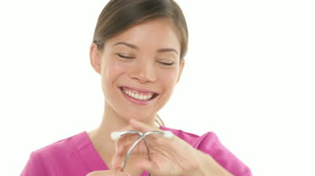
Mary
She discovered FACT and decided to develop a chronic pain PCBH pathway that utilized the Bulls Eye Plan and workability questions
She shared the protocol with MDs and nurses, and started a monthly group
Outcomes from the chronic pain class included improved satisfaction with care for clients and for primary care providers and nurses as well
She feels more engaged with her work than ever and looks forward to developing more protocols to serve her clients

Slide 12
References:
Bryan, Corso, Corso, Morrow, Kanzler, et al., 2012; Bryan, Morrow, & Appolonio, 2008; Cigrang, Dobmeyer, Becknell, Roa-Navarrete, & Yerian, 2006; Corso, Bryan, Corso, Kanzler, Houghton, et al., 2012; Ray-Sannerud, Dolan, Morrow, Corso, Kanzler, et al., 2012; Simon, Katon, Rutter, VonKorff, Lin, Robinson, et al., 1998; Smith, Rost, & Kashner, 1995

