Slide 1
Learning to Fly: How I Found My Wings
& Built an ACT Research Program
Jonathan B. Bricker

Slide 2
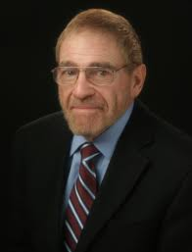

Slide 4
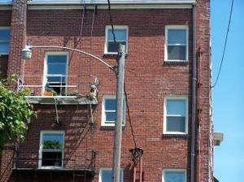
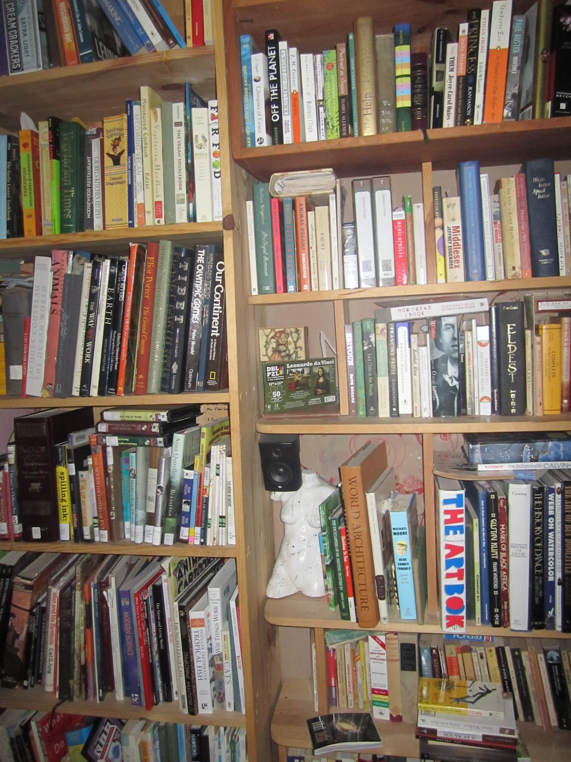

Slide 6
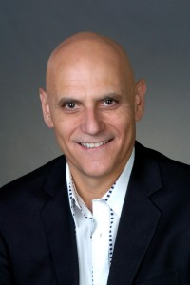

Slide 7
Boring
Unlikeable
Don’t Belong

Slide 8
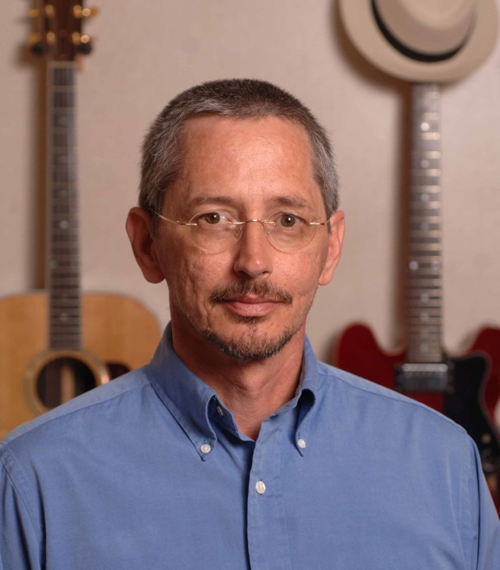
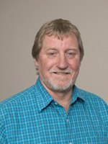
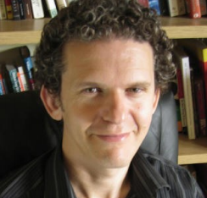

Slide 9
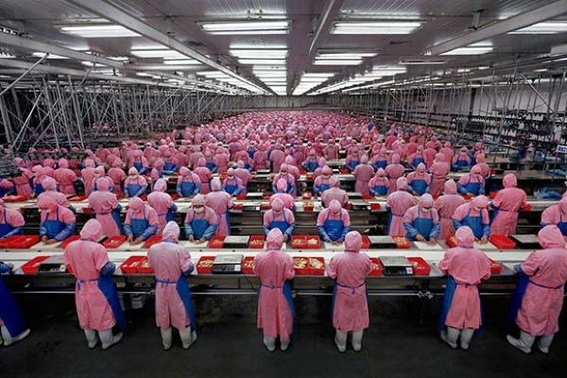
This talk is terrible.
Let’s write a grant on…
Did I just offend Bob Kohlenberg?
Let’s use clinical process data to predict smoking.
Do I look fat in this shirt?
Oh, that’s an idea!

Slide 10
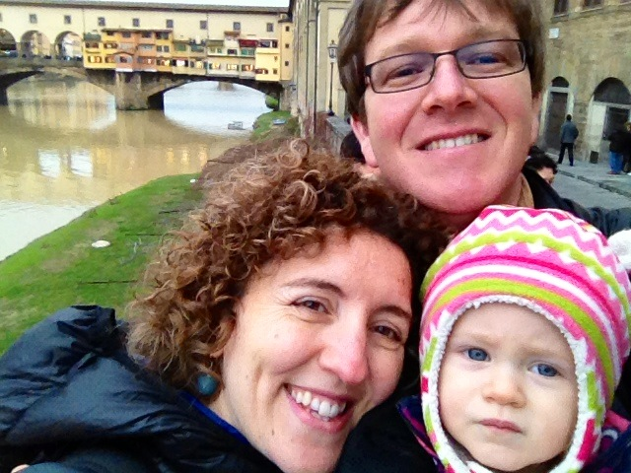
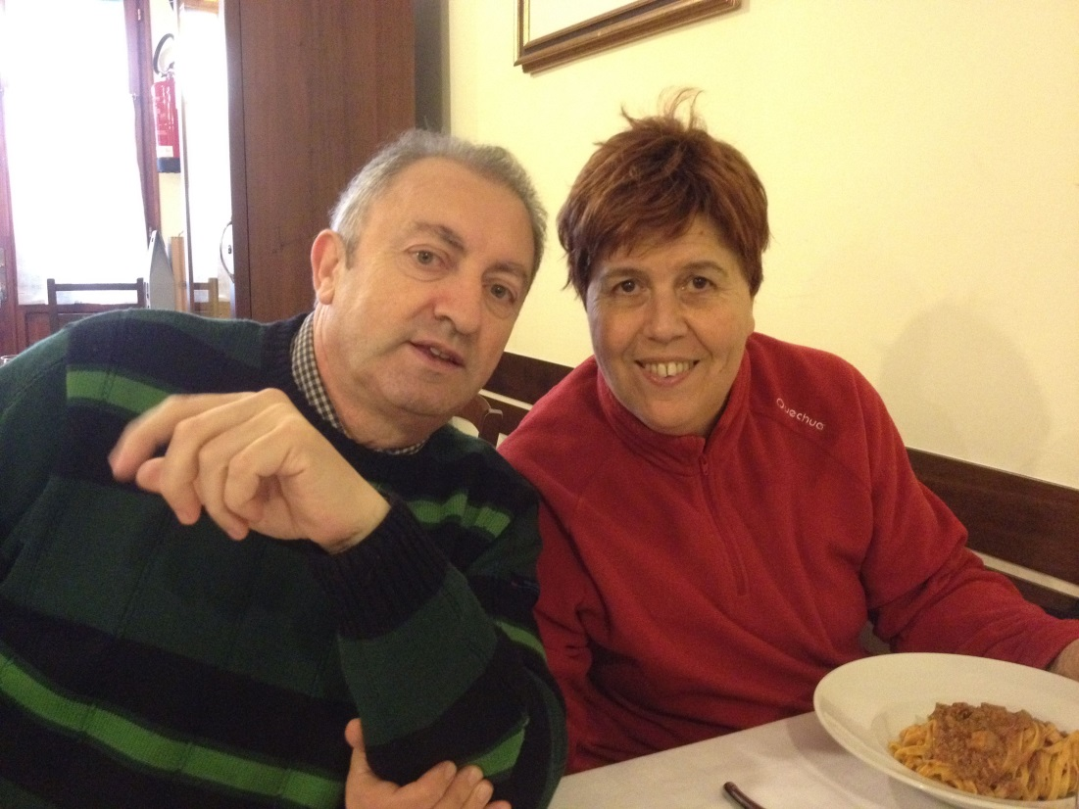
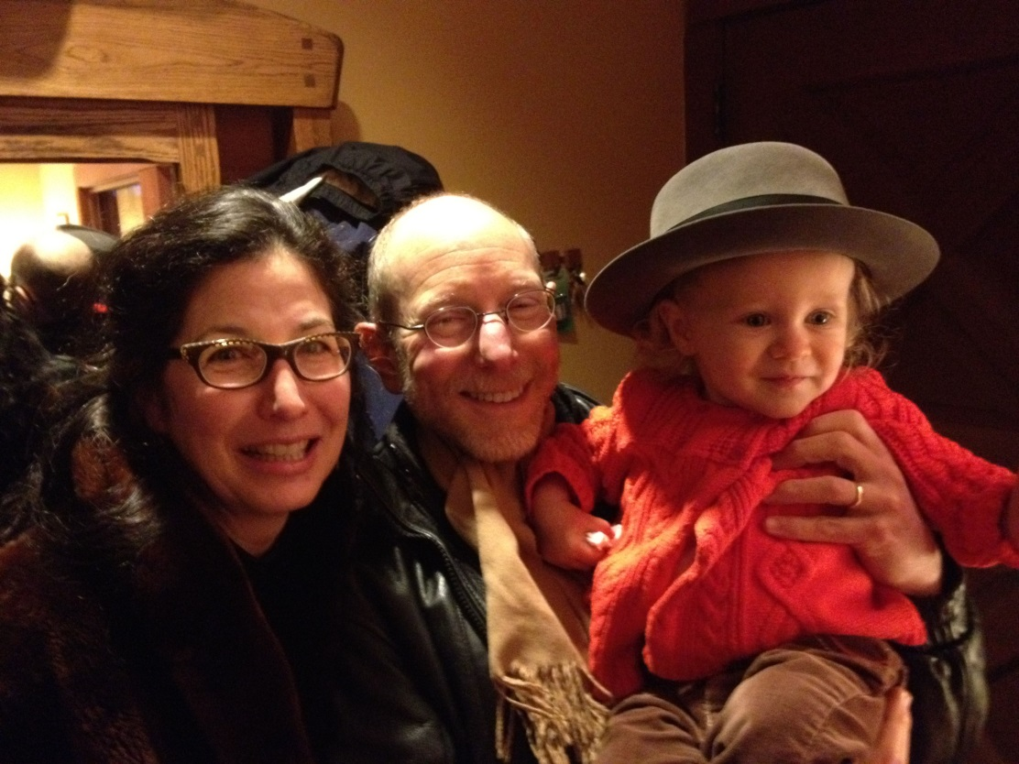
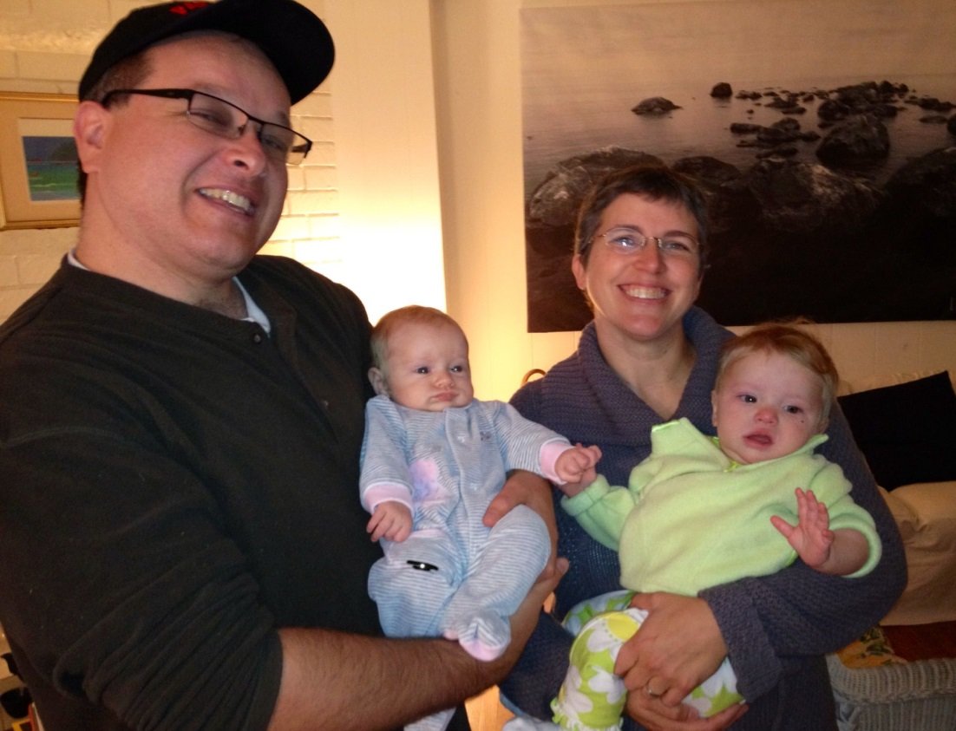

Slide 11
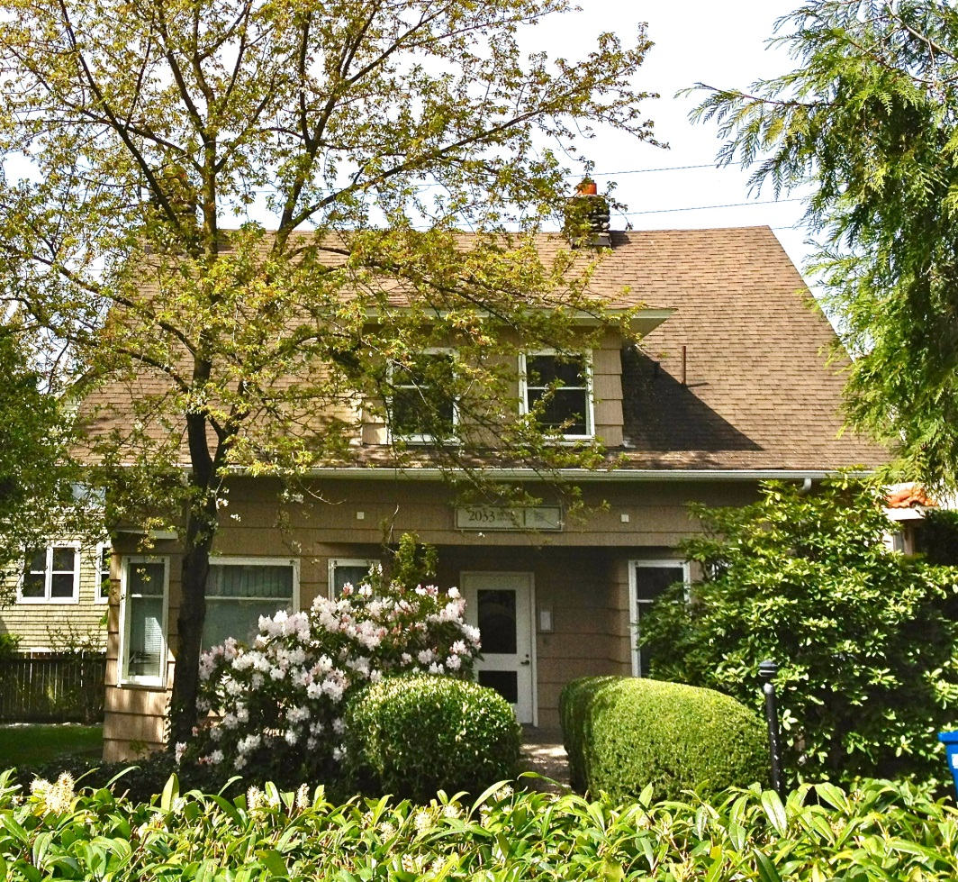
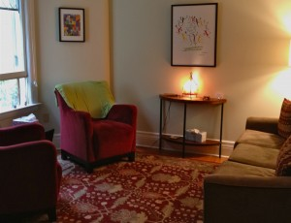

Slide 12
Am I denying them proven tx?
Am I a helpful ACT therapist?
Am I an ACT fraud?
I don’t know what I am doing.
I forgot the metaphor.
I can’t believe I just made that up.

Slide 15
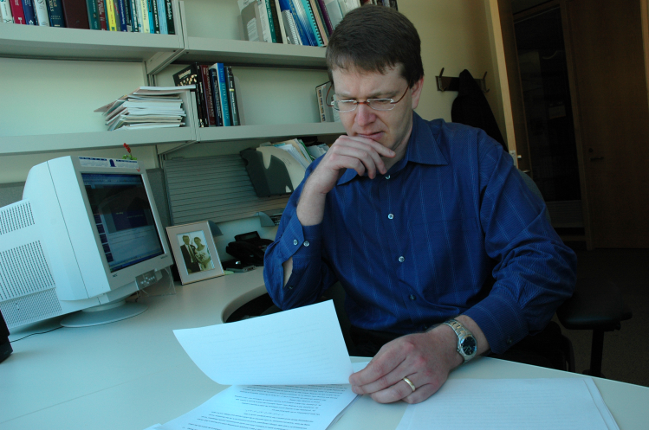
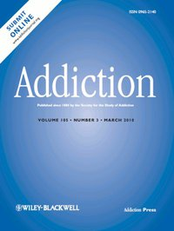

Slide 16
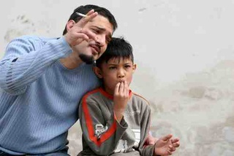
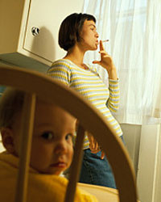
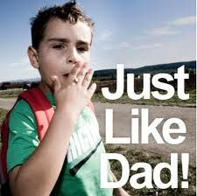

Slide 17
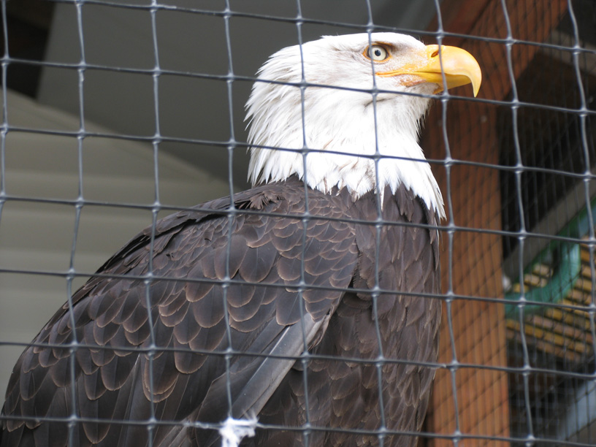

Slide 18
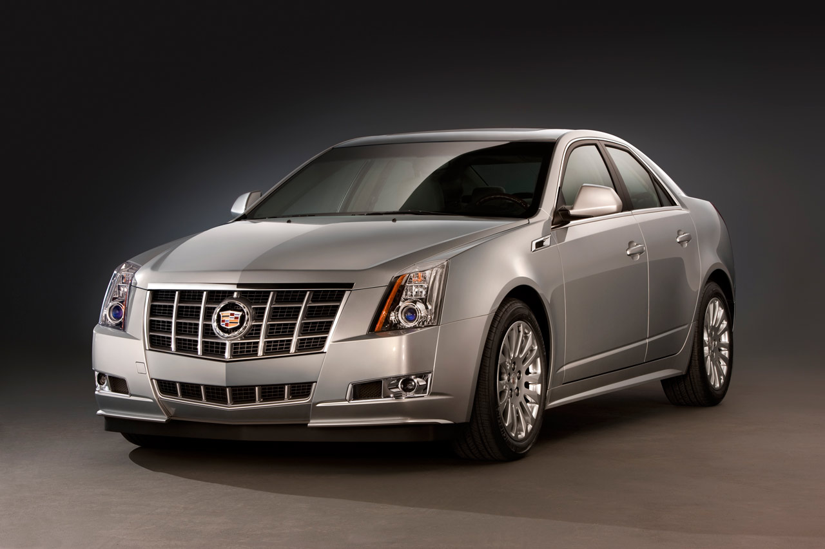

Slide 19
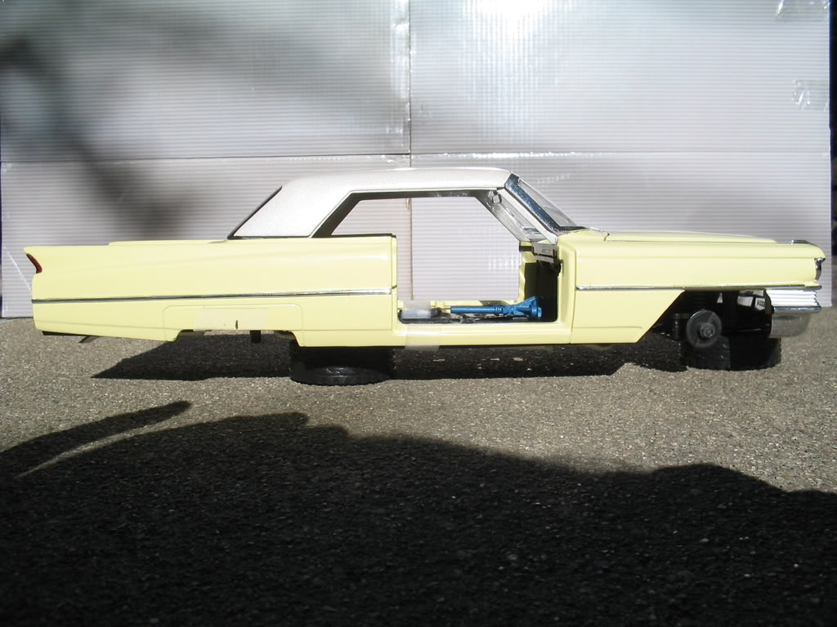

Slide 20
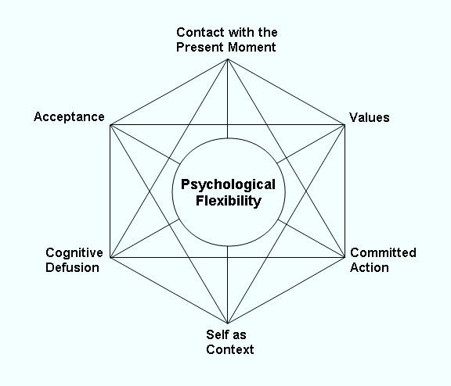

Slide 21
ACT wont work.
You can’t lead this research.
You’re not ready.
This won’t get funded.

Slide 22
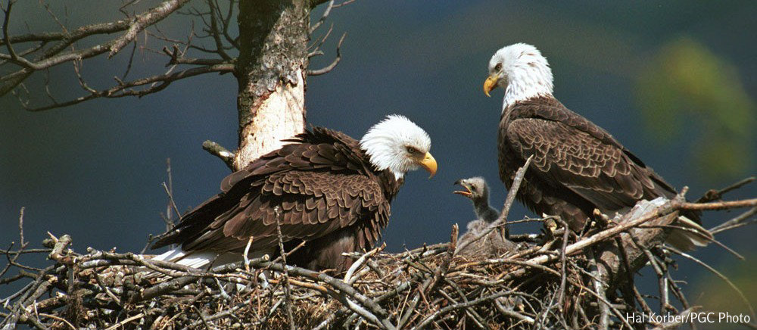

Slide 24
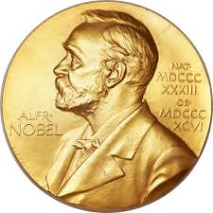

Slide 25
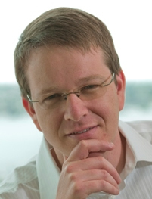
???

Slide 26
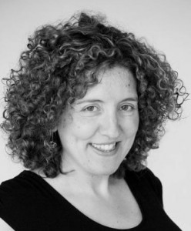

Slide 27
My Values
Discovering, developing, and rigorously testing new behavior therapies to improve health.
Disseminating scientific results and clinical methods.
Leading a professional team that fosters support, compassion, and growth.
Mentoring the next generation of behavioral scientists.
Directly helping people live healthier lives.

Slide 28
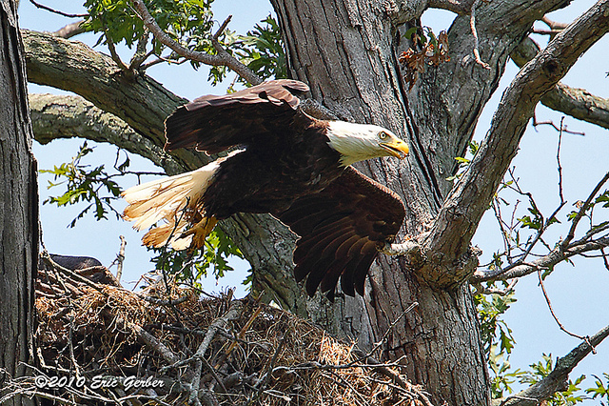

Slide 30
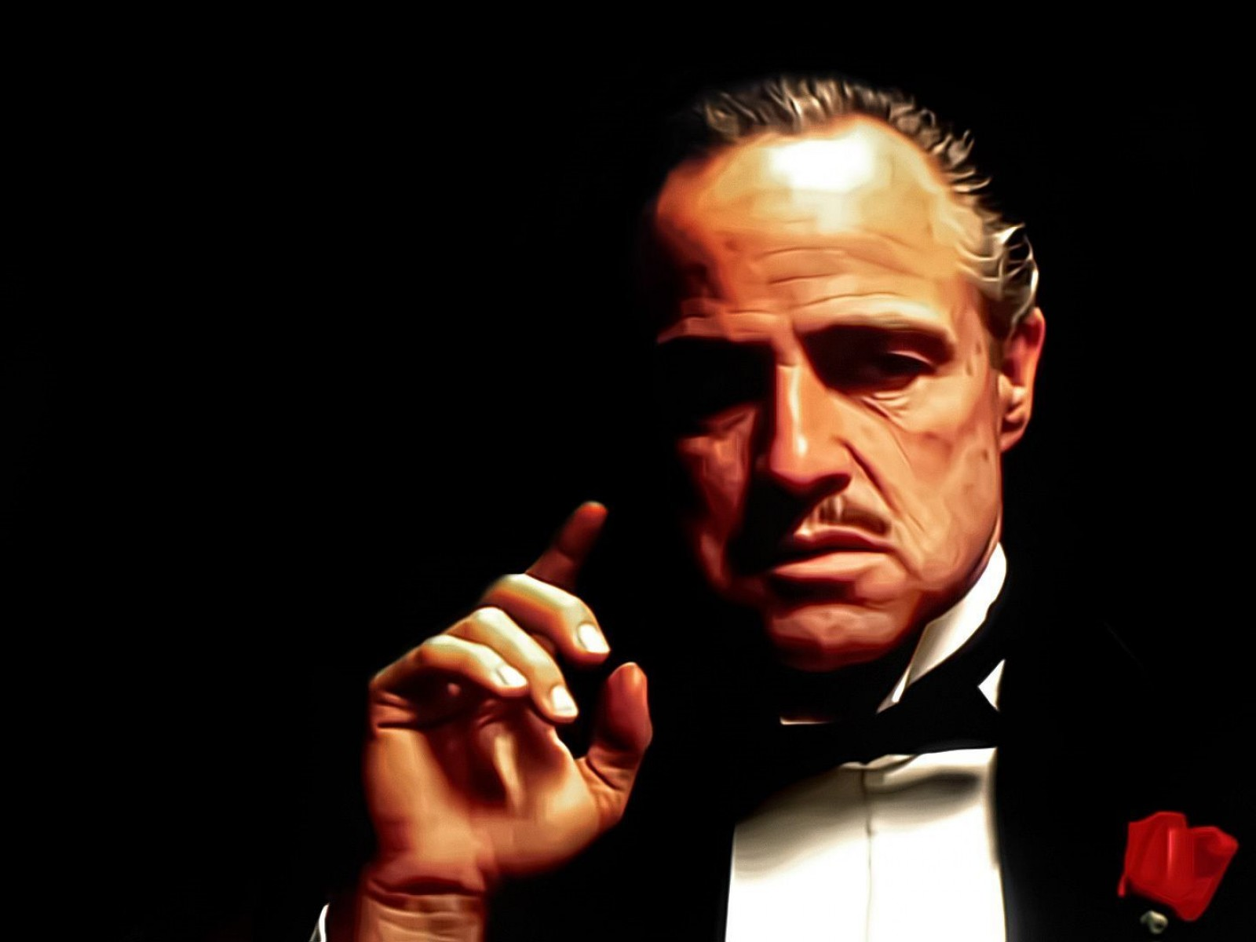

Slide 31
Mentoring Future Scientists

Slide 32
My Values
Discovering, developing, and rigorously testing new behavior therapies to improve health.
Disseminating scientific results and clinical methods.
Leading a professional team that fosters support, compassion, and growth.
Mentoring the next generation of behavioral scientists.
Directly helping people live healthier lives.

Slide 33
Mission-Focused
Preventing cancer as a cause of human suffering.

Slide 34
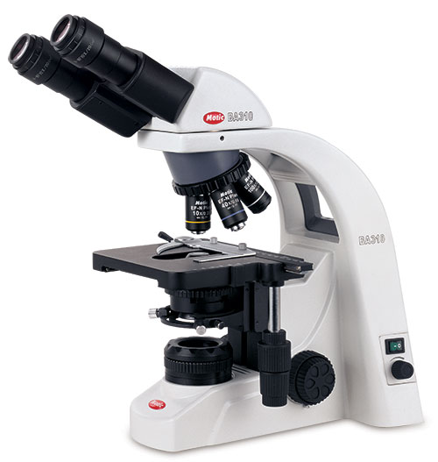
Science
Rigorous methodology.
Strong inference.
Solid science will take ACT to the next level.

Slide 35
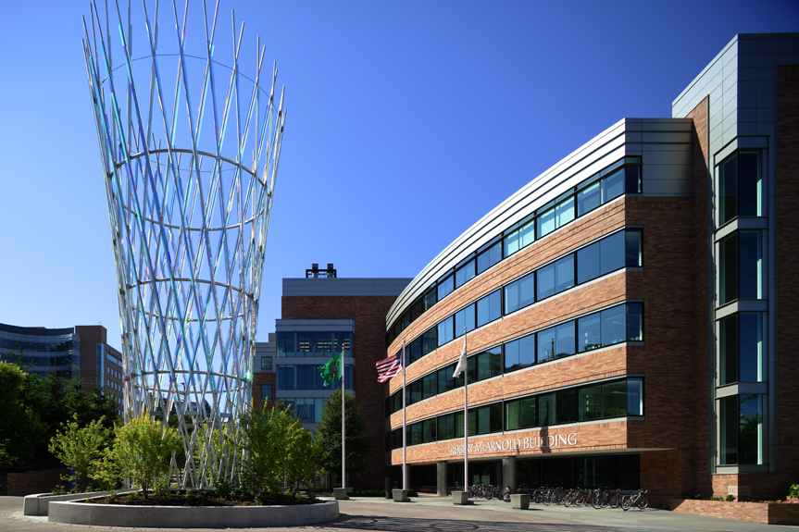
Impact

Slide 36
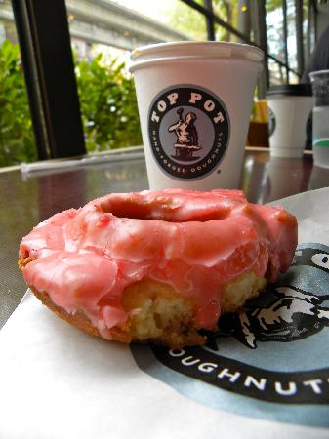

Slide 38
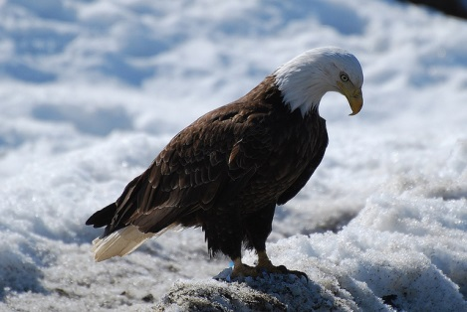

Slide 39
I should have gone to Reno.
I made a mistake.
The Hutch is not for me.

Slide 40
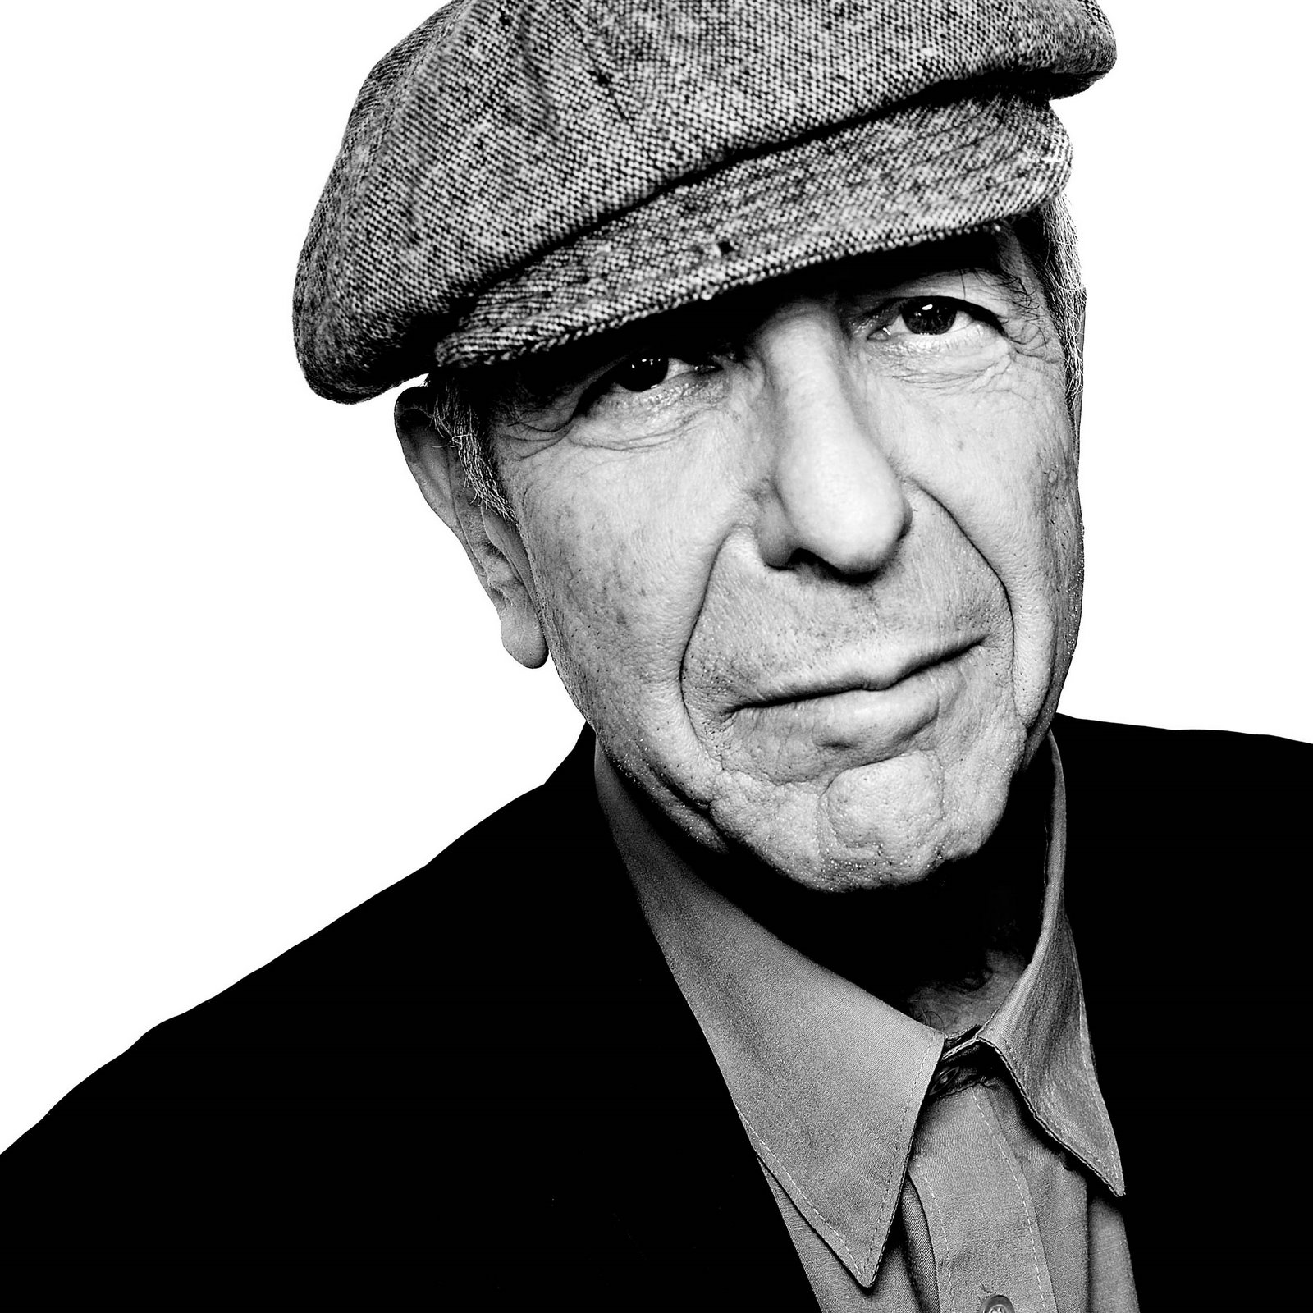

Slide 42
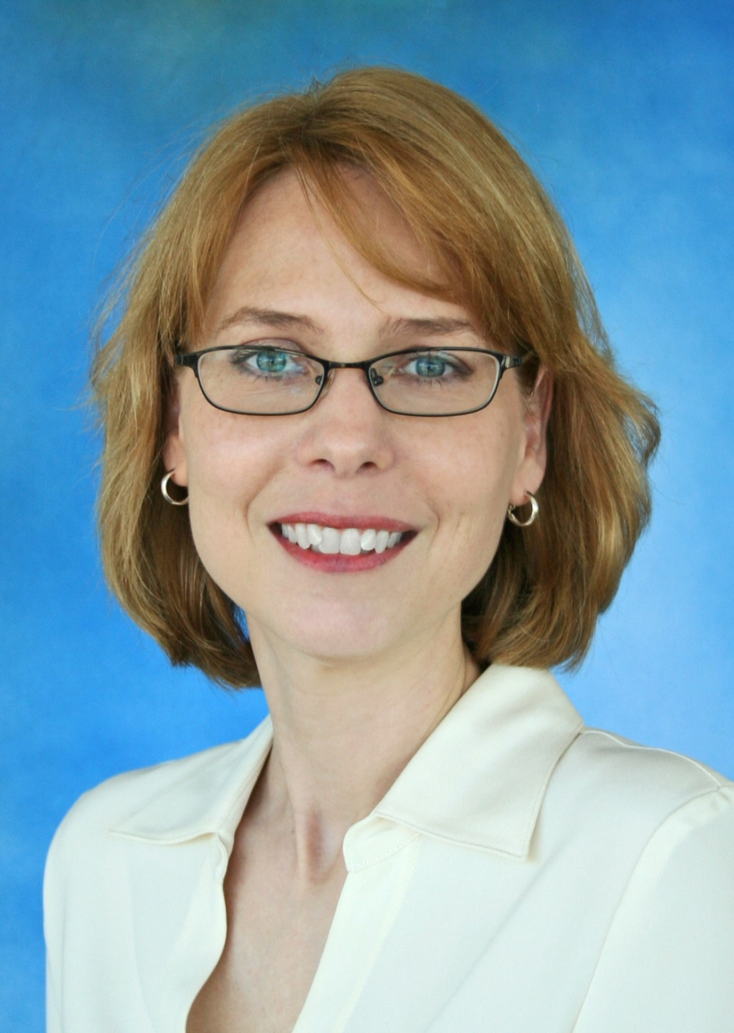

Slide 43
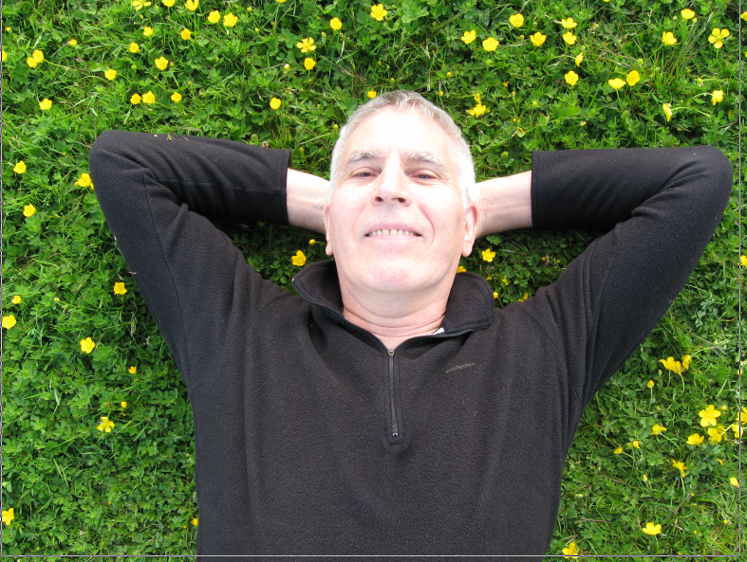

Slide 44
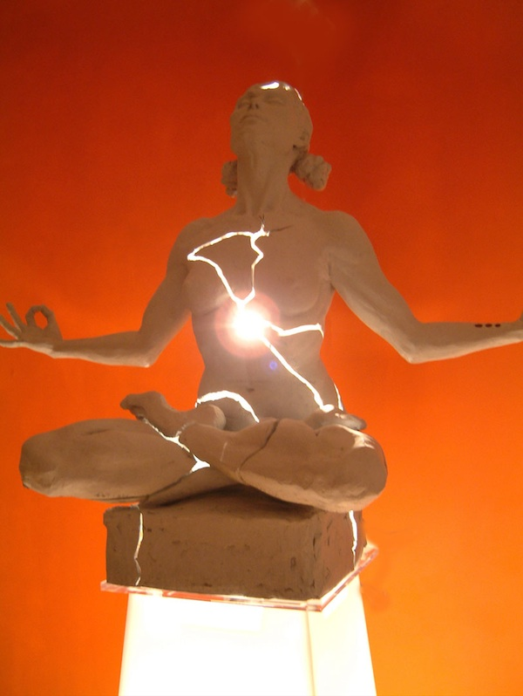
I’m ineffective.
My ideas are unworthy.
I’m not as good as…

Slide 45
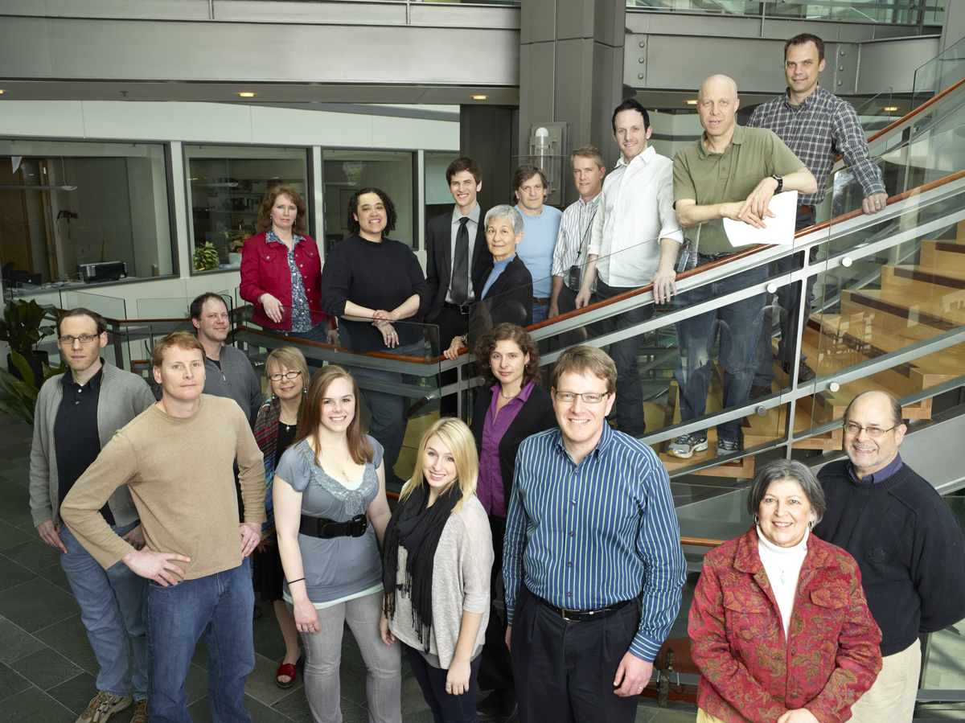

Slide 46
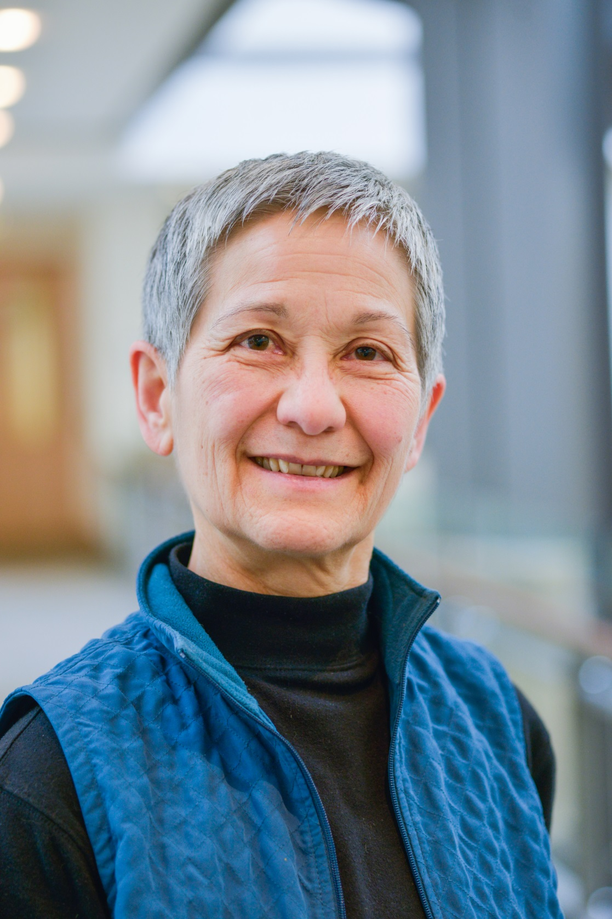

Slide 47
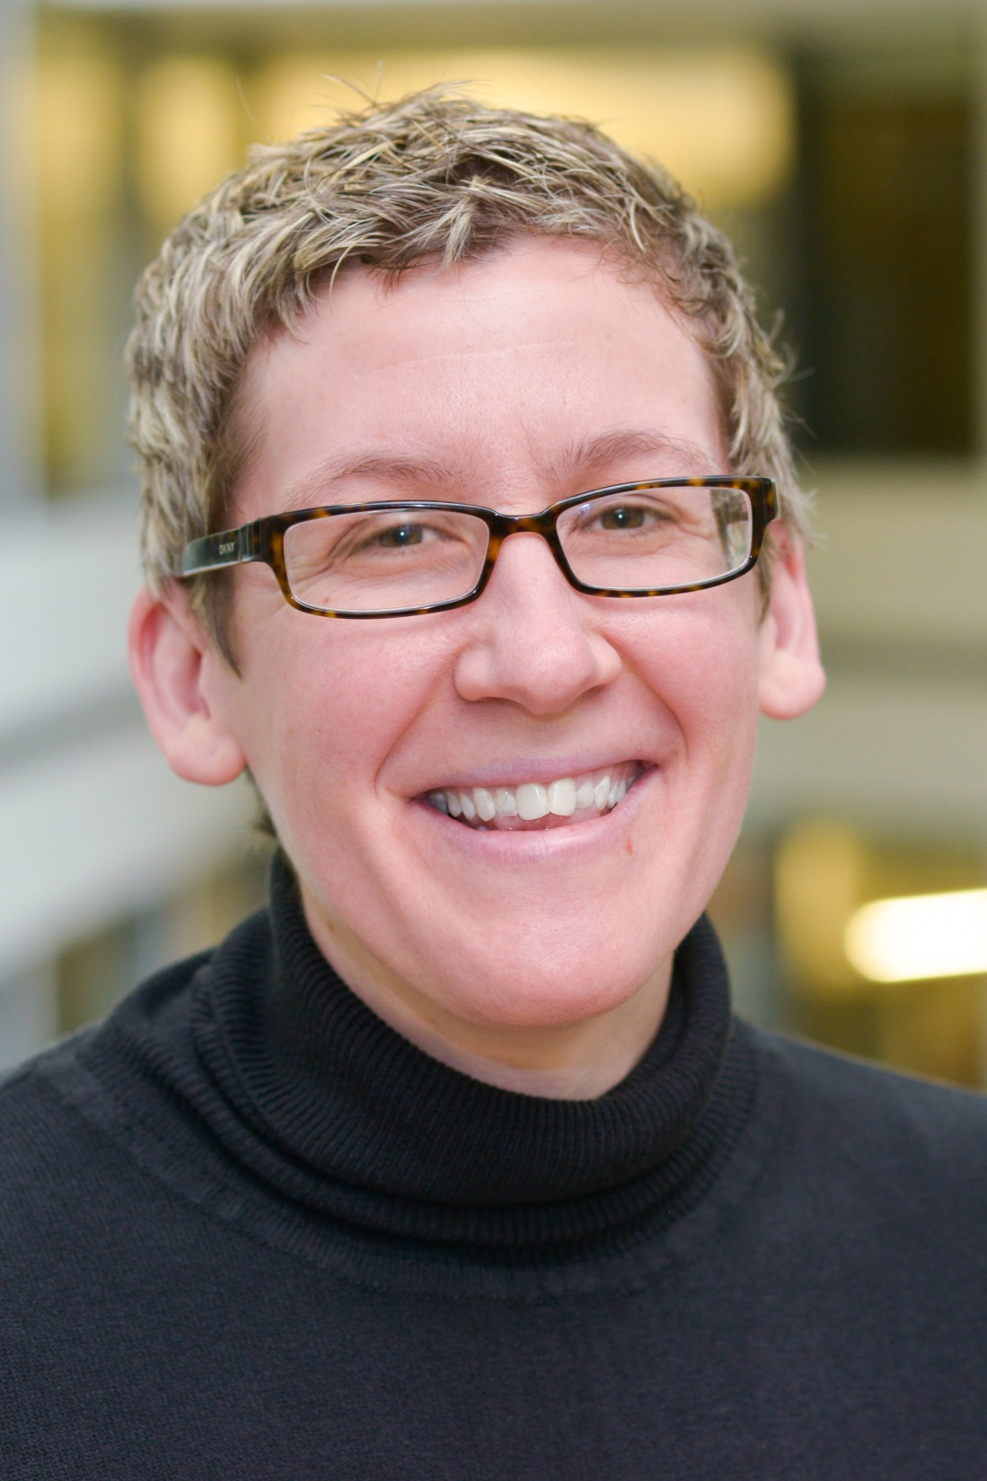

Slide 48
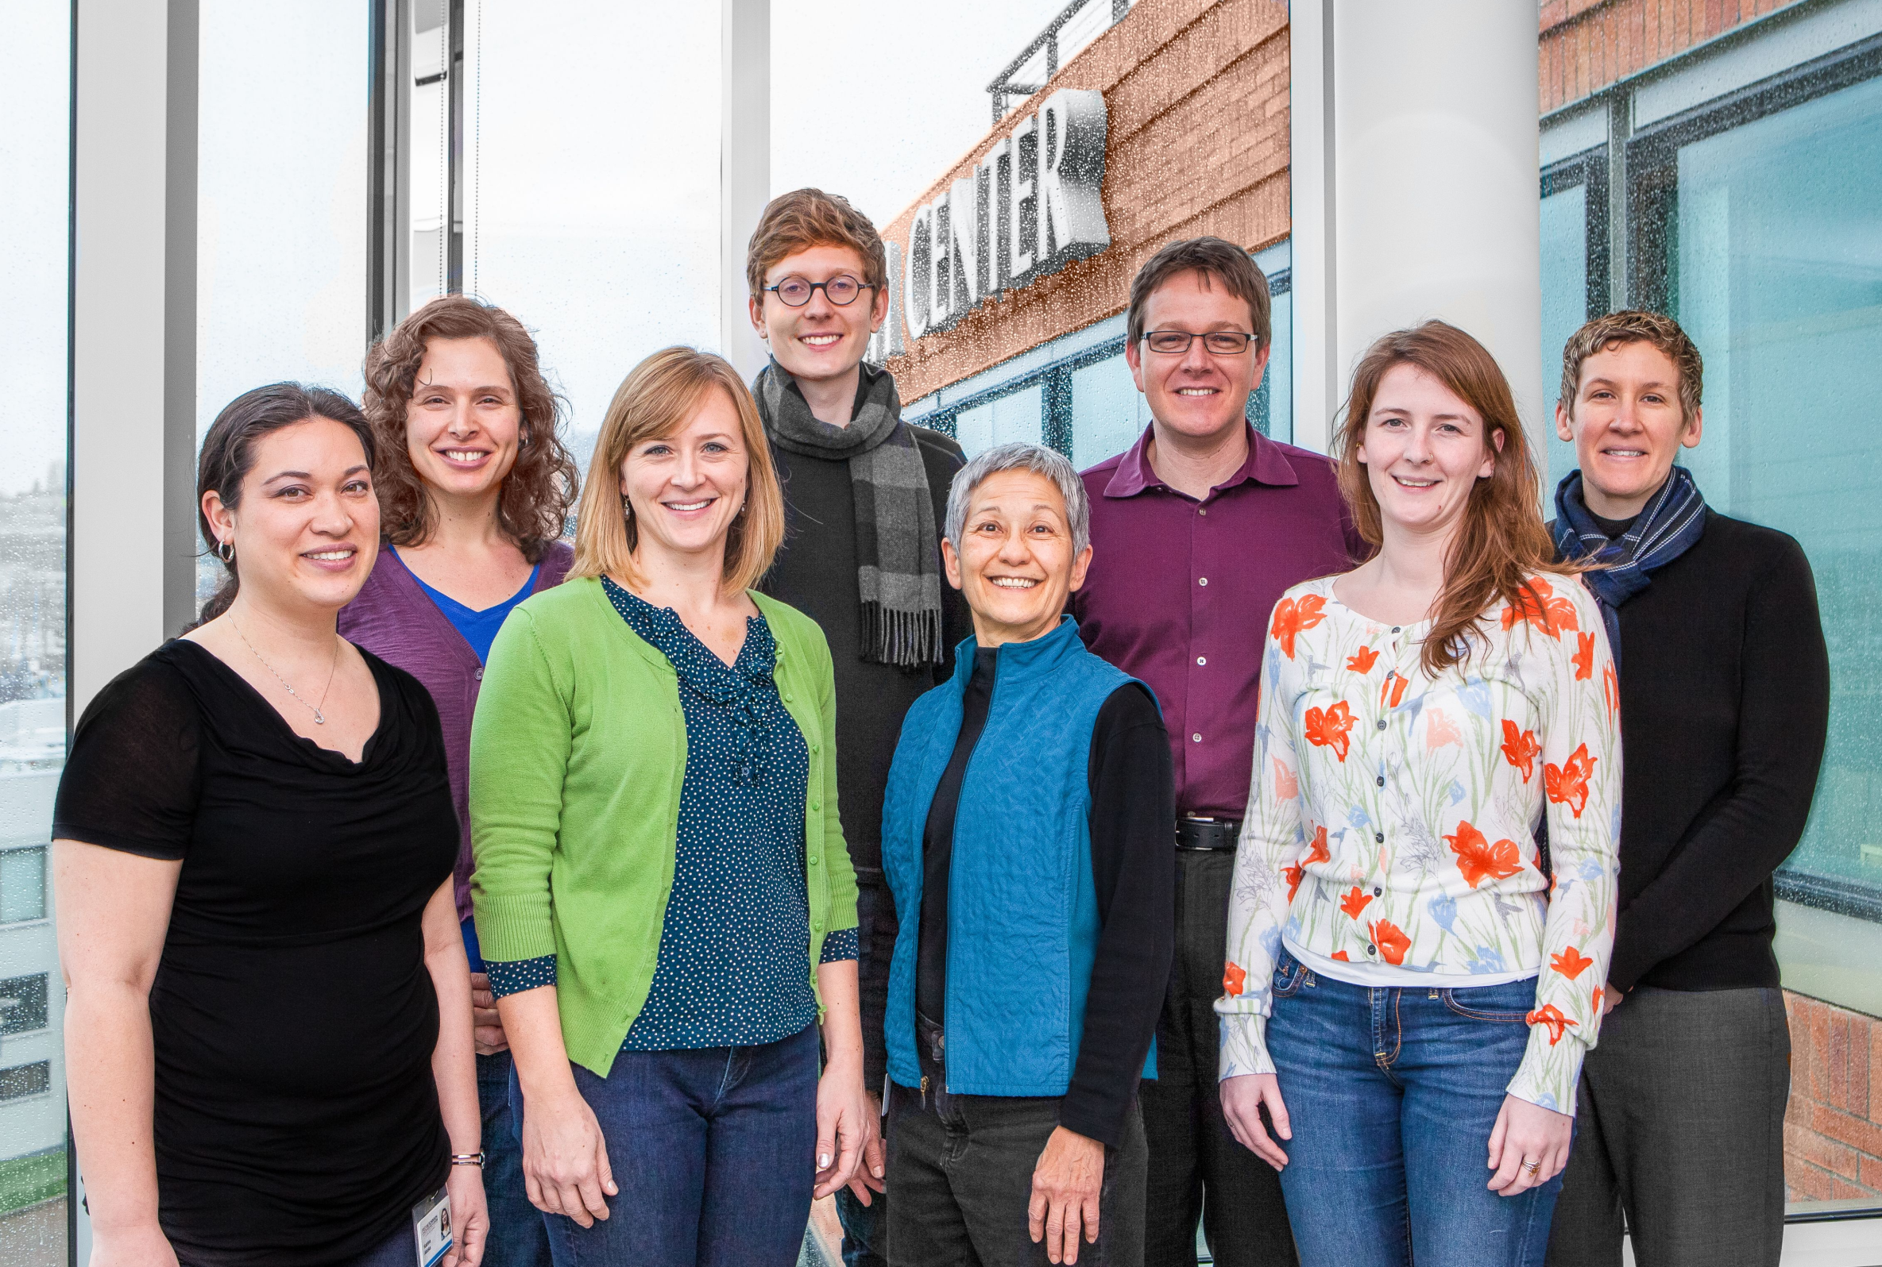

Slide 50
Our Clinical Trials: The Wheel of Delivery
Notes:
Jonathan B. Bricker, PhD
jbricker@u.washington.edu
1/17/2008
50

Slide 51
We won’t get another grant funded.
Results will be terrible.
I’ll lose the team.

Slide 52
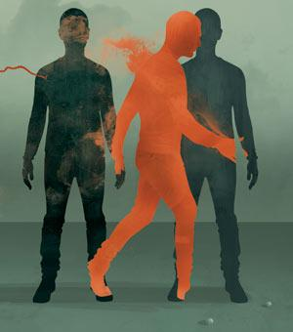
Self-Perceptions are an Illusion.
You are not who you think you are.

Slide 53
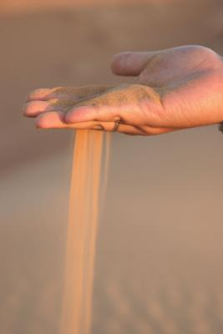
Expectations predict nothing.
They are sand between your fingers.

Slide 54
Seek and love those who support you.

Slide 55
Learn from those who don’t.

Slide 56
Remember your passions.
They are your guiding light.

Slide 57
Return to books collecting dust.
They just might change your life.

Slide 58
Be willing to jump, fall, & soar.
Either way, you are traveling.

