Slide 1
Acceptance and Commitment Therapy with deaf clients: Staff training and organizational intervention
Hassinen Leena, Med, Psychotherapist
Riihimäki Jouni, Service Director,

Slide 2
The Service Foundation for the Deaf
Organization in brief:
In Finland there are approximately 4000 - 5000 people who are deaf and use sign language as their mother tongue.
The Service Foundation for the Deaf provides housing services for 240 residents in service centres and supported homes. The average age is around 56 years. Organization has about 200 out-patient clients and 1000 service users all together. Most of the service users have quite severe disabilities, handicaps and/or mental health and social problems. The number of the staff members is 250

Slide 3
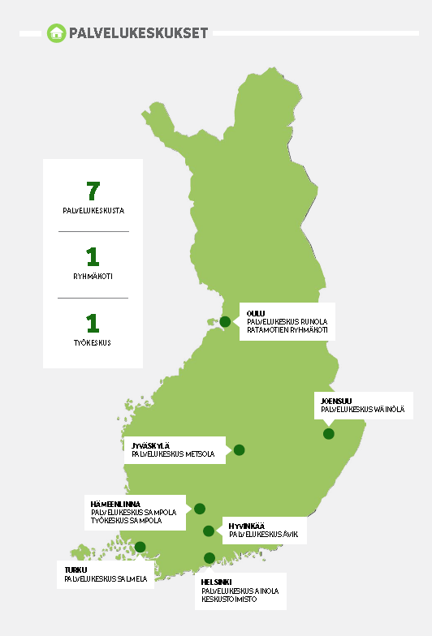

Slide 4
1. Staff Training: The first trial
2009 in the Service Centre Sampola
9 councelors and 16 clients attended the trial
First there was a two day workshop about ACT principles and methods
During the trial the councelors had supervision every second week
They formed study groups: They studied the theory and methods of ACT and had discussions five times
One councelor had 8-10 meetings / client during 10-12 weeks

Slide 5
The clients
Their mean age was 44.3 years (22-60).
All except one were working in the Service centre Sampola (94%), 9 (64%) were living there.
There was an equal amount of men and women.
Ten (71%) of the subjects were single.
Seven (50%) clients had psychiatric diagnoses and medication, only 4 (29%) were receiving treatment

Slide 6
Intervention
The staff members were instructed to draw a case formulation of the clients´ situation and then formulate a value analysis based on ACT principles with the client.
According to the clients needs the intervention included experiential exercises and metaphors of ACT.
All intervention was done in sign language.
Following exercises were translated into the Finnish sign language: the Observer exercise, The Putting Emotions In Front of You Exercise.
7 metaphors were translated: The Quicksand, The Man in the Hole, The Tug-of-War with a Monster, the Jelly Donuts, Hungry Tiger, The House, The Bird House.

Slide 7
Measurements
The clients´ situation was assessed by The Symptom Checklist 90 (SCL-90), Beck Depression Inventory (BDI) and AAQ 2 before, during and after the trial
These measurements were translated into sign language before the trial.
The time between Pre- and Post-measurements was 3 months.
The follow –up was done six months after the intervention ended

Slide 8
Results: Figure on changes in SCL GSI (n =14)
Decrease of symptoms
10 of 14 subjects reported decrease of psychological symptoms
Notes:
Oliko tämä Pre- F-up muutos?

Slide 9
Results: Figure on changes in BDI (n = 14)
Decrease of depression symptoms
8 of 14 subjects reported decrease of depression symptoms

Slide 10
Results
The ACT sign –intervention was well accepted both by the clients and by the counselors.
There were reports indicating that there were positive changes at the Sampola community during and after the intervention.
The measures were translated into Finnish Sign Language and they were used for the first time in this study. Thus, there is a possibility of misunderstanding of the measurements. We must be careful when we draw conclusions on the basis of the data.
The model of training staff members to use ACT seems to be workable.

Slide 11
Value based counselling (2nd process)
2012-2013 value based counselling in the Service Foundation
20 instructors in 6 service centres attended the second process
There was a training of ACT methods for 3,5 days
Supervision was arranged regularily and workshop in the end of the process
The group included members of middle management
Each councelor had 10-20 meetings with one client during 16 weeks

Slide 12
Value based counselling (3rd processes)
2013-2014 further value based counselling in the Service Foundation
13 cousellors in four differet service centres attended the third process
Orientation day including counsellors who attended the previous processes
First there was a training in ACT methods for two days
Supervision was arranged approximately once a month
Discussion groups were arranged with councelors who had ettended the previous processes
Each councelor had 10-15 meeting with one client during 16 weeks
Process more srtuctured than the previous ones

Slide 13
2. Organizational intervention
During the 3rd process of staff training started organizational developement due to promising results in staff well being and working atmosphere in service centers
Our goal was to develope structure that supports and make possible to use value based methods.
Support staff well being – > organizational well being.

Slide 14
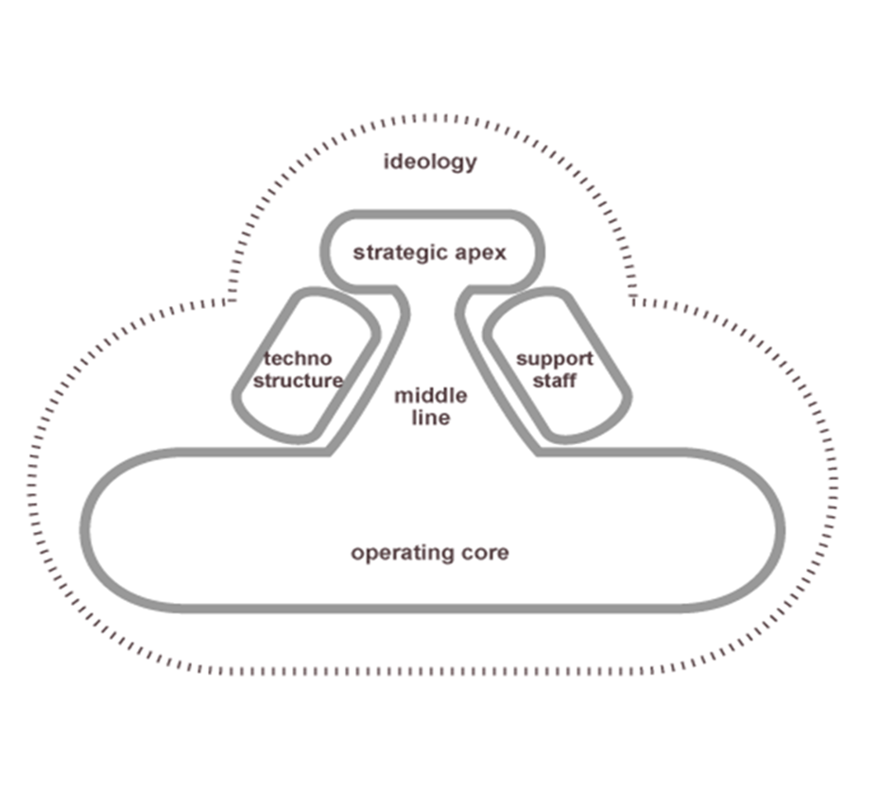
Organization by Mintzberg
Values, norms
Top management
Middle management
Operations, staff
Processes
Support staff
Mintzberg,1991

Slide 15
1. Ideology
Service Foundation for the deaf is non-govermental and non-profit organization
Organization’s vision and mission emphasize clients well being and interaction with others.
In annual planning focus was shifted from structured processes to outcomes.

Slide 16
2. Top Management
During the processes it’s important that top management understands the changes what need to be done and allocate resources needed.

Slide 17
3. Middle management
Commintment on ACT processes.
Participation in staff training processes.
Coordination of clients act processes (resources, service plans, staff training)

Slide 18
4. staff
Value based and ACT methods:
In counselling
In client documentation
In client goal setting
Understanding clients needs
In their own personal lives .

Slide 19
5. Service processes
Client service plans
Goal setting and clients role
Clients rights to make their on decission
Service plan meetings
Documentation in CRM
Annual planning in service centers

Slide 20
6. Support staff & business networks
Co-operation is easier and more efficient when sharing mutual frame of reference.
First ACT-process started this spring with non-client staff, eg. accountants. Through this we set values of head office.

Slide 21
Organization outcomes
Organisation
Unit
Unit
Unit
Unit
Unit
Unit
Unit
Client
Client
Client
Client

Slide 22
leena.hassinen@pp.inet.fi
jouni.riihimaki@kuurojenpalvelusaatio.fi

