Slide 1
Stepping Stones Triple P and Acceptance & Commitment Therapy for Acquired Brain Injury
Felicity Brown
PhD Candidate
School of Psychology
The University of Queensland, Australia

Slide 2
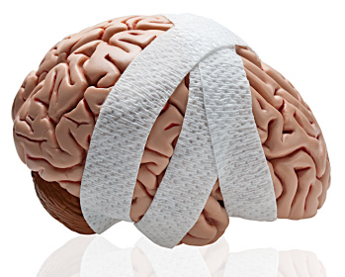
What is ABI?
Any damage to the brain that has occurred after birth (AIHW, 2007;2008)
Mechanisms of brain damage can include head trauma, stroke, hypoxia, degenerative neurological disease, tumors, or substance abuse or poisoning
Approximately 20,000 Australian children under 15 have an ABI (ABS, 2003) greater and more global (Anderson et al., 2009)
Lifetime costs per individual (Access Economics, 2009)
$2.5 million for moderate TBI
$4.8 million for severe TBI

Slide 3
“It was just the most out of control, horrendous thing that’s ever happened in my life” (Mother)
Qualitative study
Brown, FL, Whittingham, K., Sofronoff, K., Boyd, R. Parenting a Child with a Traumatic Brain Injury: Experiences of Parents and Health Professionals , Brain Injury, [in review]
Notes:
Going to be showing quotes from Focus Groups I conducted with parents and professionals.

Slide 4
Impact of ABI
“I would suggest that it’s nearly like going through death; watching somebody die. Personally, I think the emotions are very similar” (Step-Father)
“He’ll just lash out for no apparent reason...you’re just on your guard all the time because you don’t know what’s going to happen.” (Mother)
(Catroppa & Anderson, 2009; Fay et al., 2009; Gerrard-Morris et al., 2010; Ganesalingam et al., 2008; Micklewright et al., 2012; Stancin et al., 2008; Taylor et al., 2001)

Slide 5
Role of Parenting
Warmth
Authoritarian traits
Scaffolding
Negativity
Permissiveness
“After you’ve seen your child like that, you’re not going to hurt them more, are ya?” (Mother)
(Gerrard-Morris et al., 2010; Kurowski et al., 2011; Micklewright et al., 2012; Potter et al., 2011; Wade et al., 2011; Yeates et al, 2010)

Slide 6
Predictors of negative impact on family
Pre-injury functioning
Injury severity
Child deficits and behaviour
Perception of met needs
Interpersonal stressors and resources
Material resources (SES)
Parental coping Style
Denial/disengagement
Active-coping (for severe TBI but not mild or orthopaedic injury)
Seeking social support for emotional coping
Acceptance
Use of humour

Slide 7
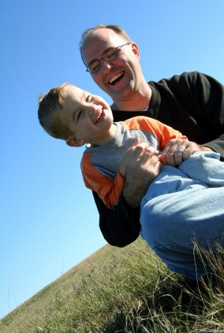
Rationale for study

Slide 8
Limited research trialling family interventions in this population
Systematic review
Brown, FL, Whittingham, K., Boyd, R., Sofronoff, K. A Systematic Review of Parenting Interventions for Traumatic Brain Injury: Child and Parent Outcomes, Journal of Head Trauma and Rehabilitation, 2012 May 28 [Epub ahead of print]
“I think it is a harder slog with kids with brain injury…. more repetition for a longer period, in more contexts…. you never get those….. golden responders to the behaviour management that you do see in normal families” (Health Professional)

Slide 9
ABI brings unique challenges compared to other disabilities
“One thing that stood out for me was when they behave in a certain way….. you flashback to the time of the accident, constantly….. it’s back to the trauma, every time.” (Mother)

Slide 10
Methods

Slide 11
Design: RCT

Slide 12
“Parents can often be so engaged in doing everything they can for their child, they forget to look after themselves. And so there needs to be some discussion around that, and relaxation strategies or time out for themselves…… so they are able to continue caring for their child..”
(Health Professional)

Slide 13
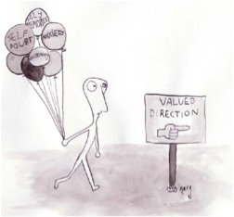
“Acceptance and Commitment Therapy for Parenting Stress”
Targets parental stress and adjustment
Incorporates mindfulness and acceptance of emotional and cognitive responses in service of valued living
ACT has been found to decrease distress in parents of children with autism (Blackledge & Hayes, 2006)
Preliminary evidence from studies at UQ
2 x 2 hour session workshop

Slide 14
Stepping Stones Triple P Positive Parenting Program
Triple P - Efficacy demonstrated through 4 independent meta-analyses (de Graaf et al., 2008a;2008b; Thomas & Zimmer-Gembeck, 2007; Nowak & Heinrichs, 2008)
Stepping Stones is a new variant of Triple P, specifically for parents of children with disabilities.
It has demonstrated positive outcomes in child behavioural and emotional outcomes in mixed samples and in children with ASD (Plant & Sanders, 2007; Roberts et al., 2006; Whittingham et al., 2009; Sofronoff et al., 2011)
Notes:
Social learning models of parent-child interaction highlight the bi-directional nature of parent-child interactions. Learning mechanisms can maintain coercive and dysfunctional family interaction patterns, leading to worse behaviour outcomes for child.
Also based in applied behaviour analysis, particularly rearranging antecedents of problem behaviour, creating a positive environment for children.
Functional assessment of behaviour conducted with parents- why do children behave the way they do→ individualised assessment

Slide 15
Sessions cover
Principles of positive parenting
Developing positive relationships
Encouraging desirable behaviour
Teaching new skills and behaviours
Managing misbehaviour
Parenting plans for “high risk” situations
Planning for the future
6 x 2 hour group sessions, 3 x 30 minute individual phone calls

Slide 16
“I wanted to meet other people... I wanted to meet someone else who sort of got it instead of, just doctors... it's like what do you know? ... Like you know, you can tell me what you've heard, but you can't tell me what the real deal is. Like, you know, someone else that feels it…“ (Mother)
Group format chosen
Conducted by intern psychologists at University of Queensland
Free of charge
Offered at a variety of times and locations
Make-up sessions offered when parents unable to attend group session.

Slide 17
We hypothesised that relative to the waitlist control group, the treatment group would demonstrate improvements on:
Child behavioural and emotional functioning
Parenting style
Parental adjustment
Parental confidence
Family functioning
Relationships between parents
Parent psychological flexibility
Notes:
AAQ measure, parent-specific measure, defusion measure based on believability scale of ATQ

Slide 18
Sample
Inclusion criteria:
Parents of children 2-12 y.o. with ABI
Parents report behavioural or emotional difficulties
Injury sustained at least 3 months prior
Parents have effective communication in English
Exclusion criteria
Child still acutely unwell
Child has degenerative neurological condition
Child lives with foster family
Notes:
Families identified from patient databases of 2 state-wide paediatric rehabilitation services (public hospitals) and contacted directly
Advertising in waiting rooms, websites, radi
To detect a large effect size on primary outcomes, allowing for attrition, we needed to recruit 59 families
Using WHO and ACRM (american congress rehabilitation medicine) guidelines for TBI.

Slide 19
CONSORT flow chart
Potentially eligible parents identified and attempt made to contact (n=385)
Self-referred or clinician referred parents (n=8)
Could not contact (n= 56)
Contacted and conducted screening call (n= 337)
Not eligible (n=127)
Eligible (n= 210)
Declined participation (n= 151)
Baseline: (T1) (n = 59)
Randomisation
Allocated to Treatment (n = 30)
Allocated to Waitlist (n = 29)
Did not complete T2
Too busy (n= 2)
Did not complete program
Illness in family (n=2)
Separation (n= 2)
Too far to travel (n=1)
Treatment
Did not commence program
Times unsuitable (n=3)
Tumor recurrence (n=1)
Moved away (n=1)
Post-treatment: (T2) (n=25)
Post-waitlist: (T2) (n= 27)
Treatment
Did not complete program
Too busy (n=4)
Unknown (n=2)
Lost to follow up:
Reason unknown (n=4)
Post-treatment: (T3) (n=16)
6 month follow up: (T4) (n= 12)
6 month follow up: (T4) (n= 12)
Lost to follow up:
Reason unknown (n=4)

Slide 20
Statistical Approach
Compared baseline variables
(χ², t-tests)
Analysis of factors predicting participation
(logistic regression)
Analysis of factors predicting drop-out
(logistic regression)
Mixed-Model Repeated Measures regressions on intent-to-treat sample
Uses maximum likelihood methods, rather than sum of least squares
Time and treatment as categorical fixed factors, subject as random factor.
Post treatment to 6 month follow up (collapsed between groups)
(equal variance-covariance structure assumed, sattherthwaite approximation for denominator df)
MMRM conducted post-intervention to 6-month follow up collapsing over groups (small sample sizes at 6-months)
p < 0.05 reported as significant- due to a-priori hypotheses.
Effect sizes presented as Cohen’s d
Reliable change and clinical significance calculated

Slide 21
Who were the children?

Slide 22
 | Treatment (n=30) | Waitlist (n=29)
Age at baseline, M (SD) | 7.13 (3.17) | 6.87 (3.03)
Time since injury, M (SD) | 3.13 (2.62) | 3.63 (2.52)
Male, N (%) | 17 (57) | 18 (62)
Caucasian, N (%) | 26 (87) | 26 (90)
Cause of ABI, N (%)
TBI | 21 (70) | 13 (45)
ABI | 9 (30) | 16 (55)
Other diagnoses, N (%)
Intellectual Impairment | 2 (7) | 3 (10)
Learning difficulties | 18 (60) | 9 (31)
Autism spectrum disorders | 2 (7) | 0 (0)
ADHD | 2 (7) | 1 (3)
*
Notes:
All ABIs had evidence of injury on scans, except for 2 encephalitis- had neurological signs.

Slide 23
What were the families like?

Slide 24
 | Treatment (n=30) | Waitlist (n=29)
Relationship to child, N (%)
Mother (1 custodial GM in Treat) | 27 (90) | 26 (90)
Father | 3 (10) | 3 (10)
Relationship status, N (%)
Married/ defacto | 18 (60) | 27 (93)
Separated/divorced/Widowed | 12 (40) | 2 (7)
Participating parent's employment, N (%)
Full-time | 13 (43) | 4 (14)
Part-time | 5 (17) | 9 (31)
Home-duties/Unemployed | 12 (40) | 16 (55)
Family annual income (AUD), N (%)
< $25 000 | 7 (23) | 4 (14)
$25 000 to $50 000 | 4 (13) | 3 (10)
$50 000 to $75 000 | 6 (20) | 9 (31)
> $75 000 | 13 (43) | 13 (45)
*
*
Notes:
In Australia, poverty line for couple in workforce & 2 children is $46, 315; for single person in workforce & 2 children is $38, 317.
Minimum wage is $31, 532

Slide 25
Did participation in the program improve child behavioural and emotional outcomes relative to waitlist?

Slide 26
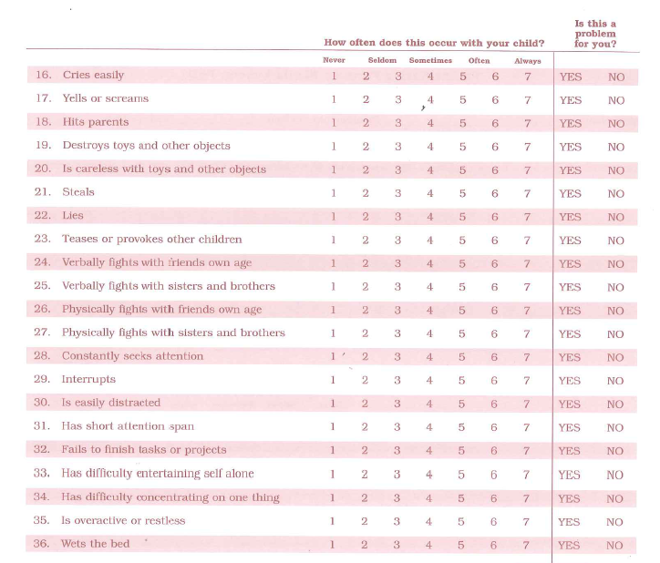
Eyberg Child Behaviour Inventory (Eyberg & Pincus, 1999)

Slide 27
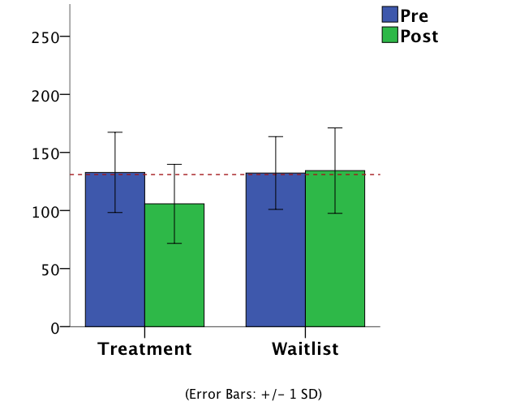
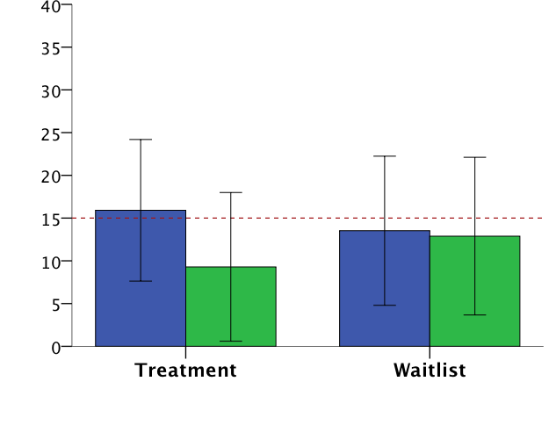
ECBI- Intensity
ECBI- Problems
(Error Bars: +/- 1 SD)
d= 0.90
β: -30.06
t (52.11)= -4.51, p<.001
6-months- NS
d= 0.76
β: -6.49
t (52.54)= -2.80, p=.007
6-months- NS
32% demonstrated reliable and clinically significant change.
Notes:
In each of the cases where the interaction was sig, this occurred because the Treatment group improved significantly, control group did not. BESIDES ONE
ECBI-I – treat, D= .85; ECBI-P , treat, D= .96- LARGE EFFECT pre-post treatment group
Have reported 6 month follow up- this is POST INTERVENTION FOR BOTH GROUPS, TO FOLLOW UP. USING MMRM.

Slide 28
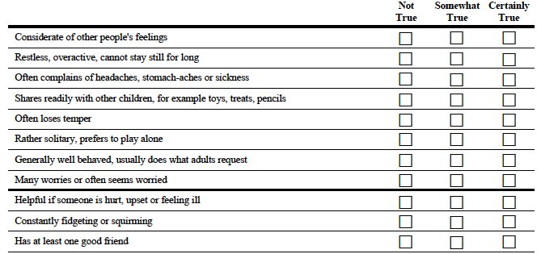
Strengths and Difficulties Questionnaire (Goodman, 1997)

Slide 29
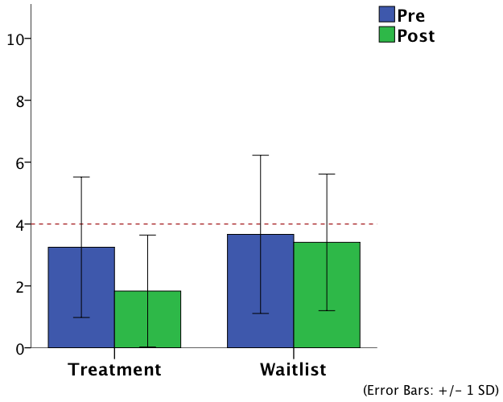
SDQ- Emotional
d= 0.50
β: -1.32
t (51.43)= 2.32, p= .025
6-months- Significant increase. d= -0.18
Notes:
Emotional pre-post D treat= .70, peer = .27
Peer probs- treat group did not change significantly pre-post, small effect, neither did control, interaction occurred because slopes different direction.

Slide 30
Did participation in the program reduce dysfunctional parenting practices relative to waitlist?

Slide 31
Parenting Scale (Arnold et al., 1993)

Slide 32
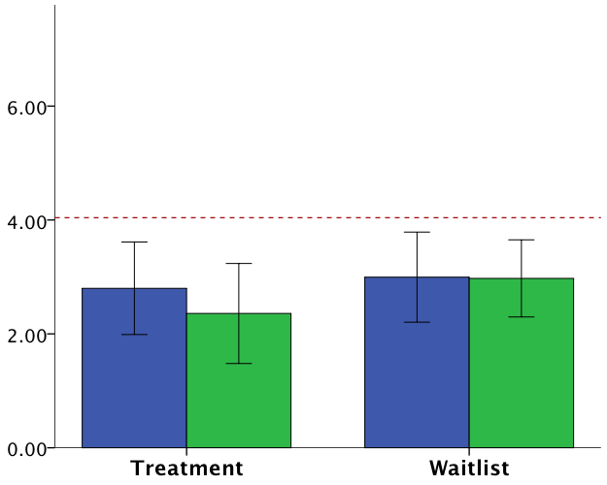
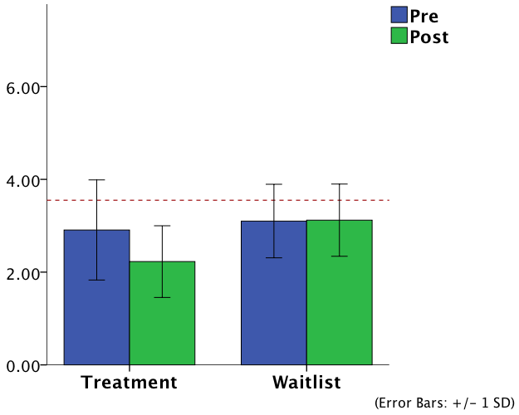
Laxness
Over-reactivity
d= 0.76
β: -0.74
t (52.58)= -4.00, p<.001
6-months- NS
d= 0.54
β: -0.39
t (52.45)= -2.25, p=.029
6-months- NS
Notes:
Lax D=.74 treat
OR D =.43 treat

Slide 33
Did participation in the program improve parental adjustment relative to waitlist?

Slide 34
Depression Anxiety and Stress Scale (Lovibond and Lovibond, 1995)

Slide 35
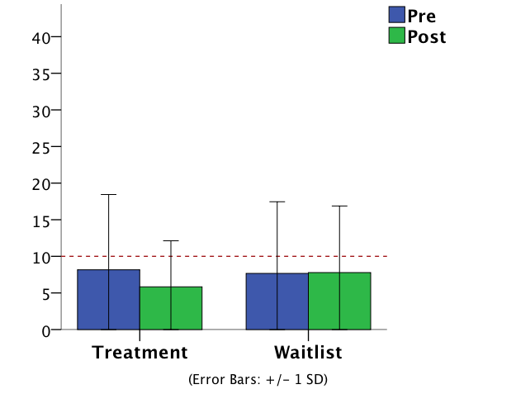
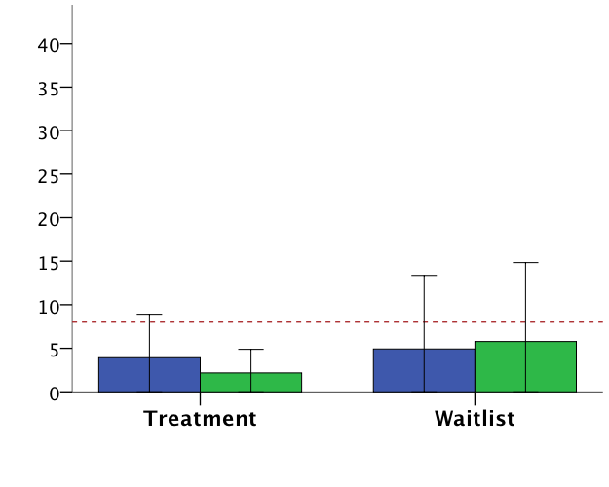
Depression
Anxiety
d= 0.24
β: -2.29
t (51.21)= -1.06, p=.297
6-months- NS
d= 0.39
β: -2.98
t (52.58)= -4.00, p=.039
6-months- NS
Notes:
Dep- D treat= .30
Anx- D treat=.54

Slide 36
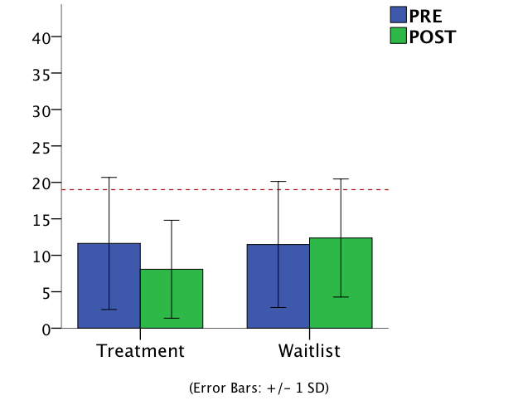
Stress
d= 0.56
β: -4.77
t (50.88)= -2.20, p=.032
6-months- NS
Notes:
d treat= .54

Slide 37
Did participation in the program improve parental psychological flexibility (a.k.a. experiential acceptance) relative to waitlist?

Slide 38
AAQ for ABI
Rated 1 (never true) to 7 (always true), σ= .78

Slide 39
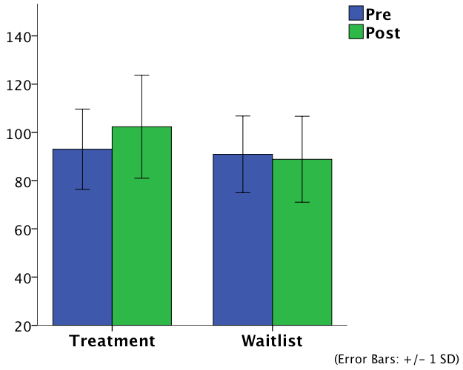
AAQ (ABI)
d= 0.74
β: 11.80
t (51.98)= 3.34, p=.002
6-months- Significant decrease, d= -0.29
Notes:
.01–.05 small, .05–.14 moderate, and .14 large.

Slide 40
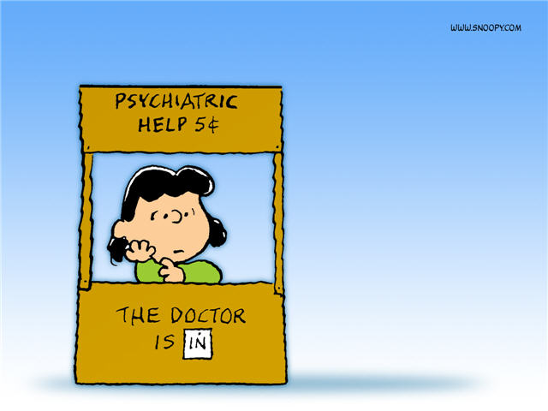
Satisfaction with program
15 item satisfaction questionnaire
Scored 1 to 7
Average Score = 6
Would you recommend ACT to other parents?
Average = 6
Was ACT helpful for you?
Average = 6
Notes:
Asked for feedback from drop –outs, only received from 1. Was rated highly, just reported learning difficulties, travel difficulties, and family stressors.

Slide 41
Which program would you prefer?

Slide 42
“Greatly improved my awareness in what part I play in my child's behaviour.. I feel empowered and have increased confidence in my parenting abilities.. I liked the "support group" aspect of the program and feeling like I'm not alone. I really got a lot out of the stress management sessions- could do a whole program just on that.” (Dad)
“I liked the centred, being in the moment attitude “ (Mum)

Slide 43
Effect of ACT?
Mediation analysis conducted
Question 1:
At baseline, was AAABIQ correlated with psychological well-being?
At baseline, was AAABIQ correlated with parenting style?
Note, * p<.05, **p<.01
small = 0.1, medium = 0.3, large = 0.5
Measure | Correlation AAABIQ
Depression | - .619 **
Anxiety | - .420 **
Stress | - .574 **
Laxness | - .345 **
Over-reactivity | - .210
Notes:
Asked for feedback from drop –outs, only received from 1. Was rated highly, just reported learning difficulties, travel difficulties, and family stressors.

Slide 44
Question 2:
Did change on AAABIQ mediate change on depression, anxiety and stress?
Change AAABIQ
?
a path, p= .001
b path, p= .003
?
Treatment
Change stress
C path, p= .03
C’ path, p= .38
Using boot strapping for indirect effects: 95% CI: -6.94, -0.55

Slide 45
Question 3:
Did change on AAABIQ and/or DASS mediate change on laxness and over-reactivity?
Change AAABIQ
a path, p= .001
?
b path, p= .01
?
Treatment
Change over-react
C path, p= .02
C’ path, p= .38
?
a path, p= .06
Change DASS
b path, p= .14
?
Using boot strapping for indirect effects on AAABIQ : 95% CI: -0.45, -0.05
DASS not significant

Slide 46
CAUTION!
In order to assess mediation, proposed mediators should be measured prior to the outcome
We lack temporal precedence
These results should be interpreted as very preliminary.

Slide 47
Summary/ Discussion
High satisfaction reported by parents, quantitative results appear to support efficacy of program BUT
Future Research:
Efficacy vs. effectiveness?
Unique effects of ACT and Triple P?
Online delivery?
Mediational analyses should be conducted measuring psychological flexibility prior to measuring outcomes.

Slide 48
Stepping Stones TBI Project Team:
Supervisors:
A/Prof Kate Sofronoff
Dr Koa Whittingham
Prof Roslyn Boyd
Dr Lynne McKinlay,
Mr Owen Lloyd and Dr Valda Biezaitis
Parents and professionals who participated in focus groups and RCT
RCH and Mater staff for recruitment support
Funding: UQ Graduate School International Travel Award
QCMRI Science PhD Scholarship- funded by Golden Casket Research support from Parenting and Family Support Centre and QCPRRC

Slide 49
Criteria
Mild TBI
GCS 13-15
LOC <30 minutes
PTA < 1hr
+/- simple skull fracture (eg. Linear, non-depressed)
Mild Complicated TBI
As above
+ changes on cerebral imaging not needing neurosurgery
Moderate TBI
LOC 30-60 minutes
GCS 9-12
PTA 1-24 hours
OR any neurosurgical intervention
Severe TBI
LOC>60 minutes
PTA > 24 hours
GCS< 9

