Slide 1
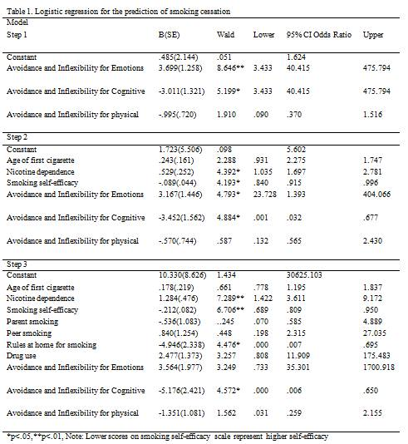
Can undergoing an internet based ACT intervention
change the impact of predictors thought to lead to Substance Use?
Leonidou. G., Savvides. S., N. & Karekla. M.
ACThealthy laboratory, University of Cyprus
E-mail: leonidou.georgia@ucy.ac.cy or mkarekla@ucy.ac.cy
Introduction
Results:
Research suggests that there are several factors to consider for smoking cessation success:
-High Nicotine dependence is associated with unsuccessful attempts to quit. Withdrawal symptoms in nicotine dependent smokers interferes with smoking cessation or smoking reduction (Colby, Tiffany, Shiffman, & Niaura, 2000).
-Earlier age of smoking onset is associated with lower cessation rates. The longer the duration of smoking , the harder it is to quit (Breslau & Peterson, 1996).
-Lower Self-efficacy leads to significantly lower quit smoking attempts (Lichtenstein, 1981).
-Lack of rules enforced at home results in higher smoking behaviors (Emory, Saquid, Gilpin, & Pierce, 2010) and may potentially influence cessation.
-The use of Illicit drugs has a strong correlation with cigarette smoking (Torabi, Bailey, Majd-Jabbari, 1993). It may be the case that individuals who use drugs would have a harder time quitting smoking.
→Acceptance and Commitment Therapy (ACT) for smoking cessation is presenting with promise for successful smoking cessation. It is not clear yet whether variables targeted by ACT and assumed to be related with the maintenance of the problem and difficulties in changing smoking related behaviors are indeed contributing to smoking cessation difficulties.
Also it is not clear how ACT based variables relate to the above mentioned factors.
Analyses: Logistic regression due to the dichotomous nature of the outcome variable (quit smoking or not).
→Zero step: no variables were inserted in the model, apart from the constant. correctly predicted the participants that would quit smoking at 67,3%. The model showed that variables not included in the model were significant, thus indicating the need to continue with the first step.
→First step: Avoidance and inflexibility variables were included (Emotional, cognitive & physical scales). The model explained 27,5% of the variance in smoking cessation, while the percentage of correct prediction of participants was 78,2%. That model was significantly better than the one at the zero step, but the variables not included in the model were again significant indicating the need to add more variables in the model.
→ Second step: smoking-related variables were included (age of first cigarette, nicotine dependence and smoking self-efficacy). The model explained 42,8 % of the variance in smoking cessation, while the percentage of correct prediction of participants was 81,8%. →Third step: environmental or contextual factors (i.e. demographic characteristics, home rules on smoking, parental and peer smoking, and smokers’ drug use) were included and resulted in significantly additional explained variance of smoking cessation of 63,9%. The importance of the variables added at the third step was also demonstrated by the reductions in -2 Log likelihood (from 57 to 49,36), though not the contribution of all the factors in the model reached significance (parental and peer smoking, personal drug use). The final model could correctly predict the percentage of smoking cessation at 85,5%. The predicting ability of each variable is presented in Table 1.
Conclusion:
Aim
The aim of the present study was to examine predictors of smoking cessation outcome in a youth sample who underwent an Acceptance and Commitment Therapy (ACT) internet – based intervention (Savvides, 2014).
Methodology
-Fifty-five university students aged 19-28 (M=22.84, SD=2.58) were randomly assigned to either the treatment or waitlist control group.
-The treatment group completed 6 sessions of internet – based ACT for smoking cessation.
-The assessment included demographic characteristics, smoking history, smoking cessation outcomes and ACT process variables at pre and post treatment.
-The demographic characteristics included: Parental and peer smoking, personal drug use and rules at home regarding smoking.
Questionnaires:
-Fagerstrom Test of Nicotine Dependence (FTND; Heatherton, Kozlowski, Frecker, & Fagerström, 1991).
-Smoking self-efficacy Questionnaire (SSEQ; adapted from Etter, Bergman, Humair, & Perneger, 2000).
-Avoidance and Inflexibility Scale (AIS-27; Bricker et al., 2013).
Conclusion
References:
Avoidance and inflexibility variables have adequate predictive ability upon the outcome of smoking cessation, but smoking-related variables and environmental or contextual factors had also important contribution to the model.
As proposed by ACT, avoidance and Inflexibility variables are significant factors contributing to smoking cessation. However, the present study indicated that other factors such as environmental or smoking related factors, influence quitting smoking significantly also and a combination of examining these factors leads to a better cessation prediction.
Many factors (e.g. parental and peer smoking, personal drug use, age of first cigarette) did not reach significance but they increased the variance explained by the model.
Limitations & Future directions :
-The absence of a comparison group receiving a different treatment. Future studies should include comparison group as a control group to examine whether influential factors for smoking cessation vary depending on the treatment approach being utilized.
Breslau N., Peterson E. L., (1996). Smoking cessation in young adults: age at initiation of cigarette smoking and other suspected influences. American Journal of Public Health, 86, 214–20.
Bricker, J., Wyszynski, C., Comstock, B., & Heffner, J. L. (2013). Pilot Randomized Controlled Trial of Web-Based Acceptance and Commitment Therapy for Smoking Cessation. Nicotine & Tobacco Research,15(10), 1756-1764.
Colby, S. M., Tiffany, S. T., Shiffman, S., & Niaura, R. N. (2000). Are adolescent smokers dependent on nicotine? A review of the evidence. Drug and Alcohol Dependence, 59(1), 83 – 95.
Emory, K., Saquid, N., Gilpin, E., A., & Pierce, J. P. (2010). The association between home smoking restrictions and youth smoking behavior: a review. Tobacco control, 19, 495 – 506.
Etter, J. F., Bergman, M. M., Humair, J. P., & Perneger, T. V. (2000). Development and validation of a scale measuring self‐efficacy of current and former smokers. Addiction, 95(6), 901-913.
Heatherton, T. F., Kozlowski, L. T., Frecker, R. C., & FAGERSTROM, K. O. (1991). The Fagerström test for nicotine dependence: a revision of the Fagerstrom Tolerance Questionnaire. British journal of addiction, 86(9), 1119-1127.
Lichtenstein, E. (1981). Self- efficacy and relapse in smoking cessation programs. Journal of consulting and Clinical Psychology, 49(5), 648 – 658.
Savvides,S., N. (2014). Evaluating an Acceptance and Commitment therapy internet-based intervention for smoking cessation in young adults (Unpublished doctoral dissertation). University of Cyprus, Nicosia, Cyprus.
Torabi, M. R, Bailey, W. J., Majd-Jabbari, M. (1993). Cigarrete smoking as a predictor of alcohol and other drug use by children and adolescents: Evidence of the ‘’Gateway Drug effect’’. The Journal of school health,63(7).

