Slide 1
Stella Nicoleta Savvides, M.A. , Andrea Christodoulou, M.S., Vasilis Vasiliou, M.Sc., & Maria Karekla, Ph.D. University of Cyprus
How Mobile Text-Messages And The Internet Can Be Of Service In Delivering an ACT-Intervention For Achieving Smoking Cessation
mkarekla@ucy.ac.cy

Slide 2
Text messages
Notes:
We will be presenting on two separate studies today. Both are part of an ongoing longitudinal study on smoking cessation in adolescents. The first one was a face to face 8-session ACT intervention which included the component of text messages.

Slide 3
Theoretical Background
Written text messages are a recent tool used by health services to help patients in their therapies.
Research endeavors for smoking cessation have positive results.
Obermayer et al. (2004), Bramley et al. (2005), Rodgers et al. (2005), Brendryen and Kraft (2008), Free et al. (2009)
Written text messages are a productive channel of communication for teenagers, promoting behaviors and skills necessary for smoking cessation.
Notes:
Studies show that text messages when included in smoking cessation studies add positively to the efficacy of the study. Since we are dealing with an adolescent population, text messages are a more approachable technique for getting their attention and promoting behaviors and skills necessary for smoking cessation.

Slide 4
Theoretical Background
Combination of ACT and technology with the goal of smoking cessation
Bricker et al. (2010)→ Telephone based therapy using ACT in adults for smoking cessation
Up to 5 scheduled phone sessions with the goal of clarifying and reevaluating values and adoption of behaviors based on such values.
Positive results regarding smoking cessation and 12-month abstinence compared to a control group.
Notes:
So far telephone based research in smoking cessation has involved adults. It has shown positive results regarding smoking cessation and 12 month abstinence compared to a control group.

Slide 5
Current Study
Objective: Combine ACT and text messages for smoking cessation and assess how effective the combination is in adolescents for promoting smoking cessation and relevant behaviors.
Hypotheses:
1st: The ACT-SMS group will have lower percentages of smokers compared to the ACT group or the control group, based on the carbon monoxide (CO) levels before and after treatment.
2nd: The ACT-SMS group will have lower levels of nicotine dependence compared to the other two groups, based on the scores on the Fagerstrom Test of Nicotine Dependence (FTND) before and after treatment.
3rd: The ACT-SMS group will have lower levels of inflexibility compared to the other two groups, based on the scores on the Avoidance and Inflexibility Scale (AIS) before and after treatment.
4th: The ACT-SMS group will have lower levels of experiential avoidance and cognitive fusion compared to the other two groups, based on the scores on the Avoidance and Fusion Questionnaire for Youth (AFQ-Y8) before and after treatment.
5th: The ACT-SMS group will have lower levels of perceived stress compared to the other two groups, based on the scores on the Perceived Stress Scale (PSS) before and after the treatment.
Notes:
The aim of our study was to combine ACT and text messages and assess how effective the combination is in adolescents for promoting smoking cessation and relevant behaviors.
In our own study we introduced three groups. ACT-SMS group, ACT group, control group – hypotheses stipulate that smoking will decrease as CO level, nicotine dependence, psychological inflexibility, experiential avoidance and cognitive diffusion as well as perceived stress will decrease more in the ACT-SMS group than the other two groups.

Slide 6
Methodology
Participants:
Phase 1: 471 students, 15-20 years old (Μ=15.68, SD=1.04), from one high school and four technical schools participated in one briefing and motivation meeting.
Phase 2: 225 smokers, 15-20 years old (Μ=16.23, SD=1.24) were randomly selected to participate in the three groups.
ACT group involved the participation of 80 smokers
ACT-SMS group involved the participation of 38 smokers
Control group involved the participation of 137 smokers
Notes:
Only mention mean age and how many participants in each group – as quickly as possible.

Slide 7
Methodology
Measures
Demographic questionnaire
Carbon monoxide measurement
Fagerstrom Test of Nicotine Dependence
Avoidance and Inflexibility Scale
Perceived Stress Scale
Avoidance and Fusion Questionnaire for Youth
Notes:
Measures used – just read them out

Slide 8
Methodology
Procedure
Phase 1:
Briefing and motivation meeting regarding the smoking cessation program
Followed by the completion of questionnaires and measurement of carbon monoxide
Phase 2:
Acceptance and Commitment therapy group for smoking cessation
Acceptance and Commitment therapy group in combination with text messaging for smoking cessation
Control group – no intervention
Notes:
There was a psychoeducational session for everyone at the beginning where we collected measurements of CO and the packet of questionnaires from everyone. Then split them into groups according to their smoking status, and then randomly into the three groups. After eight sessions of ACT and then more questionnaires we analyzed the results to see how the combination of ACT and text messages did.

Slide 9
Results
MANOVA with the groups on all tools used (CO level, FTND, AIS, AFQ-Y8, PSS) before and after intervention
Showed that:
No significant statistical differences between the groups in relation to the levels of PSS, AFQ-Y8 CO level.
On the contrary, significant statistical differences are noted between the groups related to the levels of FTND and AIS.
Notes:
Statistical analyses showed that:
No significant differences between groups in relation to the levels of Perceived Stress, Experiential Avoidance and Cognitive Fusion or Carbon Monoxide.
On the contrary, significant differences were noted between groups related to the levels of Nicotine Dependence and Inflexibility.

Slide 10
Measures before treatment | ACT |  | ACT-SMS |  | CONTROL |  | P
 | M | SD | M | SD | M | SD
Fagerstrom Tolerance Nicotine Dependence (FTND) | 12.35^{b} | 3.17 | 9.42^{b} | 4.59 | 13.11ª | 2.26 | .000
Perceived Stress Scale (PSS) | 23.66 | 7.09 | 22.03 | 4.55 | 25.08 | 6.18 | .169
Acceptance and Inflexibility Scale (AIS) | 39.67^{b} | 8.89 | 31.67^{b} | 14.73 | 39.94ª | 7.82 | .002
Avoidance and Fusion Scale – Youth (AFS-Y8) | 13.52 | 7.86 | 12.50 | 7.84 | 11.67 | 6.99 | .535
Carbon Monoxide Level (CO) | 9.11 | 5.10 | 8.93 | 4.21 | 9.91 | 4.90 | .676
Notes:
This is a table showing the means and standard deviations of the measures before treatment

Slide 11
Results
Analyses of Two-Way Repeated Measures ANOVA with group (ACT vs ACT-SMS vs Control) and time (before and after intervention) on all measures (CO, FTND, AIS, AFQ-Y8, PSS).
1st Hypothesis (CO):
Main effect of time: F _{(1, 120)} = 69.27, p < .05, η² = .37
M_{pre}= 9.61 vs M_{post}= 7.14
Main effect of the group: Statistically insignificant
Interaction between time & groups: F _{(2, 120)} = 20.94, p < .05, η² = .26
TIME | ACT |  | ACT-SMS |  | CONTROL |  | P
 | M | SD | M | SD | M | SD
Before intervention | 9.62 | .73 | 11.05^{b} | 1.13 | 8.16ª | .68 | .032
After intervention | 8.66ª | .65 | 5.45^{b} | 1.02 | 7.32 | .61 | .009
Notes:
Only mention the repeated measures anova and the significant main effect of time and the interaction.

Slide 12
Results
2nd Hypothesis (FTND):
Main effect of time: Statistically insignificant
Main effect of the group: Statistically insignificant
Interaction between time & groups: Statistically insignificant
3rd Hypothesis (AIS):
Main effect of time: Statistically insignificant
Main effect of the group: Statistically insignificant
Interaction between time & groups : F _{(2, 44)} = 2.86, p = .068, η² = .12.
4th Hypothesis (AFQ-Y8):
Main effect of time: Statistically insignificant
Main effect of the group: Statistically insignificant
Interaction between time & groups: Statistically insignificant
5th Hypothesis (PSS):
Main effect of time: Statistically insignificant
Main effect of the group: Statistically insignificant
Interaction between time & groups: Statistically insignificant
Notes:
Very quickly just mention that only AIS showed significance in the interaction between time and groups with an F value of 2.86 and p at .068

Slide 13
Discussion
Only the 1st Hypothesis is supported by data→ The ACT-SMS group showed a significant decline of the CO index after therapy, compared with ACT group and control group.
Text messaging may have enhanced the ACT therapy in regards to helping smokers to reduce or quit smoking.
2nd Hypothesis:
The level of nicotine dependence (FTND) had no significant reduction in any of the three groups → in contrast with the other related research (Gifford et al., 2004; Hernandez-Lopez et al., 2009; Bricker et al., 2010)
Findings of significant differences after 12 months → important period for showing significant change in the nicotine dependence index.
Recommendation: Use data after 12 months in order to detect changes in the index of nicotine dependency among groups.
Notes:
No significant differences between groups in measurements before and after treatment in relation to the Perceived Stress (PSS), the CO index and the experiential avoidance and cognitive fusion (AFQ-Y8).
Significant differences between groups with respect to nicotine dependence (FTND) and psychological inflexibility (AIS) → Significant decline
Recommendation: Balanced separation of groups based on several indicators: number of cigarettes smoked, nicotine dependency ratio (FTND), Index CO, years of smoking, etc.
Only the 1st Hypothesis is supported by data→ The ACT-SMS group showed a significant decline of the CO index after therapy, compared with ACT group and control group.
Text messaging may have enhanced the ACT therapy in regards to helping smokers to reduce or quit smoking.
We expected that our data would follow previous research in reducing the level of nicotine dependence in the ACT and ACT-SMS group. Perhaps in followup measures this would be the case.

Slide 14
Discussion
Limitation of current study → there is no uniformity in the sample characteristics of this study compared to those of previous related studies (e.g. years of smoking, nicotine dependency index, number of cigarettes smoked)
Recommendation: Sampling with nicotine dependence criteria (e.g. increased years of smoking and higher nicotine dependency index) & Integration groups with high and low nicotine dependency.
No other hypotheses were confirmed
Recommendation: Use data after 12 months → Psychological parameters which are considered traits or habits of an individual need a period of more than 8 weeks to identify significant changes.
Notes:
These are some limitations of the study and recommendations for the future. We were worried that the lack of significance in many cases was due to the lack of uniformity in the sample compared to previous studies. We are therefore recommending sampling with nicotine dependence criteria and inegrating groups with high and low nicotine dependence. Also we are recommending more follwup data to be used in order to identify significant changes that need more time to develop.

Slide 15
The Internet
Notes:
We are now in the process of using the Internet to incorporate some of the things we learned from previous face to face studies in adolescents and smoking cessation and also use our knowledge of technology from the text messages study and other studies out there already using the Internet.

Slide 16
Theoretical Background
Recent years - Internet based interventions steadily increasing in numbers → research has shown efficacy in RCTs.
Objective - support and reinforcement of participants toward behavioral change, so that they can cope with any problems they might be facing.
Notes:
There are many reasons for using the Internet to reach youth and promote behaviors. Most importantly is that the Internet has been shown to be a powerful tool and is able to reach individuals far and wide. It has shown efficacy and thus its use has been increasing.
With the specific study, we hope to support and encourage individuals toward behavioral change and more specifically, smoking cessation.

Slide 17
Development
This study includes:
Clinical psychologists in charge of validating questionnaires in Greek and designing the script for the sessions
Computer systems specialists (i.e. a group of programmers, animation designers and web designers) in charge of:
design and operation of the online program
confidentiality and protection of personal data of the participants
Notes:
This study includes:
-Clinical psychologists in charge of validating questionnaires in Greek and designing the script for the sessions – this part of the study has finished - the measures to be used have been chosen and the script has been written
-Computer systems specialists (i.e. a group of programmers, animation designers and web designers) in charge of:
design and operation of the online program
confidentiality and protection of personal data of the participants
-this part is taking much longer than expected and as you can imagine the back and forth with the psychologists has been numerous and very time consuming.

Slide 18
Procedure – Privacy policy
Parents and teens must sign consent form and agree to the collection and storage of data
Participants and their parents will have the necessary information on the limitations of online interventions and the difficulties in ensuring complete confidentiality
Online assistance will only be provided through a "secure" website of the online program, which will use appropriate encryption technology to protect the transmission of confidential information
Appropriate procedures will be implemented to ensure the security and confidentiality of information of participants through electronic communications, including encryption software (proprietary on-site file servers with fire walls)
Copies of all data and online information will be stored on a secure server anonymously and encrypted
Notes:
Vasili - Read as much as you want from this. It is all important

Slide 19
Initial Assessment
The initial assessment → will evaluate the appropriateness of involvement in the online intervention
If not appropriate → the parents and the teen will be informed and referred to appropriate services
Participants need to be assessed as having spiritual and emotional ability to use the online interventions and will be able to understand the potential risks and limitations of these services
Notes:
There will of course be an initial assessment where we will determine whether teens will be able to be introduced to the online treatment – examples of exclusion criteria will be serious illnesses or heavy drug use that will need immediate and more appropriate interventions.

Slide 20
Participants will…
A) have the opportunity to come into contact with the research team through email
B) be given → access code to the website (password). If user is inactive for 15 minutes the password needs to be re-entered
C) be informed that the messages will be checked on specific hours in the day and the response will be immediate
D) be informed that by law, confidentiality will be breached only if it appears that their life is in danger or of another person
Notes:
Participants will
A) have the opportunity to come into contact with the research team through email
B) be given → access code to the website (password). If user is inactive for 15 minutes the password needs to be re-entered
C) be informed that the messages will be checked on specific hours in the day and the response will be immediate
D) be informed that by law, confidentiality will be breached only if it appears that their life is in danger or of another person

Slide 21
Online intervention will…
be formulated using specific software platforms
include consecutive packet interactions between the participant and the program → participant will follow the program in six sessions
First page → a brief description of the program
Subsequently → development of interactive boxes where the participant will be able to enter the dialog
In each dialog box → a description of the session and its content. Before the start of each session, participants will complete questionnaires to assess the effectiveness of therapeutic goals set each week
After each session → participants will complete questionnaires on the evaluation of the web-based session (Session content, understanding of thematic and general satisfaction)
The manual was developed based on the empirically documented treatment protocols that have already been evaluated by other relevant studies.
Notes:
The script for the online intervention has been written based on other face to face ACT interventions for smoking cessation and will include six sessions. We hope to be able to show you more of this website very soon but just to get the general idea:
First page → a brief description of the program
Subsequently → development of interactive boxes where the participant will be able to enter the dialog
In each dialog box → a description of the session and its content. Before the start of each session, participants will complete questionnaires to assess the effectiveness of therapeutic goals set each week
After each session → participants will complete questionnaires on the evaluation of the web-based session (Session content, understanding of thematic and general satisfaction)

Slide 22
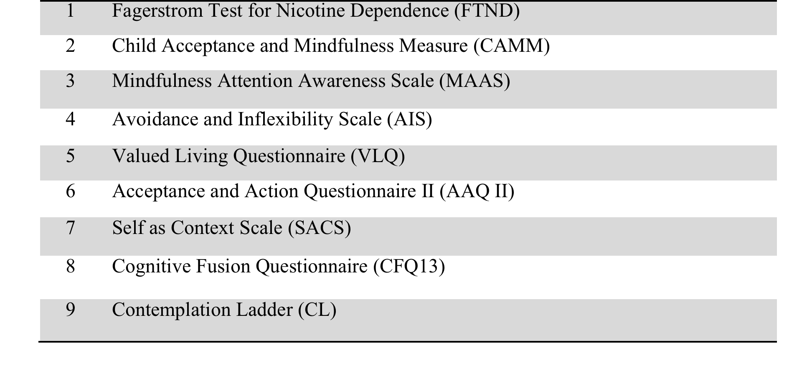
Measures
Notes:
These are the measures to be used at different times during the intervention. They have all been as of now validated in Greek using Greek-Cypriot teenagers in Cyprus

Slide 23
Problems with implementation of internet based intervention
Before writing the script for each session it was important to:
Decide which questionnaires were to be used for each phase of the study to test
the depth of the reach of the sessions and the number of skills adopted by the participants
The mediation of each of the six core processes of ACT in the cessation or reduction of the smoking habit
Validate existing questionnaires in Greek and create new measures or questions for core processes of ACT not assessed by current measures
Notes:
More detail on the method we used to validate and create new measures. The validation or creation of measures was important in the writing of each session as they were all incorporated in the online intervention in such a way as not to bore teenagers and improve attrition rates and blank questionnaires or skipped items.

Slide 24
Problems with implementation of internet based intervention
The collaboration of psychologists and web designers is rather problematic
Our psychologists do not speak “computer language” and our programmers absolutely do not speak “psychology language”
The communication barriers made the timely completion of the website difficult.
Issues with anonymity and the internet had arisen during bioethics committee hearings and ways to eliminate disclosing information to parents and principals and teachers
Notes:
The communication barriers made the timely completion of the website in time for the scheduled pilot study and the results to be presented at this conference impossible.
Unfortunately due to these problems, we are unable at the present to present results from the pilot study. We are expecting to finally have the website and internet program up and running by the end of July so as to be able to conduct the pilot study prior to starting to run the study in the fall.

Slide 25
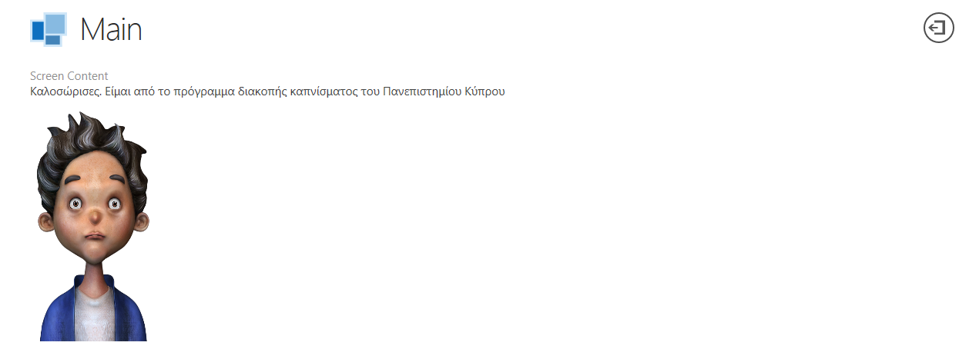
Main welcome page in the works
Notes:
Examples of the workings of how the page and characters will look.

Slide 26
Notes:
Another example that we hope will improve by our next meeting with the website designers.

Slide 27
Thank you for your attention!
ssavvide@gmail.com
mkarekla@ucy.ac.cy
Notes:
We thank you for your attention and ask you to ask your questions. Please understand however that I will probably not give you the best answers to your questions as our main presenters are currently in Cyprus. For the best answers contact Stella Savvides and Maria Karekla at the email addresses shown above. ……Thank you again.

