Slide 1
The ProACTive program for children with anxiety disorders:
Longitudinal data and community dissemination
Angela Dixon, PhD
Jessica Swain, PhD
Children’s Hospital at Westmead
Sydney, Australia

Slide 2
Children’s Hospital at Westmead
Department of Psychological Medicine
Research Team
Karen Hancock, PhD., Senior Research Psychologist
Angela Dixon, PhD., Senior Clinical Psychologist
Jessica Swain, PhD., Clinical Psychologist
Siew Koo, MA, Senior Clinical Psychologist
Karen Munro, MA, Senior Clinical Psychologist
Cassandra Hainsworth, BA, Research Psychologist

Slide 3
Aims
To evaluate the effectiveness of a manualised ACT group therapy program for mixed anxiety disorders in children and adolescents, at immediate post-treatment, 3 month and 2 year follow-ups, as compared to CBT and WLC.

Slide 4
Hypotheses
ACT will be at least as effective in the treatment of anxiety disorders in this population as a manualised CBT group-therapy program
ACT will be more effective in the treatment of anxiety disorders in this population than a wait-list control condition

Slide 5
Design & Participants
3 (group: 2 intervention, 1 control) X 4 (time: pre-, immediate post-, 3 month, 2 year) repeated measure factorial design
198 block randomised (157 completers) aged 7 – 17 years
  ACT 69 (15 dropouts)
  CBT 65 (8 dropouts)
  WLC 64 (18 dropouts)
Referrals from school counsellors, parents, word of mouth, medical and allied health professionals

Slide 6
Assessed for eligibility (n=278)
Excluded (n=80)
Not meeting inclusion criteria (n=43)
Declined to participate (n=37)
Block Randomized (n=198)
Allocated to ACT intervention (n=69)
Received allocated intervention (n=69)
Did not receive allocated intervention (n=0)
Allocated to CBT intervention (n=65)
Received allocated intervention (n=65)
Did not receive allocated intervention (n=0)
Allocated to control (n=64)
Received allocated intervention following wait list period (n=46)
Did not receive allocated intervention (n=18)
Lost to post follow up (n=14 Discontinued intervention)
Lost to 3mths post follow up (n=1 )
Lost to post follow-up (n=8, 7 Discontinued intervention, 1 sought individual RX concurrently)
Lost to 3mths post follow-up (n=0 )
Lost to post follow-up (sought RX elsewhere n=18)
Analysed (n=54)
Excluded from analysis (n=15 dropouts)
Analysed (n=57)
Excluded from analysis (n=8 dropouts)
Analysed (n=46)
Excluded from analysis (n=18 sought RX elsewhere)

Slide 7
Exclusion criteria
Developmental or language delay
Non-English speaker
Complex medical problems with a high degree of medical dependence
Complex mental health problems (e.g. psychosis)
Attention deficit disorder with hyperactivity not well controlled
Medicated with antidepressant < 2 mths
Posttraumatic stress disorder

Slide 8
Measures
  Primary endpoint
    Anxiety Disorders Interview Schedule for Children for DSM-IV (Silverman & Albano, 2004)
  Secondary outcomes
    Multidimensional Anxiety Scale for Children (MASC: March, 1997)
    Child Depression Inventory (CDI: Kovacs, 1992)
    The Children’s Anxiety Life Interference Scale (CALIS: Lyneham et al., 2011)
    Self−Perception Profile for Children (WIAL: Harter, 1985)
    Avoidance and Fusion Questionnaire for Youth (AFQ: Greco et al., 2005)
    Child Behaviour Checklist – Parent Form (CBCL: Achenbach, 2001)
    McMaster Family Assessment Device (FAD: Epstein, Baldwin & Bishop, 1983)
    The Child Health Questionnaire (QOL: Landgraf, Abetz & Ware, 1999)

Slide 9
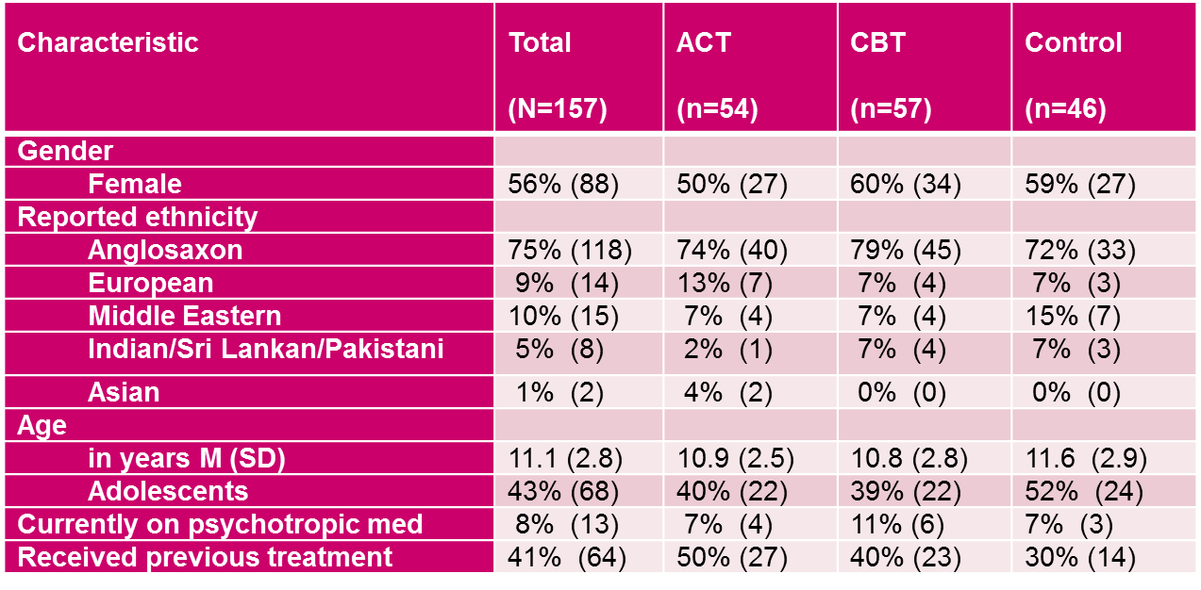
Demographic & Clinical Characteristics

Slide 10
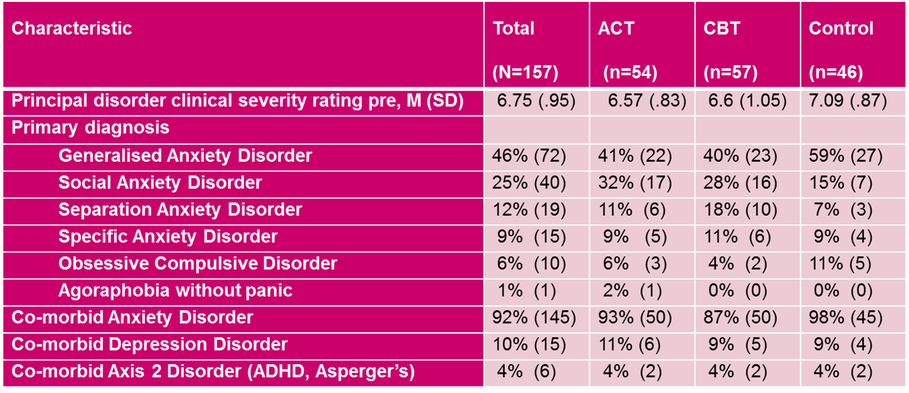
Demographic & Clinical Characteristics

Slide 11
Program Structure
Treatment groups:
  ProACTive (ACT) or Cool Kids/Chilled (CBT)
  10 sessions, 90 mins, no cost
  Child (7 – 11 yrs) & adolescent (12 – 17 yrs) programs
  Parent and child groups run concurrently
  6-8 kids & 2 therapists p/group
Wait-list control:
  Received CBT after initial + 10-week assessment

Slide 12
Cool Kids/Chilled
Cool Kids/Chilled Program (Lynehan, Abbott, Wignall & Rapee, (2009): well-validated, 10-week, manualised, group program for children and adolescents with anxiety
CBT components include:
  Psychoeducation
  Cognitive re-structuring
  Graded exposure
  Problem-solving
  Social skills training

Slide 13
ProACTive
ProACTive (Hancock, Koo, Dixon, 2013): 10-week, manualised, group program for children and adolescents with anxiety
Integrates CBT and ACT
  Psychoeducation
  Link between thoughts, feelings and behaviour
  Mindfulness
  Acceptance and values
  Cognitive defusion
  Mindful thinking worksheet
  Exposure step-ladders
  Assertiveness, problem-solving

Slide 15
Mindful walking

Slide 17
Activity

Slide 19
Data Analysis
Completers and Intention-to-treat (ITT).
Group and time differences - linear mixed models analyses.

Slide 20
Primary Outcome
Whether participants meet criteria for 1 or more DSM-IV anxiety disorders and/or
Clinically significant changes in severity scores on the ADIS, MASC, AFQ and/or CALIS

Slide 21
ADIS Clinical Severity Ratings (ITT)

Slide 22
ADIS Clinical Severity Ratings (completers)

Slide 23
MASC Child ITT

Slide 24
Avoidance and Fusion Questionnaire (ITT)

Slide 25
CALIS ITT
(parent report of child anxiety life interference)

Slide 26
ADIS no diagnosis (CSR<4), completers
CSR<4 | CSR>=4
ACT 15/35 (41.7%) | ACT 20/35 (55.6%)
CBT 22/37 (56.4%) | CBT 15/37 (38.5%)
Yates Chi square=0.02, (p=0.88), no significant differences between ACT and CBT in proportion of participants in no diagnosis category post-treatment.

Slide 27
Summary of findings
Completer and ITT analyses showed ACT and CBT were both clinically and significantly superior to WLC across all outcomes
Approximately 1/3rd of participants no longer met criteria for an anxiety disorder
No significant difference between ACT & CBT for completers
No significant improvement in WLC
Gains maintained at 3 mth and 2 yr follow-up

Slide 28
Summary of findings
Significant improvements in psychosocial measures of QOL
Age not significantly related to treatment outcome

Slide 29
Implications
Anxious children can show significant improvements with both ACT and CBT treatment protocols, regardless of age, gender, ethnicity, primary anxiety diagnosis, co-morbid anxiety, or depression prior to treatment.

Slide 30
Implications
Both treatment groups avoiding and fusing less with anxious thoughts and feelings.
  Perhaps cognitive restructuring works equally well as defusion in achieving this?
  Role of exposure?
Having high pre avoidance/fusion not predictive of outcome

Slide 31
Strengths
Largest RCT to this date, adding to scientific rigour that has previously been lacking in ACT research
Limiting noise and variability through:
  Utilisation of one clinical site
  Same assessment methods
  Minimising therapist confounding effects

Slide 32
Limitations and future research
Larger study would enable:
  More direct comparison of cognitive restructuring with cognitive defusion, while keeping elements such as exposure and skills training constant.
  Exposure-only group to further investigate mechanisms of change
One treatment site limits external validity.

Slide 33
Next step
Community dissemination and evaluation:
  ProACTive currently being rolled out to NSW Department of Education schools.
  1-day free training for school counsellors with commitment to run program in their school and evaluate

Slide 34
Conclusion
ACT can be successfully used in children and adolescents, and produce similarly effective outcomes to CBT.

Slide 35
ProACTive
ProACTive manuals are available from:
http://kidshealth.schn.health.nsw.gov.au/book-shop
ProACTive for children – Activity Book
ProACTive for children – Therapist Instructions and Activities
ProACTive for young people – Activity Book
ProACTive for young people – Therapist Instructions and Activities
ProACTive for children and young people – Parent Manual

Slide 36
Materials used to develop the program
Biegel, G.M., (2009). The Stress Reduction Workbook for Teens. Instant Help Books, Oakland, CA: New Harbinger Publications Inc.
Cayoun, B.A., (2011). Mindfulness-integrated CBT: Principles and practice. Chichester, UK: Wiley-Blackwell.
Ciarrochi, J. & Bailey, A., (2008). A CBT Practitioner’s Guide to ACT: How to Bridge the Gap Between Cognitive Behavioral Therapy & Acceptance & Commitment Therapy. Oakland, CA: New Harbinger Publications Inc.
Harris, R., (2009). ACT Made Simple: An Easy-to-Read Primer on Acceptance and Commitment Therapy. Oakland, CA: Harbinger Publications Inc.
InnerKids Foundation mindfulness video – Session at Toluca Elementary School (2010). Available at http://www.goodtube.org/video.php?search=mindfulness.

Slide 37
Materials used to develop the program
Lynehan, H., Abbott M., Wignall, A. & Rapee, R., (2009). Cool Kids Program- Children’s Workbook. Centre for Emotional health, Macquarie University. available at www.centreforemotionalhealth.com.au/pages/resources-products.asp
Murrell, A. & Wilson, K., (2002). Acceptance and Commitment Therapy Adapted for Children Working Version (August 13,2002). University of Mississippi. Available at http://www.contextualpsychology.org/system/files/Working_Protocol_Kids.pdf
Semple, R.J. & Lee, J., (2011). Mindfulness-based Cognitive Therapy for Anxious Children: A manual for treating childhood anxiety. Oakland, CA: New Harbinger Publications Inc.

Slide 38
Acknowledgments
Thank you to the children, adolescents and their parents who participated in this study
Thank you to Professor Jenny Peat for her statistical advice.
Thank you to Sangita Jaipuriar for assistance with date entry

