Slide 1
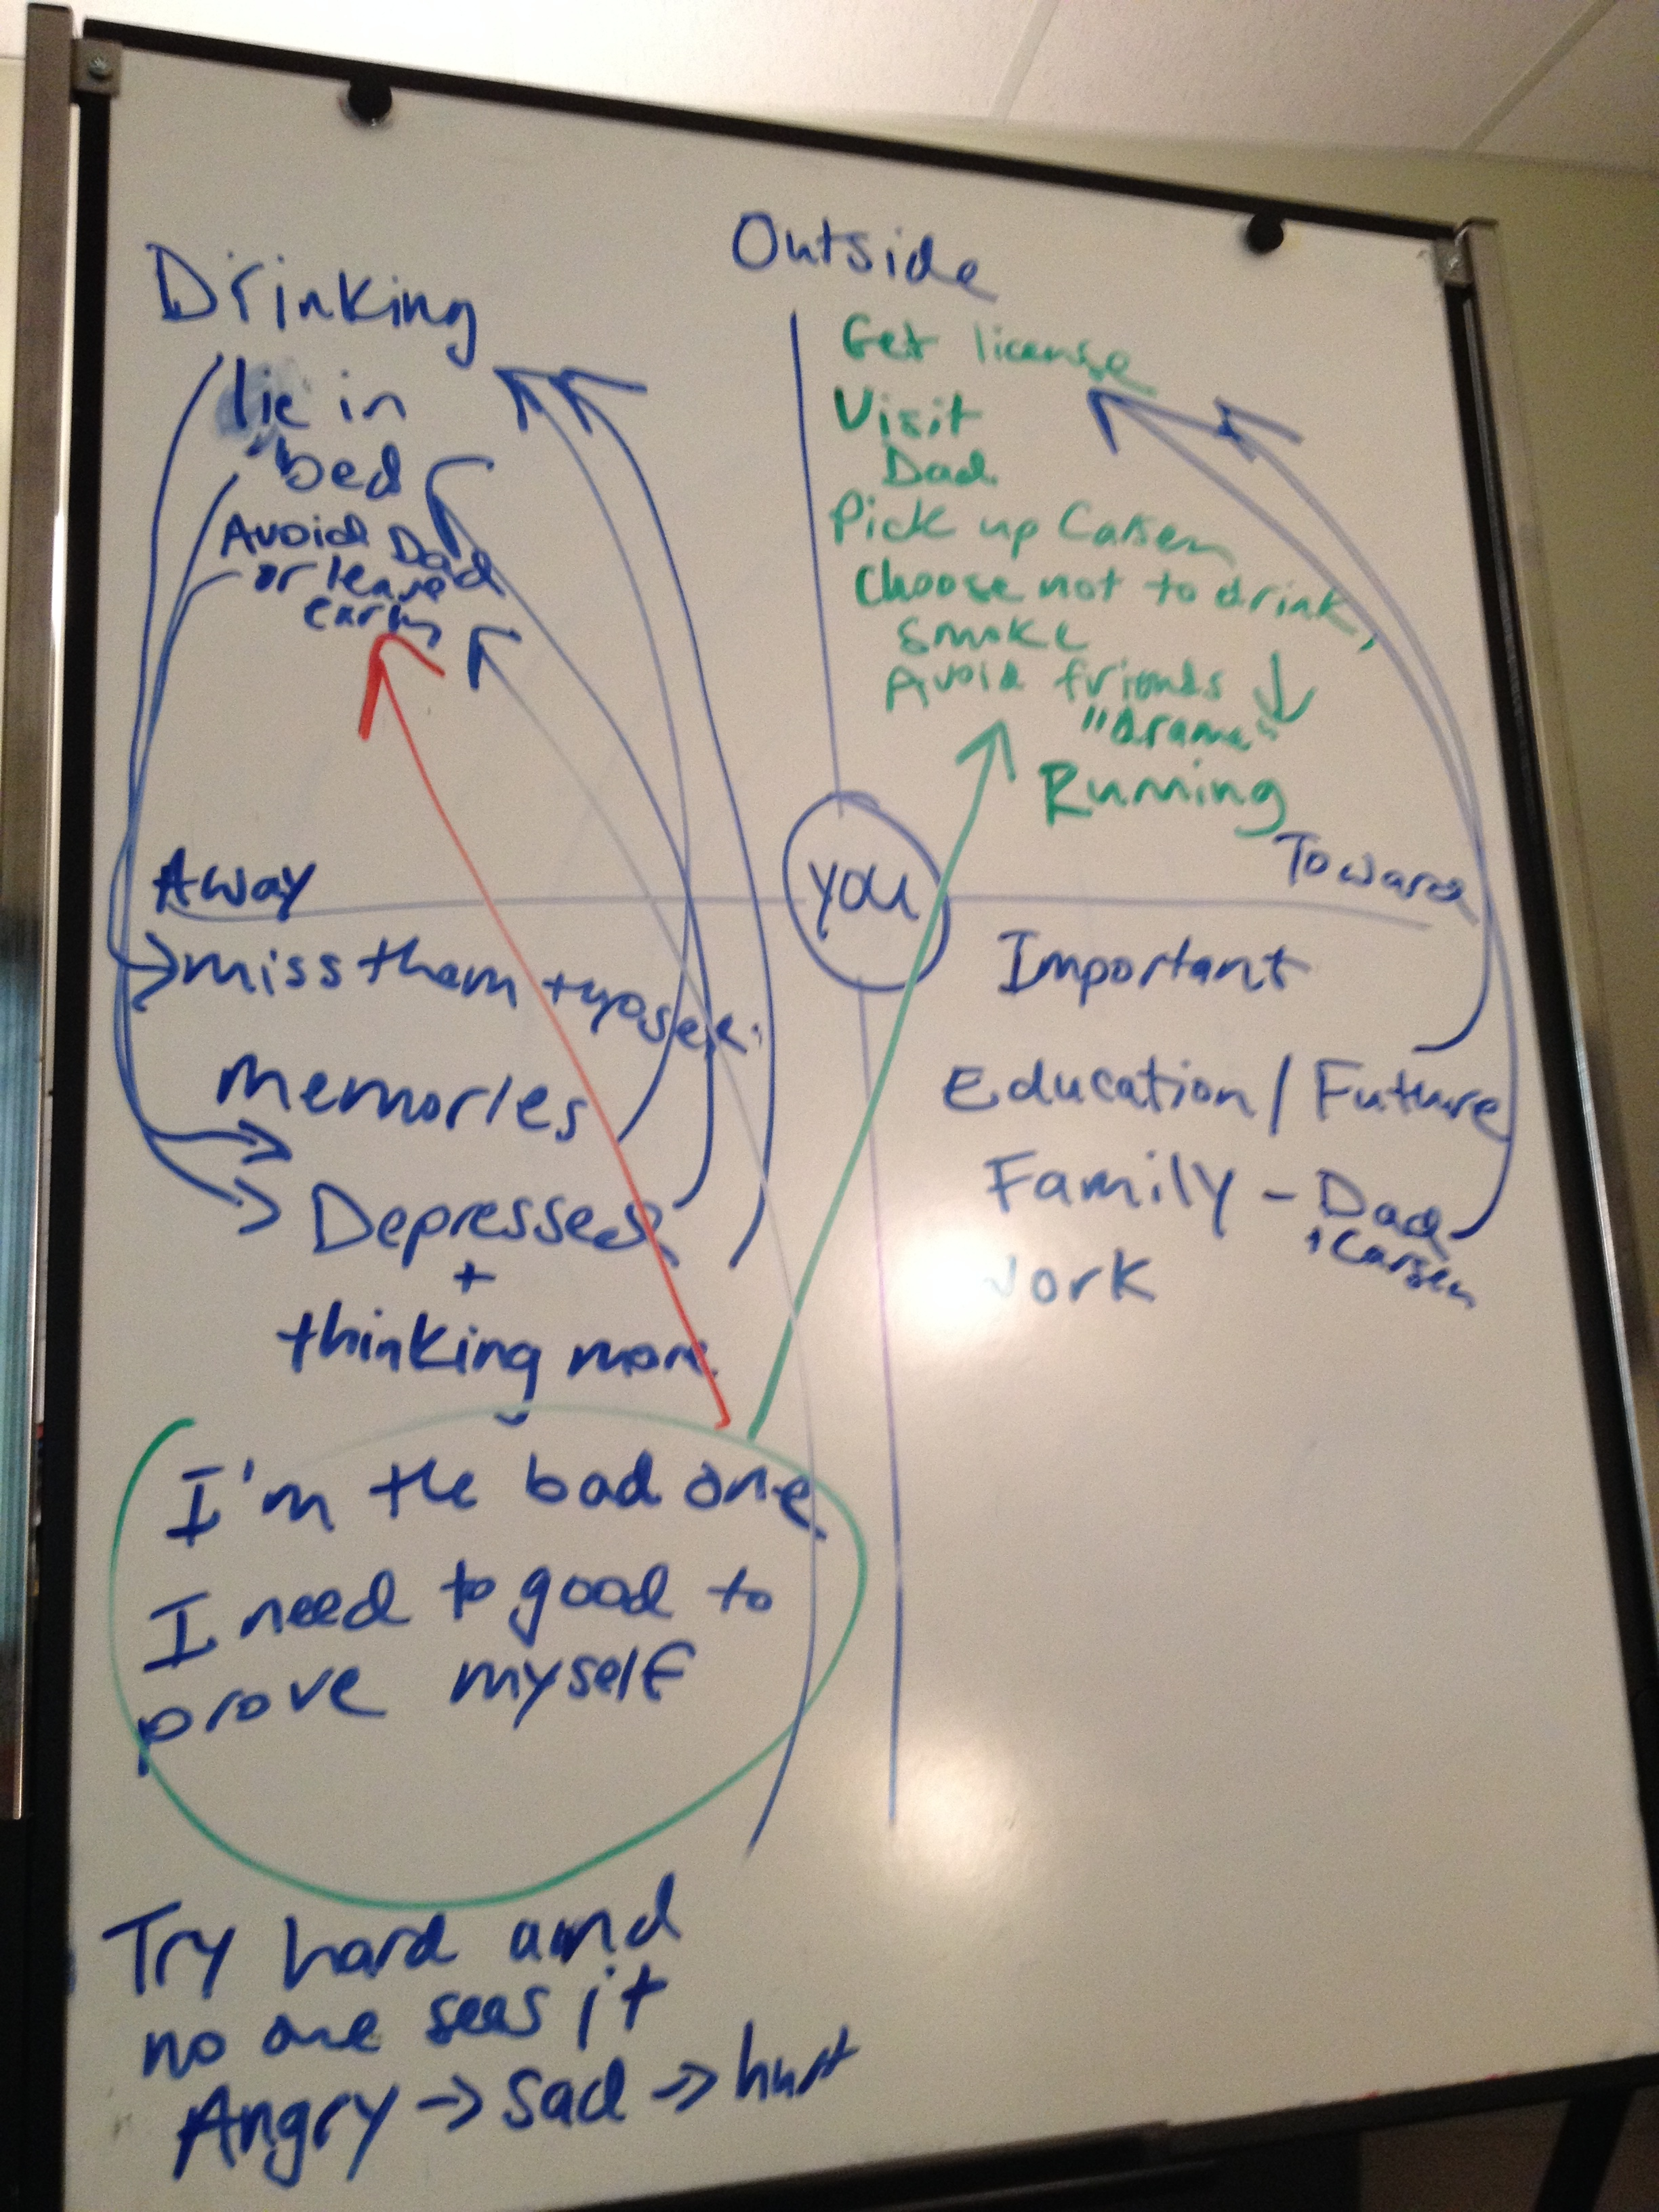
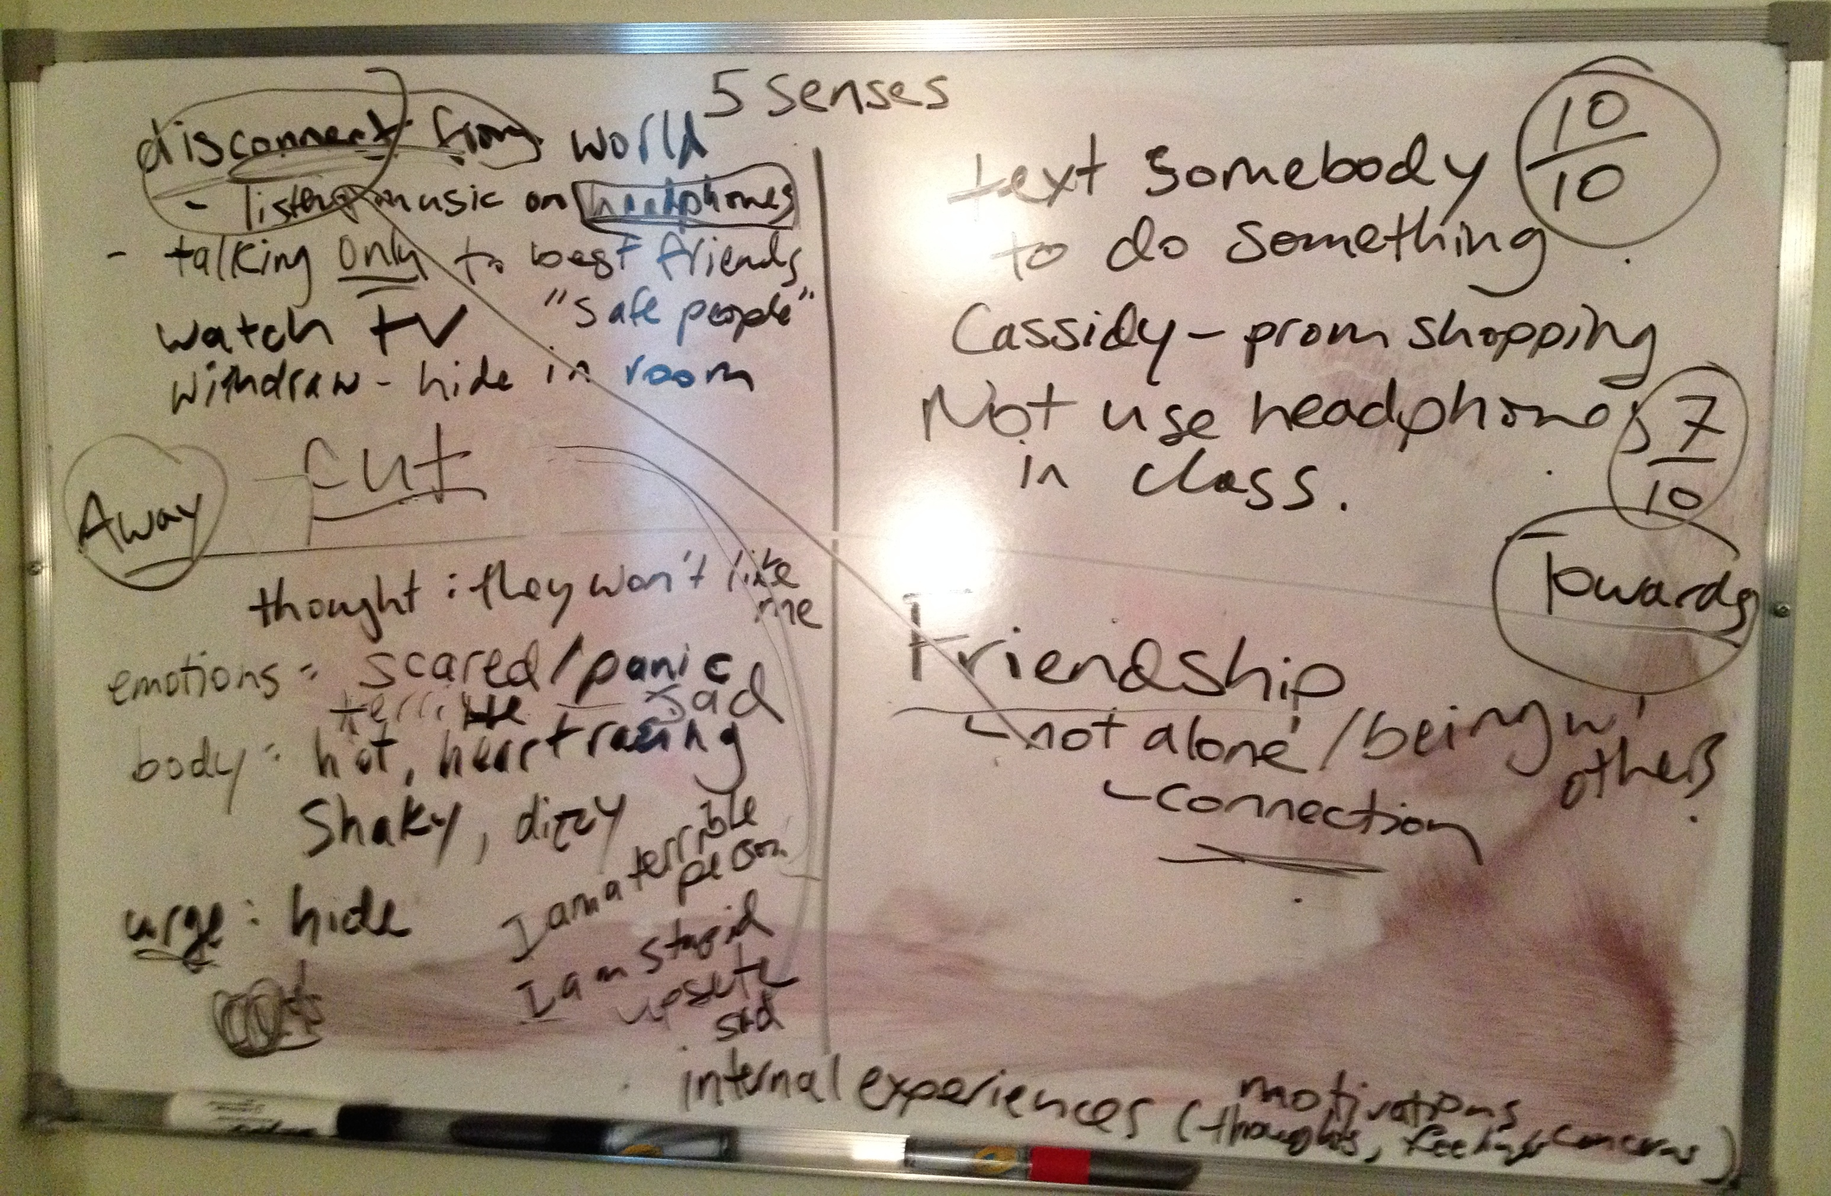
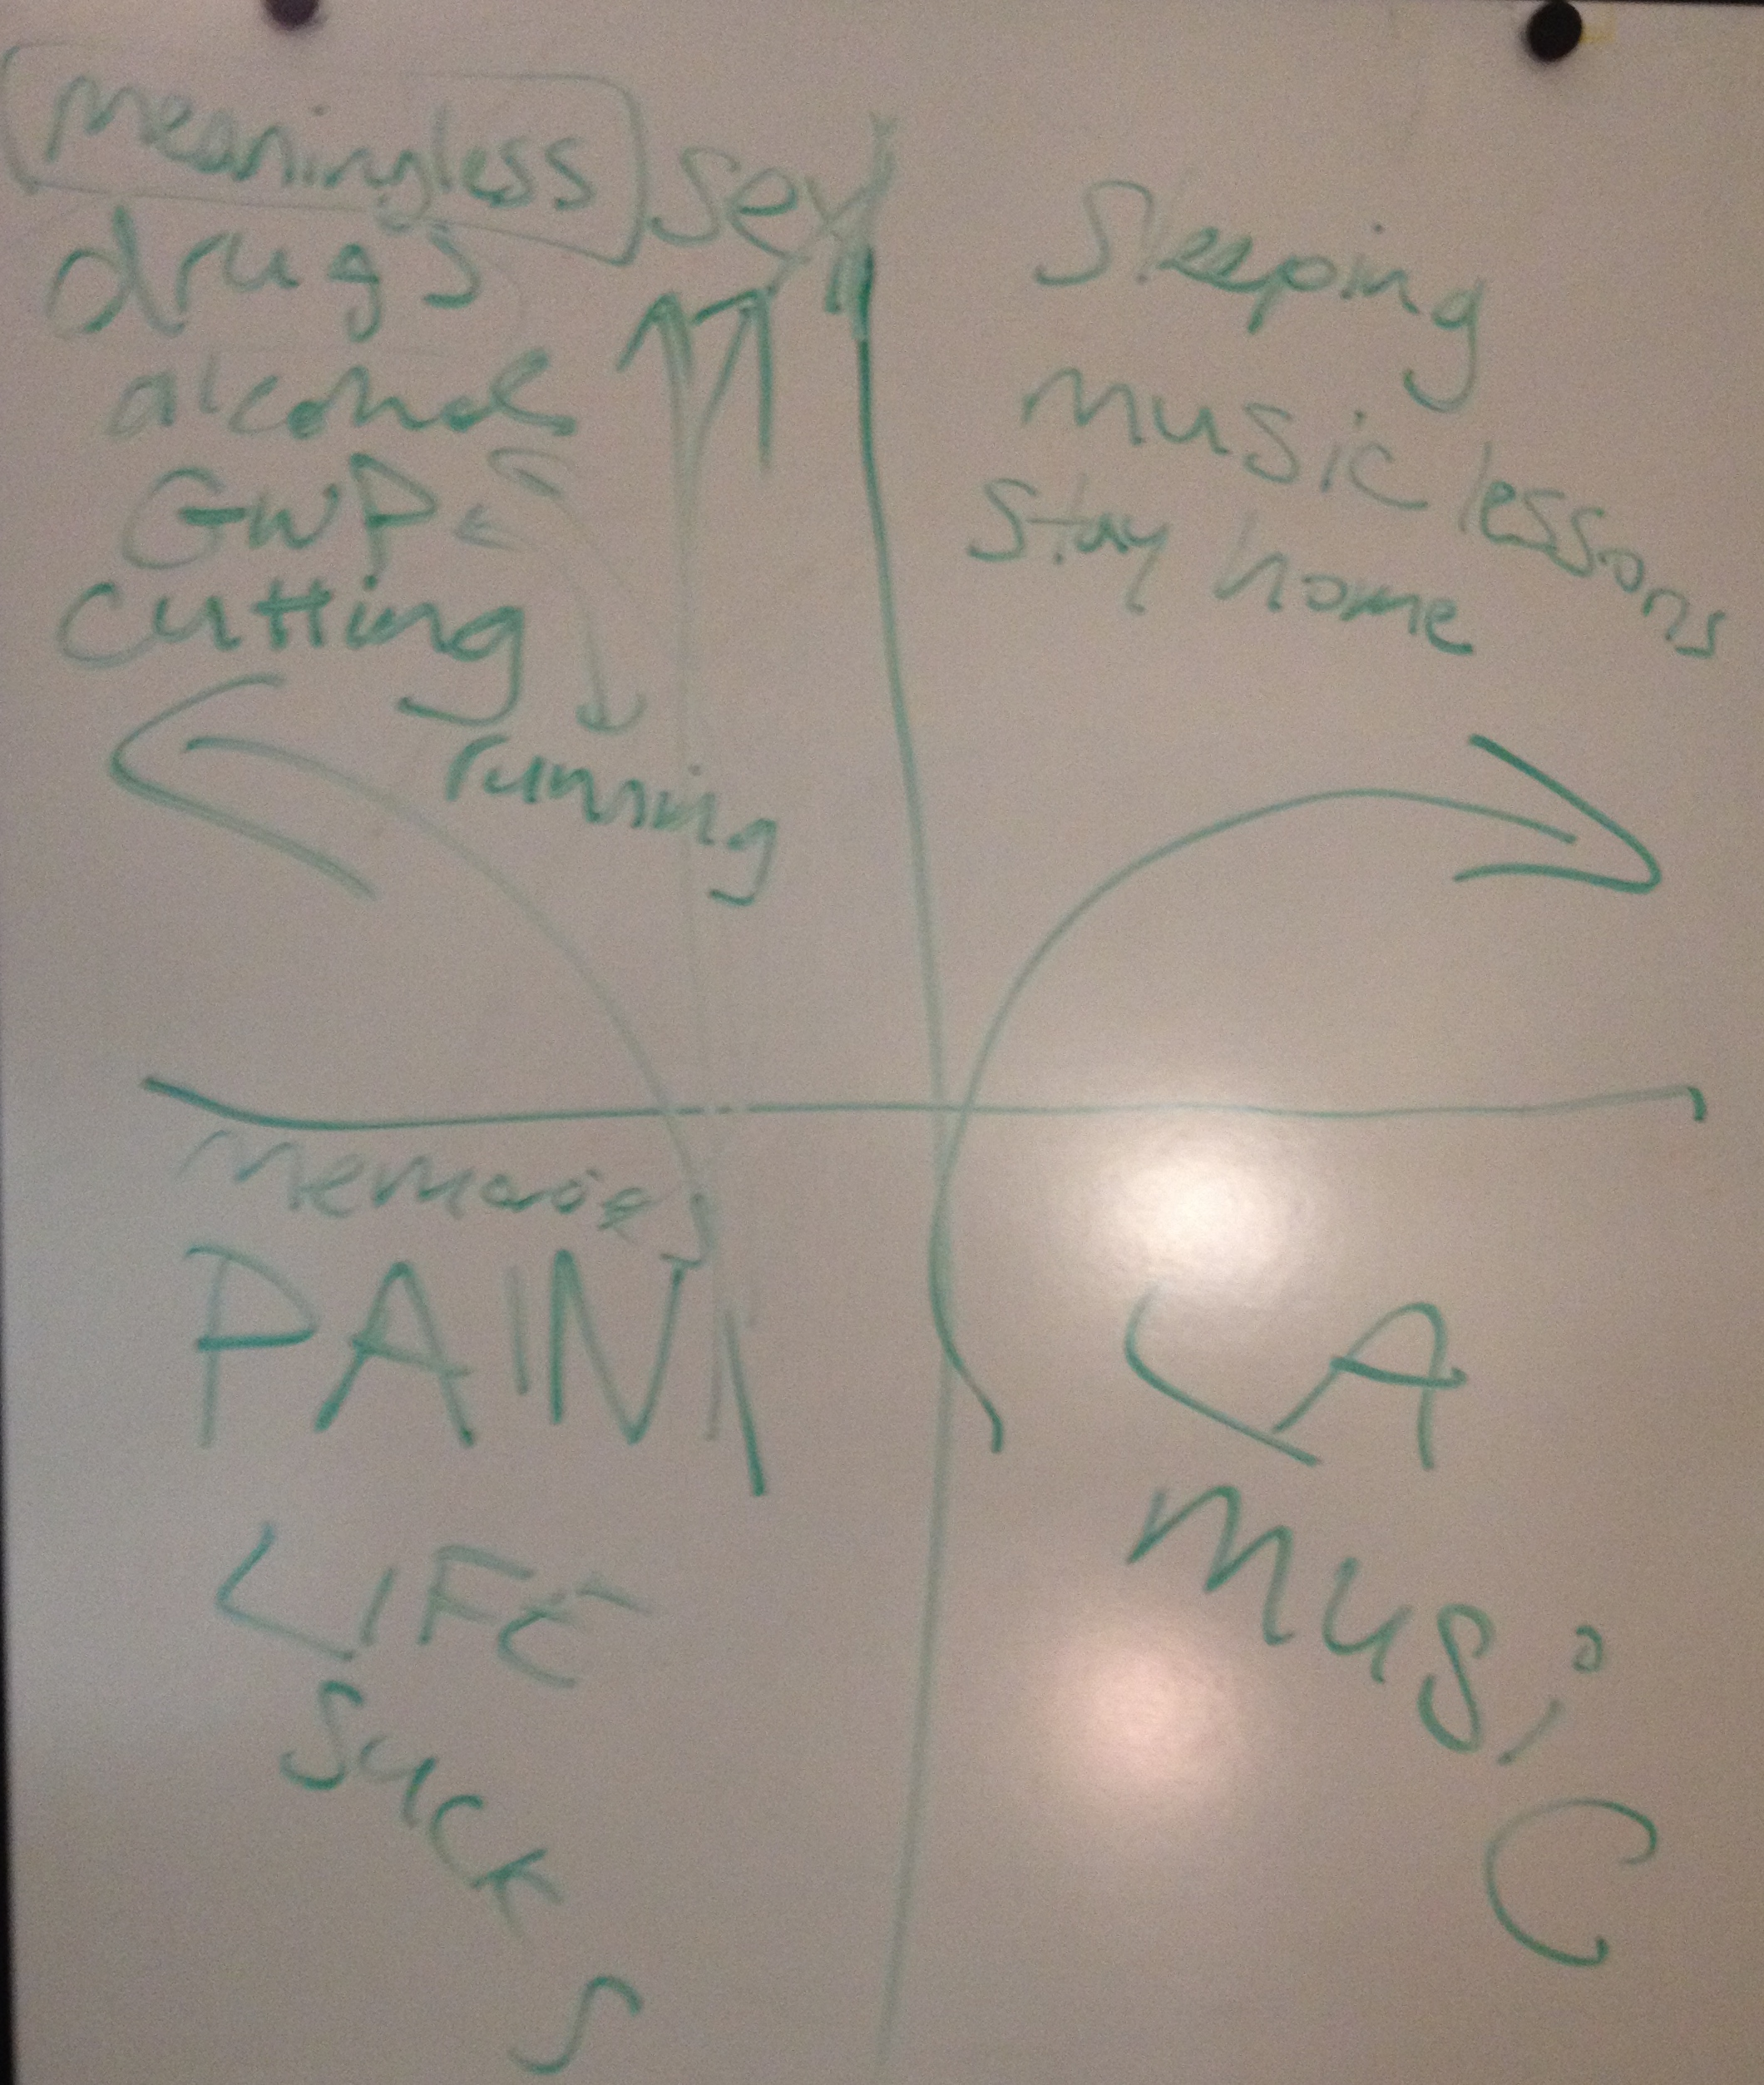
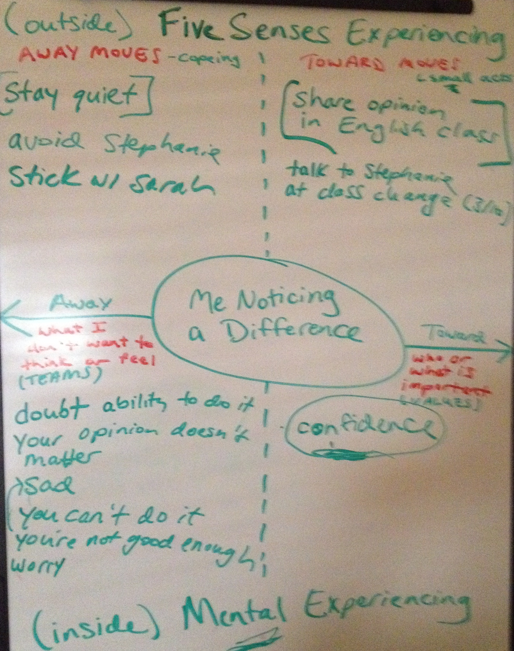
AWAY from talk, TOWARD action: Using the Matrix to engage challenging youth
Dr. Susie McAfee, IWK Health Centre, Halifax, Nova Scotia, Canada
“Megan”
“Katherine”
“Haley”
“Evelyn”
16 – ADHD; Anger; Aggression; SI; NSSI
.
18 – Attachment; Social Skill Deficits
Quickly identified friendship and connection as important values
Identified fear of rejection and self-criticism as driving avoidance
Noticed how away moves increased isolation
Independently derived committed action to stop using headphones
Engaged in group work at school for the first time!
12 – Trauma; Foster Care; NSSI; Trans
Reorient to prosocial activities after frequent hospitalizations
Reinforced existing values, strength of character, resilience
Improved perspective taking
Normalized self-sabotaging
Enhanced peer-based support in school via Gay Straight Alliance
Short-form of communication
14 – Social Anxiety; Depression
Facilitated social anxiety exposure
Confidence as action not feeling
Don’t need to be here
Multiple traumas
Values &
Actions
Matrix
Noticing
Substance abuse
Some kids….some kids are
Don’t
Talk
Shy
Tough
All
Talk
Minimize
Complain
Mental Health & Addictions
Community Mental Health
susie.mcafee@iwk.nshealth.ca

