Slide 1
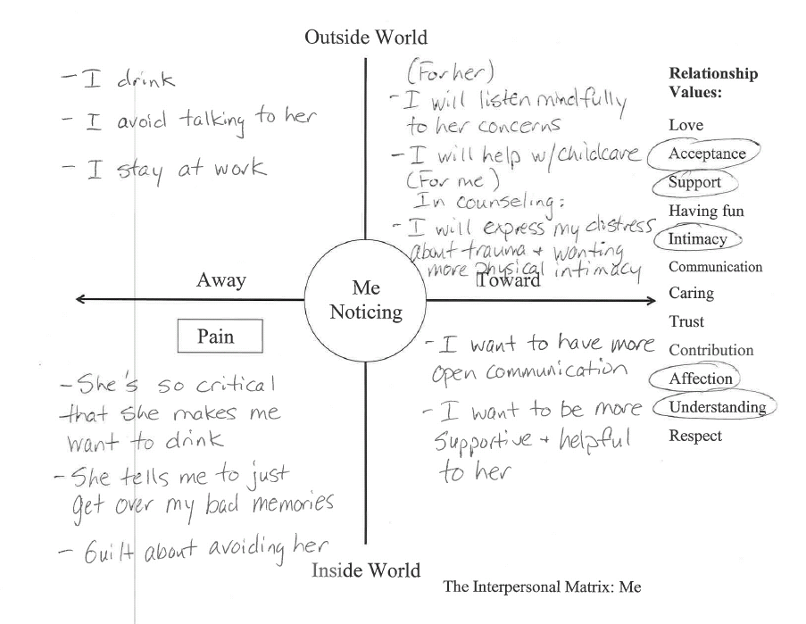
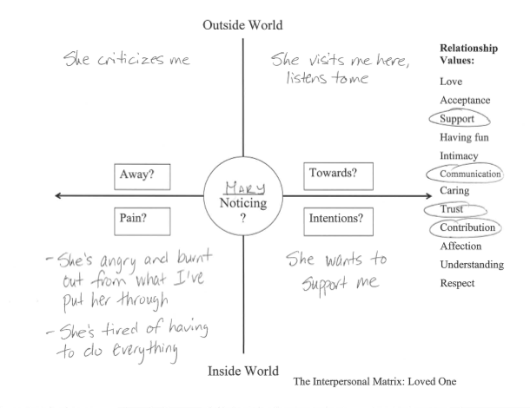
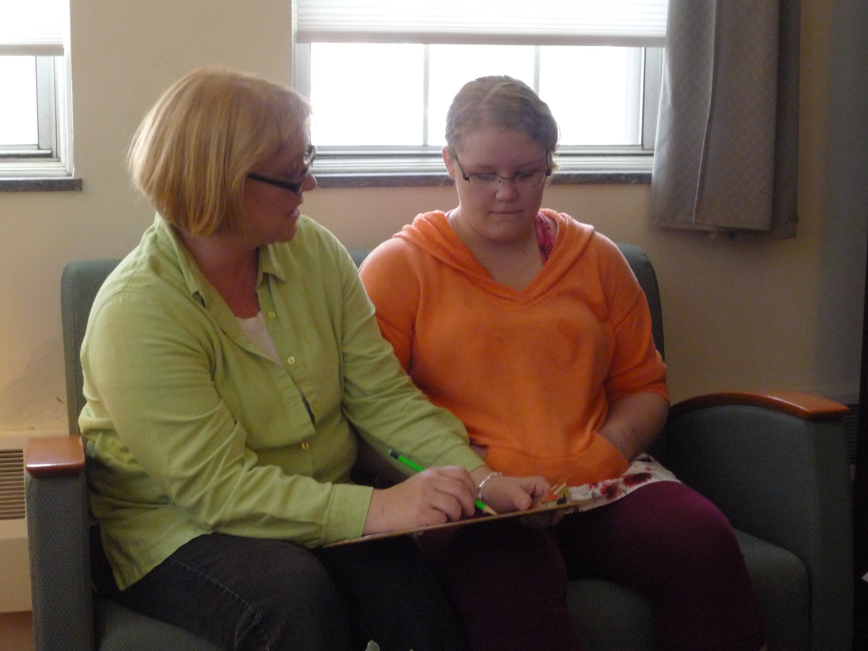
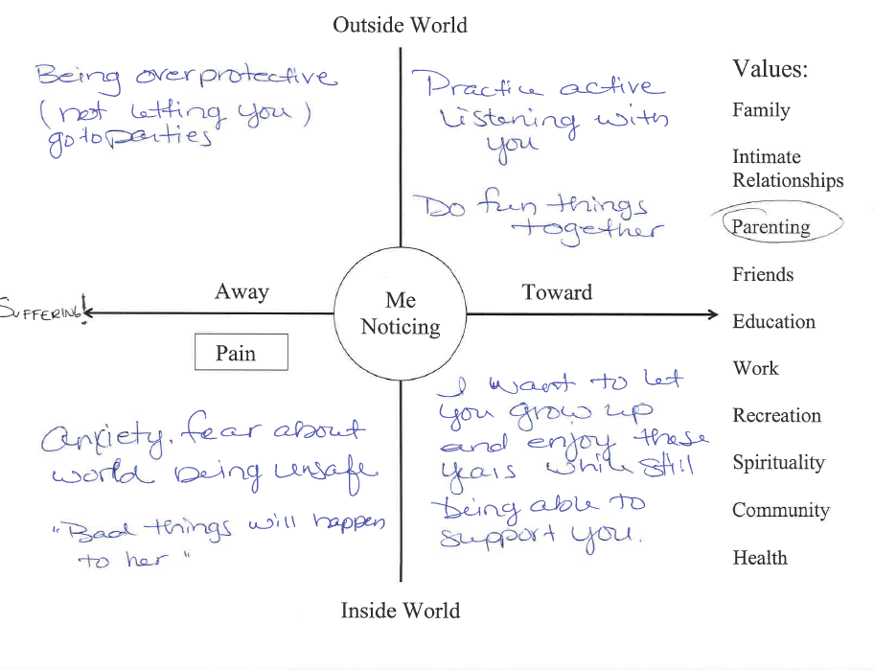
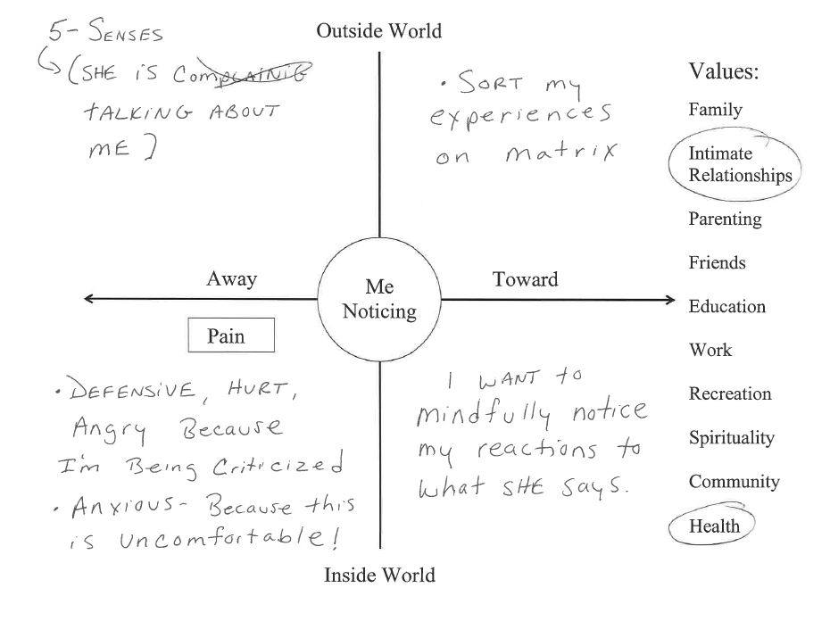
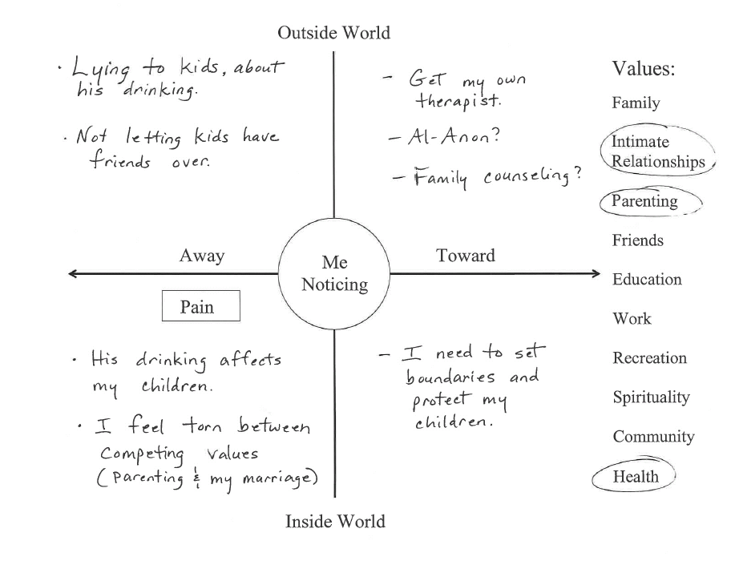
Getting Interpersonal on the Matrix:
Cultivating empathy and facilitating conflict negotiation on the matrix
Susan F. Balaban, Ph.D., Brattleboro Retreat Uniformed Services Program
Kevin L. Polk, Ph.D., The Psychological Flexibility Group
Overview
There is limited time and opportunity for family counseling in brief treatment contexts, but inpatients and patients in intensive outpatient programs tend to struggle painfully in their close relationships.
The images below show adaptations of “the Matrix” to improve interpersonal function and relationships (i.e., context) currently being used in a partial hospital and intensive outpatient program for uniformed service professionals with a variety of behavioral health problems.
The “Matrix” is employed to sort interpersonal experiences in individual, couples, family, and group modalities
Background
The ACT Matrix was developed to help patients cultivate psychological flexibility and applied in numerous clinical contexts. , (Polk & Shoendorff,2014)
Using the matrix entails distinguishing behavior and experiences occuring in the“outside ”5-sense world” from internal/ “mental” experiences,” as well as “away” (i.e., experiential avoidance) and “towards” ( i.e. values guided behaviors)
ACT has been elaborated for self-help and family therapy modalities to improve relationship quality (e.g., Harris, 2009; Coyne et al., 2011; Dahl et al., 2013; Walser & Westrup, 2014)
Interpersonal behavior can be improved by ACT (McKay et al., 2013)
ACT has also been used to help families handle health problems (Brown et al., 2013, Burke et al., 2013)
Group therapy: ACT For Close Relationships
Purpose of Group
To cultivate empathy and compassion to improve personal psychological flexibility
Improve interpersonal relationships that influence well-being
Focus on functioning in a valued relationship where there is conflict or guilt related to functioning poorly in relationship
Clarify and articulate values, intentions, and committed actions to strengthen relationships and facilitate values guided-action
Using the Matrix for Brief and Meaningful Family Interventions:
Matrix for self & loved one exercise:
Interpersonal matrices pair self and loved one using “relationship values” (Harris, 2009)
Identify personal values in this relationship
Draw on empathy to hypothesize what loved one values in relationship
Mindfully reflect on thoughts and feelings (internal/mental experiences) during painful interaction with loved one
Hypothesize painful private experiences experienced by loved one
Identify experiential avoidance strategies that impede engagement with values
Identify loved one’s behaviors that were upsetting and use empathy to sort these under “away” or “towards” moves
Generate intentions regarding personal and loved one’s values
Articulate specific and separate valued actions in the service of personal and loved one’s relationship values
Parents use matrix to provide safe structure for explaining their problems, treatment, and commitments to children and adolescents
Explaining painful thoughts and feelings.
Process of Experiential Avoidance/ Away Moves
Clarifying Intentions and Valued actions/Towards Moves to provide hope and reassurance to children
Patient practice mindfulness in relationship context
Therapist joins (Minuchin, 1974) with spouse/partner:
“How has this been for you?”
Patient practices mindfulness
listening and sorting thoughts, feelings and sensations on the Matrix
Patient uses diagram to
shares internal responses to partner’s statements
Validate & empathize with partner
Partner learns to sorts their own experiences using the Matrix
Partner develops understanding of treatment model, so they can understand and support patient using ACT
Patient learns their partner’s perspective, e.g., how their behavior has impeded partner’s towards moves
References
Coyne, L. W., McHugh, L., & Martinez, E. R. (2011). Acceptance and commitment therapy (ACT): Advances and applications with children, adolescents, and families. Child And Adolescent Psychiatric Clinics Of North America, 20(2), 379-399. doi:10.1016/j.chc.2011.01.010
Brown, F., Whittingham, K., McKinlay, L., Boyd, R., & Sofronoff, K. (2013). Efficacy of stepping stones Triple P plus a stress management adjunct for parents of children with an acquired brain injury: The protocol of a randomised controlled trial. Brain Impairment, 14(2), 253-269. doi:10.1017/BrImp.2013.18
Burke, K., Muscara, F., McCarthy, M., Dimovski, A., Hearps, S., Anderson, V., & Walser, R. (2014). Adapting acceptance and commitment therapy for parents of children with life-threatening illness: Pilot study. Families, Systems, & Health, 32(1), 122-127. doi:10.1037/fsh0000012
Dahl, J., Steward, I., Martell, C., & Kaplan, J. S. (2013). ACT and RFT in relationships: Helping clients deepen intimacy and maintain healthy commitments using acceptance and commitment therapy and relational frame theory. Oakland, CA, US: Context Press/New Harbinger Publications.
Harris, R. (2009) ACT with Love: Stop Struggling, Reconcile Differences, and Strengthen Your Relationship with Acceptance and Commitment Therapy, Oakland, CA, US: New Harbinger Publications
McKay, M., Lev, A., & Skeen, M. (2012). Acceptance and commitment therapy for interpersonal problems: Using mindfulness, acceptance, and schema awareness to change interpersonal behaviors. Oakland, CA, US: New Harbinger Publications.
Minuchin, S. (1974). Families and Family Therapy. Harvard University Press.
Polk, K.L. & Schoendorff, B. (2014). The ACT Matrix: A New Approach to Building Psychological Flexibility Across Settings and Populations. Oakland, CA, US: Context ress
Walser, R., & Westrup D. (2014) The Mindful Couple: How Acceptance and Mindfulness Can Lead You to the Love You Want. Oakland, CA, US: New Harbinger Publications.

