Slide 1
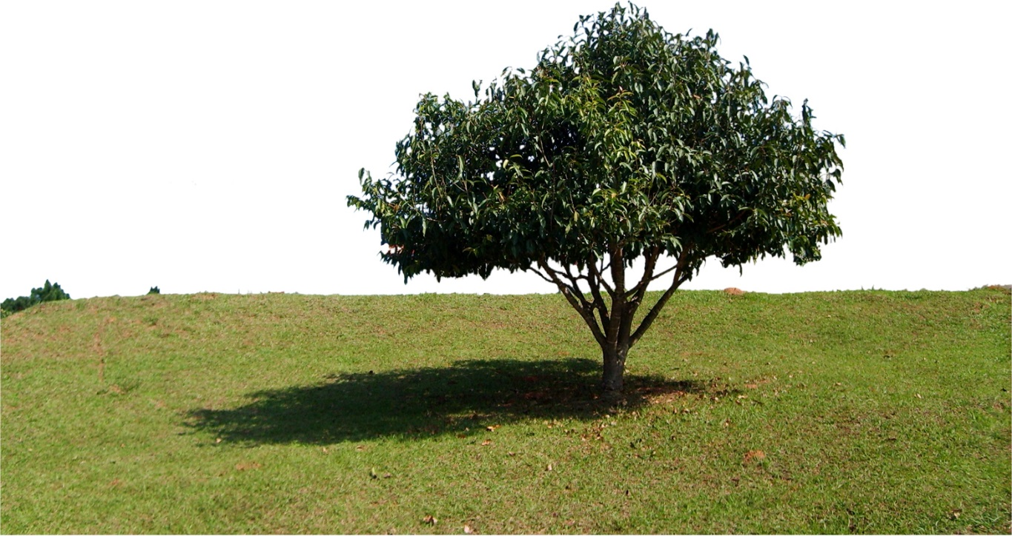
better Living with Illness
Linsay Brassington
Specialist Psychological Practitioner
Clinical Health Psychology Service
NHS Fife

Slide 2
Acknowledgements
Pam Lanza, Shona Yates, Jackie Fearn, Kim Kemp, Hannah Dale and Mandy Forbes
(NHS Fife, UK)
David Gillanders and Nuno Ferreira
(University of Edinburgh, UK)

Slide 3
Outline
Developing the Better Living with Illness group
Content of the group
Evaluation and implications

Slide 4
Context
Increase in prevalence of long-term physical health conditions
Waiting list pressures
Promoting positive adaptation to long-term conditions (de Ridder, 2008)
Commonalities across different physical health conditions
Notes:
Define LTC – lasts at least a year, and requires some kind of self-management. E.g. diabetes, chronic pain, multiple sclerosis, crohn’s disease…
LTC prevalence is rising (aging population and medical advances
Links to problems with psychological wellbeing - > referrals to clinical health and waiting list challenges.
Consequence of this and budget reductions - waiting list pressures
Also – de Ridder, identified 4 main things important for adjustment to chronic illness
Also noticed how there are lots of things in common across different health problems – physical (e.g. pain, fatigue) but also psychological (worry, burden)

Slide 5
Notes:
got curious - what would help with this?\
Shona went to a workshop with Kelly wilson - came away inspired

Slide 6
ACT and Physical Health
Emerging evidence base in physical health settings
Focus on living with, rather than resolution of symptoms and VALUES (“potential positive outcomes of illness”… de Ridder, 2008)
Transdiagnostic!
Notes:
ACT evidence – diabetes, epilepsy, chronic pain, IBS, MS…
Focus on living with and accepting, rather than getting rid of – parallels with LTC, cross referenced to de Ridders 4 things…
ACT is one approach that has been highlighted as fitting very well within a transdiagnostic framework. Also growing evidence for ACT in a for a number of health problems (epilepsy, chronic pain, multiple sclerosis, diabetes, IBS). Clinically, the focus on acceptance, rather than resolution of symptoms also seemed a good fit with living with long term health problems.

Slide 7
Better Living with Illness workbook
5
1
2
VALUES
6
3
FUNCTION
4
Follow up
Notes:
Use of metaphors and experiential learning
1: orientation to group and model. Primary and secondary suffering
2: passengers on the bus, theme throughout
3: introduction to values using compass
4: goal setting and defusion and problem solving
5: stepping stones to values
6: toolbag metaphor for setback preparation
Also assertiveness, pacing

Slide 8
Evaluation measures
Brief Illness Perception Questionnaire
Hospital Anxiety and Depression Scale
RAND SF-36
Acceptance and Action Questionnaire II
Valuing Questionnaire

Slide 9
Evaluation procedure
- 6 weeks -
- 6 weeks -
- 3 months -
Assessment
Pre group
Post group
Follow-up 2
53
43
33
22

Slide 10
Results: Psychological Distress
Notes:
overall effect of time - very sig, medium effect
Low scores good
t1 to t2 : not sig
t2 to t3 : p<.01 (total p < .001); partial eta medium
t3 to t4 : not sig
same using ITT

Slide 11
Results: Valued Living and Psychological Flexibility
Notes:
overall effect of time for both (p=.001 and .002)
Low scores good for obstruction; high scores good for progress
t1 to t2 : not sig for progress, slightly sig for obstruction (but not in ITT)
t2 to t3 : p<.05 for progress(partial eta small); not sig obstruction
t3 to t4 : not sig
same using ITT

Slide 12
Results: Illness Cognitions
Notes:
Low scores good
no overall effect of time
t1 to t2 : not sig
t2 to t3 : p<.05; partial eta small
t3 to t4 : not sig
same using ITT

Slide 13
Results: Health Status
Notes:
no overall effect of time - except pain p=0.050
High scores good
pain worsened in control period
Physical - t1-t2 not sig; t2-t3 not sig; t3-t4 not
Fatigue - t1-t2 not sig; t2-t3 p<.05; t3-t4 not
General - t1-t2 not sig; t2-t3 not sig; t3-t4 not
Pain - t1-t2 sig p<.001; t2-t3 not sig; t3-t4 not

Slide 14
Results: Health Status
Notes:
overall effect of time - except social p=0.052
High scores good
Physical limits - t1-t2 not sig; t2-t3 p<.01; t3-t4 not
Emotional limits - t1-t2 not sig; t2-t3 p<.05; t3-t4 not
Emotions - t1-t2 not sig; t2-t3 not sig; t3-t4 not
Social - t1-t2 not sig; t2-t3 p<.05; t3-t4 not

Slide 15
Results: Process
Change in Valued Living Progress
(R2=.271; p=.007)
Pre group distress
Post group distress
Change in Psychological Flexibility
(R2=.235; p=.004)

Slide 16
What does this mean?
More evidence for using ACT in physical health settings
Reductions in psychological distress in the context of limited change in perception of physical health
ACT processes mediated change

Slide 17
And transdiagnostic approach?
Layers of transdiagnostic processes
Psychological
Physical
But… what works best in a transdiagnostic physical health group?
Diagnosis characteristics?
Personal characteristics?
Health adjustment characteristics?
Notes:
We know a bit about transdiagnostic psychological processes – whether that’s rumination, emotion regulation or experiential avoidance
Don’t know so much about physical transdignostic processes – but maybe there are some?
And what about checking out psychological processes in physical health
Lots to do!
Diagnostic – life limiting / terminal? Medically unexplained vs explained?
Personal – age? Gender?
Health adjustment – cure seeking?

Slide 18
Interested in doing something similar?
Download the protocol and workbook for free on www.contextualscience.org
And please let us know if you do :)

Slide 19
Thanks!

