Slide 1
Avoidance versus Defusion in the Reduction of Smoking Behavior
Nic Hooper (University of the West of England)
Charlotte Dack (University of Bath)
Maria Karekla (University of Cyprus)
Asli Niyazi (Middle East Technical University, Northern Cyprus Campus)
Louise McHugh (University of College, Dublin)

Slide 2
Smoking is bad
Smoking is the leading cause of preventable death
Two-thirds of smokers start before they are 18
Smoking prevalence is highest in the 25-34 age range and groups such as University students, present with higher smoking rates than ever before (Peters, Meshack, Kelder, Springer &Agurcia, 2011; Soteriades, Spanoudis, Talias, Warren, & DiFranza, 2011; Villanti, 2011; Wechsler, Rigotti, Gledhill-Hoyt& Lee, 1998).
Two-thirds of smokers would like to quit but around only 30% make an attempt
Important to find interventions to reduce smoking behavior

Slide 3
Avoidance is bad
One way people manage unwanted thoughts and cravings is avoidance.
However, much research suggests that trying to avoid an unwanted thought may increase the amount it intrudes.
It may also cause a behavioral rebound effect:
Hooper, Sandoz, Ashton, Clarke and McHugh (2012)

Slide 4
But it may work short term…..
Erskine, Georgiou and Kvavilashvili (2010) measured smoking behaviour over 3 weeks
Pts divided into 3 groups
Suppression group – supress all thoughts of smoking
Expression group – think about smoking as much as possible
Control group – just monitor smoking behaviour
Wk 1: just monitor smoking behaviour
Wk 2: intervention (supress/express/monitor)
Wk 3: just monitor smoking behaviour

Slide 5
ACT is good
Investigations have been conducted which display that the full ACT package may be useful in the treatment of smoking cessation (Gifford et al., 2004, 2011; Hernandez et al, 2009; Bricker et al. 2010, 2013, 2014 ).
However, it is important that we understand the processes that contribute to clinically relevant improvements in clients.
For this reason, the investigation of each ACT component is crucial.
A recent meta-analysis conducted by Levin, Hildebrandt, Lillis & Hayes (2013) investigating the utility of each ACT process indicated generous effect sizes.

Slide 6
Therapy takes time
Another reason that the investigation of each component is important is because applying specific process based interventions takes less time than full-blown therapy.
If brief and effective interventions can be developed then these could be administered to those in the general public who do not have the time or financial resources for Nicotine Replacement Therapy or full length Psychological Therapy.
We feel that a brief defusion intervention could alter smoking behavior.

Slide 7
Defusion is good
Defusion encourages clients to distance themselves from their thoughts, whilst helping them to understand that their thoughts do not have to be causal to their actions when they are not in the service of valued ends.
Much research suggests that defusion may be worth investigating as an alternative to avoidance in the management of unwanted thoughts (De Young et al. 2010; Deacon et al., 2011; Healy et al., 2008; Hooper, Sandoz, Ashton, Clarke & McHugh, 2012; Hooper & McHugh, in press; Masuda et al., 2009; Masuda, et al., 2010; Masuda, Twohig, et al., 2010;).

Slide 8
The current study
Participants, recruited based on their desire to quit smoking, were asked to reduce and measure their smoking behavior for a one-week period.
In order to help participants reduce their smoking behavior they were given one of two interventions; avoidance or defusion. A wait list control group was also included.
A rebound week was included where all participants were relieved of the instruction to reduce cigarette consumption and were simply instructed to monitor and measure their smoking behavior.

Slide 9
Method
Participants
54 recruited
Inclusion Criteria
Participants had to a) have been smoking for at least 2 years b) smoke at least 10 cigarettes a day c) and be at least 18 years old.
Baseline: Control Questions
Years smoking
Number of quit attempts
Cigarettes smoked on an average day
Motivation to quit

Slide 10
Defusion
Notice your craving to smoke and take a step back from those thoughts.
It will help you to think ‘right now, I’m having the thought that I’m craving a cigarette, but I can notice that craving, and not act on it’.”

Slide 11
Defusion
Dealing with cravings is an important aspect of quitting smoking. Often what people notice about their cravings is a feeling of wanting to smoke. This feeling can sometimes be so strong that people act on it and pick up a cigarette. What people don’t often notice are the thoughts and feelings that seem to come with cravings. These may be thoughts like, “Today was upsetting so I deserve to smoke,” “I need to smoke right away to be okay,” “I shouldn’t have to quit smoking,” or “I might as well smoke now because eventually I’ll just fail anyway.” These thoughts may result in feelings like disappointment. And more times than not, the craving may lead to smoking.
One popular and effective way of handling these cravings is to take a step back from your thoughts and notice the experience of thinking. Many believe that our thoughts cause our actions. So that because you crave smoking you will often smoke. However this is a mis-representation. In fact, when cravings arise it may be helpful to simply notice them, to feel what the strong urges feel like, but to understand that you are in control of your hands! Despite having the craving you do not have to act on it. Next time you get a smoking craving, it may be helpful to change your thought from ‘I’m craving a cigarette’ to ‘right now, I’m having the thought that I’m craving a cigarette’. At this point it is important to understand that you can choose to act or not act on this craving. In particular, keep an eye out for thoughts like ‘it would feel real good’, or that ‘it wouldn’t hurt to have one cigarette’. Your mind may try a number of ways to make you act on the craving; you can step away from these too.

Slide 12
Avoidance
Notice your craving for smoking and suppress it.
It will help you to think about something else or move onto another activity.

Slide 13
Avoidance
Dealing with cravings is an important aspect of quitting smoking. Often what people notice about their cravings is a feeling of wanting to smoke. This feeling can sometimes be so strong that people act on it and pick up a cigarette. What people don’t often notice are the thoughts and feelings that seem to come with cravings. These may be thoughts like, “Today was upsetting so I deserve to smoke,” “I need to smoke right away to be okay,” “I shouldn’t have to quit smoking,” or “I might as well smoke now because eventually I’ll just fail anyway.” These thoughts may result in feelings like disappointment. And more times than not, the craving may lead to smoking.
One popular and effective way of handling these cravings is to suppress and avoid all thoughts and feelings associated with the craving. In other words, when cravings arise throughout the day, or when your mind tells you that you really need a cigarette, suppress the urge and suppress the thought. When you stop yourself from thinking about smoking, or the feeling of craving cigarettes then you are less likely to act on it. In particular, keep an eye out for thoughts like ‘it would feel real good’, or that ‘it wouldn’t hurt to have one cigarette’ suppressing these thoughts will help you to reduce the amount of cigarettes you smoke. Many people find it helpful to distract themselves as way to suppress cravings e.g. by having a conversation with one’s friend, by watching TV, by eating a chewing gum etc. By doing this it is possible to suppress the urge to smoke and control ones cravings. Remember that often cravings come and go, meaning that if you can distract yourself with another activity for a short amount of time your craving will disappear.

Slide 14
Method
Baseline: Adherence Question
How confident they were that their intervention would help them in reducing their smoking behaviour
Week 1: Adherence Questions
How useful they found their intervention
How much they used their intervention
‘The intervention has now finished, however please continue to complete the tally questionnaire for the next 7 days’.

Slide 15
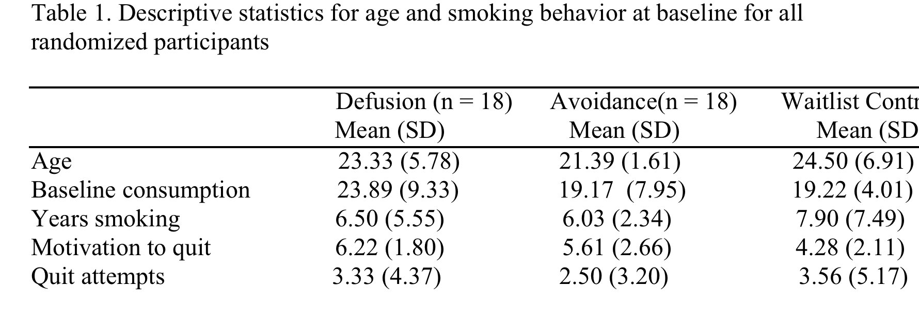
Results: Control questions

Slide 16
Results: Adherence Questions
Baseline
Confidence (Defusion 4.38, Avoidance 4.47)
Week 1
Usefulness (Defusion 4.00, Avoidance 3.80)
Use (Defusion 3.88, Avoidance 3.87)

Slide 17
Results: Smoking Behaviour

Slide 18
Defusion is good
The participants in the defusion group smoked significantly less than those in the waitlist control group in week 1.
They smoked significantly less than both groups (avoidance and waitlist control) in week 2.
No differences were found between the avoidance and waitlist control group at week 1 or week 2.

Slide 19
Improvements are good
There are a number of ways the research could be improved:
A better measure of treatment adherence.
A biological measure of smoking behaviour.
Were people seeking help elsewhere?
Believability measures.
A post-experiment interview to note if participants avoided situations in order to control their smoking behaviour.
Appropriate follow up measures

Slide 20
Take home message
Smoking is bad
We all knew that.
Defusion is good
A 1o-15 minute defusion intervention allowed participants to control their behavior such that a significant reduction in smoking behavior was recorded.

Slide 21
Thank moo for listening!

