Slide 1
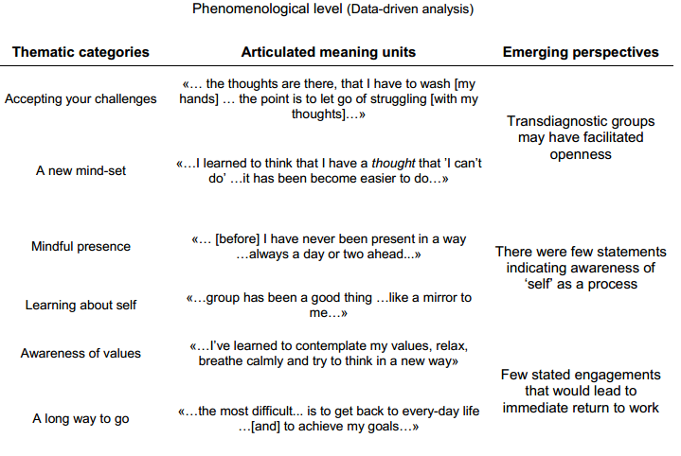
Patient Experiences with Acceptance and Commitment Therapy
for Return To Work: A Qualitative Focus Group Study
Sigmund Ø. Gismervik, Marius S. Fimland, Egil Fors, Roar Johnsen, Marit B. Rise
Hysnes Occupational Rehabilitation Centre, Department of Physical Medicine and Rehabilitation, St. Olav’s Hospital
Department of Public Health and General Practice, Norwegian University of Science and Technology, Trondheim, Norway
Background and Aims: An ACT based occupational rehabilitation program was developed for musculoskeletal, common mental and unspecific symptom disorders. Participants with different diagnoses were mixed in this transdiagnostic mainly group based intervention of 3 ½ week duration. The aim of this study was to explore patient experiences with the rehabilitation program and how their experiences reflected the intended ACT core processes.
Methods: Twenty-three participants were included in five focus group interviews at the end of their stay. Findings from phenomenological and thematic analysis were reflected upon the six core processes in the ACT model.
Main results: Participants described changes in perspectives that reflected varying degrees of comprehension, integration and implementation of the intended ACT processes. There were few statements indicating awareness of “self” as a process. Transdiagnostic treatment groups were perceived by participants as a strength of the program. Participants talked about behaviour changes in direction of their values but committed actions indicating immediate return to work were not mentioned.
Conclusions: This study found mainly positive participant experiences with a transdiagnostic occupational rehabilitation program for musculoskeletal and common mental disorders. The transdiagnostic approach may have facilitated openness. However, few statements indicated immediate return to work and this raises the question of return to work efficacy.
Contact information: Sigmund Gismervik, NTNU, Dep. of Public Health and General Practice, PB 8905, 7491 Trondheim,
Phone: +47 45885125, E-mail: Sigmund.Gismervik@ntnu.no

