Slide 1
Effectiveness and cost-effectiveness of a guided and unguided online-based acceptance and commitment therapy for chronic pain (ACTonPain): preliminary results of a three-armed randomized controlled trial
M.Sc. Psych. Jiaxi Lin
Department of Rehabilitation Psychology and Psychotherapy, Institute of Psychology, University of Freiburg, Germany,
Medical Psychology and Medical Sociology, Faculty of Medicine, University of Freiburg

Slide 2
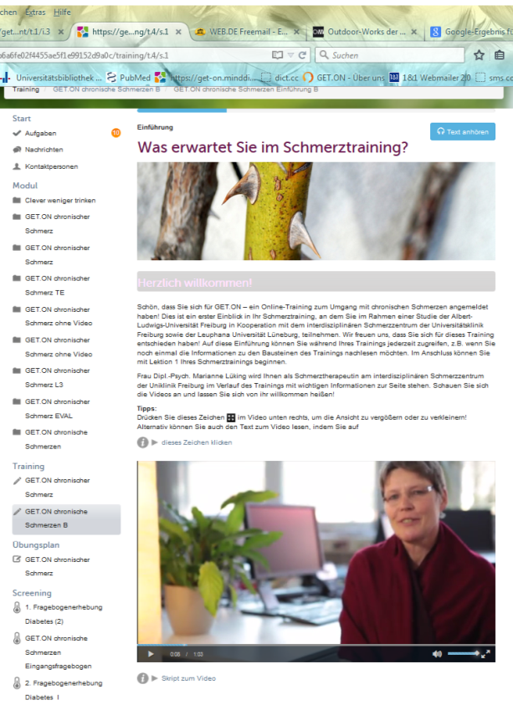
Overview
Background
Rationale of the study
Methods
ACTonPain intervention
Preliminary results
Discussion

Slide 3
Chronic pain, ACT and Internet-based Interventions (IBIs)
High prevalence of chronic pain: about 17% in Germany (Wolff, Clar, Lerch & Kleijnen, 2011)
ACT is an effective intervention for the treatment of chronic pain
small to medium effects of acceptance based interventions for chronic pain (d = .37 Veehof, Oskam, Schreurs & Bohlmeijer, 2011)
ACT as effective as cognitive behavioral therapy (Veehof, et al., 2011; Wetherell et al., 2011)
Internet-based interventions (IBIs) might be a (cost-)effective way to overcome treatment barriers of traditional face-to-face pain interventions

Slide 4
Rationale of the study
Previous IBIs almost exclusively with cognitive- behavioral therapy (Macea et al., 2010, Eccleston et al., 2014)
lack of economic and external validity
Small to medium effects (SMD=.37, Eccleston et al., 2014)
Unclear:
general (cost-)effectiveness of pain IBIs
the specific (cost-)effectiveness of guided and unguided IBIs (Baumeister et al., 2014a)

Slide 5
ACTonPain study project
Effectiveness and cost-effectiveness of a guided and unguided internet-based Acceptance and Commitment Therapy (ACT) for chronic pain patients: a randomized controlled trial
Lin J^{1, 2}, Baumeister H^{1, 2}
Collaborators: Marianne Lüking, Dipl.-Psych.³, David Daniel Ebert, PhD ^{4.5}, Monica Buhrman, PhD⁶, Gerhard Andersson, PhD^{7,8}
Institutes: 1) Department of Rehabilitation Psychology and Psychotherapy, Institute of Psychology, University of Freiburg, Germany, 2) Medical Psychology and Medical Sociology, Faculty of Medicine, University of Freiburg, Germany, 3) Interdisciplinary Pain Center, University Medical Center, Freiburg, Germany 4) Innovation Incubator, Division Health Trainings online, Leuphana University Lueneburg, Germany 5) Department of Psychology; Clinical Psychology and Psychotherapy, Philipps University Marburg, Germany, 6) Department of Psychology, Uppsala University, Sweden, 7) Linnaeus Centre HEAD, Swedish Institute for Disability Research, Department of Behavioural Sciences and Learning, Linköping University, Sweden, 8) Department of Clinical Neuroscience, Division of Psychiatry, Karolinska Institutet, Stockholm, Sweden

Slide 6
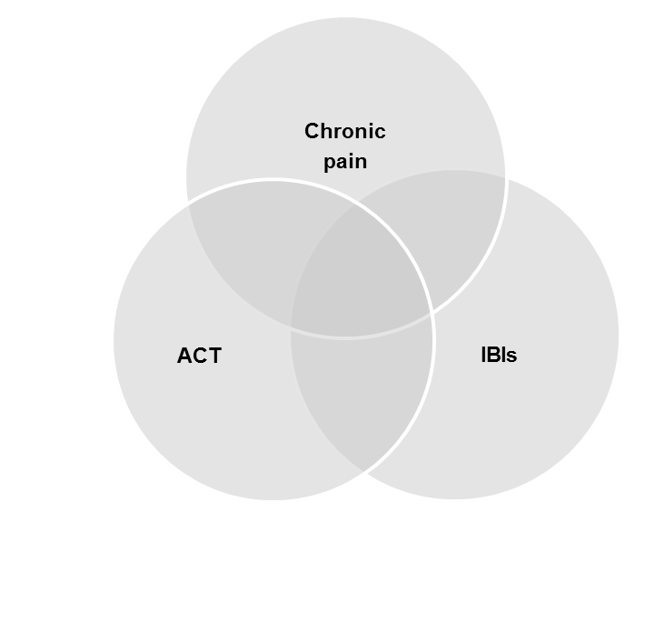
Aim of the study
1. Effectiveness (guidance, no guidance, waitlist)
2. Potential moderating or
mediating variables
3. cost-effectiveness

Slide 7
Methods
Primary outcome: pain interference (MPI)
Secondary outcomes:
physical (BPI) and emotional functioning (PHQ-9, GAD-7),
pain intensity (NRS)
ACT related variables (CPAQ, FAH-2)
health related quality of life (SF-12, EQ-5D, AQoL)
cost-effectiveness analysis from a societal perspective (TiC-P)
Demographic and medical variables to detect potential moderators or mediators of the effects

Slide 8
Study flow chart
Exclusion:
- meeting exclusion criteria (N= 142)
- no T0 or informed consent (N= 43)
Interested in participation (N=875)
Screening
(N= 539)
ACTonPain guided (N=89)
Randomisation (N=265)
ACTonPain unguided (N=88)
Waitlist control group (N=88)
Assessment T0: Baseline (N= 281)
Assessment T2: 6 months after randomisation (N=21)
Assessment T1: 9 weeks after randomisation (N=59)
No screening
(N= 336)
status: 09.07.2015

Slide 9
The intervention
ACTonPain is based on a prior intervention by Buhrman et al. (2013) and consists of 7 modules that should be processed weekly
The two ACTonPain interventions differ only with respect to guidance, consisting of feedback emails from an e-coach after each module:
Encouraging and motivating
Feedback on exercises
Reminding function

Slide 10
The 7 modules of the intervention
 | Module 1: creative helplessness Acute and chronic pain How to deal with pain
 | Module 2: Control and acceptance Primary and secondary pain short- and longterm problem solving
 | Module 3: Thoughts and feelings SMART aims Defusion
 | Module 4: Me and my self-image The self-image Self as context
 | Module 5: What I value in life The importance of values The values compass
 | Module 6: Commited action The ACT-formula Obstacles
 | Module 7: The way forward Review to the last modules Future plan
All modules include:
Mindfulness exercises
Information
Patient vignettes
Metaphors
Assignments
Interactive exercises
Audio and Video files
SMS Coach
E-Coach (ACTonPain guided only)

Slide 11
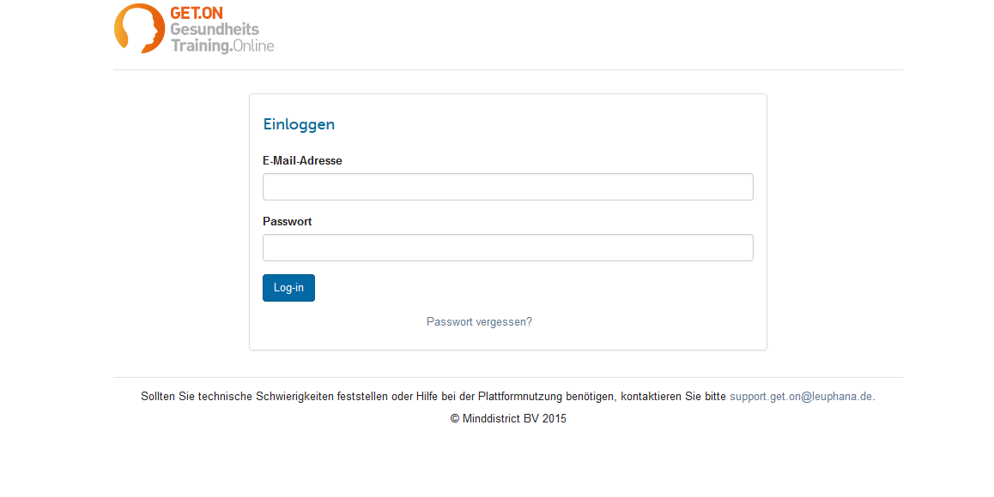
https://get-on.minddistrict.de/
For access, please contact me: jiaxi.lin@psychologie.uni-freiburg.de

Slide 12
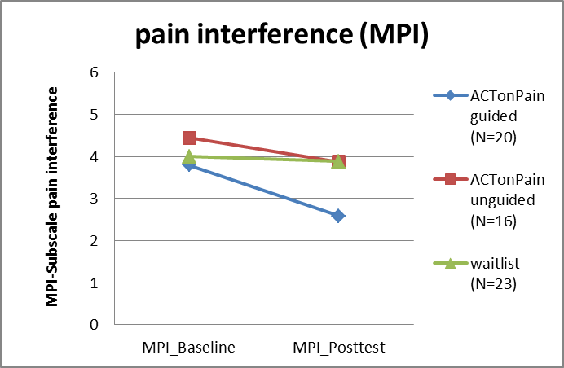
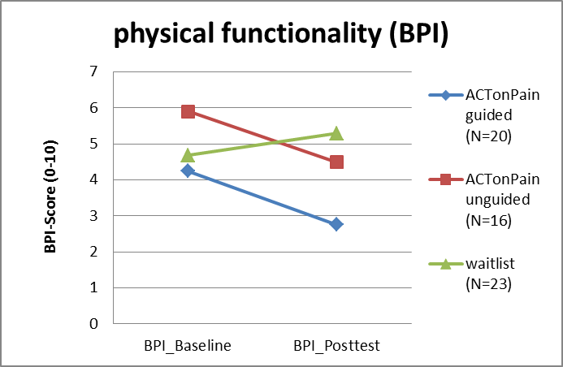
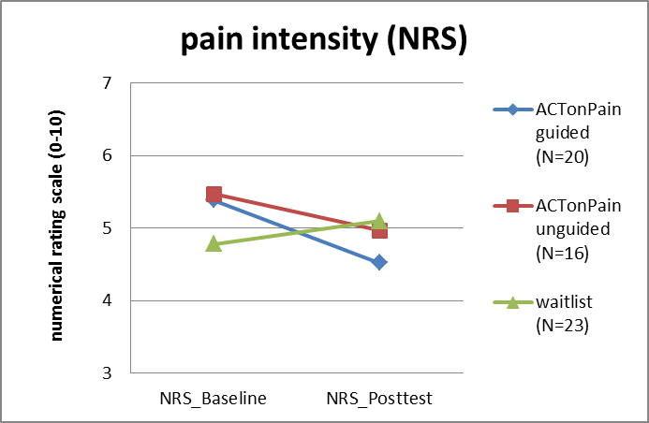
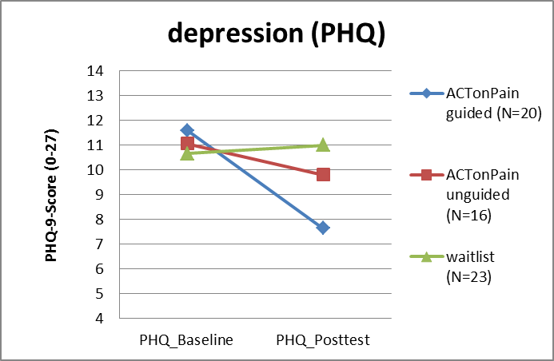
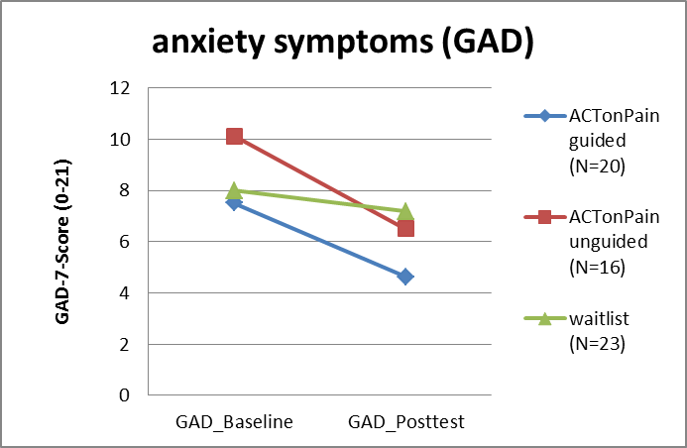
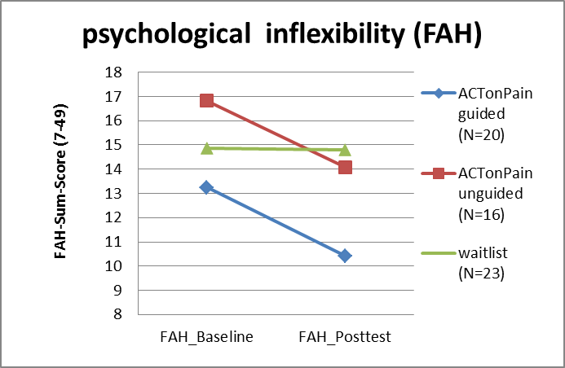
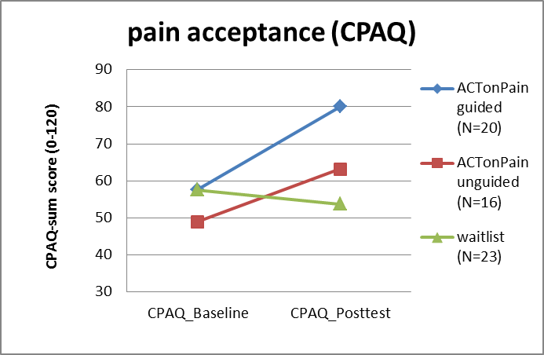
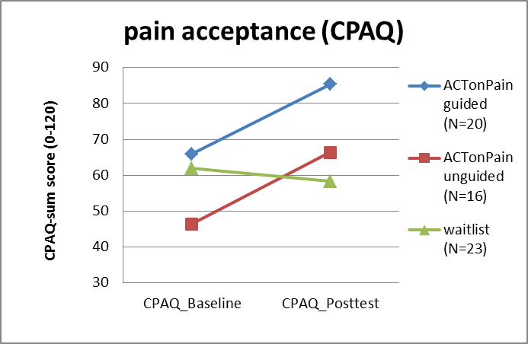
Preliminary results (main effects)
= p<.05,

Slide 13
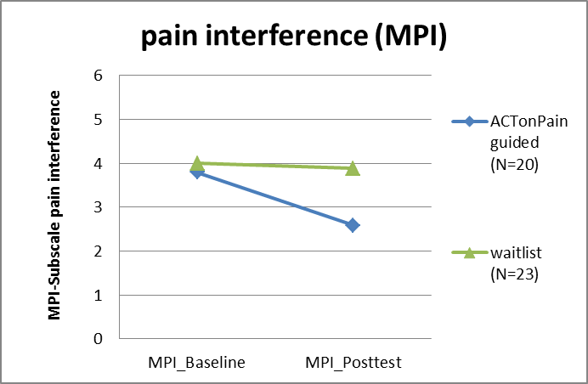
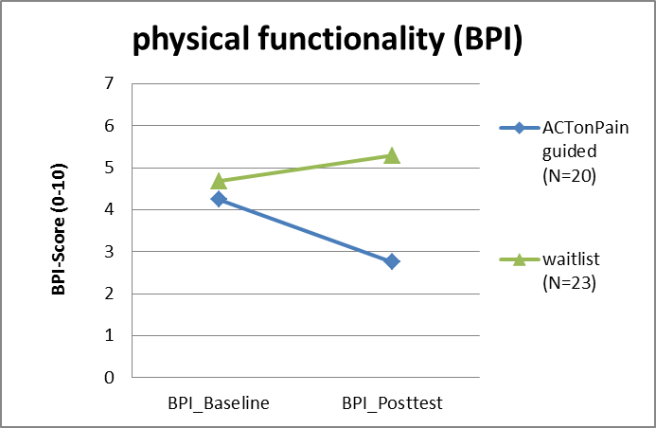
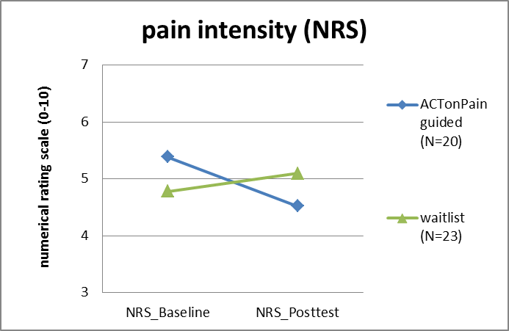
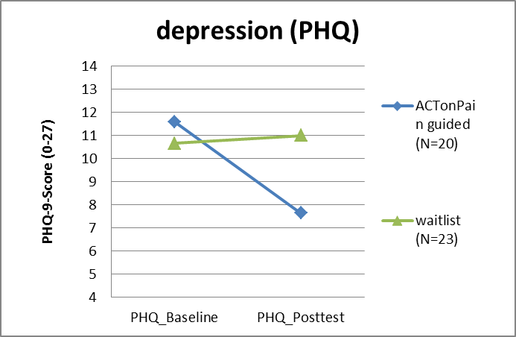
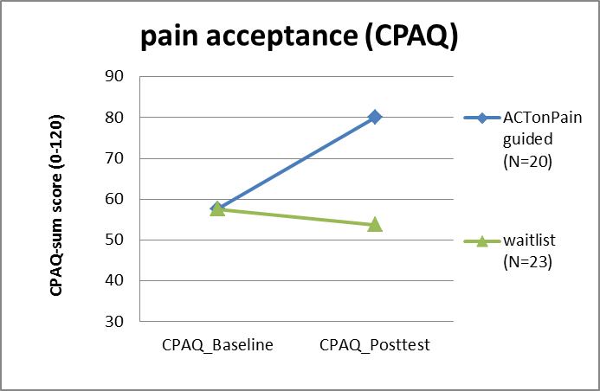
Preliminary results (ACTonPain guided vs. waitlist)
ACTonPain guided shows significant greater improvements in MPI, BPI, NRS, PHQ and CPAQ compared to waitlist (p<.05)

Slide 14
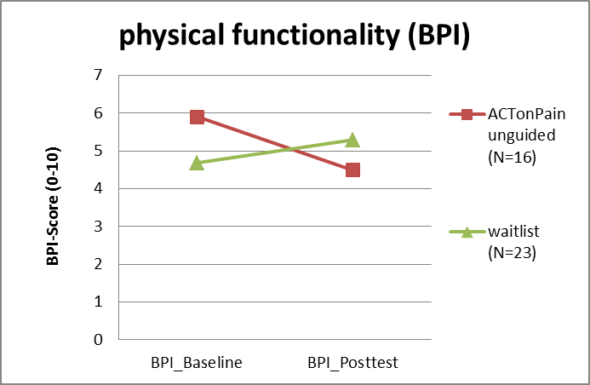
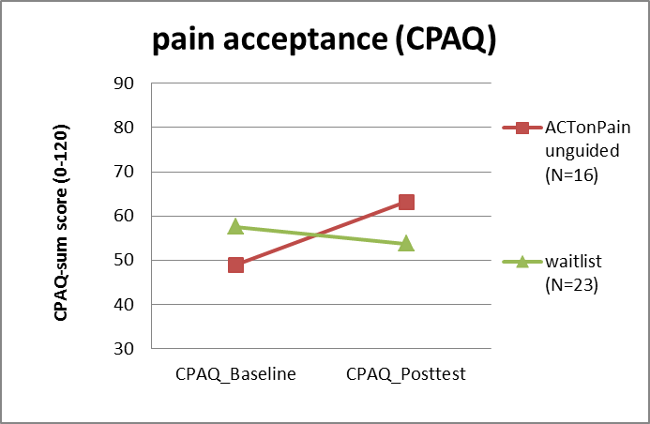
Preliminary results (ACTonPain unguided vs. Waitlist)
ACTonPain unguided shows significant greater improvements in BPI and CPAQ compared to waitlist (p<.05)

Slide 15
Discussion and outlook
Preliminary results!
E-ACT: chances and challenges
The role of guidance
Possibilities for use of the intervention
Implementation in healthcare system: Stepped-Care, blended, stand-alone
Reduce waiting times and treatment costs
Expand access to pain treatment
acceptance facilitating interventions in order to implement IBIs for chronic pain (Baumeister et al., 2014b)

Slide 16
Acceptance of pain IBIs
N= 52
%
low (4-9)
medium (10-15)
high (16-20)
(Baumeister et al., 2014b)

Slide 17
Effects of an Acceptance Facilitating Intervention
N=104, p=.00,
d=.81 (95% CI[.41;1.21]
48.1
Control group
Intervention group
42.31
%
25.0
26.9
3.85
Low (4-9)
Medium (10-15)
High (16-20)
(Baumeister et al., 2014b)

Slide 18
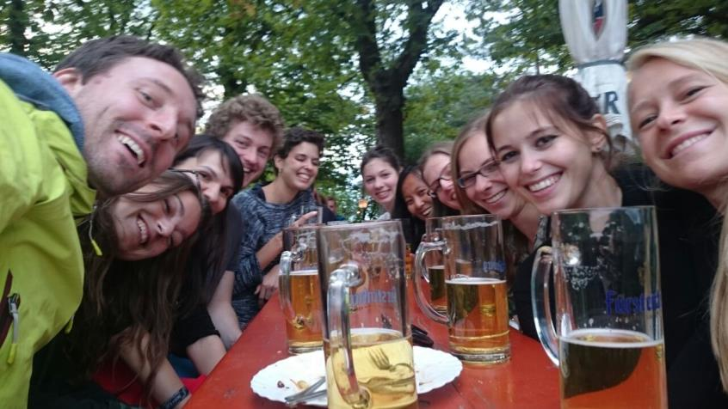
Thank you for your attention! Team Jiaxi Lin, Sarah Paganini, Lasse Sander, Julian Mack, Ann-Marie Küchler and a lot of student reasearch assistants, interns und BSc/MSc-students and Harald Baumeister

