Slide 1
AAQ-II and Its Application to High Performance Populations
Author: Patrick Smith
Emily Leeming M.A.
Steve Hayes Ph.D.
Presented By: Patrick Smith

Slide 2
AAQ-II Measures…
Experiential Avoidance
Psychological Inflexibility

Slide 3
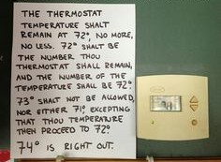
AAQ-II Theory…
Relational Frame Theory
Strict Rule Governed Behavior

Slide 4
AAQ-II Looks Like…
7 Self Report Questions
Example
“My painful memories prevent me from having a fulfilling life.”
Never True-1 2 3 4 5 6 7-Always True
Min
Overall Score
Max
7
49

Slide 5
Overall Score Implications
Degree of Experiential Avoidance
Min
Max
7
49
14
21
28
35
42
Non Clinical/Low EA
Clinical/High EA
Increasing score strongly predictive of future clinical depression and anxiety
Notes:
Higher scores also correlate with higher job burnout, lower employee productivity, higher incidence of employee absenteeism, and reduced job satisfaction

Slide 6
Reference Points
Degree of Experiential Avoidance
Monestes N=2507 Transcultural Study
20.69 (SD 7.97)
Substance Abuse Treatment Participants
Min
28.34 (SD 9.92)
Max
7
49
14
21
28
35
42
Non Clinical/Low EA
Clinical/High EA
Strongly predictive of future clinical needs

Slide 7
Contemplate this…
What does a single score in this range imply?
What about a whole sample?
Min
Relatively Normal
Max
7
May Need Help/Is Receiving Help
49
14
21
28
35
42
How do we track improvement if this is a client’s baseline score?

Slide 8
Methods
164 Participants
Recruited from Campus and Area Crossfit Gym sessions
Completed a survey(AAQ-II) for a “Mental Toughness” study

Slide 9
What is Crossfit?
“Forging Elite Fitness”
High Intensity Short Duration Interval Training
Constantly Changing Workouts
Communal Environment
Idealizes the All-Around athlete
High Performance Generalist Athletes

Slide 10
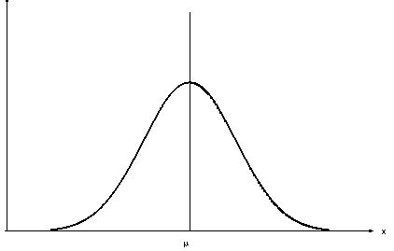
Why Crossfit Athletes?
Population self selects for higher performance
Population anecdotally known for high rule governed behavior
Clinical
High Performance
Firefighters
EMT
Police
Military
Etc
Notes:
Go into some depth describing crossfit and HIIT/Military imitation training
Growing popularity drawing more rule governed individuals
High participation of professionals from high performance/stress careers(firefighters, police)
High performance individuals have already met or exceeded many of the standards used by clinicians to designate them as “healthy” or improved
Most participants reported training or competing with injury AFTER participation in study.

Slide 11
Drumroll please….
Sample Athletes
14.55 (SD 5.724)
Monestes N=2507 Transcultural Study
20.69 (SD 7.97)
Substance Abuse Treatment Participants
Min
28.34 (SD 9.92)
Max
7
49
14
21
28
35
42
Non Clinical/Low EA
Clinical/High EA

Slide 12
Significantly Lower M & SD
Sample Athletes
Monestes N=2507 Transcultural Study
14.55 (SD 5.724)
20.69 (SD 7.97)
t(2671)=9.7026,
p<0.0001, d=0.88
14
21
Competitive Males
Sample Mode = ???
7
Notes:
t(2671)=9.7026, p<0.0001, d=0.88
Lower mean AND lower standard deviation
Mode for Competitive Men = 7
1 more slide showing comp v non comp and male v female

Slide 13
Despite significantly lower AAQ-II Scores, there is data to suggest prevalence of pathologies over a high performing athlete’s lifetime remains relatively similar to general population.
-(Schaal, et al., 2011)
Are High Performers Really This Flexible?
Are These False Positives?
Notes:
What does this mean if they are this flexible?
Is the AAQ identifying potential false positives?

Slide 14
Same but Different
Clinical
High Performance
More Precision Required?
Notes:
Since high performance populations are already exceeding many normative standards of “healthy” or “good” or “achievement,” current tools are not sensitive enough to their specific population.
Need to approach both assessment and treatment with greater precision as we depart from clinical populations

Slide 15
Limitations
Social Expectations
Group Survey
Language Cueing
Team vs Solo
Notes:
There are many different directions we can go from here. This is much like opening pandora’s box.
Do our assumptions about clinical populations apply to high performance populations?
What needs to be done to become sensitive to these populations?
What does dysfunction look like in high performance populations?
How do these low scores correlate to quality of life for high performers?

Slide 16
Bringin’ It Back…
“My painful memories prevent me from having a fulfilling life.”
How can we identify improvement if AAQ-II scores start low?
How do we improve quality of life and performance?
Notes:
There are many different directions we can go from here. This is much like opening pandora’s box.
Do our assumptions about clinical populations apply to high performance populations?
What needs to be done to become sensitive to these populations?
What does dysfunction look like in high performance populations?
How do these low scores correlate to quality of life for high performers?

Slide 17
AAQ-II and Its Application to High Performance Populations
Author: Patrick Smith
Emily Leeming M.A.
Steve Hayes Ph.D.
Presented By: Patrick Smith

