Slide 1
Mindfulness Soup for the Inattentive College Student Soul
The use of mindfulness as an Intervention for College Students with ADHD:
A Pilot Study
The University of North Texas
Ethan G. Lester, B.S
Daniel S. Sternberg, M.S
Amy R. Murrell, PhD

Slide 2



Adult ADHD and College

Slide 3


College Specific Issues
Time management
Poor organization skills
A deficit in parental support
Greater substance use
SIGNIFICANT ACADEMIC
DIFFICULTIES!

Slide 4


ADHD and Structure
How weird!
When I raise my hand, the teacher calls on me!

Slide 5




Slide 6




Treatment

Slide 7

Mindfulness
  “The awareness that emerges through paying attention on purpose, in the present moment, and non-judgmentally to the unfolding of experience, moment to moment”
  (Kabat-Zinn, 1995)

Slide 8


Slide 9


Previous Research
Mindfulness
Perceived Stress
  (Baer et al., 2012)
Mindfulness
Attention
Satisfaction
Depression
Anxiety
(Zylowska et al., 2008)

Slide 10






Effective Treatment

Slide 11


Structure
Less
More

Slide 12
Why?
Notes:
Investigate how individuals with ADHD in a college setting respond to two different kinds of mindfulness intervention structures:
More structure vs. less structure and the effect on the symptoms of ADHD, depression, anxiety and stress
More structure vs. less structure and the effect on mindfulness traits
Individual preference of mindfulness intervention

Slide 13







MBSR

Slide 14

Vipassana

Slide 15
Hypothesis 1
Mindfulness
MBSR
Psychological Distress
Vipassana
MBSR
Vipassana

Slide 16
Hypothesis 2
Psychological
Distress
Weeks

Slide 17

Hypothesis 3
Mindfulness
Traits

Slide 18


Hypothesis 4

Slide 19

Research Design
Notes:
The research design we used was a Quasi-single case experimental design with marked changes and repeated assessment *pause*
Uses visual inspection of the data, as well as qualitative data to strengthen the findings.

Slide 20




Participants
4
3
18-26 years old
M = 20.71; SD = 2.81
Notes:
Also talk about medication

Slide 21
Measures
Adult ADHD Self Report Scale (ASRS)
Depression Anxiety and Stress Scale (DASS)
Kentucky Inventory of Mindfulness Skills (KIMS)
Toronto Mindfulness Scale (TMS)
Demographics and Preference
Questionnaire

Slide 22
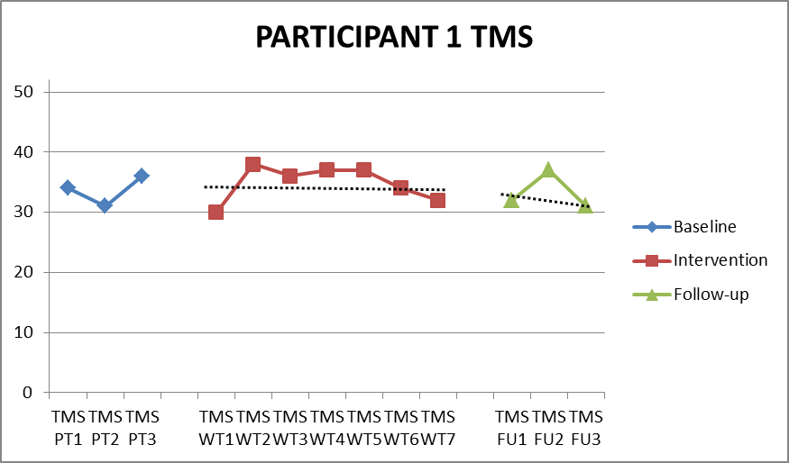


Slide 23
Magnitude of Change ASRS
Baseline to Follow-up
Average Change of 13.25 Points

Slide 24
Rate of Change ASRS
Baseline to Follow-up
Latency not reported

Slide 25
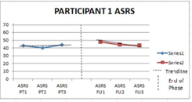
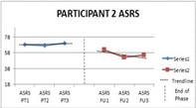
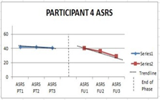
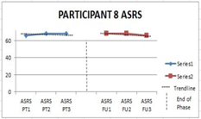
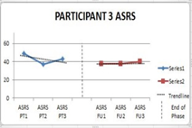
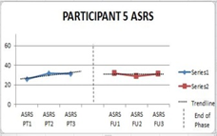
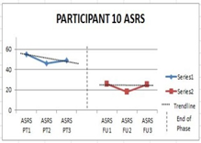
Visual Inspection- ASRS
MBSR
Vipassana
Notes:
*Wait 10 seconds for the committee to look at graphs.*

Slide 26
Magnitude of Change DASS
Baseline to Intervention
Average Change of 22 Points

Slide 27
Magnitude of Change DASS
Intervention to Follow-Up
Average Change of 22 Points

Slide 28
Rate of Change DASS
Baseline to Intervention
Average Latency
4 Weeks

Slide 29
Rate of Change DASS
Intervention to Follow-Up
Average Latency
0->4 Weeks

Slide 30
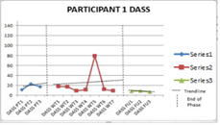
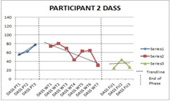
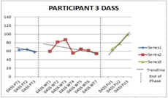
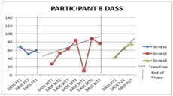
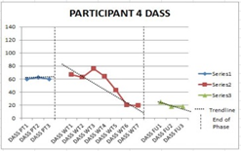
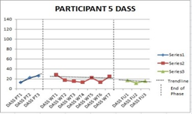
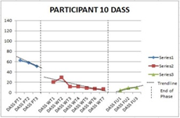
Visual Inspection- DASS
MBSR
Vipassana
Notes:
Here are the graphs for each participant for psychological distress *wait 8 seconds*

Slide 31
Magnitude of Change TMS
Baseline to Intervention
Average Change of 4 Points

Slide 32
Magnitude of Change TMS
Intervention to Follow-Up
Average Change of 6.67 Points

Slide 33
Rate of Change TMS
Baseline to Intervention
Average Latency
1-2 Weeks

Slide 34
Rate of Change TMS
Intervention to Follow-Up
Average Latency
1-2 Weeks

Slide 35
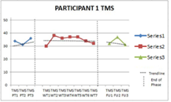
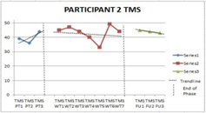
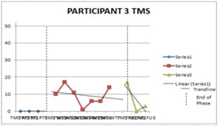
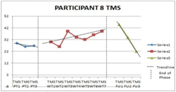
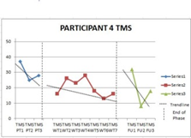
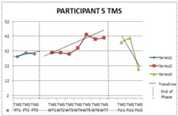
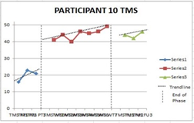
Visual Inspection- TMS
MBSR
Vipassana
Notes:
Here are the graphs for state mindfulness *wait 8 seconds*

Slide 36
Magnitude of Change KIMS
Baseline to Follow-up
Average Change of 24 Points

Slide 37
Rate of Change KIMS
Baseline to Follow-up
Latency not reported

Slide 38
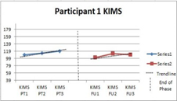
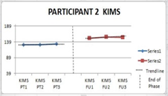
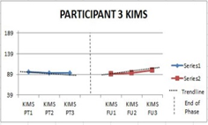
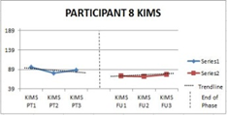
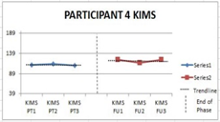
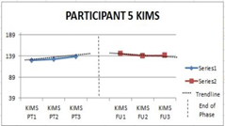
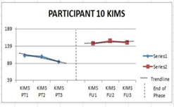
Visual Inspection- KIMS
MBSR
Vipassana
Notes:
Here are the last sets of graphs for trait mindfulness.

Slide 39


Slide 40
Reliable Change Indices
4
3
2
1

Slide 41



Engagement
Satisfaction
Helpfulness

Slide 42



Well-being
Attention

Slide 43




Slide 44




Slide 45



VS

Slide 46


Slide 47
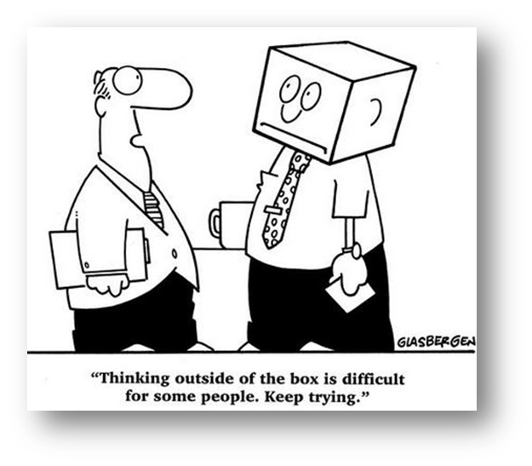


Slide 48


Slide 49

Ethan Lester
ethanglester@gmail.com
Amy Murrell, PhD.
amurrell@unt.edu
The University of North Texas

