Slide 1
ACT for Parents: An Open Trial with Parents Raising a Child with Severe Emotional and Behavioral Problems
Carlos E. Rivera, M.S. ^{a,b}, Lisa W. Coyne, Ph.D., ^{a,b,c},
& Mitch Abblett, Ph.D. ^{b,d}
ª Suffolk University, ^{b} The New England ACT Institute,
^{c} McLean Child and Adolescent OCD Institute at Harvard Medical School, &
^{d} The Manville School/Judge Baker Children’s Center at Harvard Medical School
Boston, MA

Slide 2
The Importance of parenting
First & among most important interactions
Among highest values
Often not easy

Slide 3
What we know…
Parents of children who have emotional and behavioral special needs experience a great deal of parenting stress and distress
Parent psychological problems and stress arising are known barriers to positive outcomes in parent training (e.g., Reyno & McGrath, 2005).
There are numerous evidence-based parent training programs THAT ARE AWESOME…
BUT few of these programs address the issues of parent psychological well-being and parenting stress wrought by the demands of raising a child with serious psychopathology.

Slide 4
Mindfulness and Acceptance
Acceptance and mindfulness-based programs might help.
Improving parent mindfulness and acceptance may have a positive influence on parents’ …
Sense efficacy in raising their children,
level of self-compassion,
quality of life, and possibly
improved family functioning

Slide 5
The Present Study
The present study piloted an Acceptance and Commitment Therapy (ACT) parenting workshop to
improve parent psychological well-being,
reduce parenting stress, and
improve parenting efficacy
through targeting the promotion of mindfulness and acceptance in parents raising children with severe emotional and behavioral difficulties.

Slide 6
Study Aims
To develop a manualized 5-session Acceptance and Commitment Therapy (ACT) workshop for parents of children aged 5-16 in a day-treatment educational setting
To provide initial evidence of the feasibility, acceptability, and effectiveness of this intervention with parents of children with emotional and behavioral special needs

Slide 7
Our questions…
1. Did parents find the program acceptable and feasible?
2. Did parents report increases in acceptance and mindfulness?
3. Did those who reported post-program increases in acceptance and mindfulness would also report reduced parenting stress, distress, improved quality of life, and improved parenting efficacy?

Slide 8
Who was this workshop for?
Parents of children with severe emotional/behavioral difficulties
Recruited from an urban day treatment school in the Northeastern US
Excluded if in concurrent parent training programs; not comfortable speaking/reading English
Invited to participate in a 5 session (90 minute per session) parent training workshop
Co-led by two experienced ACT therapists

Slide 9
ACT for Parents Program
Session 1: Mindfulness: Finding Stillness
Session 2: Defusion: Weathering Thoughts & Feelings
Session 3: The Matrix: Moving Towards vs. Moving Away
Session 4: Valuing/Committed Action: Doing What Matters
Session 5: Self-Care: There’s Only One You

Slide 10
Example of Session Structure
Session 2: Defusion: Weathering Thoughts & Feelings
Objective 1: Listening to Difficult Parenting Thoughts & Feelings
Objective 2: Home practice check in: Mindfulness in daily life
Objective 3: Creating Connections/Centering Exercise
Objective 4: Introducing How the Mind Works, Fusion/Experiential Avoidance, & Defusion
Home Practice: Defusion/Weathering Parent-Child Interaction

Slide 11
Mitch’s Parenting Crystal Ball Exercise

Slide 12
ACT for Parents Program
Session 1: Mindfulness: Finding Stillness
Session 2: Defusion: Weathering Thoughts & Feelings
Session 3: The Matrix: Moving Towards vs. Moving Away
Session 4: Valuing/Committed Action: Doing What Matters
Session 5: Self-Care: There’s Only One You

Slide 13
The Matrix: Moving Towards vs. Moving Away

Slide 14
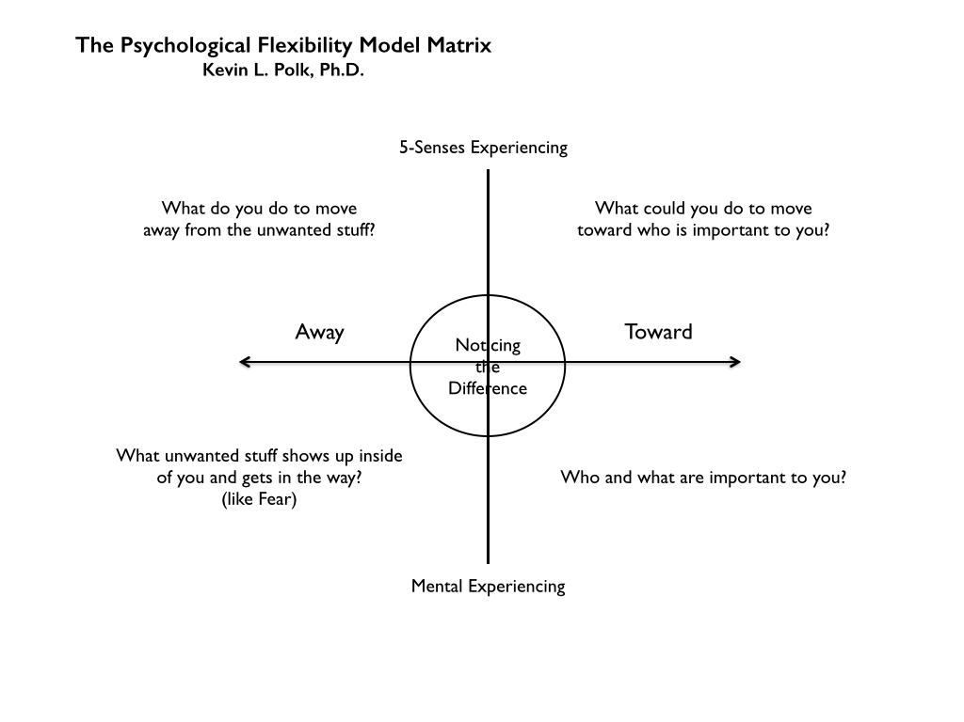

Slide 15
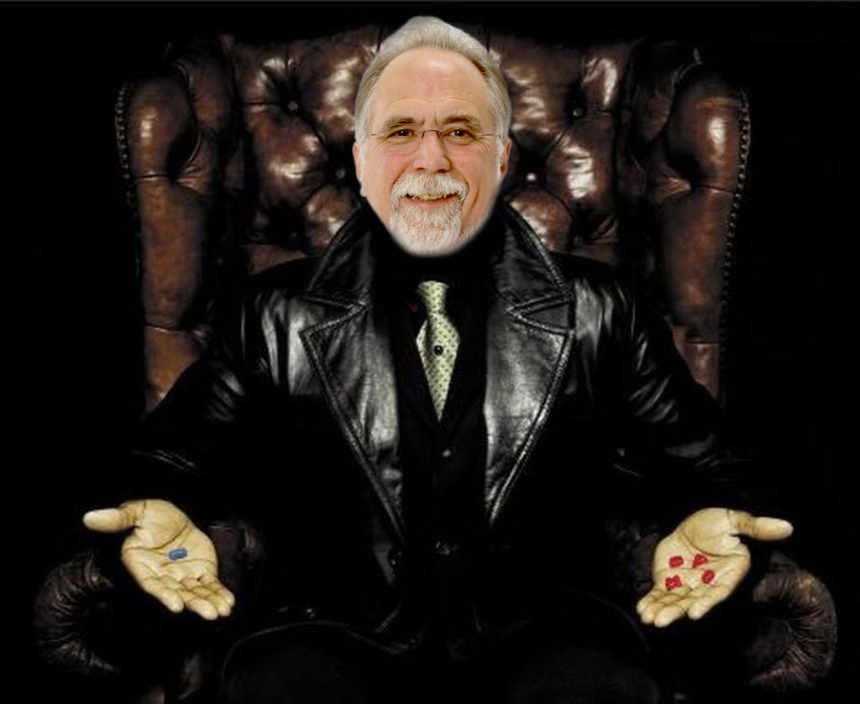
Moving Towards vs. Moving Away

Slide 16
ACT for Parents Program
Session 1: Mindfulness: Finding Stillness
Session 2: Defusion: Weathering Thoughts & Feelings
Session 3: The Matrix: Moving Towards vs. Moving Away
Session 4: Valuing/Committed Action: Doing What Matters
Session 5: Self-Care: There’s Only One You

Slide 17
Our Participants
N = 17
88% employed, 61% full time
Salaries ranged from $40,000.00 - $200,000.00 per year
67% had professional degrees; 13% had 1-4 years of college; 3.8% had a high school degree/GED
67% rated their children as extremely challenging; 33% as overwhelmingly challenging

Slide 18
Not Getting Hooked

Slide 19
Results

Slide 20
1. Was the program acceptable and feasible?
Attendance
Therapy Attitude Inventory (TAI; Eyberg, 1974)

Slide 21
Attendance
Over half of the participants attended the majority of the sessions
6 dropped: 3= sched. conflict;
1=child inpatient; 2 =unknown
20 Parents consented
11 attended 3 or more sessions
3 never showed; no reason given
15 completed baseline measures
10 completed post-treatment measures

Slide 22
Therapy Attitude Inventory (TAI)
10 item 5-point likert-type scale (1 = low efficacy, 5 = high efficacy)
Regarding techniques of discipline, I feel I have learned
1 = Nothing – 5 = Many useful techniques
I feel the type of program that was used to help me improve the behaviors of my child was
1 = Very poor – 5 = very good
My general feeling about the program I participated in is
1= I disliked it very much – 5 = I liked it very much

Slide 23
Therapy Attitude Inventory (TAI)
Mean = 37.86 (SD = 6.27)
Possible scale range = 10 – 50
Actual range = 30 – 48
No scores of 1
Less than 7% of all items got scores of 2, (10 out of 140)
62% of all items were scored at 4 and above

Slide 24
2. Did parents report changes increases in acceptance and mindfulness?
Measure | Pre-Tx M (SD) | Post-Tx M (SD) | eta² | N | t-value | Sig (2-tailed)
Acceptance | 47.60 (7.34) | 47.00 (8.60) |  | 10 | .35 | .74
Cognitive Fusion | 52.30 (12.99) | 40.80 (11.68) | .43 | 10 | 2.58 | .03
Mindfulness | 50.50 (14.35) | 60.70 (12.63) | .53 | 10 | -3.16 | .01
Notes:
Acceptance and Action Questionnaire II (AAQ-II; Bond et al., 2011)
Cognitive Fusion Questionnaire 13 (CFQ-13; Brown & Ryan, 2003)
Mindfulness Attention and Awareness Scale (MAAS; Gillanders et al., 2010)

Slide 25
3. Did those who reported post-program increases in acceptance and mindfulness also report reduced parenting stress, distress, improved quality of life, improved parenting efficacy?
Measure | Pre-Tx M (SD) | Post-Tx M (SD) | eta² | Sig (2-tailed)
Parenting Stress | 91.67 (22.49) | 102.89 (15.50) |  | .14
Depression | 11.11 (11.79) | 6.00 (6.40) |  | .10
Anxiety | 4.00 (5.92) | 0.67 (1.00) |  | .14
Stress | 18.44 (10.48) | 9.56 (7.80) | .40 | .05
Fam. Conflict | 61.44 (9.00) | 50.78 (11.36) |  | .08
Fam. Cohesion | 23.78 (17.19) | 37.44 (19.01) | .38 | .05
Life Satisfaction | 14.63 (6.40) | 17.38 (6.72) | .53 | .03
Parenting Competence | 58.44 (14.18) | 64.00 (12.17) |  | .17
Nurturance | 78.00 (13.33) | 80.38 (13.07) |  | .70
Notes:
Parenting stress = Parenting Stress Inventory
Distress = DASS 21 (Depression, Anxiety, Stress)
Quality of Life = Family Environment Scale (FES) Cohesion and Conflict subscales
Life Satisfaction = Satisfaction with Life SLS

Slide 26
Summary
Evidence of acceptability and feasibility for those who attended
Important to be mindful of schedule conflicts for working parents
Evidence of increases in Acceptance (per CFQ) and mindfulness
Increases in life satisfaction and family cohesion
Decreases in stress

Slide 27
Strengths and Limitations
Very highly stressed sample (parents and children)
Small sample size ☹
Future Directions
Data collection for future workshops
6th session on Anxiety being developed by Dr. Phoebe Moore
Manual will be available in the CAF SIG toolbox

Slide 28
Thank you!
Contact Carlos Rivera at cerivera@suffolk.edu
Lisa Coyne at lcoyne@partners.org

Slide 29
Assessment Procedures and Timeline
Measure | Pre-Treatment | Post-Treatment | 3 Month F-U
Demographic Questionnaire | X
Parent Stress/Distress
PSI-SF –Parenting Stress | X | X | X
DASS-21-Parent Distress | X | X | X
Quality of Life
SLS | X | X | X
FES-Family Environment | X | X | X
Parenting & Parenting Efficacy
PSOC-Parenting Efficacy | X | X | X
MBCRPR- Parent Nurturance | X | X | X
ACT Process Variables
AAQ-II-Psychological Flexibility | X | X | X
MAAS-Mindfulness | X | X | X
CFQ-Cognitive Fusion | X | X | X
Treatment Acceptability
TAI-Treatment Acceptability |  | X | X
*Merged Post Treatment and 3 month Follow-up measures
Notes:
Modified Block Child Rearing Practices Report (Nurturance subscale)

Slide 30
Measure | Name | Meaning of Values | Possible Range |  | Alpha | N of Alpha
PSI Pre | Parent Stress Inventory | Higher Values = Lower Stress | 36 | 180 | 0.88 | 8
PSI Post |  |  |  |  | 0.83 | 8
DASS21 Depression Pre | Depp, Anx, & Stress | Higher Values = Higher DAS | 0 | 21 | 0.90 | 14
DASS21 Depression Post |  |  |  |  | 0.88 | 9
DASS21 Anxiety Pre |  |  | 0 | 21 | 0.63 | 14
DASS21 Anxiety Post |  |  |  |  | 0.90 | 9
DASS21 Stress Pre |  |  | 0 | 21 | 0.84 | 15
DASS21 Stress Post |  |  |  |  | 0.86 | 9
SLS Pre | Satisfaction with Life Scale | Higher values = Higher Satisfaction | 5 | 35 | 0.81 | 15
SLS Post |  |  |  |  | 0.90 | 9
FES Cohesion Pre | Family Environment Scale | Higher Values = Higher Cohesion | 4 | 65 | 0.84 | 14
FES Cohesion Post |  |  |  |  | 0.74 | 8
FES Conflict Pre |  | Higher Values = Higher Conflict | 33 | 80 | 0.72 | 15
FES Conflict Post |  |  |  |  | 0.74 | 9
PSOC Pre | Parenting Sense of Competence | Higher Values = Higher sense of Competency | 17 | 102 | 0.85 | 14
PSOC Post |  |  |  |  | 0.83 | 9
MBCRPR Nurturance Pre |  | Higher Values = Higher level of Parental Nurturance | 18 | 108 | 0.80 | 13
MBCRPR Nurturance Post |  |  |  |  | 0.90 | 9
AAQII Pre |  | Higher Values = Higher Acceptance | 10 | 70 | 0.71 | 14
AAQII Post |  |  |  |  | 0.75 | 10
MAAS Pre |  | Higher Values = Higher Mindfulness | 15 | 90 | 0.91 | 13
MAAS Post |  |  |  |  | 0.90 | 10
CFQ Pre |  | Higher Values = More Cognitive Fusion | 13 | 91 | 0.89 | 14
CFC Post |  |  |  |  | 0.91 | 10
TAI Post (Tx Attitude Inventory) |  | Higher Values = More Tx Acceptance | 10 | 50 | 0.85 | 8
TAI 3MFU |  |  |  |  | 0.92 | 6

