Slide 1
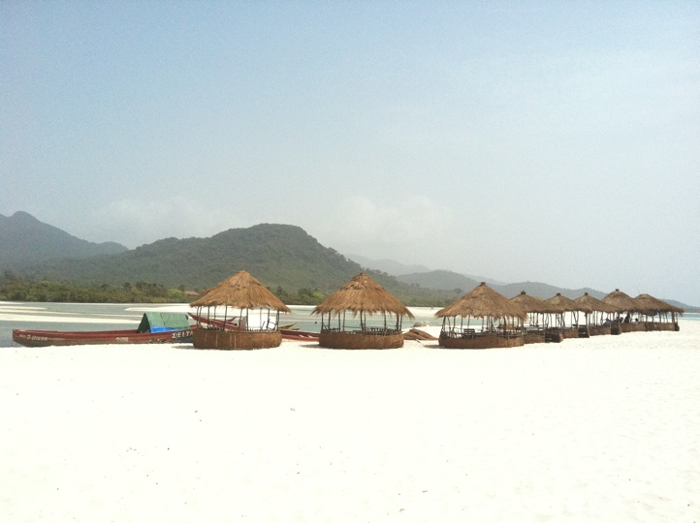
ACT, Prosocial and the Matrix in the Prevention of EVD and Sexual Gender Based Violence in Southern Sierra Leone
Mrs. Hannah Bockarie – Director
commit and act foundation

Slide 2
How I come to stand here today
Introduction
How I came to learn ACT
How ACT changed me
How ACT is changing Sierra Leone
The people that helped me come here
The way forward and the challenges now
Notes:
Director of c and a. worked in project management, social worker, teacher
ACT since 2010
Taught by Beate
Local NGO in BO
Married with 2 children,
Values passion for helping humanity. Esp in SL, 11 years of war, passion with helping my people in SL
How to help them recover.

Slide 3
What I hope to do with you today
Tell you about how we adapted ACT to fit with our culture
Teach you about the mistakes we made
Show you the successes
Explore with you how we plan to move forward to make ACT part of Sierra Leonean culture.
The connection we have with ACBS – ‘I am because you are, you are because I am’.

Slide 4
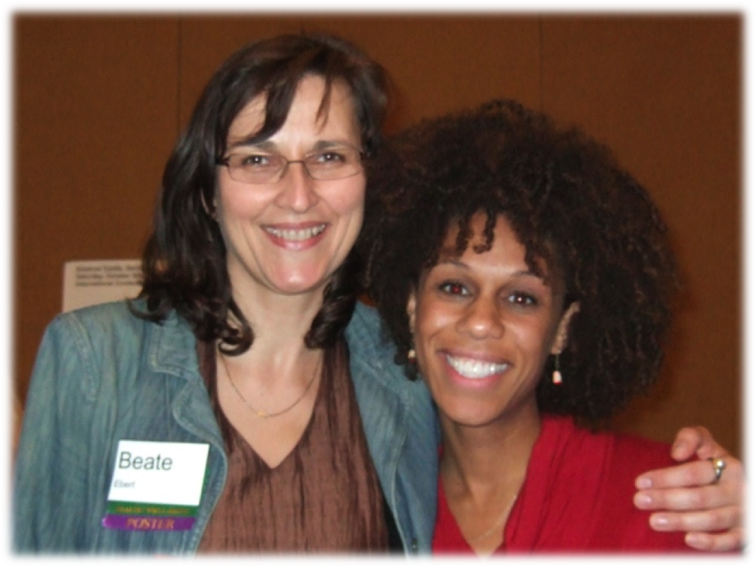
... in 2008 Beate Ebert became friends with Sarah Culberson, who is half Sierra Leonean and has been adopted by a Caucasian American upper class family
Notes:
In her late 20s she had the courage to look for her birth parents and found out that her mother had passed away already and that her father was the member of a ruling family of the Mende Tribe in Sierra Leone. She visited her African family and was highly welcomed as the lost daughter and a princess. This was a few years after the end of the war, which destroyed big part of the country.
When I heard from her about the cruel civil war ...

Slide 5
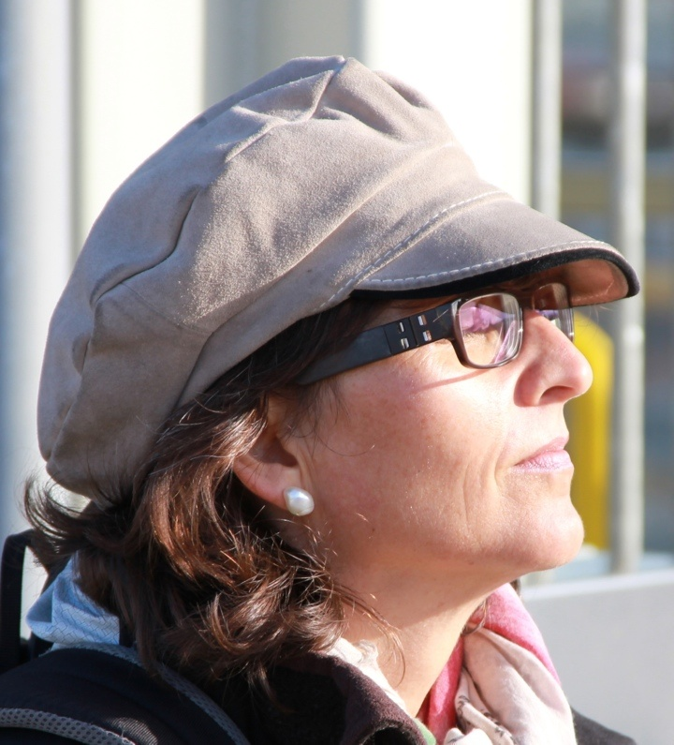
Beate’s first thought was:
I’ll go to Sierra Leone during holiday time and do some therapy there and help people.
Notes:
Initiated by the Revolutionary United Front (RUF), supported by Charles Taylor, president of Liberia to overthrow the All Peoples Congress (APC), accused of „rampant corruption, nepotism and fiscal mismangement“

Slide 6
Our Aims
To bring psychotherapy support to people in areas of post-conflict areas.
To help people trust again and find the courage to create their lives according to their own vision.
To train professional helpers on site in effective methods of psychotherapy (Acceptance and Commitment Therapy) and support them through regular supervision.
To use a training for trainers model.

Slide 7
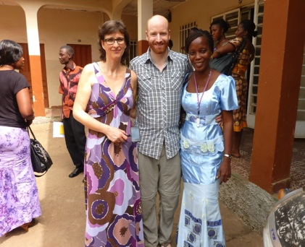
Connecting
Caring
Creating
2011
The University of Glasgow became our partner in preparing, facilitating and evaluating the workshops, as part of their MSc Global Mental Health Programme
Notes:
The MSc in Global Mental Health is unique to Scotland and one of only two in the UK.
, designed to produce graduates who can take charge of mental health service provision at a global level.

Slide 8
How we learned ACT
What worked best for you and the other act trainers in SL in terms of learning ACT?
Training and supervision
Applying ACT and getting supervision
Using the Matrix in context
Using the Prosocial approach
What would you have liked to do differently?

Slide 9
What I learned professionally
It is not necessary to dig up old wounds
No matter what happened to you, you can live a life of meaning and value.
Pain need not be a problem.
Being flexible also works
Identifying my values and committed action
Being clear on your values

Slide 10
What I learned that changed me personally
I learned that making room for the emotions I felt from the war made life easier for me.
I was deeply changed personally.
I wanted to share that change with others.

Slide 11
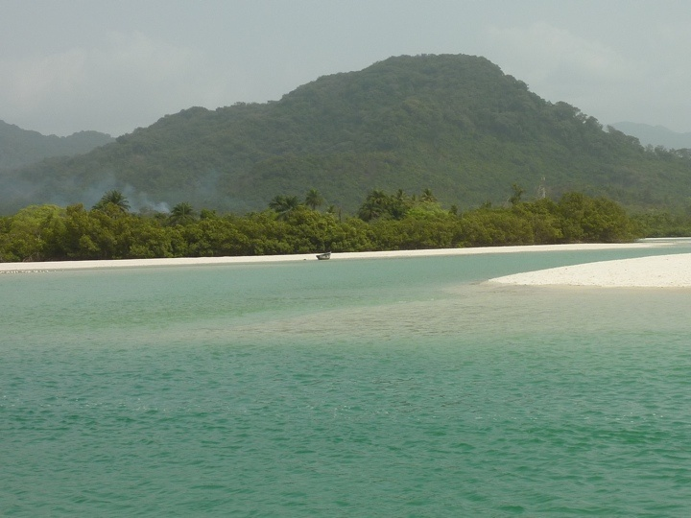
Sierra Leone is a beautiful country ...
Notes:
The people are open, acccomodating and flexible. Family ties and community ties have traditionally been very strong.

Slide 12
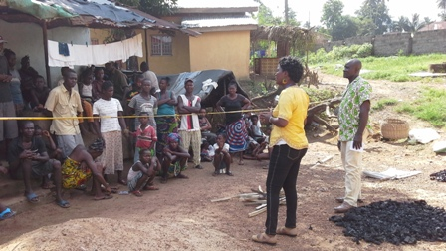
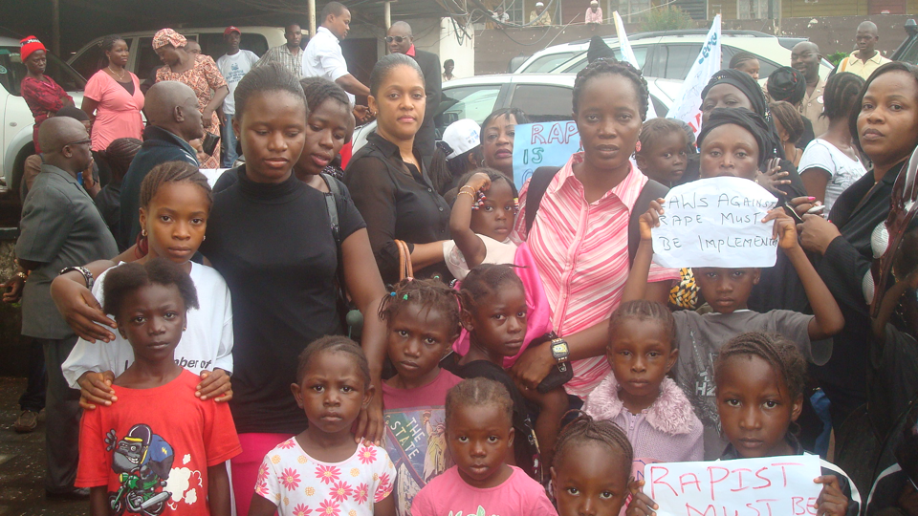
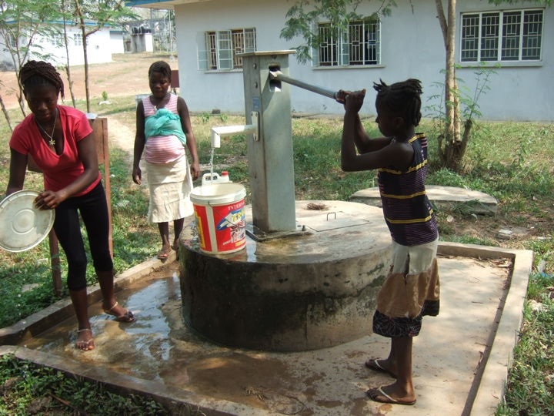
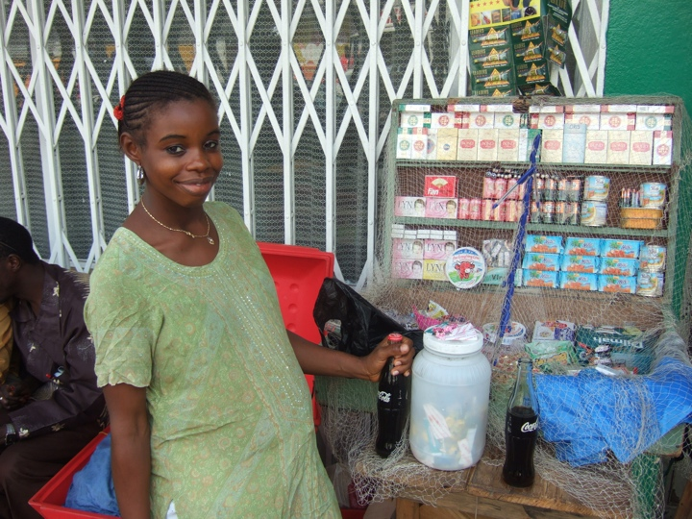
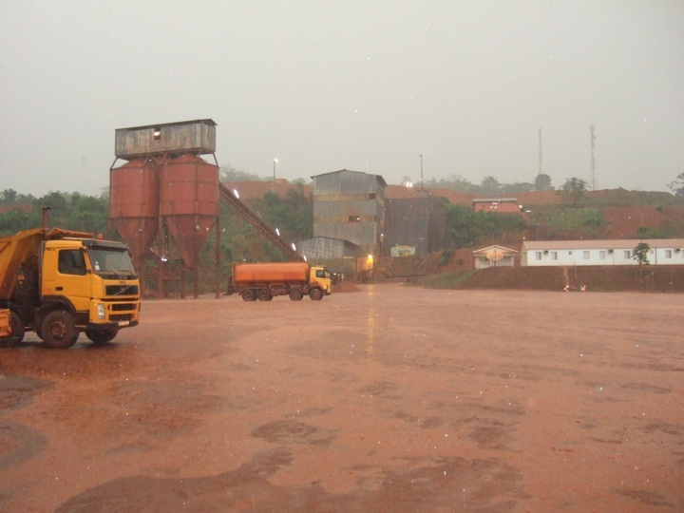
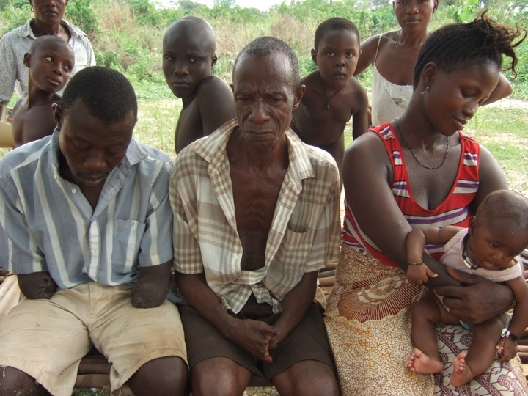
... and it has multiple problems:
No access to clean water
Ebola
Gender based violence
Teenage moms
War victims
Exploitation
Notes:
HIV: 810 von 100.000 Einwohnern (499 weltweit)
Malaria: 30.000 von 100.000 Einwohnern (4082 weltweit)

Slide 13
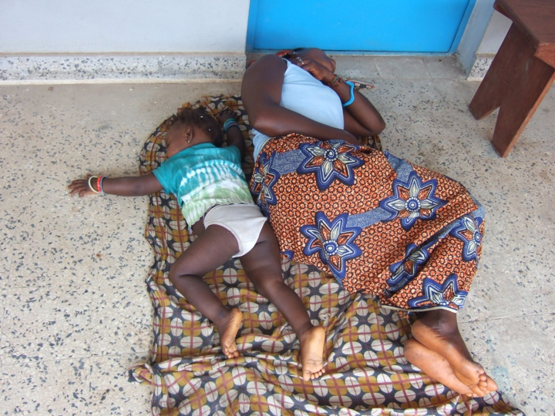
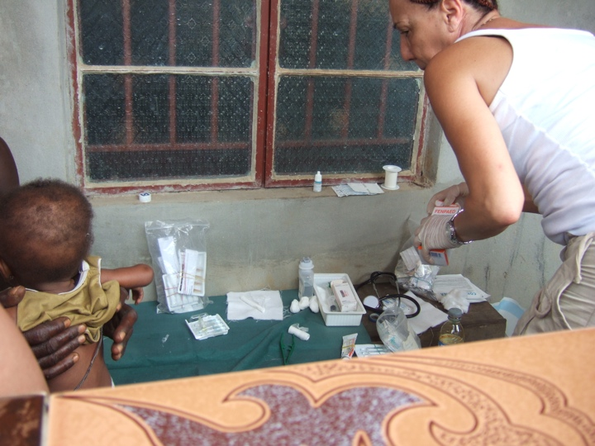
Facts Sierra Leone (WHO 2013)
6 million inhabitants
Life expectancy 47 years (70)
1 of 5 children die before 5 yo (1 of 20)
Income 840 USD/year (11.536 USD)
Expenditure for medical needs per person, per year 107 USD (5635 USD)
1 Psychiatrist (retired) in the country
1 Clinical psychologist
Notes:
HIV: 810 von 100.000 Einwohnern (499 weltweit)
Malaria: 30.000 von 100.000 Einwohnern (4082 weltweit)

Slide 14
A history of Sierra Leone
The civil war
Trauma and grief
Traditional attitudes towards women and girls
FGM
Ebola and it’s impact on families and communities.
Notes:
Beautiful country, beaches natural beauty
People are accomodating and flexible, have passion to see a transformed nation
Lion is something hero of the jungle. Mountains and lion lion mountain
Strenghts of SL undermined our friendhships and family
Quarantine houses
Limit our culture and tradition no shaking hand and hug.
Still undermining the traditions of connection.
More conflict among families and communties. Anger and resentment about Ebola teams.
Teenage pregnancy increased drastically.

Slide 15
EVD in Sierra Leone
First case conﬁrmed in May 2014
As of 9 June, 2015:
8,636 conﬁrmed cases
3,549 conﬁrmed deaths
4,016 survivors
Active as of 7 June, 2015:
– Port Loko District, Kaﬀu Bullom Chiefdom
– Kambia District, Tonko Limba Chiefdom

Slide 16
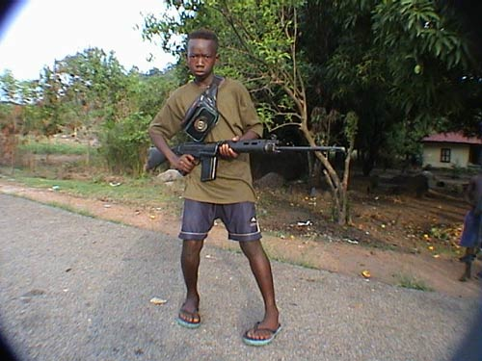
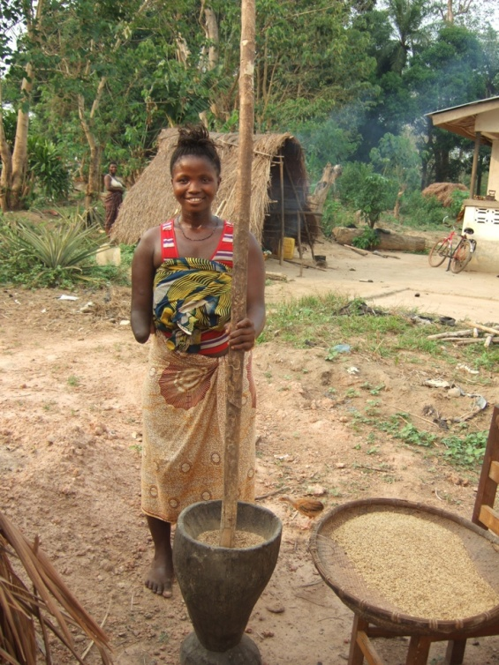
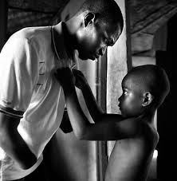
The civil war in Sierra Leone
10 years long
10,000 child soldiers
60,000 women experienced all kinds of violence
20,000 amputees
50,000 people killed
Dufka 1999
Notes:
Initiated by the Revolutionary United Front (RUF), supported by Charles Taylor, president of Liberia to overthrow the All Peoples Congress (APC), accused of „rampant corruption, nepotism and fiscal mismangement“

Slide 17
Teaching ACT in Sierra Leone
The problems: EVD, domestic violence, FGM
The outbreak of EVD
Pain and suffering,
Use of ACT helps break the chain of transmission
Prosocial, ACT and matrix
Training women to go back to their communities.

Slide 18
What we discovered about learning and teaching ACT
What works best?
Understand what ACT is,
apply it in my own life,
Putting ACT into local metaphor, local problems,
River of life
Get out of the box, be flexible
Tools are so practical
What mistakes did you make that you learned from?
Trying to use other psychologies. Dig up wounds?
Long sessions
Provide food for the training, not enough food for the participants
Losing my job, my boss did not understand and she was not happy.

Slide 19
Eyes on
Staring into someone’s eyes is sexual, especially if it’s the opposite sex.

Slide 20
River of Life
A very good SL metaphor
Very acceptable to Sierra Leoneans.

Slide 21
What questions do you have?
What problems are you facing?
What are you trying to achieve?
What resources do you have?

Slide 22
What we have accomplished
Training, supervision and counseling
Clinic at the center
Empowering women’s groups
Organization that we have formed that is able to reach out to many
Working with different partners (e.g. WHO, Red Cross, Caritas), teachers, medical personnel
People are calling for more training.

Slide 23
Providing psychosocial support to EVD affected families in quarantine home

Slide 24
Living ACT
My experience of the war
Struggles with balancing my family and my community
My father’s death

Slide 25
Effects of ACT on myself and other trainers
How ACT helps us with
Fear
Feeling overwhelmed and tired
Anger
Sadness
Grief

Slide 26
Using ACT with the Matrix
I would like to show you how I teach ACT by using the matrix.

Slide 27
Using ACT Matrix

Slide 28
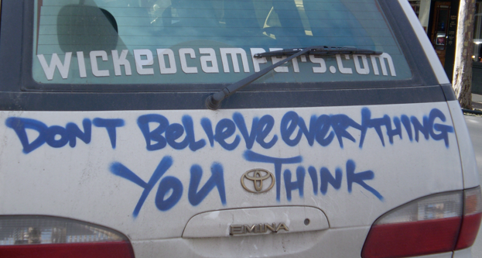
When your Mind tells you: “Don’t do that!” ….

Slide 29
THE MATRIX
VALUED DIRECTION
Away from Pain Towards Values

Slide 30
Outside
Keep doing what is familiar
What if what we know dose not work?
Where to now?
Away
Ebola spreads→
Fear
Grief
Loss
What else?
Inside
Notes:
Then ask what happens long term? Kissing the body can spread the virus. So the cost of staying safe is to give up the feeling of loving and respecting the person they lost.

Slide 31
Outside
Committed Action
Keep doing what is familiar
Doing something different
and unfamiliar.
Willingness/Acceptance
Away from Pain
Toward Values
Painful feelings
Values
Defusion
Acceptance
What value would matter enough?
Inside

Slide 32
How to make a good decision when you are struggling and confused or frightened.
 | Negatives Now | Positives Now | Negatives Later | Positives Later
Yes
No

Slide 33
Let’s walk through a decision together.
Kissing your loved one? | Negatives Now | Positives Now | Negatives Later | Positives Later
Yes | I risk catching Ebola. I feel fear.
No | I feel bad and unloving.
Notes:
Here’s a way to walk people through a complicated decision. I think if you validate that it’s hard to give up the loving act of kissing their loved one, then it’s more likely that they will be able to do it. Making room for the distress we all feel when we cannot do what we are used to doing helps create acceptance.

Slide 34
Let’s walk through a decision together.
Kissing your loved one? | Negatives Now | Positives Now | Negatives Later | Positives Later
Yes | I risk catching Ebola. I feel fear. | I feel loving and respectful.
No | I feel bad and unloving. | I feel less fear and I know I won’t catch Ebola.
*
Notes:
Here’s a way to walk people through a complicated decision. I think if you validate that it’s hard to give up the loving act of kissing their loved one, then it’s more likely that they will be able to do it. Making room for the distress we all feel when we cannot do what we are used to doing helps create acceptance.

Slide 35
Let’s walk through a decision together.
Kissing your loved one? | Negatives Now | Positives Now | Negatives Later | Positives Later
Yes | I risk catching Ebola. I feel fear. | I feel loving and respectful. | I may get sick or pass the virus.
No | I feel bad and unloving. | I feel less fear and I know I won’t catch Ebola. | I still feel sad I wasn’t able to kiss them.
Notes:
Here’s a way to walk people through a complicated decision. I think if you validate that it’s hard to give up the loving act of kissing their loved one, then it’s more likely that they will be able to do it. Making room for the distress we all feel when we cannot do what we are used to doing helps create acceptance.

Slide 36
Let’s walk through a decision together.
Kissing your loved one? | Negatives Now | Positives Now | Negatives Later | Positives Later
Yes | I risk catching Ebola. I feel fear. | I feel loving and respectful. | I may get sick or pass the virus. | I feel like I honored my loved one.
No | I feel bad and unloving. | I feel less fear and I know I won’t catch Ebola. | I still feel sad I wasn’t able to kiss them. | I keep healthy and don’t infect anyone.
Notes:
Here’s a way to walk people through a complicated decision. I think if you validate that it’s hard to give up the loving act of kissing their loved one, then it’s more likely that they will be able to do it. Making room for the distress we all feel when we cannot do what we are used to doing helps create acceptance.

Slide 37
ACT and Prosocial
Using Prosocial to empower communities.
Do you have a case example that you can discuss?
Pictures and video of these cases would be very useful.

Slide 38
PROSOCIAL FRAMEWORK FOR EBOLA PREVENTION

Slide 39
Food for thought
“The purpose of life is not to be happy. It is to be useful, to be honourable, to be compassionate, to have it make some differences that you have lived and lived well.”
(Ralph Waldo Emerson)

Slide 40
Design Principles
Clearly defined boundaries
Equivalence between benefits and costs
Inclusive decision making
Monitoring
Graduated sanctions
Conflict resolution mechanisms
Right to self organize
Appropriate coordination with relevant groups in the larger system

Slide 41
Design Principles

Slide 42
Clearly Defined Boundaries
When things are normal and we are faced with a problem in the community, what do we do? (Towards behaviours/conflict resolution).
What are you all faced with here and now in this community (Facts happening, thoughts and feelings, values).
How have you been managing in order to stop the painful thoughts and emotions in the context of Ebola? ( Outside behaviours, former towards, no longer functioning in the current context)

Slide 43
The approach: In this community what feelings and thoughts are expressed in this crisis? (Away thoughts and feelings).
In the midst of all the things you have talked about, what is your value as a community or what do you want to see for self, family, community, chiefdom and district as a whole? (Towards thoughts and feelings).
If you keep doing what is familiar what will happen? (Away behaviours).
What are the things you do as an individual or community to help you go towards having good health for self and community? (Towards behaviours or prevention actions).

Slide 44
2. Equivalence Between Benefits & Costs
What do you think you have to do differently which will help everyone to be safe and healthy? (What are the benefits and costs of such actions?)
ACTION(S) | BENEFIT(S) | COST(S)
No eating of bush meat | Being safe and healthy | A new behaviour which can be difficult
 | Having a healthy family | Monitoring the action
 | A healthy community | Watching one another
 | Free from the pains of Ebola

Slide 45
3. Inclusive Decision Making
As a community how can you try to make an informed decision collectively that can help everybody to be free from Ebola? (What are the behaviours we can agree on as a community?)
No eating bush meat | Negatives Now | Positives Now | Negatives Later | Positives Later
 | I am hungry and feel that I am wasting food. | I am not taking any risk because of hunger. | None. | I stay healthy and don’t catch Ebola.

Slide 46
4. Monitoring
How can you all ensure that everybody in the community do things differently in this fight against Ebola?
(The community collectively agrees on new structures to which they become committed. E.g. neighbourhood watch, adoption and implementation of by-laws, formation of task force etc.)

Slide 47
5. Graduated Sanctions
What do you think you can do if somebody is not doing what you collectively agreed upon.
(Community agrees collectively on sanctions e.g. paying a fine.

Slide 48
6. Conflict Resolution Mechanisms
When things are normal and the community is faced with a problem what do we do?
Now that Ebola is here what are we going to do?

Slide 49
7. Right to Self Organize
All communities in Sierra Leone have self organized groups like women’s groups, youth groups, men’s groups which may be focused on support/self-help, growth/self improvement, socialization etc.

Slide 50
8. Appropriate coordination with relevant groups in the larger system.
In the traditional system stakeholders in the village community collaborate with the section leaders who collaborate with the paramount chiefs.
This process facilitates harmony, peaceful coexistence, effectiveness and efficiency in our concerted efforts.

Slide 51
The community’s solution

Slide 61
The future: What still needs to be done
Stigma
Orphans
Communities destroyed
Financial devastation
Hunger
Education disrupted.
FGM
SGBV ETC

Slide 62
Road blocks to teaching ACT
No stable internet connections
Cars can’t make it to the villages
Orphans , widowers and widows
Children sexually abused, raped then staying in the communities feeling shame and guilt.
Some places have no good drinking water, no electricity, no crops, no food.
Traditional people: Training against domestic violence
How ACT helps couples change men’s violence
FGM another sensitive issue, group counseling sessions
We don’t have the resources. FGM 70% of women have had it.

Slide 63
How we use ProSocial and the Matrix with FGM
Discuss the girls and families who are not practicing FGM

Slide 64
Going forward. Where to go to help us.
Technical consultative meetings for EVD affected countries Sierra Leone, Monrovia and Guinea
Training different partners
DEFET, training 2-3 thousand health workers staff in Sierra Leone.

Slide 65
Where to learn more
hannahbockarie2008@yahoo.com
www.commitandact.com

Slide 66
THANK YOU

