Slide 1
Testing a transdiagnostic web-based act self-help program for college students
Michael E. Levin, Jack Haeger & Michael P. Twohig
Utah State University

Slide 2
Mental Health Challenges in the College Population
Mental health problems are prevalent and costly among college students
Many campuses are struggling to keep up with rapid increases in demand for services
And many students still don’t seek treatment
Self-help websites can
Increase reach and access
Reduce the burden on counseling centers with a low cost solution

Slide 3
ACT as a Transdiagnostic Web-Based Self-help approach
But there are challenges to matching students to self-help websites for specific problems
A transdiagnostic self-help program could target a range of disorders with a single program
ACT is a promising transdiagnostic approach
Psychological inflexibility is related to a range of problems
ACT is effective at treating a range of problems
ACT outcomes are mediated by reducing inflexibility

Slide 4
Current project
Testing a web-based self-help program for distressed college students
RCT design relative to a waitlist condition
Using a new prototyping method
Is the web-based self-help program acceptable to college students?
Does it impact a range of psychological outcomes relevant to students?
Does it impact outcomes by targeting key processes of change?

Slide 5
participants
79 college students were recruited
Eligibility criteria
18 or older
Self-identified as being in distress and interested in web-based self-help
Demographics
66% female , Age (M = 20.51, SD = 2.73)
Primarily Caucasian race (88%)
Distress rates
87% at least mildly severe scores on one or more CCAPS scale
68% clinically significant scores on one or more CCAPS scale
45% depression, 40% social anxiety, 30% general anxiety, 30% eating problems, 24% academic concerns, 22% hostility, 14% alcohol problems

Slide 6
Spring 2015 semester participants
86% said main reason for participating was for extra credit
14% participated primarily for help with a psychological problem or both help and credit
67% agreed with the statement “I am interested in using the self-help website being tested in this study”
29% were ambivalent saying “neither agree nor disagree”
Where they learned about the study
86% from the SONA research platform website
Only one participant from counseling or student health centers

Slide 7
Procedures
79 Students recruited
CCAPS:
Depression
Social Anxiety
General Anxiety
Academic Concerns
Eating Problems
Alcohol Problems
MHC-SF: Positive Mental Health
Process Measures
AAQ-II: Psychological Inflexibility
CFQ: Cognitive Fusion
PHLMS: Acceptance and Awareness subscales
VQ: Obstacles and Progress
Online baseline survey
Randomly assigned to
ACT website for 4 weeks
(n = 40)
Waitlist for 4 weeks
(n = 39)
Post Assessment:
Completed by n = 62, 78%

Slide 8
Website development

Slide 9
Development strategy
Using existing content management systems (CMS) can
Increase speed and efficiency of development
Reduce costs significantly
Provide unique features and widgets
Increase platform stability
But many CMS do not provide
database integration
Survey platforms like qualtrics do

Slide 10
Using qualtrics to build prototypes
Interactive options
Multiple choice, checkboxes, matrix tables, etc…
Fill in the blank, forms, essays, etc..
Drag and drop tools
Rank order
Sliders
Heat maps
File upload
Timers
Video and audio file embedding
File download

Slide 11
Using qualtrics to build prototypes
Features
Formatting look and feel for font, images, buttons, background, etc…
Carry forward of data
Skip logic and branching
Randomization
Email triggers
Stability and cross platform
consistency managed by qualtrics
Mobile phone compatibility
HTML code (expand/collapse, etc…)
Database
Completion of sessions
Can track time on any page
User responses to any exercise

Slide 12
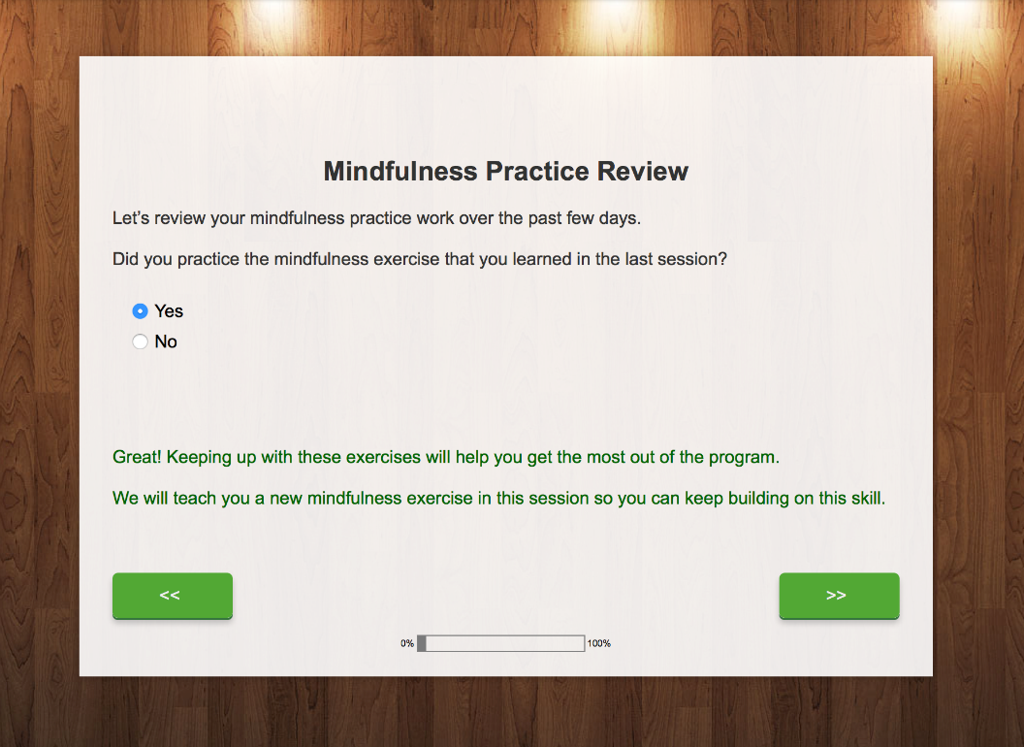
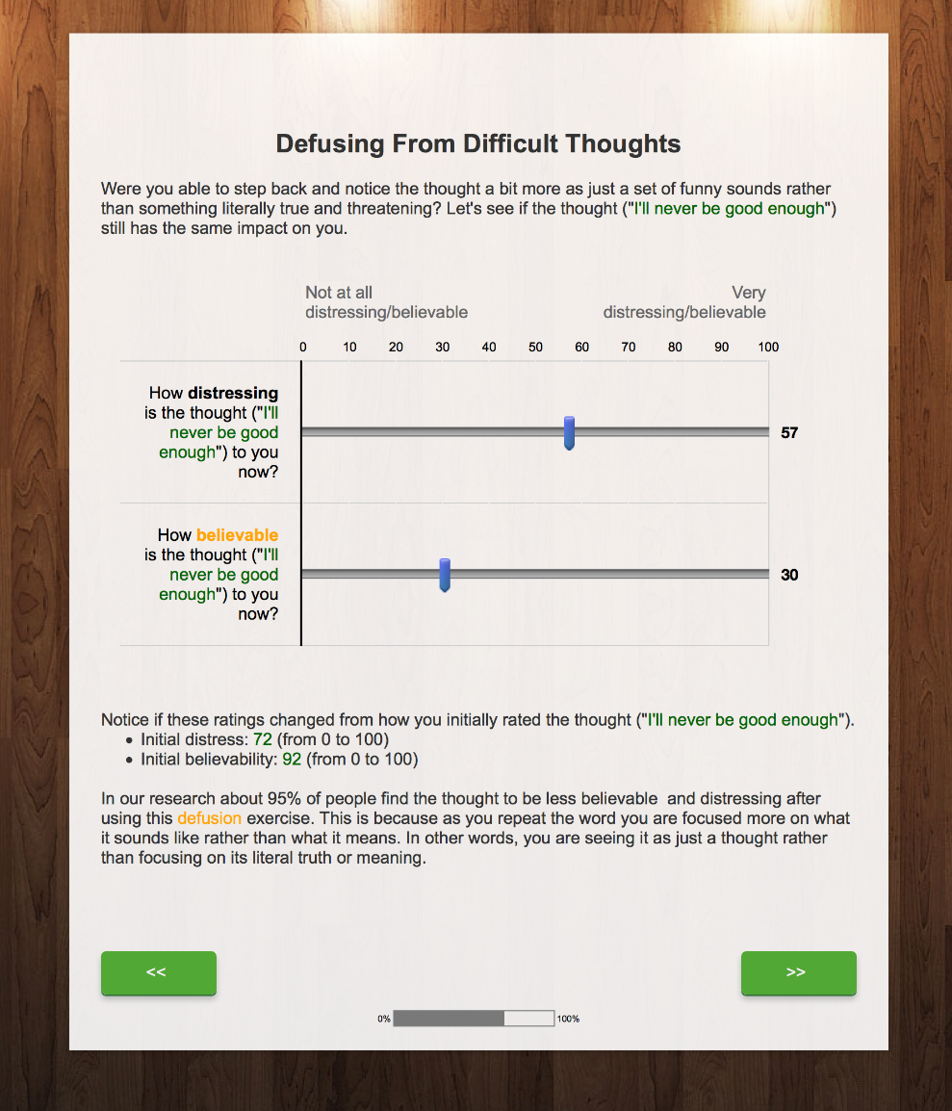

Slide 14
Content development questions
How long should the sessions be? 30-45 minutes
How many sessions should we have? 6 sessions
Should we tunnel vs. use an open browsing format? Sessions were tunneled and sequential, but with no wait between
Take a general ACT training approach or tailor content for specific problems?
General approach with content
But with expandable examples illustrating with specific problems
How much coaching/guidance should we provide?
Minimal reminder emails and calls
but no other guidance/coaching to use the program

Slide 15
Results

Slide 16
Program usage/Satisfaction
Completion rates
83% completed the first session
75% completed half or more of the program
Only 55% completed all six sessions
Time in the program
Total time in program: M = 74 minutes, SD = 83 minutes
Average time in a session: M = 17 minutes, SD = 16 minutes
System Usability Scale: M = 71.13, SD = 16.78
In the “Good” range (Bangor, 2008)

Slide 17
Mental health outcomes
Time by condition interactions showed improvements in ACT vs. waitlist for:
CCAPS total distress, F = 6.59, p = .013, d = .66
CCAPS depression, F = 4.20, p = .045, d = .52
CCAPS social anxiety, F = 8.43, p = .005, d = .75
CCAPS academic concern, F = 5.75, p = .020, d = .62
MHC Positive mental health, F = 4.28, p = .043, d = .53
CCAPS general anxiety, F = 3.27, p = .076, d = .46
No effects on CCAPS eating concerns, hostility, or alcohol subscales (p > .10)

Slide 18
Processes of change
Time by condition interactions showed improvements in ACT vs. waitlist for:
PHLMS Acceptance, F = 4.50, p = .04, d = .52
VQ Obstruction, F = 6.38, p = .04, d = .62
No effects on AAQ-II, CFQ, PHLMS awareness, or VQ progress (p > .10)

Slide 19
Mediation analyses-VQ Obstruction
Significant full mediation of total distress, depression, general anxiety, and positive mental health
Partial mediation for social anxiety
Proportion mediated ranging from 27% to 56%
 | a path X - M | b path M(X) - Y | c path X - Y | c’ path X(M) - Y | 95% CI | Proportion mediated
Total Distress | 2.70*** | 3.80*** | 2.43* | 1.26 | .05, .37 | 48%
Depression | 2.73*** | 3.77*** | 2.13* | .94 | .06, .50 | 56%
General Anxiety | 2.63* | 3.05** | 1.94† | .96 | .04, .39 | 51%
Social Anxiety | 2.61* | 2.69** | 3.29** | 2.39* | .03, .31 | 27%
Academic distress | 2.71** | 1.13 | 1.79† | 1.31 | -.05, .26
Positive MH | 2.38* | 3.28** | 2.01* | 1.09 | .32, 5.99 | 46%

Slide 20
Mediation analyses-PHLMS Acceptance
Significant full mediation of total distress, depression, and general anxiety
Partial mediation for social anxiety
Proportion mediated ranging from 17% to 40%
 | a path X - M | b path M(X) - Y | c path X - Y | c’ path X(M) - Y | 95% CI | Proportion mediated
Total Distress | 1.90† | 3.73*** | 2.34* | 1.60 | .003, .33 | 32%
Depression | 1.87† | 3.78*** | 1.92† | 1.16 | .001, .41 | 40%
General Anxiety | 1.85† | 3.01** | 1.78† | 1.13 | .01, .36 | 37%
Social Anxiety | 1.84† | 2.34* | 3.19** | 2.66* | .01, .24 | 17%
Academic distress | 1.81† | .50 | 1.85† | 1.67 | -.08, .16
Positive MH | 1.80† | 1.42 | 1.92† | 1.56 | -.10, 3.79

Slide 21
What did you like least about the program?
60% said it was too long and/or too repetitive
17% said each session was too long
7% said reading segments were too long
7% did not have the time or privacy to use the program
7% emphasized inadequate coverage of certain mental health problems
Only 3% reported not liking the web-based format for self-help

Slide 22
Discussion

Slide 23
Key findings
Adequate usability/satisfaction ratings with the qualtrics prototype
Though not as high as we would want for a high quality website
May have been affected by the recruitment methods and sample
Improvements on depression, anxiety, academic concerns, and positive mental health
Lack of improvement on eating, hostility and alcohol problems
Suggests challenges with transdiagnostic treatment or floor effects?
Improvements in mindful acceptance and reduced disruption of valued living due to inflexibility
Which fully mediated treatment effects
Lack of changes on AAQ-II, CFQ, PHLMS awareness, and VQ progress
Suggests weak impact on key processes? Measurement issues?

Slide 24
Lessons learned
Developing self-help programs through a survey CMS can lead to adequate acceptability, usability and efficacy
But results are weaker than hoped for on key usability, usage and process measure variables
Effects might be improved by reducing length of sessions and longer reading segments
Or possibly integrating guidance/coaching
A general, transdiagnostic approach reduced a range of problems
But did not impact outcomes largely outside of internalizing disorders
There are recruitment challenges in engaging college students in web-based self-help
Passive recruitment methods are unlikely to be sufficient

Slide 25
Thank you
And join the ACTing with Technology SIG if you are interested in these topics and not a member yet.

