Slide 2
ACT on Bullying
Bullying occurs when there is a power differential
Or a perceived power difference
Usually happens multiple times
Can include varied behaviors
Physical harm (e.g., hitting, pulling hair)
Threats of physical harm (e.g., I am going to kill you)
Verbal attacks (e.g., name calling, sexual harassment)
Relational aggression (e.g., exclusion, rumor spreading)
A lot of this now occurs via social media

Slide 3
ACT on Bullying
According to YRBSS in 2011 in US, 20% of 9-12 graders endorsed being bullied on school property,16% said they had been electronically bullied, and about 6% reported being afraid to go to school
Both being a bully and being bullied are associated with negative outcomes and sometimes kids are both
Depression, suicidal ideation, somatic concerns, lower grades, higher absences and (rarely) violent retaliation in both children who are bullied and children who witness it
Children who commit bullying have higher rates of alcohol and substance abuse, aggression in other settings, tendencies to engage in criminal activity such as stealing…

Slide 4
ACT on Bullying
Taking a functional contextual approach
Don’t label “a bully,” “a victim,” OR “a bystander”
Reduces likelihood of changes
Increases rigidity of narrow self-content
And may limit child seeing they play multiple roles play
Neglects broader contextual factors which could be readily changeable
Really consider the purpose(s)
Child could be target because he/she doesn’t fit in
Disability, LGBTQ, Demographically Different from Norm, etc.
Child could be target just because often alone so seem weak
Child be targeted because he/she does fit in
Instrumental to take down a popular kid

Slide 5
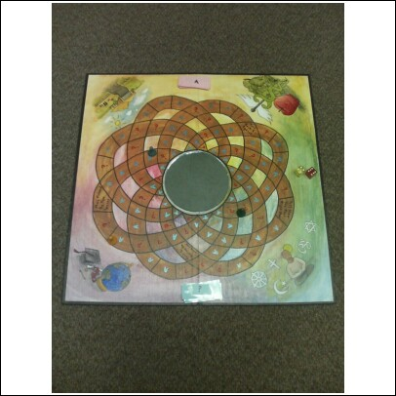
My First Clinical Work on Bullying ( &1st ACT Protocol Work)
Work at Magnolia – school for students who meet “handicap eligibility” because of “serious emotional disturbance”
Idea was to develop a positive behavior program that included skills training components: social, conflict resolution, anger management, etc.
Principal asked me to “do something about bullying”
Ways of being game in groups (process heavy)
No end point, no right or wrong, no winner nor loser
Answer questions about thoughts and feelings
Particularly related to values, barriers to values, and related issues
Act out values-consistent and in-consistent behaviors
Outcomes
Future Treatment Designs…
Act cool.
What happens when you lose at your favorite game?

Slide 6
Important Ideas to Confer to Parents (to Share with Their Children)
Being with at least one other kid is better than being alone
Telling adults every time bullying occurs is important
And who and how matters
Just reporting to adults who are engaged and committed to helping without a lot of fuss that might reinforce bullying behaviors is key

Slide 7
Ideas to Confer to Parents
Everyone worries what others think about them – that is normal and it’s ok
Ok to feel whatever you feel (scared, sad, mad, frustrated) and not ok to act out reactively (regulate and respond instead)
Be compassionate – it is better for everyone involved that way
It does not really matter if other people believe what you say about your feelings – you are the expert on your feelings and you have the right to protect yourself/your child based on your truth
Unconditional support matters
Life has ups and downs and this will pass

Slide 8
Ideas to Confer to Children
*All (well, most) taken from Toni Zimmerman
Sharks, Carps, Crabs, & Dolphins
Context dependent
Sharks- Swim at the top of the water looking down on everyone else as their prey.
Carps- Swim at the bottom of the ocean with their heads down while they eat other fish’s poop. They don’t complain; they just keep their heads down and accept that lifestyle.
Crabs- Can see what’s going on around them but cannot move forward or backwards, only side to side. Therefore, they never take a stand one way or the other.
Dolphins- Can swim at the top, the bottom, and everywhere in between. They can make friends with the carps and stand up to the sharks.
Notes:
Toni Zimmerman, Ph.D.’s RELATE Program
Colorado State University – Human Development and Family Studies
http://www.relate.chhs.colostate.edu/files/RELATE%20Workshop%202_Bullies.pdf

Slide 9
Ideas to Confer to Children
*All (well, most) taken from Toni Zimmerman
FLOAT acronym
Link to values
Use a client example to talk about this
Forget about it: First try to just forget about it; ignore the person bullying you. You can take a time out to cool down.
Leave: If forgetting about it doesn’t work, you may need to walk away.
Openly express yourself: You may want to tell the person bothering you how you feel, “Hey, that isn’t nice. Stop saying that.”
Apply strong words: If the person still isn’t being nice, you may have to apply your strong words, “Stop now.”
Tell somebody: If you have tried all of the above and the person is still bothering you, tell someone. Get help from an adult.

Slide 10
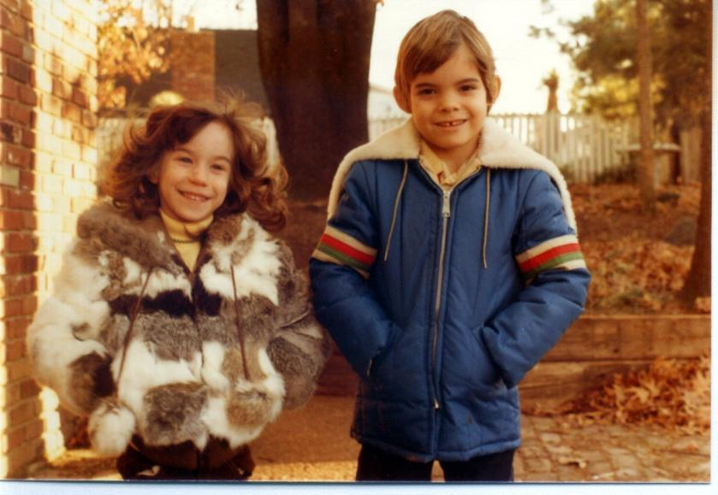
Research Question I Have
What leads to kids being more dolphin-like more often than not?
Personal story tied to ACT

