Slide 1
Using web/mobile technology to enhance your clinical work
Michael E. Levin, Megan Oser & Jack Haeger

Slide 2
Goals of the workshop
What technologies are currently available and what can they do for you
How can you use these technologies in your clinical work
How supportive accountability principles can help guide your clients’ uses of these technologies

Slide 3
A quick poll – How many of you are…
Doing clinical work?
Used a mobile app with your clients?
Doing research on technology?

Slide 4
Unique Features of Apps
Portability
Acceptability
Ability to “push” to clients
Tracking and monitoring

Slide 5
Current Status of the Research
Two pilot RCTs show promising results
Bricker et al., 2014: SmartQuit produced non-significantly better results on smoking than QuitGuide (OR = 2.7)
Ly et al., 2014: App reduced stress for managers relative to waitlist
11 published studies total have tested traditional and contextual CBTs
Only four of which are RCTs

Slide 6
A list of available ACT apps
ACT Coach
ACT Companion
I Here Now
Oiva – 1 pilot
The Sleep School App
SmartQuit – 1 RCT
Somatiq ACT apps
Viary – 1 pilot, 1 RCT?
We have a lot more apps than research studies.
But ACT is doing better than some areas.

Slide 7
Questions We Often Have
How would I use mobile apps in my clinical work?
For what role and function?
How do I navigate all of the mobile apps that are available?
How do I know which app to choose for this client?

Slide 8
What functions would you want an app to serve clinically?
How would you use a mobile app in therapy?
How might it help your clients?

Slide 9
Enhancing ACT work – In context of therapy
Targeting specific processes: acceptance, defusion, values, …
Skill acquisition – Introducing it
Skill strengthening – Learning more
Skill generalization – Applying it across contexts
Goal setting
Self monitoring
Assessment feedback
Crisis support
Social engagement/support
Communicating with therapists
Homework/Practice between sessions
For highly engaged clients looking for more tools

Slide 10
Adding a support for clients – outside context of therapy
Before starting therapy
After termination
For time limited settings/contexts
Stepped care model

Slide 11
App Handout
You can access the handout here: http://tinyurl.com/pztm7tv
Reviews a range of ACT apps in terms of main features, goals, etc…
Provides detailed information on key apps.

Slide 12
ACT Core processes in mobile apps
To be used in conjunction with ACT therapist
And after course of ACT to maintain practice

Slide 13
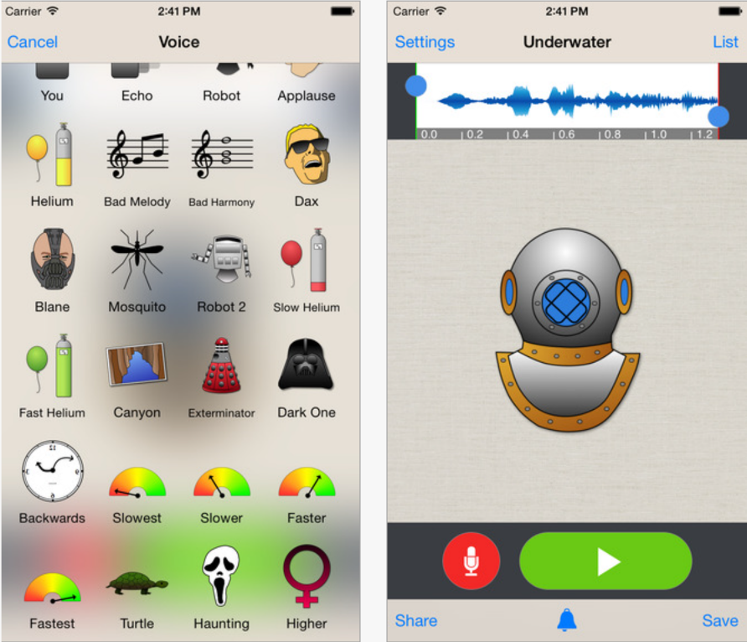
Defusion
Voice modulator apps
Songify (iOS & Android), https://www.smule.com/songify/index
Talking Tom Cat 2 (iOS & Android), http://outfit7.com/apps/talking-tom-cat-2/
Voice Changer Plus (iOS), https://itunes.apple.com/us/app/voice-changer-plus/id339440515?mt=8

Slide 14
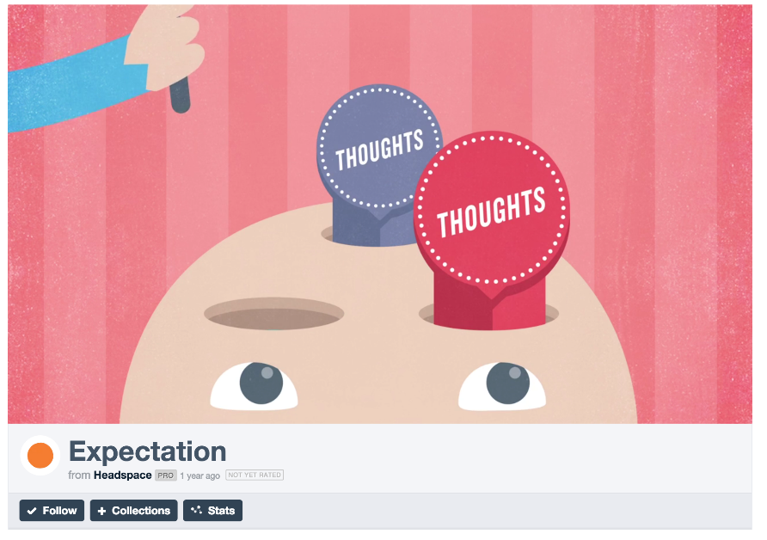
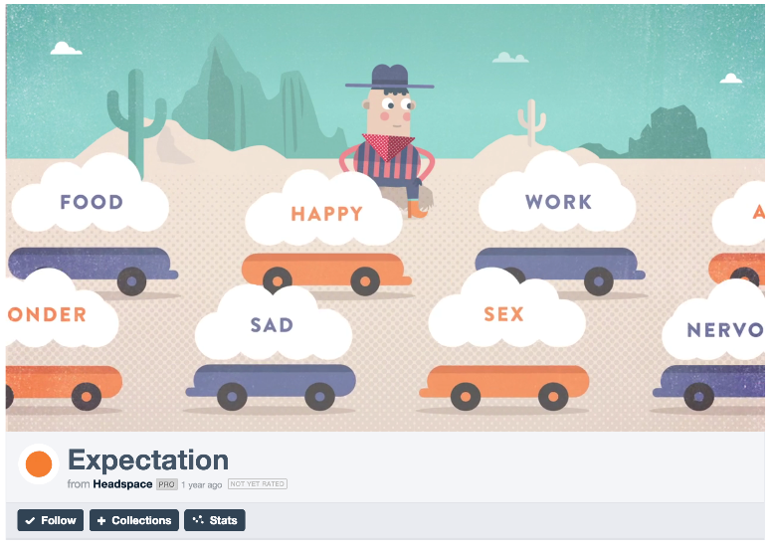
Headspace

Slide 15
Acceptance
ACT Companion
ACT Coach
Somatiq ACT: Willingness
SmartQuit

Slide 16
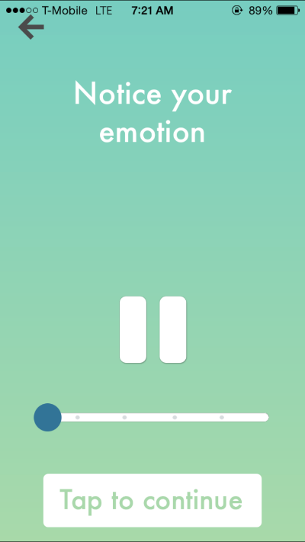
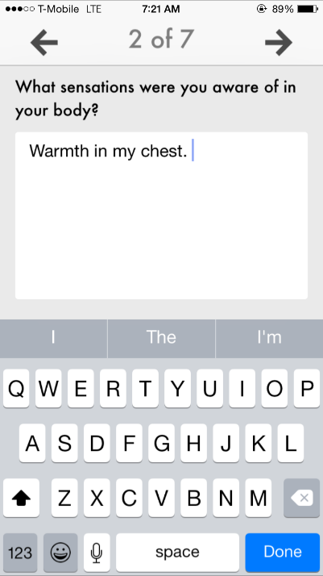
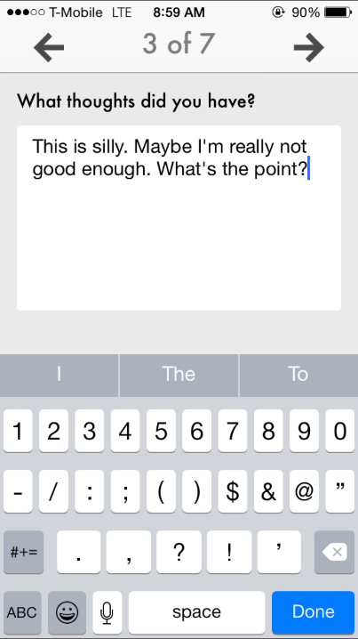
ACT Companion (Acceptance Exercise)

Slide 17
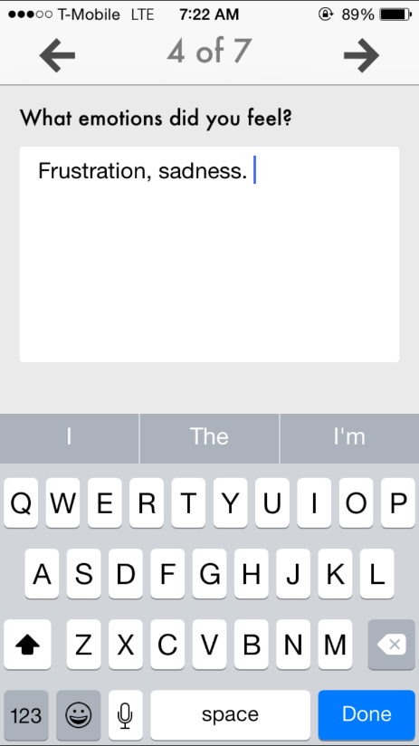
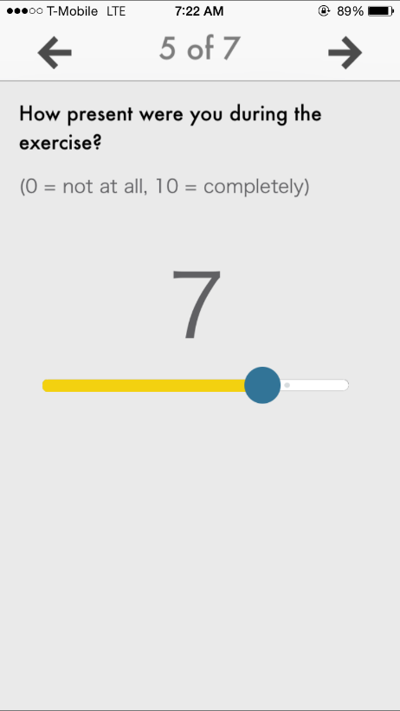
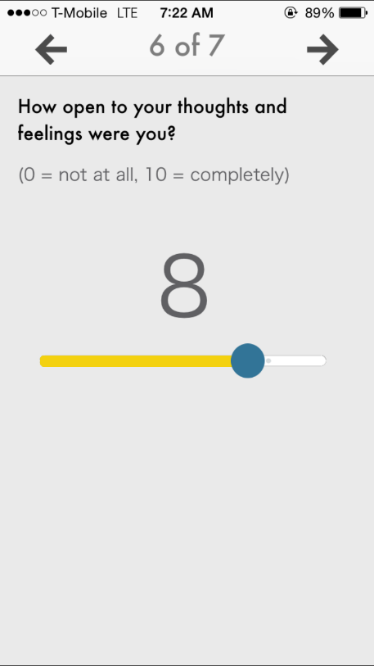
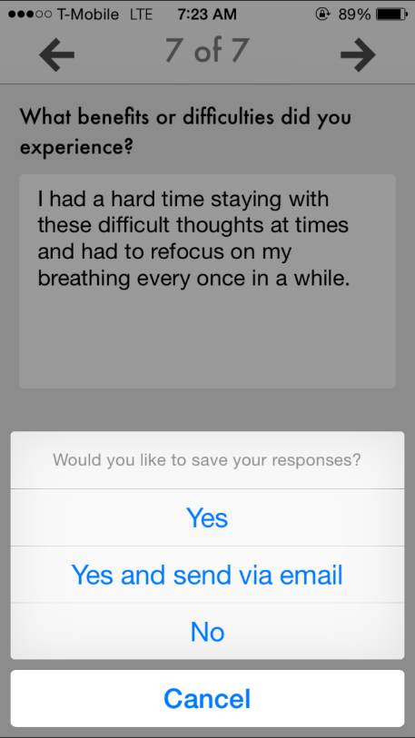
ACT Companion

Slide 18
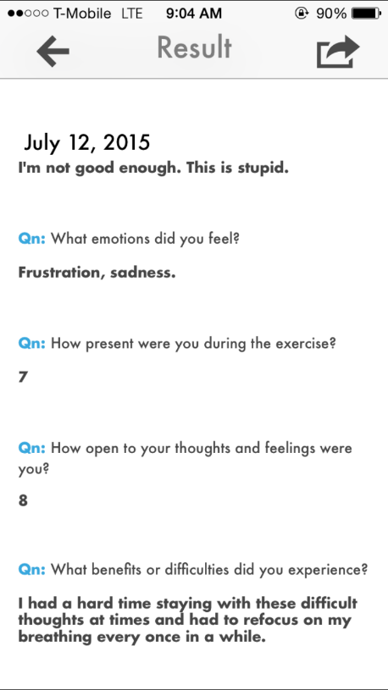
ACT Companion

Slide 19
Mindfulness Apps
Headspace (iOS & Android), https://www.headspace.com/
Stop, Breathe & Think (iOS), http://stopbreathethink.org/
Buddhify (iOS), http://buddhify.com/
Mindfulness Coach (iOS), http://www.ptsd.va.gov/public/materials/apps/mobileapp_mindfulness_coach.asp
Note that many other apps like ACT Coach and ACT Companion also include mindfulness exercises

Slide 20
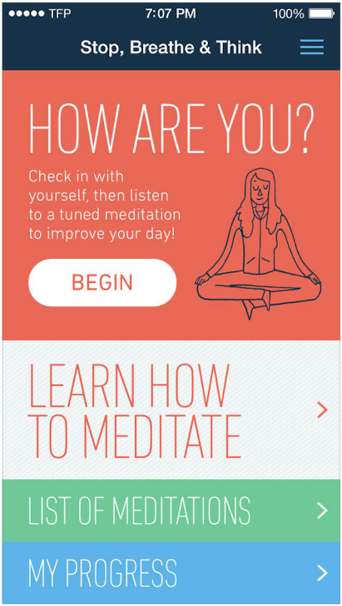
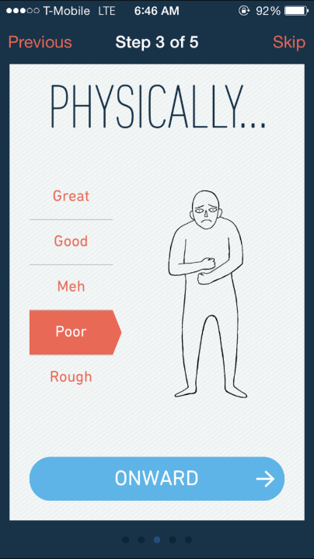
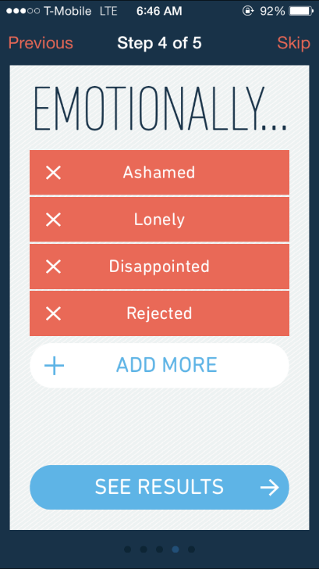
Stop, Breathe, & Think

Slide 21
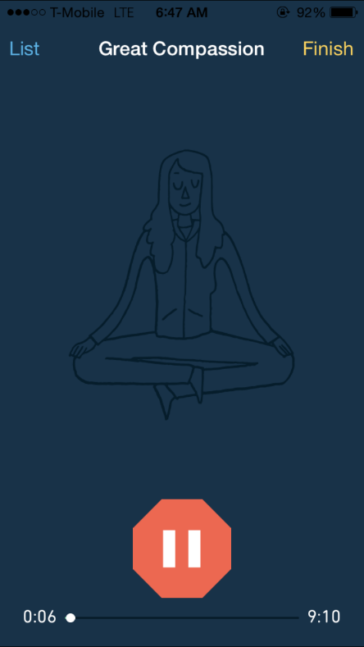
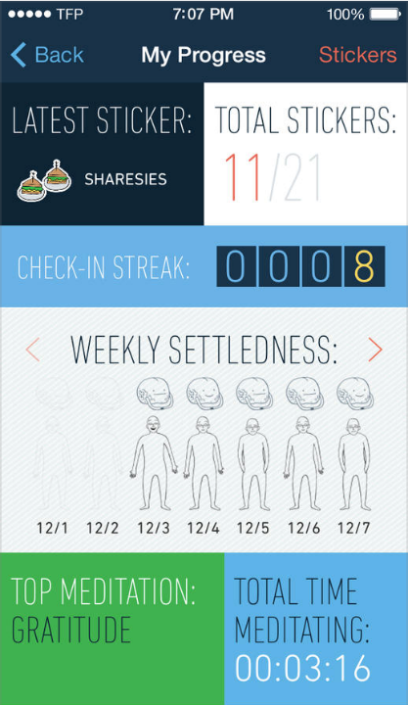
Stop, Breathe, & Think

Slide 22
Headspace

Slide 23
Clarifying Values
Forstara Values Card Sort
ACT Companion
Somatiq - ACT: Values
ACT Coach
Gratitude Journal (iOS), http://happytapper.com/gratitude-journal

Slide 24
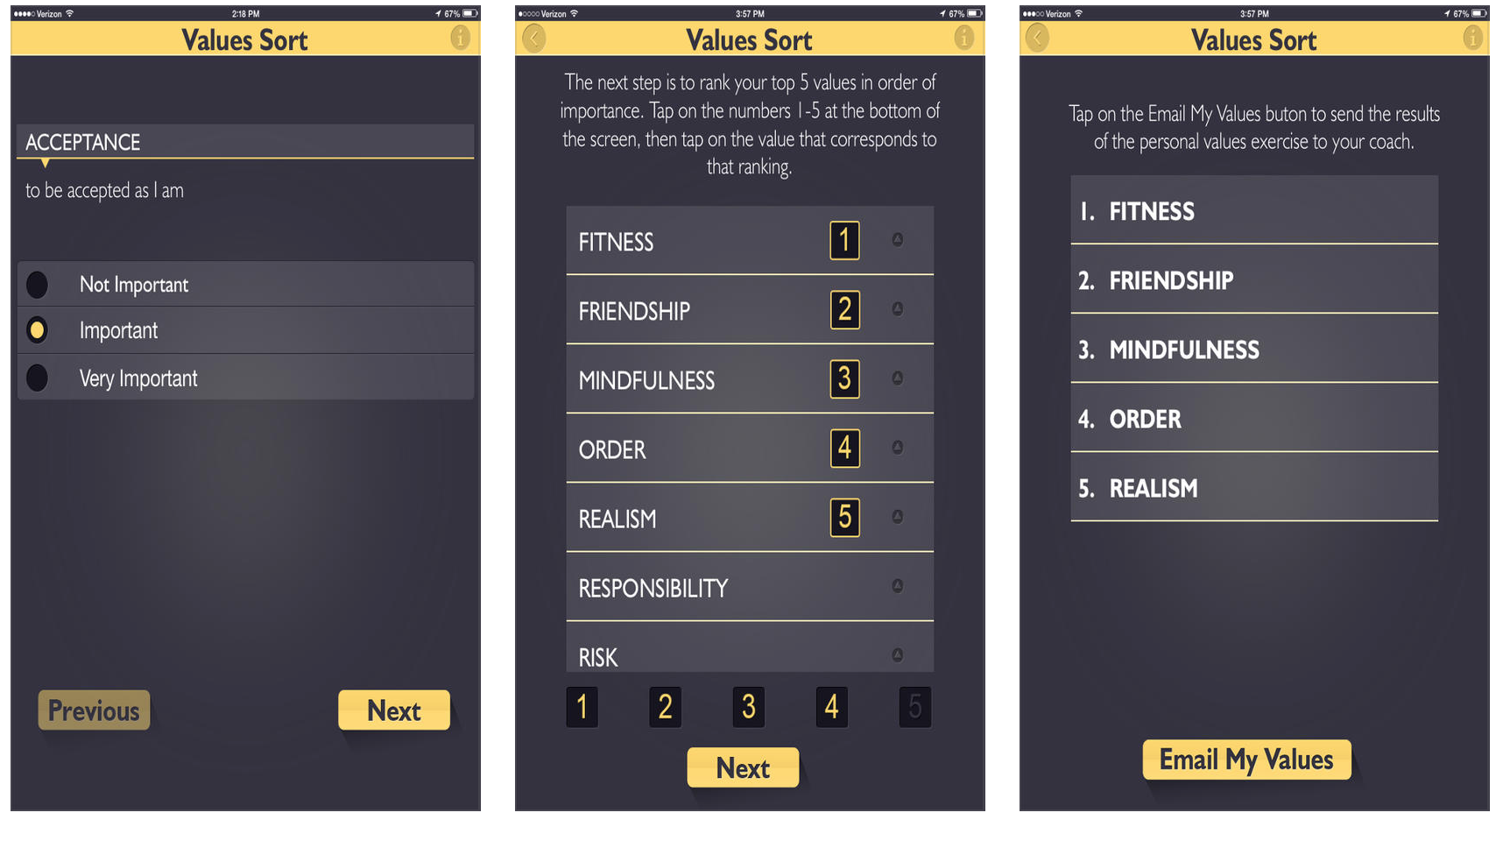
Forstara Values Card Sort

Slide 25
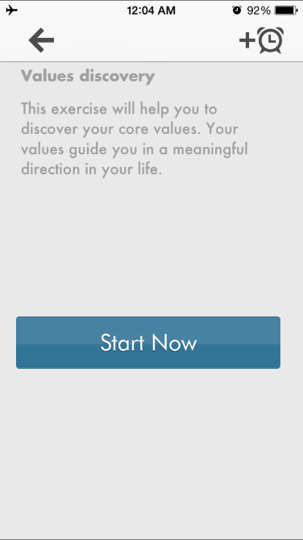
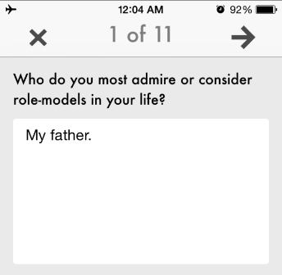
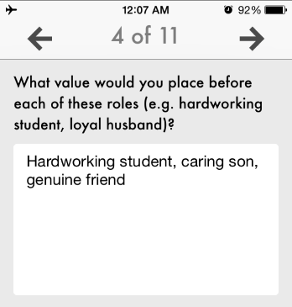
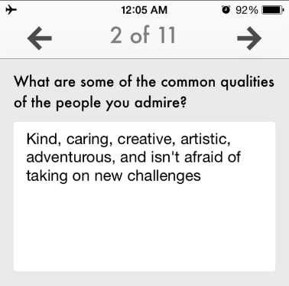
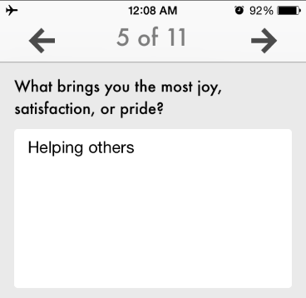
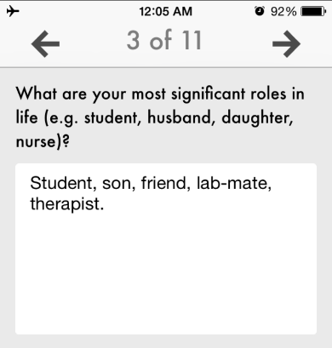
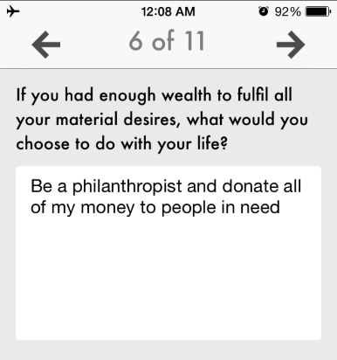
ACT Companion (Values Discovery)

Slide 26
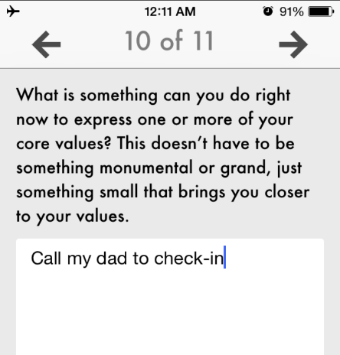
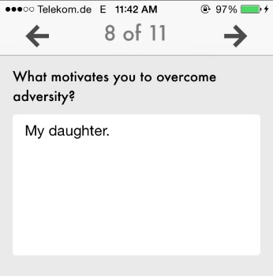
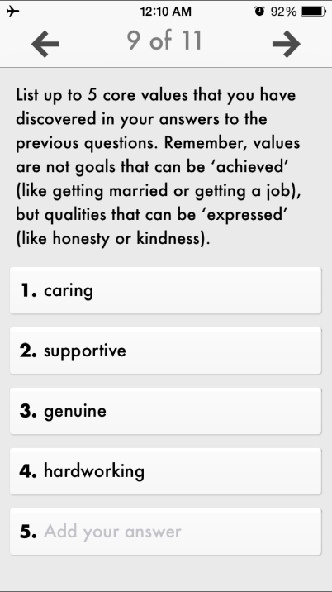
ACT Companion (Values Discovery cont.)

Slide 27
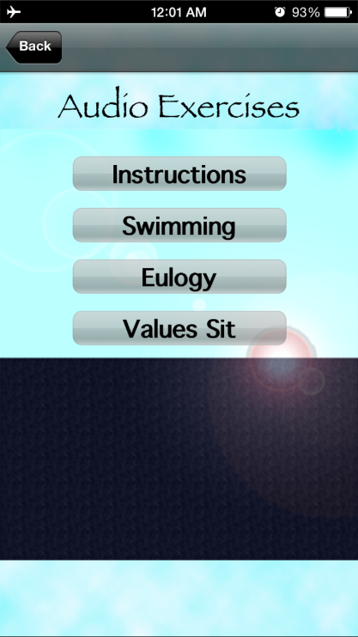
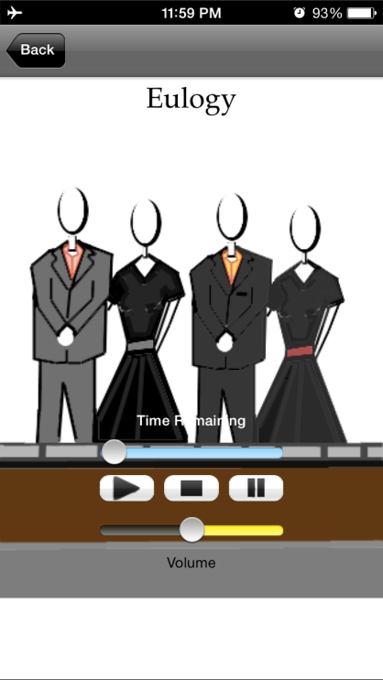
Somatiq – ACT: Values

Slide 28
Committed Action
ACT Coach
ACT Companion
Viary
Coach.me
Habit List
Lifetick.com

Slide 29
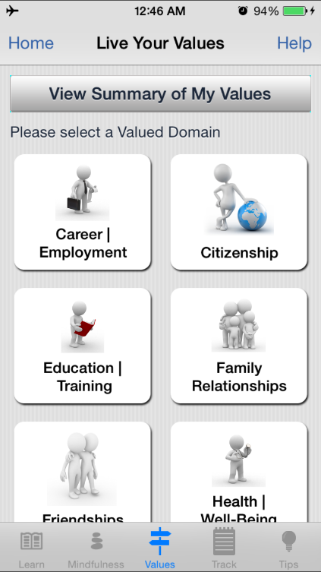
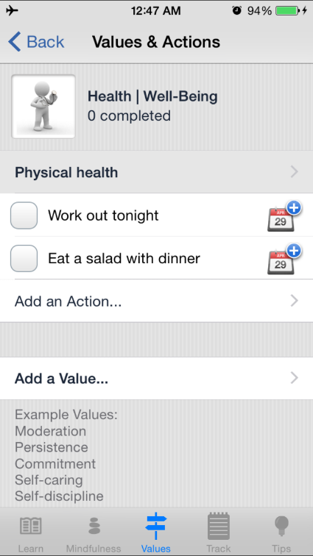
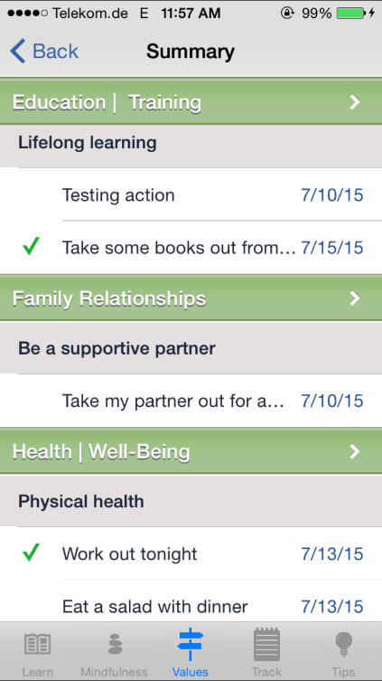
ACT Coach

Slide 30
Core behavioral components/functions with apps
Goal setting
Self-monitoring
Generalization and prompting

Slide 31
Goal setting (primary application)
Coach.me
Habit List
Viary
Lifetick.com

Slide 32
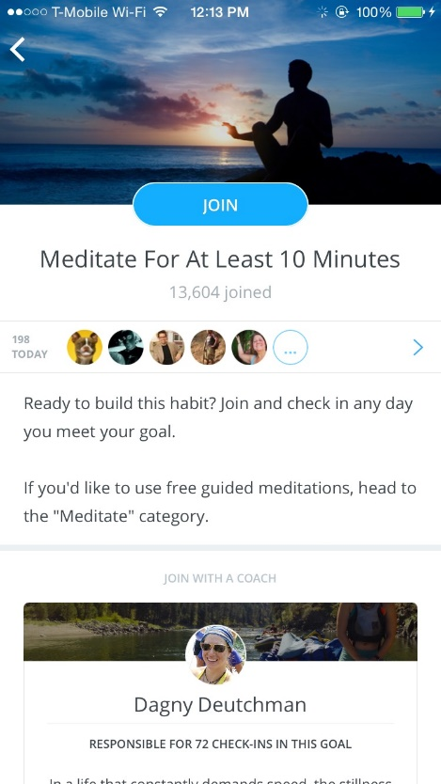
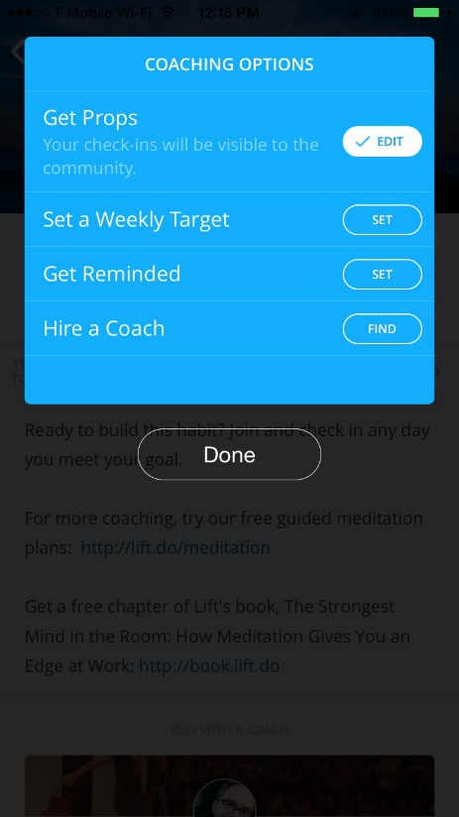
Coach.me

Slide 33
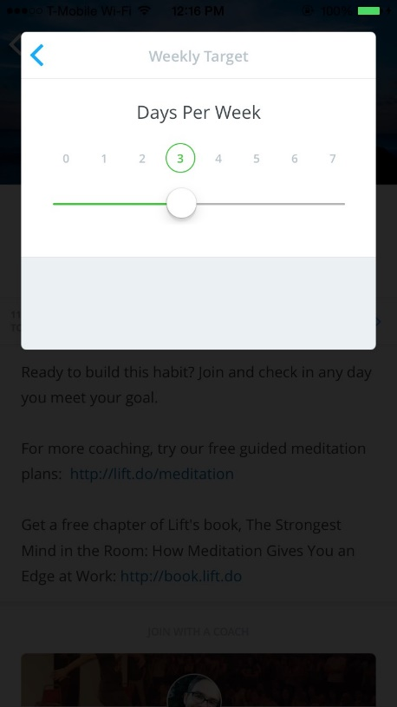
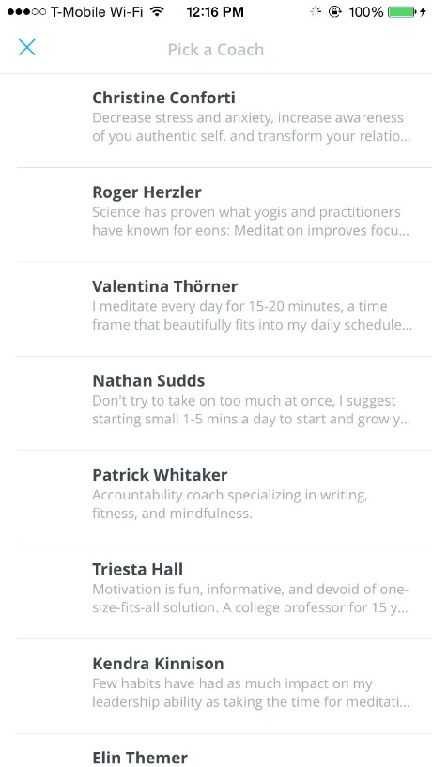
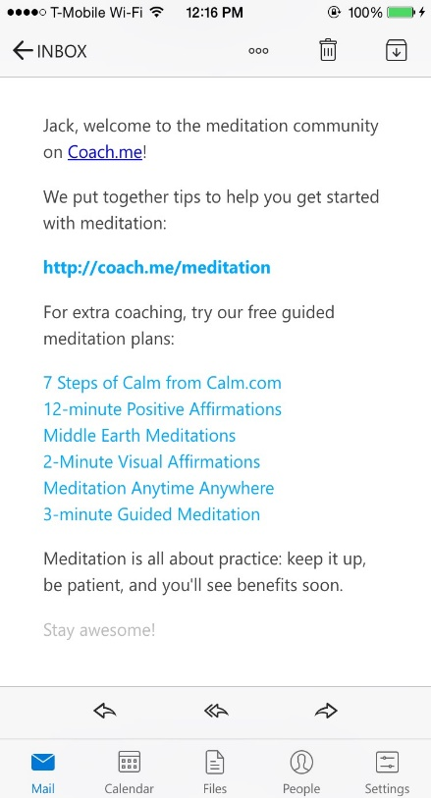
Coach.me (cont.)

Slide 34
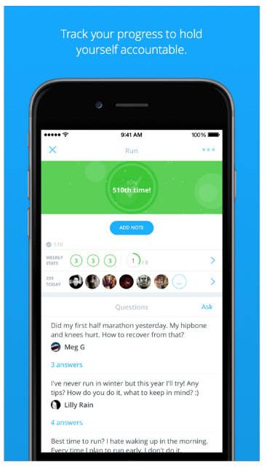
Coach.me

Slide 35
Self monitoring
Moodlytics (iOS & Android), http://www.moodlytics.com/
T2 Mood Tracker (iOS & Android), http://www.t2.health.mil/apps/t2-mood-tracker
Most ACT and mindfulness apps included in our handouts have a self monitoring feature

Slide 36
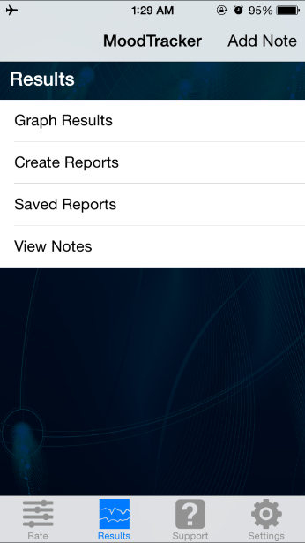
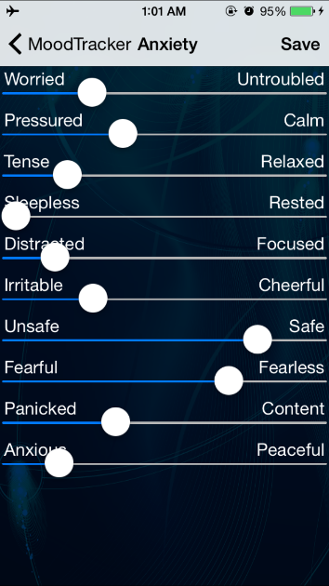
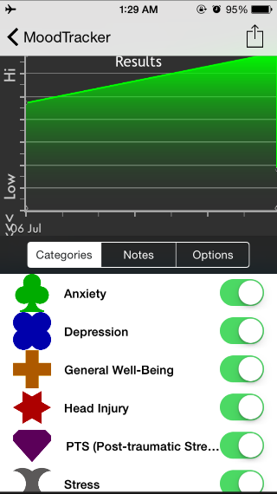
T2 Mood Tracker

Slide 37
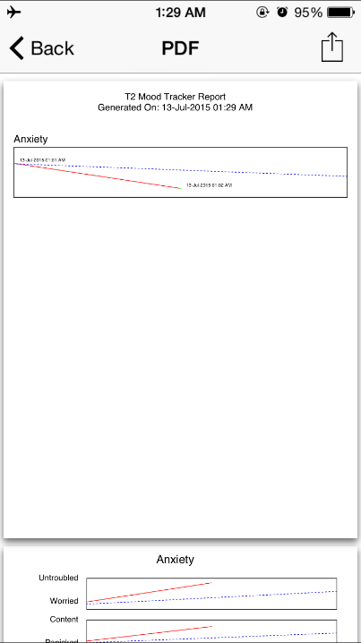
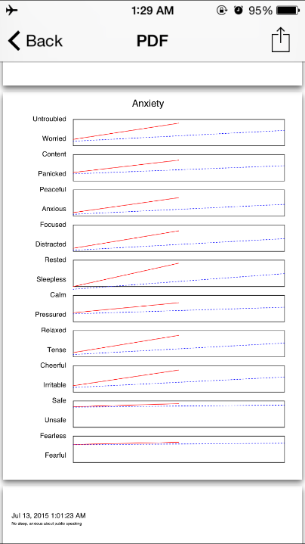
T2 Mood Tracker (cont.)

Slide 38
EMA and prompting tools
MetricWire
PACO
iPromptU
Self Echo (part of mobiletherapy.com program)
Some ACT apps include prompts to remind users to complete exercises
ACT Companion, Sleep School, Viary

Slide 39
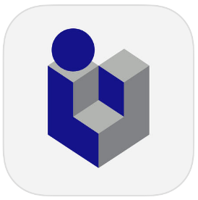
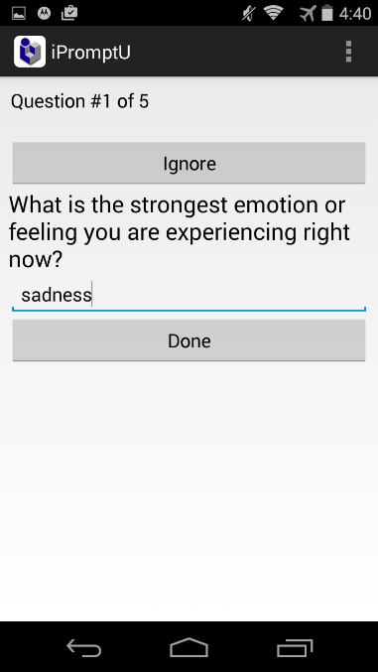
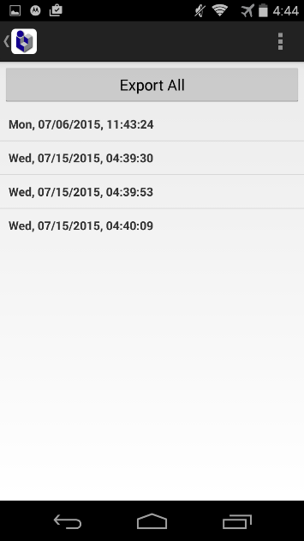
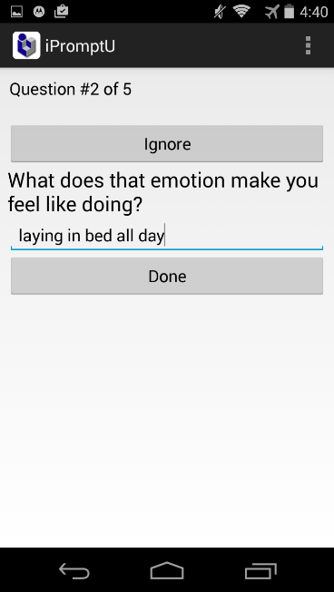
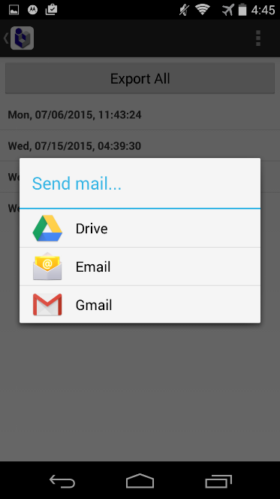
iPromptU

Slide 40
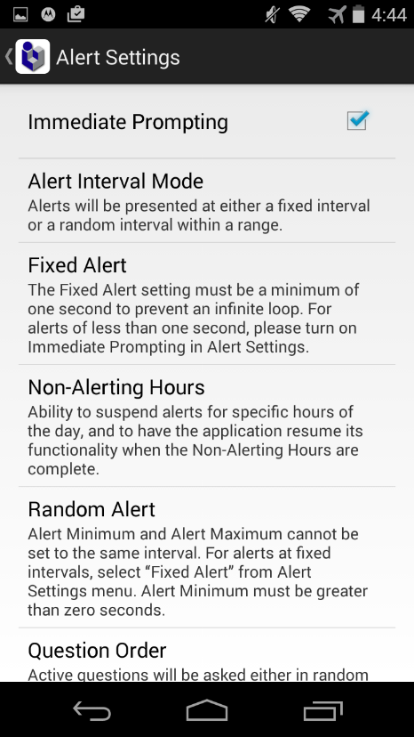
iPromptU

Slide 41
How do I decide which app to pick?
Client needs: What supports does this client need?
Be creative in finding how app features can address client needs
Practical issues: Android vs. iPhone, cost, etc…
Ratings: User ratings, colleague recommendations…
Empirical support: But few apps have been directly tested
Try out the app yourself
Is it engaging? Easy to use?
Is the content consistent with your approach?
Will the content and features fit well with what you are doing in therapy?

Slide 42
Barriers to using technology
What might get in the way of you using these technologies with your clients?

Slide 43
Overcoming Barriers
Use the handout list to find the right app for the setting
Try out the app for yourself to see what it’s like
Get colleagues opinions on apps you are considering
Setup reminders to use apps in session
Install the app with your clients in session
Show it to them on the computer so have visual cue of what searching for
Have a handout about the app available for clients

Slide 44
How do we engage clients in using these technologies?

Slide 45
Supportive accountability
Empirically supported, theory-based model for improving adherence to self-help technologies
Human support increases adherence
Clear accountability can further increase adherence
This is a model for understanding guided self-help
Can be implemented in a variety of contexts including face-to-face, email and phone calls

Slide 46
Principles of supportive accountability
Clarify expectations: in using program, adherence, receiving support from you, and why
Adherence expectations: How they are expected to use the program
Receiving support: If/how they will be monitored, be held accountable, and be contacted about the app
Role of support: This is to support them and their goals, no negative consequences for not following through
Legitimacy: You are trustworthy, benevolent, and have needed expertise
App should convey legitimacy too

Slide 47
Principles of supportive accountability
Motivation: Develop intrinsic motivators for engagement
How program is important, applies to person, fits with values, can be helpful, etc…
Avoid covert or overt pressure to use program
Choice: Provide choice and identify areas they have choice.
Goal setting: Set adherence goals linked to larger values
Avoid usage goals not linked to meaningful outcomes
Set adherence goals collaboratively

Slide 48
Principles of supportive accountability
Social presence: Sense of a human being involved can improve adherence.
Monitoring: Monitoring adherence is key.
Check in calls, quizzes, program usage logs
Clarify what you have access to (therapists may worry about this more than clients)
Address adherence level: Encourage meeting goals and address non-adherence
Threshold: Point of diminishing returns with amount of support

Slide 49
Introducing technologies
Go over the program and roles
Link program to case conceptualization and client goals
Elicit and reinforce motivation: Desire, Ability, Reasons, Need
Identify barriers and problem solve
Elicit commitment to adhere to program and to process of coaching

Slide 50
Typical call procedure
Motivate use of the program
Reinforce engagement in the program
What did they like? Not like? What did they learn?
Elicit commitment to program
Address non-adherence
Troubleshoot any problems

Slide 51
Addressing Non-Adherence
Remember accountability
Ask them why the adherence goal wasn’t met.
Remember support
Connect the goal back to larger goals and values
Collaboratively problem solve solutions
Identify and address barriers to adherence.

Slide 52
Challenges in providing supportive accountability

Slide 53
What if I don’t have time to check in?
Solution 1: Target supportive accountability in session only
Each of these principles could be targeted in session.
Solution 2: Setup clear expectations and structure to minimize time required outside of session.
Consider email or text message if clinically indicated and complies with confidentiality concerns.

Slide 54
How and when do I review app data?
Solution 1: Review the data with clients in session.
Solution 2: Use apps that can send data to you in a secure format so you can review ahead of time.
But let your clients know that this is likely right before session or during session.
You won’t follow up about their data during the week (unless you will).
Consider if data will be collected that could raise liability concerns.

Slide 55
How do I address engagement over time?
Solution 1: Help switch up what app they use on a routine basis.
Solution 2: Build app usage as a habit.
Treating app usage as a habit; find when its convenient to use app
Solution 3: Consider how long they need to use the app.
Are a couple weeks sufficient? When is it appropriate to “terminate” use of the app?
Solution 4: Use the Premack principle
Schedule a highly preferred phone activity after the app practice

Slide 56
What if a client reacts negatively or the app provides contraindicated content?
Solution 1: Review the app ahead of time to know what it includes.
Address any potential miscommunications or issues ahead of time with client.
Solution 2: Monitor how clients use and respond to the app.
Catch negative reactions or concerning responses to the app.
Solution 3: Address inconsistencies and issues.
Clarify how the app might differ from approach in therapy.
Emphasize client’s experience for what works.
Avoid being judgmental just because its not the way you would do it.

Slide 57
How do I encourage ongoing app use after therapy ends?
Solution 1: Clarify termination and the role of the app.
They can use the app as a support to keep working on skills.
You will not have access to their data and therapy is finished.
Solution 2: Teach clients how to keep using apps.
How to choose new apps well, what to look for, etc…
Give them a list of apps to use.
But also help them get oriented to using one app to promote adoption.

Slide 58
Steps for going further
Send us feedback – Mike.Levin@usu.edu
Join the ACTing with Technology SIG
Ask colleagues about their experiences with apps.
Try out some apps to see what you like and don’t like
Active use an app with a few engaged, tech savvy clients

Slide 59
Questions?

