Slide 1
A functional contextual approach to the treatment of OCD and related disorders
Michael P. Twohig, Ph.D.
Associate Professor of Psychology
Utah State University

Slide 2


Slide 3
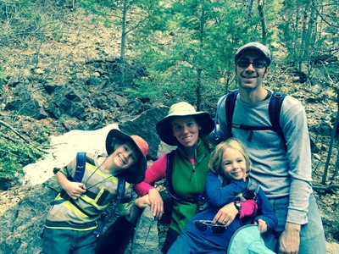
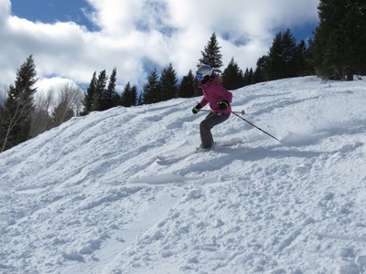
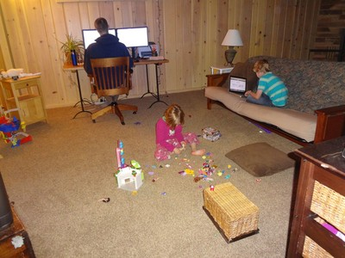
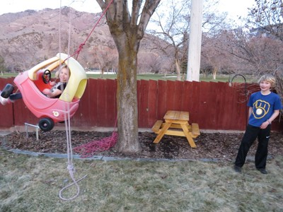
My life

Slide 4

Certain populations?
Is this said A-C-T or “ACT”?
Age groups?
How does this fit with what I do?
Empirical support?
What is contextual behavioral science?
Is it ethical to use ACT?
What do you want to get out of today?
Is this really any different than CBT?
Do I need to know about RFT?
I saw Hayes present on this and I couldn’t follow him.

Slide 5
C
B
T
Motivational Interviewing
Many others
Mindfulness Based Cognitive Therapy
Functional Analytic Psychotherapy
Exposure with response prevention
Wilhelm and Steketee’s Cognitive Therapy for OCD
Beck’s Cognitive Therapy
Appraisal work
Metacognitive Therapy
Dialectical Behavior Therapy
Barlow’s Unified Protocol
Schema Therapy
Mindfulness Based Stress Reduction
Acceptance and Commitment Therapy
Rational Emotive Behavior Therapy

Slide 6
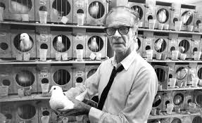
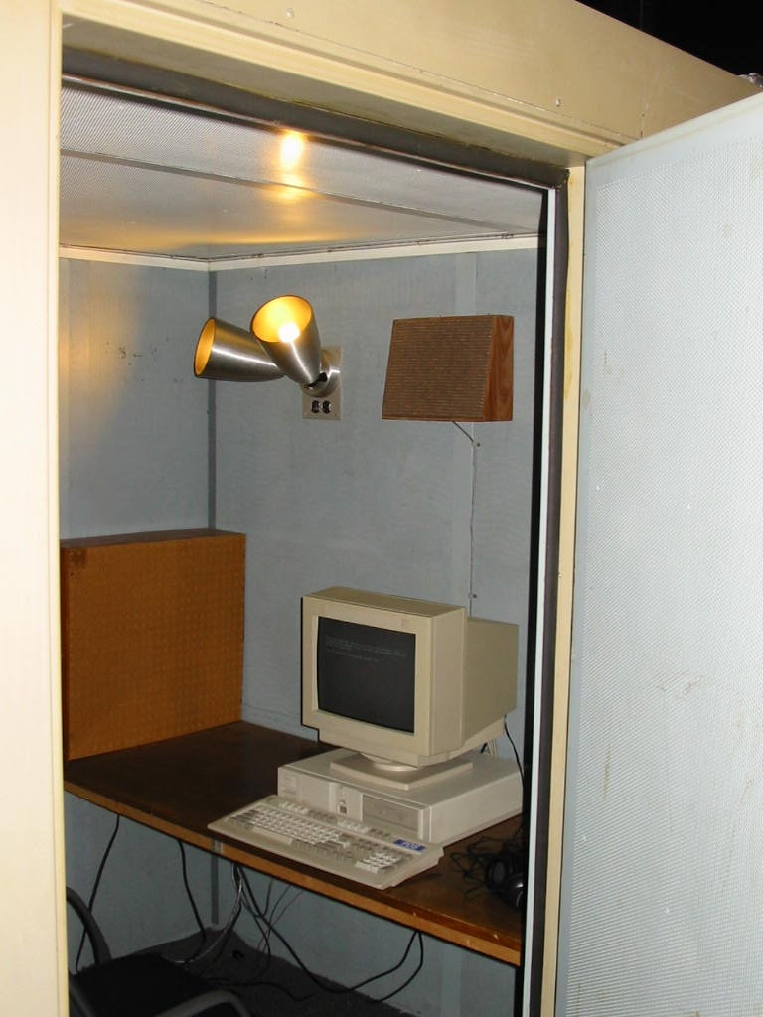
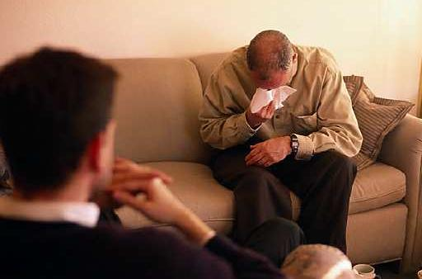
How did ACT develop?
1
2
3

Slide 7
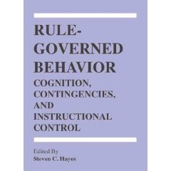
Rule Governed Behavior
Verbal humans are insensitive to
  environmental contingencies
Non-verbal ones are not
How does this happen?

Slide 8
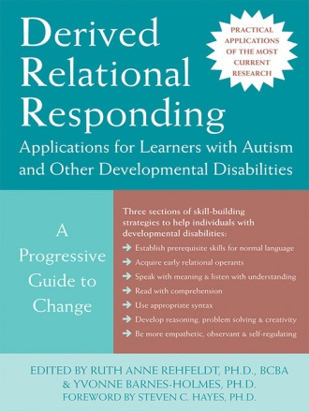

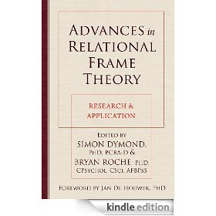
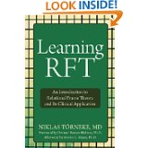


Relational Frame Theory
Stimuli
Three-term contingency
Meaning vs function

Slide 9

Language: The two-edged sword
Useful and interfering effects of this ability
Grocery store
My wife and our children, “getting older”
We can apply this to our own thinking and emotions

Slide 10
Experiential avoidance
  Experiential avoidance is the tendency to attempt to alter the form, frequency, or situational sensitivity of historically produced negative private experience (emotions, thoughts, bodily sensations) even when attempts to do so cause psychological and behavioral harm

Slide 11
Psychological flexibility
  The ability to contact the present moment more fully as a conscious human being, and based on what the situation affords, to change or persist in behavior in order to serve valued ends

Slide 13
AAQ and Anxiety
63 studies
  AAQ and all measures of anxiety r = .45
General anxiety symptoms r = .48
Specific anxiety disorder symptoms r = .42
Specific disorders
  GAD r = .61
  Social phobia r = .41
  PTSD r = .39
  OCD r = .36
  panic/agoraphobia r = .21
Bluett et al. 2015 JAD

Slide 14
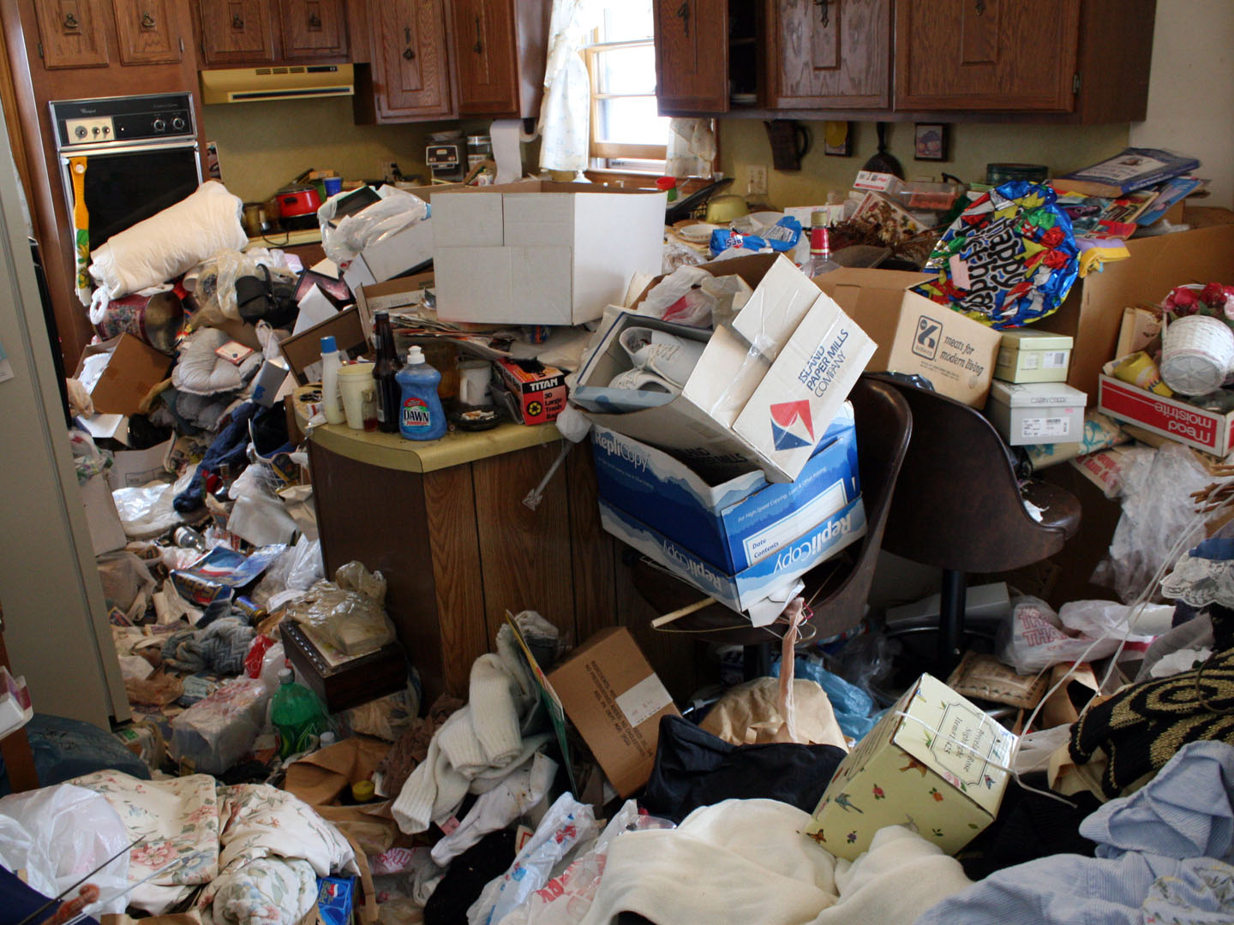
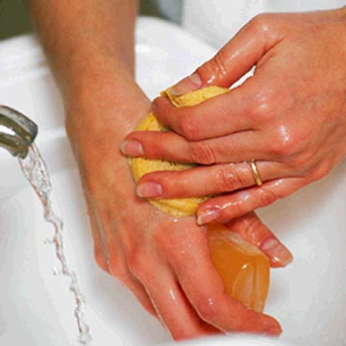

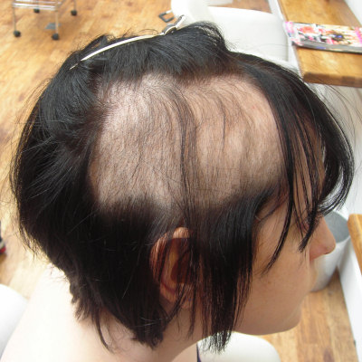
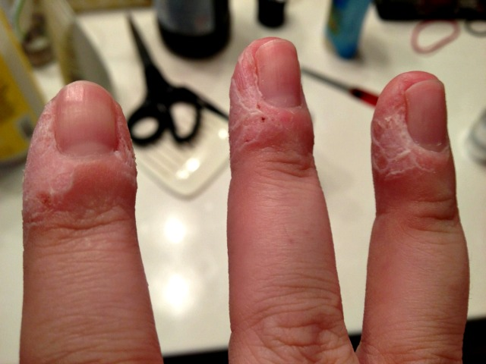
OC and related disorders

Slide 15
OCD and related disorders outcomes
Randomized Trials
Effectiveness=4
Mixed Anxiety=2
OCD=3
Trichotillomania=2
SS designs, cases, open
Mixed Anxiety=2
OCD=6
Trich and Skin picking=6

Slide 16
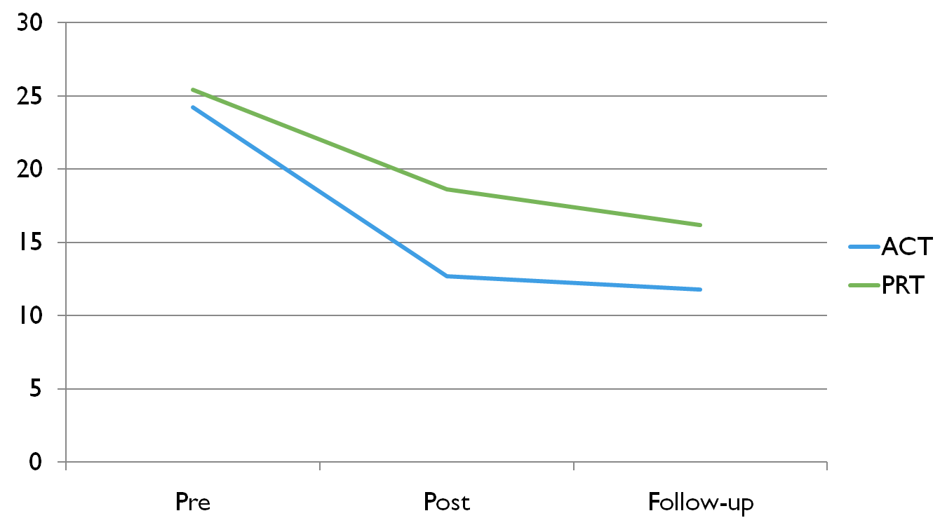
Y-BOCS Scores
Twohig et al. (2010). JCCP

Slide 17
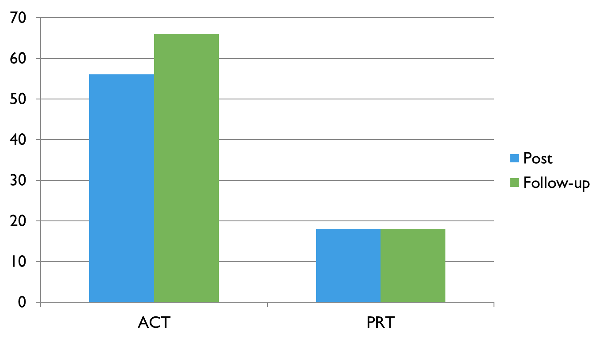
% treatment responders

Slide 18
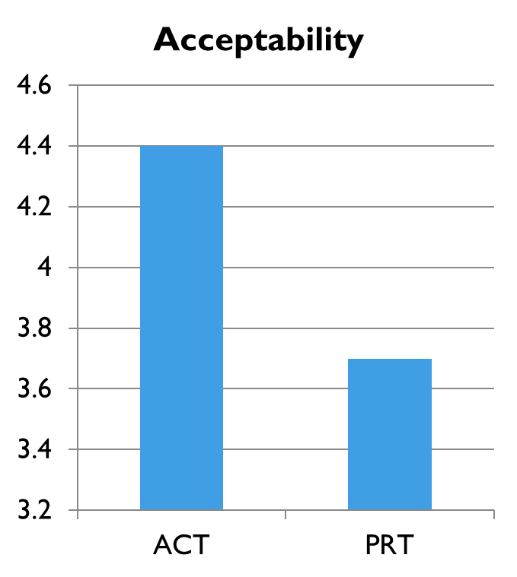
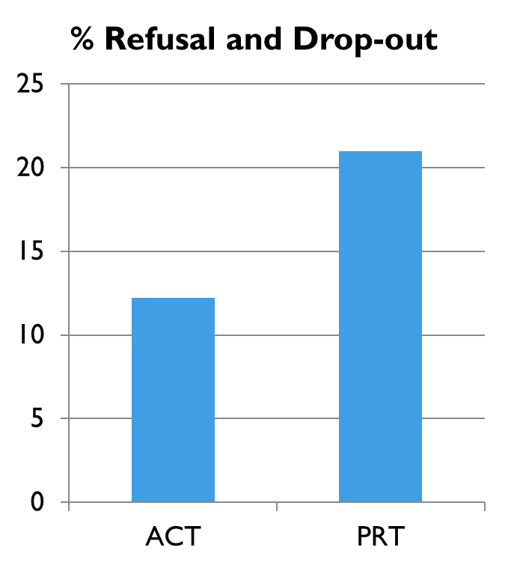
Refusal, drop-out, and acceptability

Slide 19
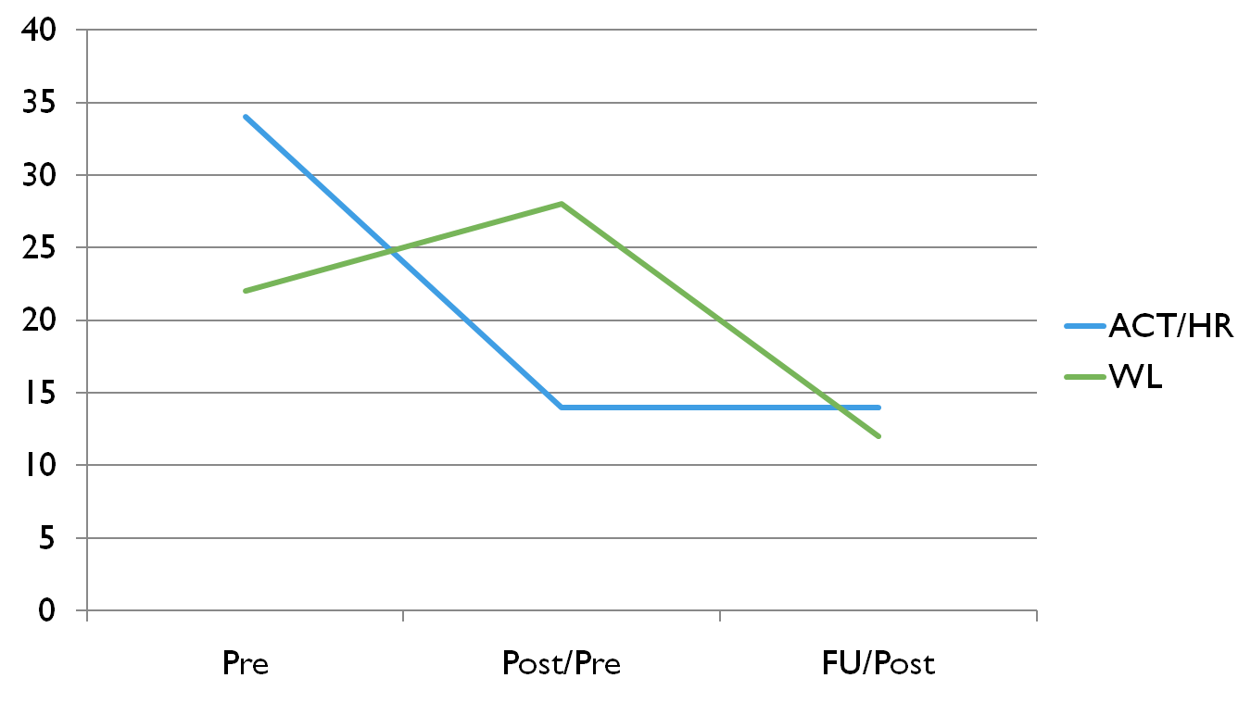
ACT+habit reversal for trichotillomania
Woods et al. (2006) BRAT.

Slide 20
Hours Viewing per week
Crosby & Twohig (not quite there yet)

Slide 22
The Primary ACT Model of Treatment
Psychological
Flexibility

Slide 23
OC and related disorders

Slide 24
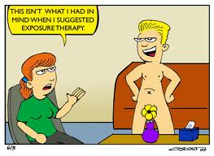
Exposure therapy is #1 treatment

Slide 25
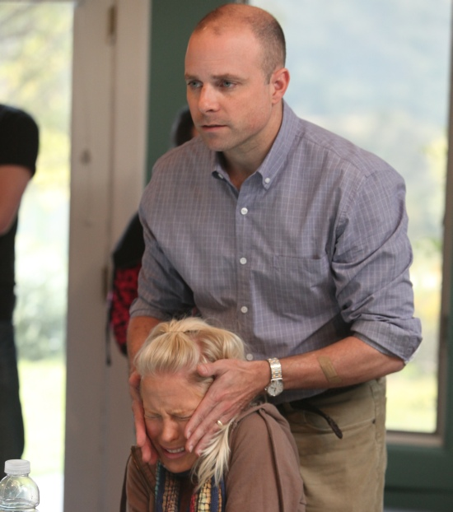
Exposure Therapy
Procedure (How you do it)?
Process of change (What type of learning do you hope is occurring)?
Outcome (How do you know you are helping the client)?

Slide 26
Some misconceptions about exposure work
Within and between session fear reduction is associated with better clinical outcomes
Moving through the hierarchy in an orderly fashion is best
Can’t stop exposures without fear reduction
Exposure is about fear reduction
  Not fear toleration
“optimizing learning …. based on increasing tolerance for fear and anxiety” (Arch & Craske, 2009)

Slide 27
Example of the importance of basic sciences
Extinction involves new leaning and not unlearning
  spontaneous recovery (passage of time)
  disinhibition (presentation of a novel stimulus)
  reinstatement (presentation of the US or reinforcer)
  renewal (a change in context)
  resurgence (new behavior introduced during extinction places on extinction)

Slide 28
Options
ACT with limited exposure or ACT with lots of exposure
Limited exposure
  Creative Hopelessness
  Control as a Problem
  Acceptance
  Defusion
  Self as context/ being present
  Behavioral commitments at session 3ish
  Values last two sessions

Slide 29
ACT’s view on Exposure
3 or so sessions setting up exposures
Procedure
  Contacting feared stimuli
  And/or engaging in valued activities
  While practicing ACT concepts
Process of change
  Psychological flexibility
Desired outcome
  Greater life functioning
  Change in internal experience not a concern

Slide 30
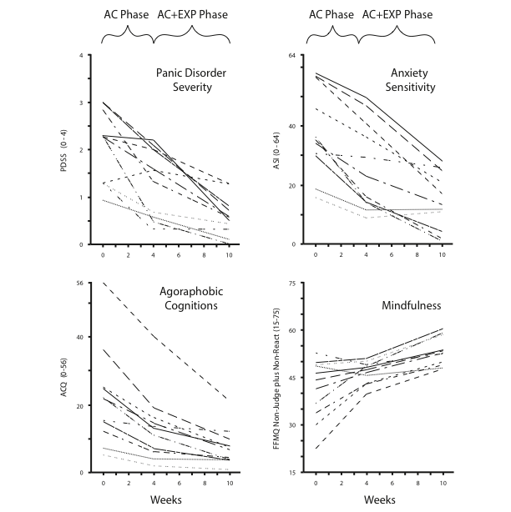
Meuret, Twohig, Hayes, Rosenfeld, & Craske, in press

Slide 31
Habit Reversal
Awareness training
Competing response training
Social support

Slide 32
Top Anxiety Reads
Arch, J. J., Eifert, G. H., Davies, C., Vilardaga, J. C. P., Rose, R. D., & Craske, M. G. (2012). Randomized clinical trial of cognitive behavioral therapy (CBT) versus acceptance and commitment therapy (ACT) for mixed anxiety disorders. Journal of Consulting and Clinical Psychology, 80(5), 750–765. doi:10.1037/a0028310
Arch, J. J., & Craske, M. G. (2006). Mechanisms of mindfulness: Emotion regulation following a focused breathing induction. Behaviour Research and Therapy, 44(12), 1849–1858. doi:10.1016/j.brat.2005.12.007
Wolitzky-Taylor, K. B., Arch, J. J., Rosenfield, D., & Craske, M. G. (2012). Moderators and non-specific predictors of treatment outcome for anxiety disorders: a comparison of cognitive behavioral therapy to acceptance and commitment therapy. Journal of Consulting and Clinical Psychology, 80(5), 786–799. doi:10.1037/a0029418

