Slide 1
Adaptation of an ACT-based intervention to a digital intervention for Chronic Pain
Orestis Kasinopoulos¹, M.Sc
Maria Karekla¹, Ph.D
Vasilis S. Vasileiou¹, M.Sc
Euaggelos Karademas², Ph.D
¹ University of Cyprus
² University of Crete

Slide 2
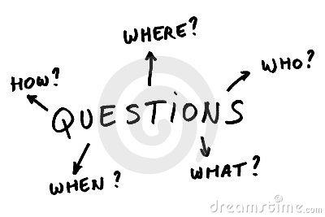
“Could a digitalized self-help intervention produce comparable results to a face-to-face intervention?”
“Can internet delivered therapies, in certain populations, increase adherence to therapy?”
“How effective could 4 sessions be?”
“Could psychologists in mental health services be ever replaced by web-based and mobile applications? If yes, to what extent?”

Slide 3
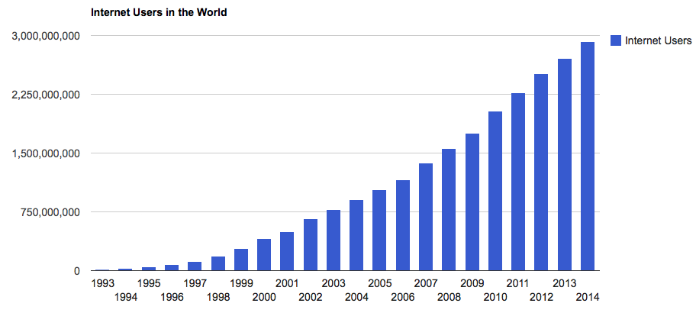
Internet Usage (1)
Source: www.internetlivestats.com

Slide 4
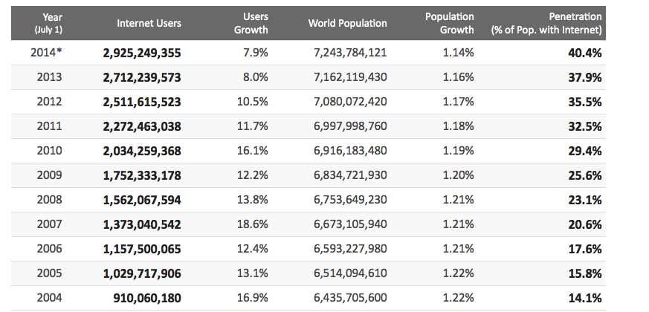
Internet Usage (2)
Source: www.internetlivestats.com

Slide 5
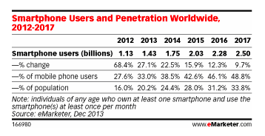
Smartphone Usage - Worldwide
Source: www.emarketer.com
According to a recent data from the European Commision, Smartphones are being
used by 52% of the population in Cyprus and 53% of the population in Greece.

Slide 6
Digitalized interventions in Health Context
Internet-supported based Interventions (Barak et al., 2009):
Self-directed program
Easily accessible
People who are looking for help regarding physical and/or mental health
Aiming to improve quality of life (understanding, knowledge, awareness, insight)
Using audio-visual content at one’s own space and time
Smartphone Interventions:
Same goals/targets
Different device= Different properties
Notes:
«...Ένα κυρίως αυτο-καθοδηγούμενο πρόγραμμα παρέμβασης που εκτελείται με τη βοήθεια ενός προγενόμενου προγράμματος και λειτουργεί μέσω μιας ιστοσελίδας και χρησιμοποιείται από καταναλωτές που επιζητούν βοήθεια σχετικά με την ψυχική ή σωματική τους υγεία. Το παρεμβατικό πρόγραμμα επιχειρεί να δημιουργήσει θετική αλλαγή ή/και βελτίωση/ενίσχυση στην γνώση, ευαισθητοποίηση και κατανόηση μέσω παροχής σχετικού με υγείας υλικού και χρήσης διαδραστικών διαδικτυακών συστατικών» (Barak et al., 2009).

Slide 7
Comparison: Web-based & Smart-phone

Slide 8
Web-based/ smartphone vs Face to Face: PROS and CONS
Therapist time reduction
Waiting list reduction
Preferred time and space
Reduced economic burden
Fascilitated access for disabled people
A way to overcome stigma?
Therapeutic alliance?
Reinforcement of Pain behaviors?
To what extend can it be tailored to needs?
Adherence rates
Notes:
Μείωση χρόνου θεραπευτή (π.χ. σε κλινικές, υποστελέχωση κτλ)

Slide 9
Web-based / Smartphones & Chronic Pain
E-CBT: Promising results in ⬆ of activities, ⬆ quality of life, ⬇cost,⬇ intensity of pain (Bender et al., 2011; Cuijpers et al., 2008; Macea et al., 2010)
E-ACT → ⬇in depressive symptoms, ⬇pain intensity, ⬇ of psychological inflexibility and ⬇ pain catastrophizing (Buhrman et al., 2013; Hester et al., 2014, Lappalainen et al., 2014)
But . . .
Need for culturally sensitive digitalized interventions in the field of Chronic Pain.
Need to understand which technological properties increase effectiveness and adherence in psychological mental health interventions (Narrowing the gap)
Notes:
Διαδικτυακές έρευνες σε Γνωστικο-συμπεριφορικές θεραπείες ασθενείς με χρόνιο πόνο → υποσχόμενα αποτελέσματα σε αύξηση δραστηριοτήτων, βελτίωση ποιότητας ζωής, μείωση κόστων, μείωση έντασης πόνου (Bender et al., 2011; Cuijpers et al., 2008; Macea et al., 2010)
ACT και χρόνιο πόνος → μόνο 2 έρευνες με βελτιώσεις στην κατάθλιψη, ένταση πόνου, μείωση ψυχολογικής δυσκαμψίας και στην καταστροφοποίηση του πόνου. (Buhrman et al., 2013; Hester et al., 2014)
Ποια τεχνολογικά χαρακτηριστικά βοηθούν στην αποτελεσματικότητα των διαδικτυακών και κινητών εφαρμογών (narrowing the gap between technological interventions and face to face interventions).

Slide 10
Web-based / Smartphones & Chronic Pain (2)
Lacking research regarding the Persuasive System Design (PSD) → improvement in treatment adherence (Fog, 2003)
Insufficient number of studies to use realistic settings (Avatar)
Introduction and exploration of a proposed therapeutic ingredient combining Social Learning and ACT.
https://www.youtube.com/watch?v=EpDX41cKhVU
Notes:
PSD is a framework of 21 elements that may be used as guidelines to increase adherence in online interventions
Examples:
Rehearsal :Provides the ability and stimulation to rehearse a behavior or to rehearse the content of the intervention
Social Learning: Provides the opportunity and stimulates participants to see others using the intervention or performing the target behavior

Slide 11
Our story . . .
1st Phase:
Validation
2nd Phase
Needs’ assessment
3rdPhase:
ACT-Group Intervention
4th Phase:

Slide 12
From to
Reasons for dropping out:
Mobility Difficulties
Pain was too severe to sit through sessions
Transportation difficulties
Health Issues
Cancer / strokes
Poor group therapy adjustment
Not fitting in well with the group
Preference for individual therapy
Lived in remote & isolated areas
Need for a slower pace
Work schedule
Headaches/migraines
Difficulties completing the questionnaires
Other health issues arising

Slide 13
“Premature termination or treatment dropout”: Missing two consecutive pre-arranged sessions
Final attendance percentage: ACT Group 31% vs Control Group 33%, χ² = 1.56, p = .21
Completers in ACT: 20 patients out of 66
Attended all sessions: 15 patients

Slide 14
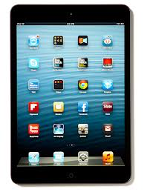
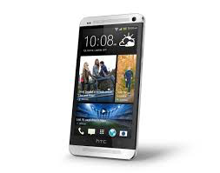
Study’s main objectives:
Adaptation of existing protocol to an Avatar-led internet based intervention
with specific technological characteristics (PSD)
targetting this specific population
while maintaining cultural sensitivity
Study’s main hypotheses:
Digitalized interventions will have higher treatment adherence than protocol group
Higher effectiveness than protocol and control group (QoL, HADS, ACT measures etc)
More engaged users will benefit more than less engaged
Notes:
1) The adaptation of the existing protocol into an electronic format with specific technological characteristics targetting this specific population 2)aiming to increased treatment adherence while simultaneously investigating and comparing its effectiveness on similar measurements (Quality of Life, Activities,ACT measures, Depressive and Anxiety symptoms etc) in respect to the group intervention and control group (waiting list).

Slide 15
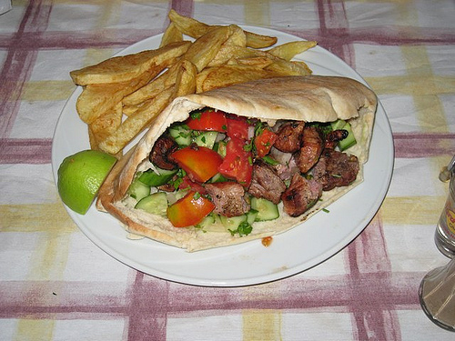
Methodology
Adaptation and modification of an ACT-protocol into an electronic template:
What works and what does not
Shorter and less measures
Shorter duration and ⬇ number of sessions
Adapt it to Greek – Cypriot Culture
Devices:
Web-based: laptops/desktops
Mobile: smartphones and tablets

Slide 16
Methodology
Sample:
Chronic Pain Patients – Mixed diagnoses
Sample recruitment: social media, newspapers, posters, leaflets, associations relevant to chronic conditions, hospitals, private clinicians
Ages: 18-65
Clinician– «Co-Traveler»
A female Avatar & a male Avatar
Realistic human movement → (motion builder capture)
Contact
Τηλεφωνική επικοινωνία ενδιαμέσα της εβδομάδας
Pre – and post – treatment meetings with a Psychologist or Skype meetings
Basic training on using the web-based / app
Email exchange
Content:
Psychoeducation via a dynamic intergation of:
AVATAR
real – life recorded video clips
youtube videos
Testimonies
audio clips
diagrams
Modules: 4-6 (1 x week)
Use of multiple choice questions
H/W: suggested exercises to implement content learnt
Notes:
Sample:
Πρόσλειψη δείγματος → facebook, εφημερίδες (αγγελίες), αφίσες, σύνδεσμοι χρόνιων παθήσεων, κλινικές, ιατρεία.
Ηλικίες: 18-65
Διαδικτυακές συνεδρίες: 4-6 (1 x εβδομάδα)
Ψυχολόγος – «Συνοδοιπόρος»
κινούμενος χαρακτήρας (Avatar)
Δυνατότητα χρήσης ρεαλιστικών ανθρώπινων κινήσεων
(motion builder capture)
Συναντήσεις με ψυχολόγο
Τηλεφωνική επικοινωνία ενδιαμέσα της εβδομάδας
Κλινική συνέντευξη πριν την έναρξη.
Διαγράμματα, βίντεο (ασκήσεις, youtube, αποσπάσματα από κλασσικές ταινίες, τραγούδια)
H/w συμπεριφορικές ασκήσεις → π.χ (αξίες, αναγνώριση σκέψεων βρώμικου και καθαρού πόνου κτλ)

Slide 17
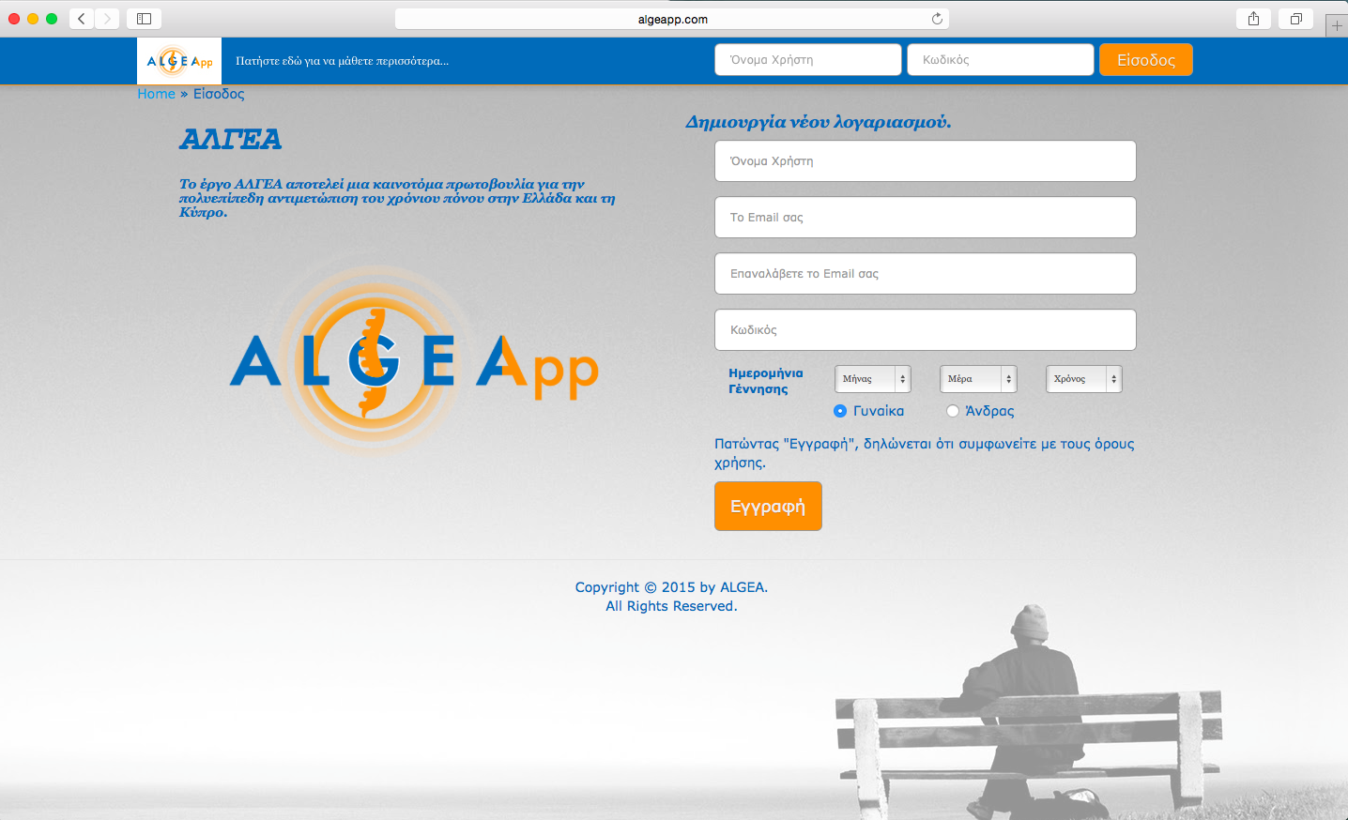

Slide 18
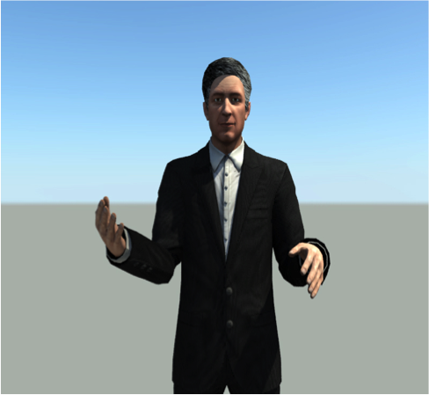
Meet our AVATARS
“Odysseas”
“Aphrodite”
Notes:
Psoriatic arthritis

Slide 23
Present Stages
Future Stages
Agreement Pack ✓
Session outline ✓
1^{η} συνάντηση ✓
2^{η}, 3^{η}, 4^{η} under construction
Dissemination of results to clinicians/associations (private & public sector)
Promotion of the digitalized intervention – desktop computers in waiting room areas
Conversion of the application in English

Slide 24
For further information:
Thanks to:
Emails:
algea@ucy.ac.cy
acthealty@ucy.ac.cy
Please visit:
www.algea.com.cy
www.acthealty.org
www.algeapp.com

